Slide 1
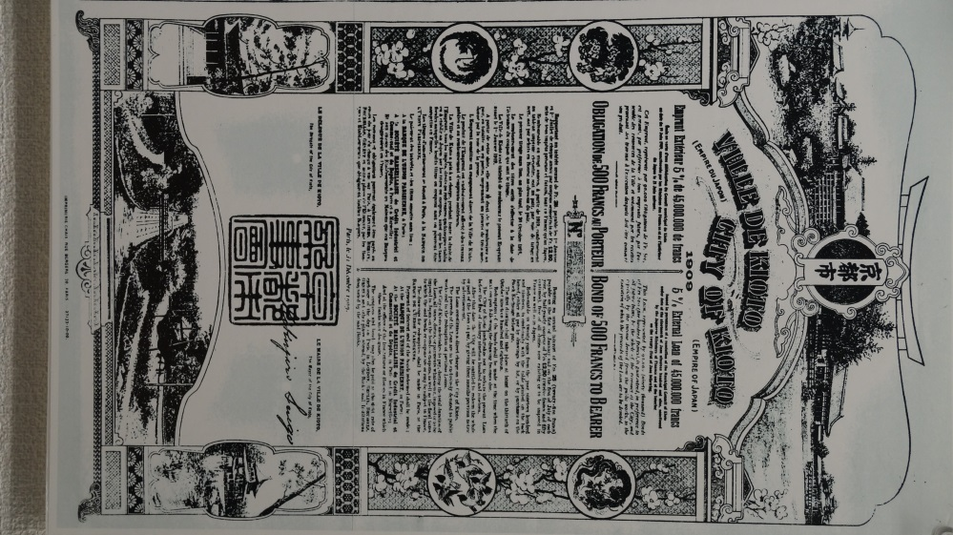
Financial Management:
Finance and Tariffs
No. T6 Ver. 1
Municipal Bond issued by Kyoto City in 1909
Source: Kyoto City Waterworks Bureau

Slide 2
Contents
      Introduction
      Financing Water Supply Development
      Water Tariff Setting
      Consideration for the Low-Income Group
      Billing and Collection
      Lessons Learned

Slide 3
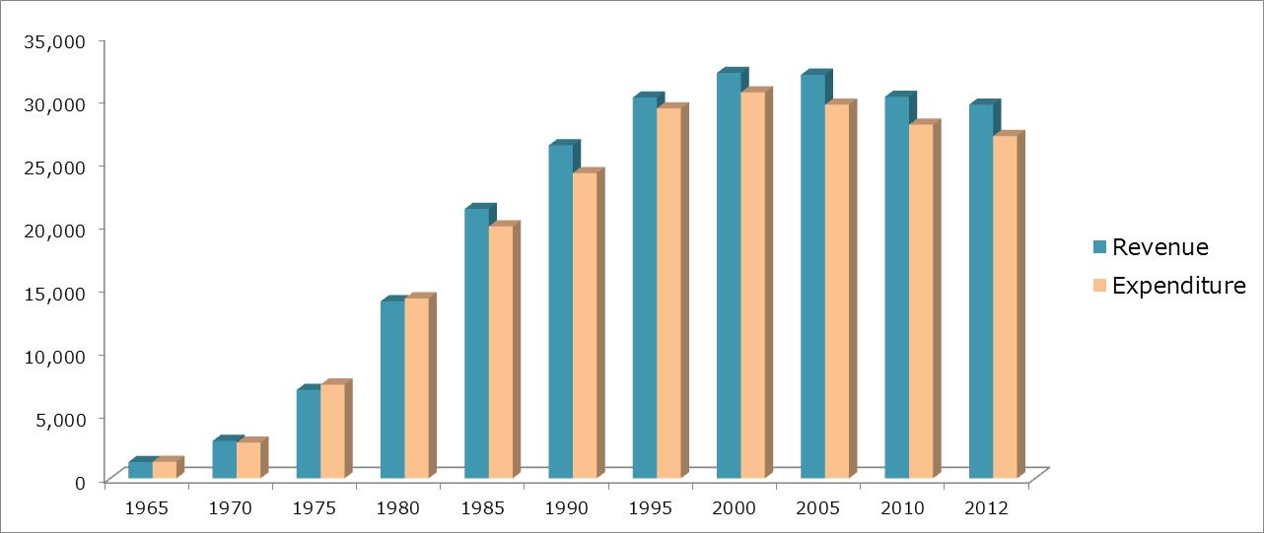
1. Introduction
        Total Revenue
        （water tariffs, etc.)
        Total Expenditures
        (repayment of long-term loans, payment of interest, operation and maintenance costs, administrative expenses, etc.)
＞
=
Unit: 100 Million JPY
Source: Based on information from JWWA, "The Outline of Water Supply,” 1st ed. 1986, and 6th ed. 2015.
Change in Total Revenue and Expenditure of Water Utilities in Japan

Slide 4
1. Introduction
Frequently asked questions from participants of the water supply training courses
Q1. How did Japanese water utilities finance water supply development during the period of high economic growth?
Q2. Have Japanese water utilities been able to achieve full cost recovery?
Q3. How do Japanese water utilities determine water tariffs?
Q4. How do Japanese water utilities serve low-income group?
Q5. How do Japanese water utilities achieve almost 100% bill collection?

Slide 5
2. Financing Water Supply Development
The balance of the bonds and water tariff revenue increases during the expansion of facilities because the population served increases. The balance of the bonds gradually levels off after the expansion of facilities.
Outstanding Balance of Public Enterprise Bond, Water Tariff Revenue (million JPY)
Water Production Capacity（thousands m³/day）
Source: Based on data from Bureau of Waterworks, Tokyo Metropolitan Government, Annual Report.
      Changes of the Balance of Public Enterprise Bonds, Water Tariff Revenue and Water Production Capacity of Bureau of Waterworks, Tokyo Metropolitan Government

Slide 6
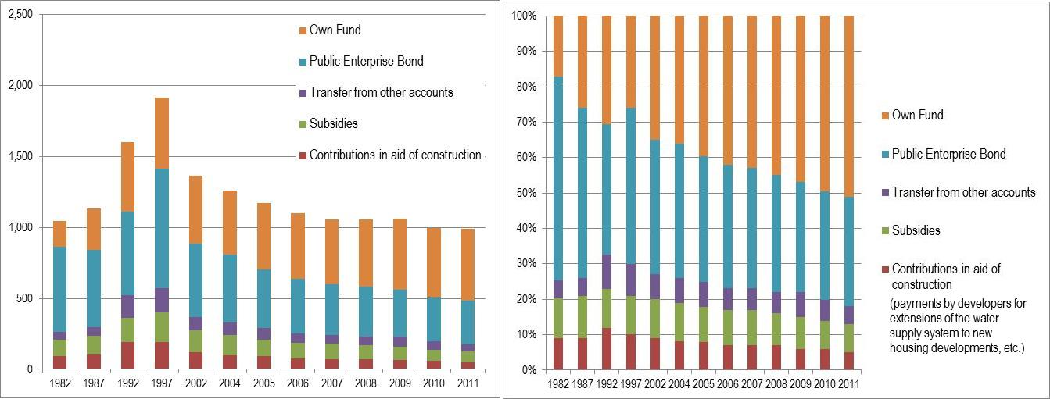
2. Financing Water Supply Development
Main funds : Municipal Bonds (Public Enterprise Bonds) and Subsidies
⇒ Japanese water supply coverage rate* increased from 26.2% in 1950 to 80% in the 1970s and 90% in the 1980s.
(*served population / total population)
      (Billion JPY) (composition ratio)
Source: Based on information from Ministry of Internal Affairs and Communications, Issues on Public Financial Plan: Appendix, 2013, http://www.soumu.go.jp/main_content/000266902.pdf
      Financial Sources for Construction of Water Supply Facilities

Slide 7
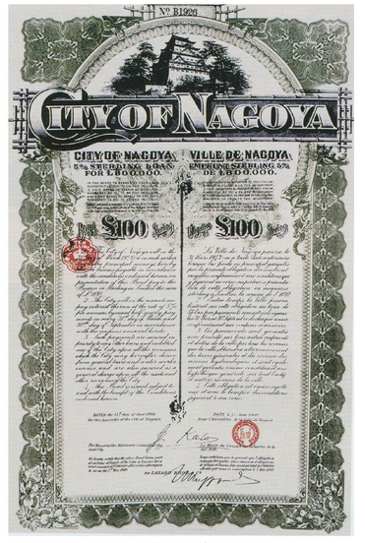
2. Financing Water Supply Development
  (1) Municipal Bonds (Public Enterprise Bonds)
  Long-term debt obligations issued by local governments for public projects including water supply development.
  The principal and interest payments are covered by revenues generated by water tariff.
  Based on the user-pay principle it is reasonable to share the liability of facility construction with future beneficiaries by long-term repayment of the bond over the life of the facilities.
Source: Nagoya City, “Nagoya City History in Taisho and Showa Period,” 1955.

Slide 8
2. Financing Water Supply Development
  Scheme of Municipal Bonds (Public Enterprise Bonds)
Ministry of Internal Affairs and Communications
Consultation on issue of bond
Financial Market
Consent
Public Fund
(Fiscal investment and loan program, Japan Finance Organization for Municipalities)
Local Government (Municipality)
Issue of bond
Water Utility
Private Fund
(Public offering, Bank, etc.)
Funding

Slide 9
2. Financing Water Supply Development
        (2) Subsidies for Urban Water Supply Developments
Water utilities generally strive for cost recovery by setting appropriate tariffs, however it has proven difficult to develop new facilities without some subsidies.
The government has set subsidies with clear targets and invested in accordance with well defined policy goals. Subsidies are not normally used to cover operational costs which should be fully covered by revenue from water tariffs.
Government
Subsidies
Water Utility
For increasing access to safe drinking water, securing water sources, etc.

Slide 10
2. Financing Water Supply Development
        (2) Subsidies for Urban Water Supply Developments
Period | Target | Rate of grant | Purpose
1888- 1900- | Three prefectures, and five port cities, Others | 1/3 1/4 | Improve public health and reduce incidents of infectious diseases in major cities and port cities.
1907- | All major cities | 1/4 | Increase access to piped water.
After World War II (1945) - 1954 |  |  | Post war reconstruction.
1954 -1966 | Abolishment of subsidies for urban water supply | - | When the urban water supply coverage reached 50%, subsidies were abolished. Government subsidies were shifted to Small-Scale Public Water Supply System development in rural areas.
1967 | Restoration of subsidy system for water resources development, facility development, and for consolidation of water utilities | 1/2 or 1/3, 1/4 | The subsidy system was restored based on the decision that it was not appropriate to have water utilities alone shoulder the increased costs.
1978-2009 | Development of laboratories | 1/4 | Improve water quality testing in small and medium scale waterworks.
＊Other subsidies : Development of advanced water treatment facilities, rehabilitation of old deteriorated pipelines, reinforcement of earthquake preparedness, development of automatic monitoring system for water source, etc.

Slide 11
2. Financing Water Supply Development
        (3) Subsidies for Small Scale Public Water Supply
The Water Supply Division of the Ministry of Health and Welfare (MHW) persuaded the Finance Division of MHW to establish the subsidy by stating that “the costs of improving water supply would be offset by economic benefits such as a reduction in health care costs.”
Subsidies for Small Scale Public Water Supply System in rural areas started in 1952.
180 Small Scale Public Water Supply System were developed in1952. After that, 500 Small Scale Public Water Supply System were developed every year.

Slide 12
2. Financing Water Supply Development
        Benefit of Rural Water Supply Development
Benefit of installing water supply facilities after 5 years of operation:
Decrease of waterborne diseases
Decrease of infant mortality rate
Decrease of damages from fires
etc.
Source: The editorial committee of the One Hundred Year History of Modern Water Supply, “One Hundred Year History of Modern Water Supply,” Nihon Suido Shimbunsha, 1988.
Reduced Incidence of Diseases and Infant Mortality, etc. (Information presented by the Water Supply Division of MHW in 1957. 100% represents the level that existed before construction.)

Slide 13
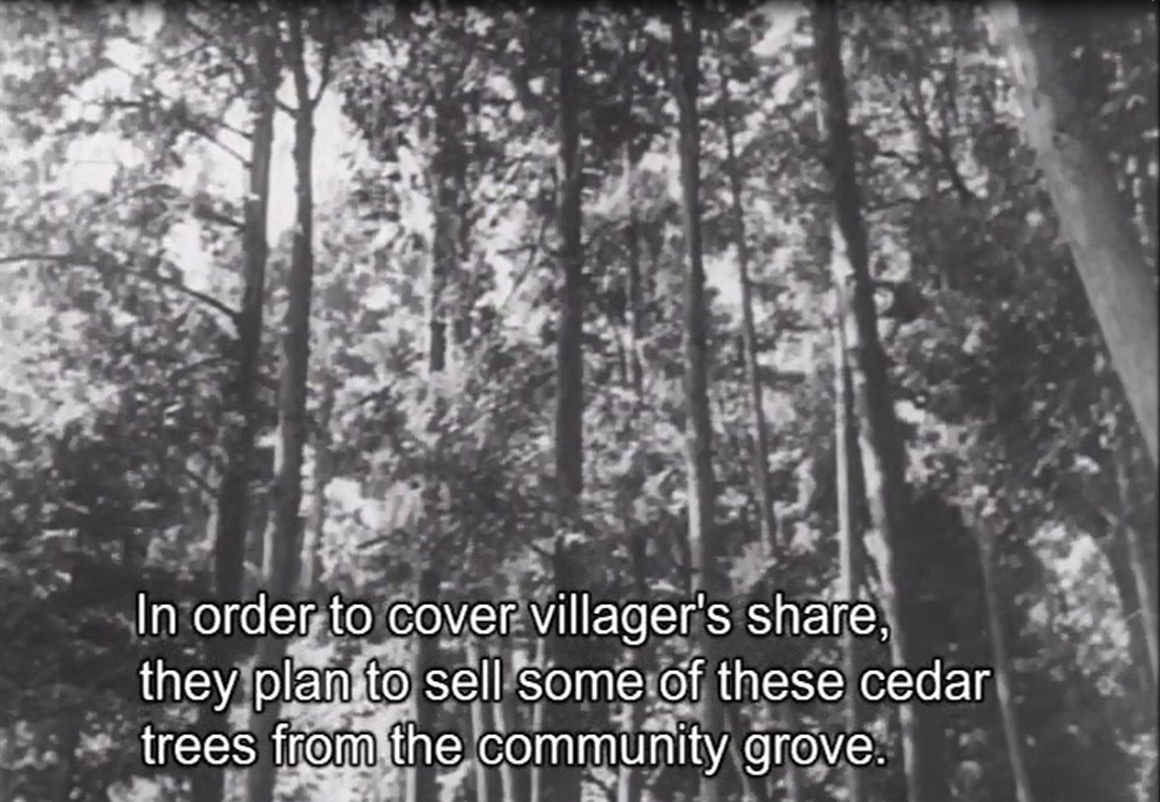
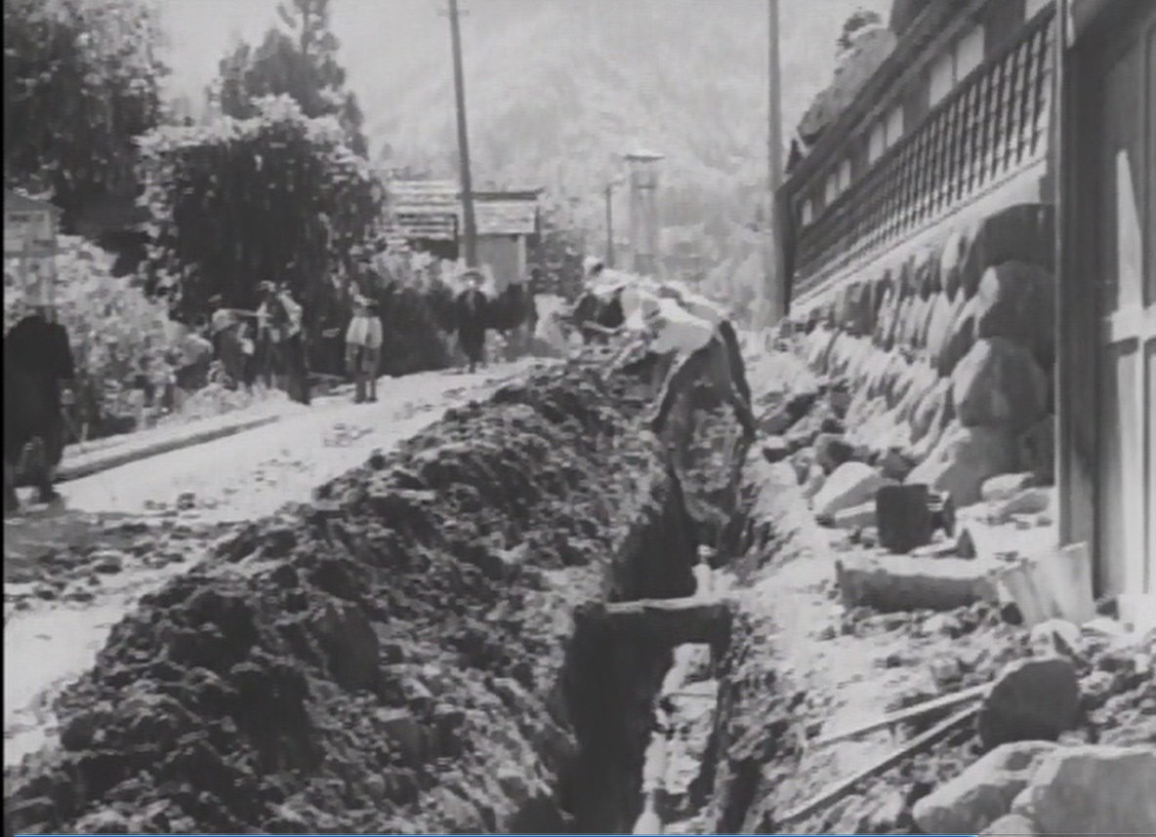
2. Financing Water Supply Development
  Volunteer work by villagers for Small Scale Public Water Supply Development
  Villagers paid their share of the costs by selling their trees
Source: Susumu Hani, the film “Water in Our Life,” 1952

Slide 14
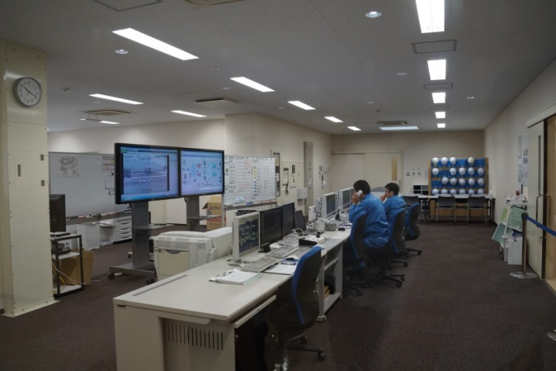
2. Financing Water Supply Development
(4) Private Sector Finance
Stagnating economic environment and the critical financial deficits of national and local governments
Act on Promotion of Private Finance Initiative (PFI Act) in 1999
Development of public facilities through the utilization of private finance, management abilities and technical capabilities by the law and guidelines
Kawai Water Treatment Plant by PFI Scheme, Yokohama City

Slide 15
3. Water Tariff Setting
  Main Components for Water Tariff Setting in Japan
Cost Recovery
Clearly Defined Structure
Self-supporting Accounting System
Efficient Management
Appropriate Water Tariff
Fairness
（User-Pays Principal）
Affordable Pricing
Customer Service and Public Relations
Transparency & Accountability

Slide 16
3. Water Tariff Setting
        (1) Self-Supporting Accounting System and Fully Distributed Cost Method
Focusing on revenue & expenditure
Cash based accounting,
Not accounting for depreciation of fixed assets
1952 : Local Public Enterprise Act
(Public Enterprise Accounting System)
Image of double-entry book-keeping
Double-entry book-keeping
Accrual accounting,
Recording depreciation of fixed assets

Slide 17
3. Water Tariff Setting
        Local Public Enterprise Act
Special Account
Article 17
The accounting of local public enterprises shall be implemented by instituting a special account.
Article 17-2
The expenses must be covered with the operating income.
Expenses not suitable to be borne by operating income shall be covered by the general account or other special accounts (e.g. Fire fighting use).
Principle of Expenses Sharing
Article 17-3
Subsidy
The local government may give support to the local public enterprise by the general account or the separate special account, when it is necessary for restoration after natural disasters or for some other special reasons.

Slide 18
3. Water Tariff Setting
        (2) Water Tariff Setting Manual
<
Total Expenditure
Total Revenue of Water Tariff
  Water Tariff Setting Manual

Slide 19
3. Water Tariff Setting
        (3) Fairness and Clear Definition
Time of founding
  Tariff level commensurate with ability to pay
  Flat rate and metered rate (decreasing-block system) were mixed
1920s-1930s
  Cost recovery
  Increasing number of water utilities adopted metered rate (decreasing-block system)
1960s-
  Water-saving
  Changing from decreasing-block tariff to increasing-block tariff
1970s-
  Clear definition and fairness
  Changing from purpose based tariff to pipe-size based tariff
Present
  Clear definition and fairness
  Revision of water tariff structure (a minimum amount of free water consumption included in the minimum charge, difference between the highest rate and the lowest rate by the increasing-block system)

Slide 20
3. Water Tariff Setting
  Lawsuit in Osaka Challenged the Fairness of the Purpose-Based Tariff System Contributed to the Shift to the Pipe Size Based Classification
Tariff system on purpose-based (e.g. domestic, industrial, commercial, etc.)
1967: An inexpensive restaurant sued Osaka Municipal Waterworks Bureau. “No reasonable reason that a restaurant is classified as a special purpose use.”
1970: Osaka Municipal Waterworks Bureau won. But it changed to pipe-size-based tariff.
Changing to tariff
pipe-size-based

Slide 21
3. Water Tariff Setting
  (4) Transparency & Accountability, Public Relations
Water Utility
Disclosure of financial information
Customer
Understanding of financial condition
Source: Kawanishi Water and Sewer Bureau, Water Supply and Sewerage in Kawanishi: Secure for Drinking, Comfortable for Using, 2015, http://www.kawanishi-water.jp/ikkrwebBrowse/ material/files/group/2/h27-12-1.pdf

Slide 22
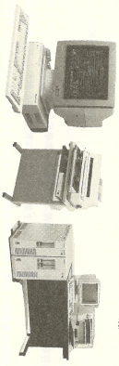
3. Water Tariff Setting
  (5) Efficient Management
Example: Osaka City
Not replacing retired engineers and technical staff
Reduction in staff requirements by improving equipment and control systems at water treatment plants
Reduction in staff requirements by introducing on-line systems in service stations and data processing of inspection book , etc.
“Water Supply Act” and “Local Public Enterprise Act”
Water tariffs must be fair and reasonable, commensurate with costs of an efficient operation.
Water Utility
Continuous efforts for optimize and streamline operations.
Source: Osaka Municipal Waterworks Bureau, “One Hundred Year History of Water Supply in Osaka City,” Osaka Municipal Waterworks Bureau, 1996.

Slide 23
4. Consideration for the Low-Income Group
  Minimum Rate and Cross Subsidy in Water Tariff Structure
Industry with large diameter pipe (100 m³/month use)
Volumetric rate
Volumetric rate
Household with small diameter pipe
(10m³ /month use)
Variable cost
Cross- Subsidy
Fixed cost
Variable cost
Variable cost
Fixed cost
Fixed cost
Minimum rate
Minimum rate
Minimum
Volume
10m³
Customer cost
Customer cost
Cost ＞ Tariff
Cost ＜ Tariff

Slide 24
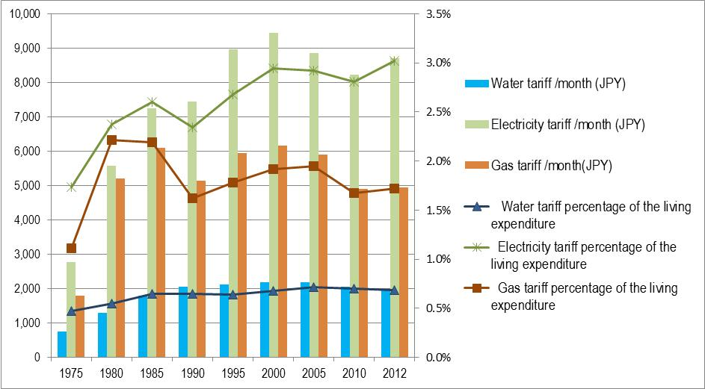
4. Consideration for the Low-Income Group
  Water tariffs are affordable compared with electricity and gas
Source: Created from the data of JWWA, "The Outline of Water Supply,” 6th ed. 2015.

Slide 25
4. Consideration for the Low-Income Group
  (2) Water Tariff Exemption
Low- Income households
Water supply service
Water Utility
Exemption
Local Government
Payment from the general account
Example: Rules for Exemption from Minimum Charge in Water Tariffs in Tokyo

Slide 26
4. Consideration for the Low-Income Group
  (3) Water Meter Policy & Connection Charge
Customer’s liability
=
Source: JWWA

Slide 27


4. Consideration for the Low-Income Group
  Financial Arrangement for Connection Charge
Monthly installment
Fund for connection charge
Planned savings by customers
Connection
Savings
Increasing connections

Slide 28
5. Billing and Collection
Improvement of Bill collection rate
Payment system for customers’ convenience
Efficient meter reading and collection
Chasing arrears continuously

Slide 29
5. Billing and Collection
Example: Changes in Water Bill Collection and Handling of Unpaid Tariffs in Osaka Municipal Waterworks Bureau
Period | Collection system | Remarks
1910 - 1930 | Quarterly payment by customers | （Issue）Only 30% of customers paid water bills by due date. The office could lose track of customers if change of address was not reported.
1931 | Introduction of monthly door to door collection | （Result）99.9% collection rate was achieved in four years after the introduction, and 100% in nine years.
1966 | Introduction of bank account transfers | （Result）More customers shifted to account transfers every year, helping improve the efficiency and reduced the need for cash handling.
 |  | （Issue）Efficiency of door to door collection was lowered. Difficult to collect during daytime because more households had no one home during daytime, and the unpaid amount went up.
1975 | Door to door collection system was abolished. | Tariff collectors were replaced by dedicated personnel assigned to receive and manage payments and settle unpaid bills. A manual on settlement of bills was prepared to set standard procedures for resolving overdue accounts.
 | Gradual promotion of bank account transfer and expansion of financial institutions handling them
1993 | Start of handling payment in convenience stores (open 24/7) Payments can be made during holidays and at night.

Slide 30
5. Billing and Collection
Example: Challenges and Solutions Concerning Meter Reading and Door to Door Collection System in the Bureau of Waterworks, Tokyo Metropolitan Government
Incentives for bill collectors and meter readers
Introduction of digital meters for accurate reading
Trainings and standardization of works
Chasing of arrears continuously (Improve convenience of customer’s payment)
collection rate
99.9％
Source: Training material of Nihon Suido Consultants., Co. Ltd..

Slide 31
6. Lessons Learned (1)
(Financial Sources for Water Supply Development) Water supply facilities were developed by public enterprise bonds and. Utilities borrowed large sums at low interest rates and long repayment periods from public financial sources. Subsidies based on well-defined policy goals were granted. This government financial assistance contributed greatly to achieving universal access to water supply service. Public enterprise bonds are an effective and fair way to share the liability of the construction costs among existing and future customers. It is important to have a financial plan showing that water tariffs can generate enough revenue to cover debt repayment and demonstrate financial soundness .
(Subsidies for Nationwide Water Supply Coverage) Although it is desirable to cover all expenses with the revenue from water tariffs, subsidies were required to achieve nationwide water supply coverage and develop water resources in Japan. Especially, in rural areas with small populations, it has been difficult to cover the construction costs of the facilities with tariffs alone.

Slide 32
6. Lessons Learned (2)
(Tariff Setting) In Japan, water tariffs are set based on the following policies and principles: (1) Utility uses the fully distributed cost method and self-supporting accounting system, (2) financial liability for construction of facilities is shared equitably and there is absolute clarity in how tariffs are set, (3) efficient management of the utilities, (4) affordability, and (5) adequate information disclosure. It is important to have legal frameworks to provide the principles and standardized procedures to guide the tariff setting process. Utilities make continuous efforts towards efficient management and information disclosure so that customers clearly understand and support the water supply business.
(Affordability) To support all households including low-income groups, water tariffs are made affordable by including a minimum volume in the minimum charge and implementing cross-subsidies. Exemption and reduced tariff systems are established as a welfare policy of the local government. Customers could pay by installments for costly new connections and were encouraged to save money systematically for the payments in the early stage of water supply development.

Slide 33
6. Lessons Learned (3)
(Increasing Bill Collection Rate) Japanese water utilities have achieved bill collection rate of nearly 100% by shifting to a payment system that is convenient for customers under the financial services available. There are clear procedures for following up on unpaid bills and applying penalties as required. Training for meter readers and tariff collectors together with performance based incentives could also help raise collection rates. Installation of meters at all customers and keeping meter accuracy, have also contributed to high collection rates.

