Slide 1

Institutional Management:
Governance,
Human Resources Development,
Consolidation of water utilities,
Public-Private Partnerships
“Let’s drink tap water with the whole family“
No. T7 Ver. 1
Poster of 58th Water Week in 2016
Source: Japan Water Works Association

Slide 2
Contents
      Introduction
      Governance
      Business Plan and PDCA (Plan, Do, Check, Act) Cycle
      Human Resources Development
      Management of Small and Medium Scale Utilities
      Public - Private Partnerships
      Lessons Learned

Slide 3
1. Introduction
Water Supply Administration
Ministry of Internal Affairs and Communications
(MIC) : Local Public Enterprise Act
Administrative matters
Ministry of Health, Labour and Welfare
（MHLW):
Water Supply Act
Technical matters
Water Utilities
under
Local Governments

Slide 4
1. Introduction
Frequently asked questions from participants of the water supply training courses
Q1. What is the governance of Japan's water utilities?
Q2. Why do Japan's water utilities emphasize business planning? What are the contents business plans?
Q3. How do Japan's water utilities develop capacities of human resources?
Q4. Do small and medium scale water supply utilities have any problems with finance and human resources? If they have problems, how do they attempt to overcome the problems?
Q5. How does Japan promote public-private partnerships in the field of water supply?

Slide 5
2. Governance
(1) Roles of the Government, Water Utilities and Citizens
Goal：Water supply for public health and good living environment
National Government
Basic and comprehensive policies on water resources development and water supply development
Technical and financial support to water utilities
Regulation・Supervision・Support
Policies/plans on water supply development, proper and reasonable water use, conservation of water sources and maintenance of water supply facilities
Implementation of those plans
Appropriate and efficient management of waterworks
Local Government
（Water Utilities）
Water Supply Service
Cooperation
Citizens
Cooperation with national and local policies
Proper and reasonable water use

Slide 6
2. Governance
Regulation & Supervision of Water Utilities
Local Assembly
A water utility is independently operated, but regulated and supervised by the local government and the assembly through checks of an annual budget, a business plan, etc.
Submission of bills (including the budget, water tariff revision)
Approval of the bills concerning water supply business
Local Government
Mayor
Water Utility
Independently operated under
Appointment
No general (daily) supervision & control
Executive Managing Director of Public Enterprise
Proposal of an annual budget, business plan, water tariff revision, etc.
Request for deliberation
Advise on administrative management
Advisory committee

Slide 7
2. Governance
(2) Roles of Executive Managing Director & Technical Administrator
Administrative Management
Technical Management
Executive Managing Director
of Public Enterprise
Technical Administrator
Establishing necessary sections and/or department
Taking charge of employment/dismissal of employees, wages, work hours and other working conditions, punishment, training, etc.
Preparing a draft of the budget and the settlement of accounts
Preparing data for a motion to the local assembly
Acquiring, managing and disposing assets
Concluding agreements/contracts
Collecting tariff, fees other than tariff, contribution, and connection charges, etc.
Carrying out temporary borrowing
  Inspecting water supply facilities based on the standards for facilities
  Conducting water quality inspection and facility inspection
  Conducting inspection of the structure and material of service connections
  Health checkups
  Emergency suspension of water supply
Water utilities have been properly managed under the technical administrators and the executive managing directors of public enterprises

Slide 8
2. Governance
(3) Organizational Management
Example: Tokyo Metropolitan Government
Cooperation
Water tariff collection section
Accounting Section
Check-and-balance
More money required for new construction
Planning Section
Open Discussion
Finance Section
Check-and-balance
Limited financial sources

Slide 9
2. Governance
Example: Tokyo Metropolitan Government (Cont’d)
Ad hoc committees
for important issues (NRW reduction, etc.)
Planning Section
Other related Section
Customer Service Section
Finance Section

Slide 10
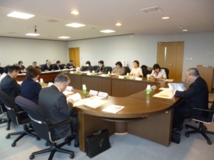
2. Governance
(4) Advisory Committee
An advisory committee is an affiliated organization ruled by the Local Autonomy Act and conducts screening, deliberations, investigations, etc. of management of a local government.
Advisory committee ensures:
accountability and information disclosure (utility has to make the case for revisions);
objectivity in the decision-making process;
use of expert advice from members;
incorporation of customer input from representatives in the committee.
Advisory committee on waterworks management in Koriyama City
https://www.city.koriyama.fukushima.jp/481000/jogesuido/shingikai.html

Slide 11
2. Governance
(5) Concept of Governance for Water Utility
Administrative Management
Technical Management
Ministry of Internal Affairs and Communications
（MIC) : Local Public Enterprise Act
Ministry of Health, Labour and Welfare
（MHLW):
Water Supply Act
Supervise
Supervise
Water Utility
Executive Managing Director of Public Enterprise
Technical Administrator
Request for deliberation
Advise on administrative management
Advisory committee

Slide 12
3. Business Plan and PDCA Cycle
Water Supply Development based on Plans
Postwar Recovery
Ongoing repairs of water supply facilities
Expansion
Water supply development based on master plans regulated by the Water Supply Act
Maintenance & Rehabilitation
Water supply business plan (including master plan) based on the future vision

Slide 13
3. Business Plan and PDCA
Example: Kyoto City
Basic Policy and Integrated Master Plan of Kyoto City
Vision & Plan of Waterworks Bureau
Management Strategy (Business Plan) of Waterworks Bureau
Water Supply Master Plan (2001~2025)
Kyoto City’s Water Vision
(2008~2017)
Sewerage
Master Plan (2001~2025)
Goals and issues to be solved
Mid- Term Business Plan
（2008-2012）＆（2013-2017）

Slide 14
3. Business Plan and PDCA Cycle
Example: Kyoto City (Cont’d)
Vision of Kyoto City Waterworks Bureau
Plan
Act
Progress review & Management
Do
Check
Information Disclosure
Customers

Slide 15
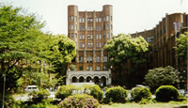
4. Human Resources Development
National Initiatives for Human Resources Development
to Achieve Nationwide Water Supply Coverage
Know-how on curriculum and teaching methods
National Institute of Public Health
The old building constructed in 1938.
National Universities
Provision of young water supply engineers
Training of utilities’ staff
Water Utilities
Source: National Institute of Public Health
Nationwide water supply coverage

Slide 16
4. Human Resources Development
Example : Nagoya City
By 1970s
Off-site training for new staff and subsequent OJT
1970s-1983
OJT only (No offsite training)
Since 1984
Training at the Technical
Training Center
Expansion of target trainees : contractors, overseas trainees, other water utilities’ staff
No standardized instructional method
Standardized know-how of procedures and operations

Slide 17
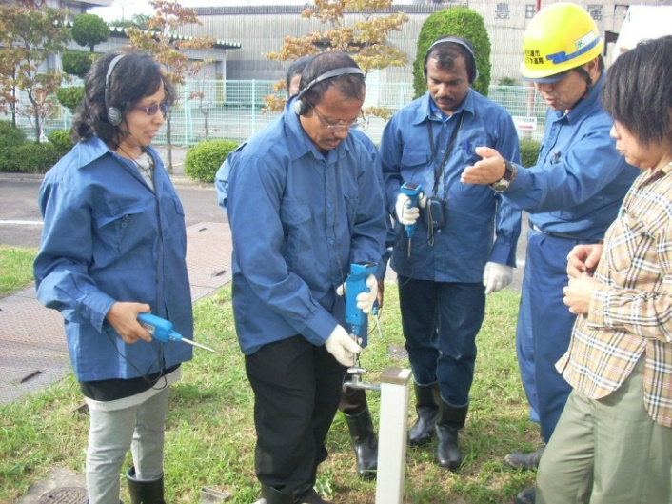
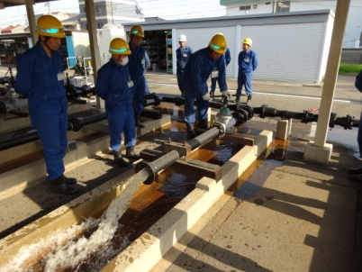
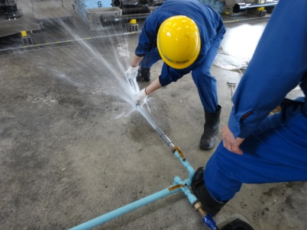
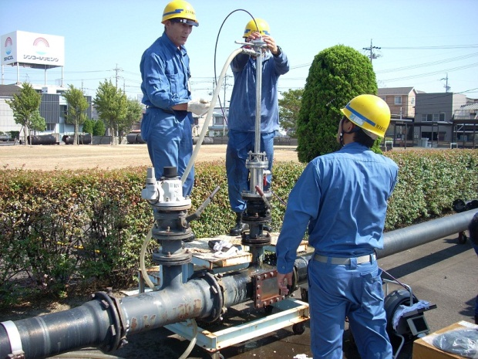
4. Human Resources Development
Example : Nagoya City (Cont’d)
Leak Detection
Valve Operation
Leakage Repair
Endoscope
Source: Presentation materials by the Nagoya City Waterworks and Sewerage Bureau in the Report of “The Third Executive Forum for Enhancing Sustainability of Urban Water Service in the Asian Region”, August 2014

Slide 18
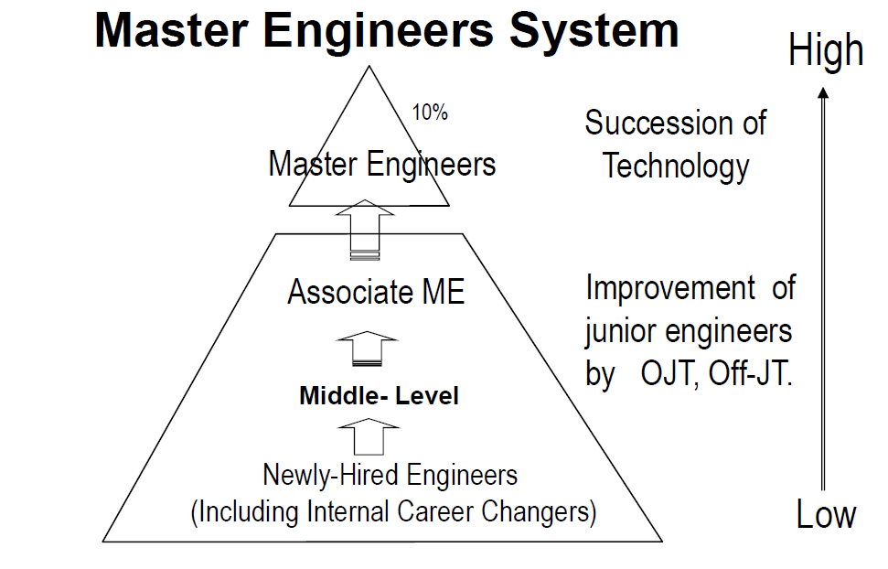
4. Human Resources Development
Level of Ability
Example : Yokohama City
Source: Presentation materials by the Yokohama Waterworks Bureau for “The Third Executive Forum
for Enhancing Sustainability on Urban Water Service in Asian Region, 2014”

Slide 19
5. Management of Small and Medium Scale Utilities
(1) Challenges of Small & Medium Water Supply Management
Cost of Water Supply / Unit Price of Water (JPY/m³)
Source: Created from the data of “Survey of financial status of local public enterprises, FY 2014”
Cost recovery in water supply business by size of operation (2014)

Slide 20
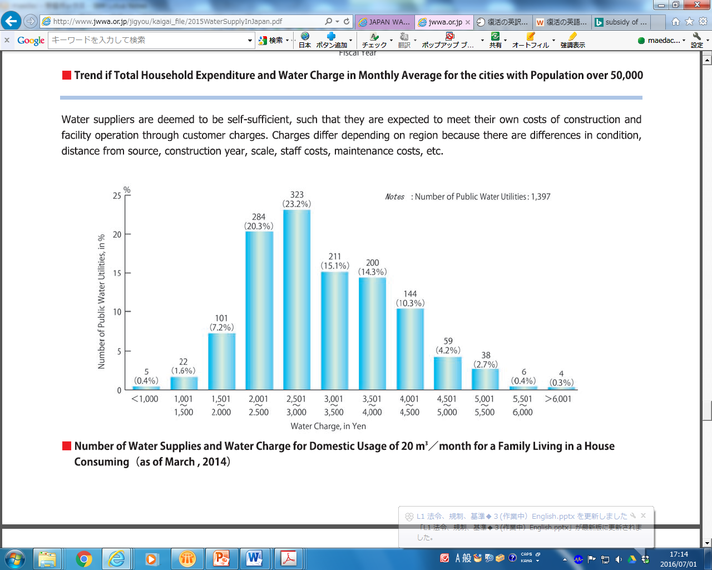
5. Management of Small and Medium Scale Utilities
Water tariffs are affected by local conditions, type of water source, degree of urbanization, composition of customer groups, etc.
Water tariff for domestic use（JPY/20m³/month）
Source: JWWA, Comfortable Life with Water Supply and Transition of Water Supply Volume, http://www.jwwa.or.jp/shiryou/water/water.html
Tariff Differential among Water Utilities

Slide 21
5. Management of Small and Medium Scale Utilities
(2) Towards Regional Collaboration
1960s
Rapid increase of water demand, construction costs and water tariffs, deterioration of water sources, inadequate operation and maintenance of small scale water supply
1966
System of “A joint public services authority” was introduced
1977
Regional Planning for Water Supply Services was included in Water Supply Act
2000s
Expansion of the concept on regional collaboration

Slide 22
5. Management of Small and Medium Scale Utilities
Previous and New Definition on
Regional Collaboration of Water Utilities
Consolidation of water utilities
Integrated management
Joint implementation or outsourcing of operation and management
Joint use of facilities
Previous Definition
Current Definition in a Broad Sense
Source: JWWA “Guidelines for the Consideration of Broadening of Water Supply: For the Promotion of Water Supply Vision”

Slide 23
5. Management of Small and Medium Scale Utilities
(3) Constraints on Consolidation
There are constrains to be overcome in order to consolidate utilities
Consolidation
Small and Medium Scale Water Utility
Differences in the scale of facilities and water tariffs
Different issues to be solved by each utility
Reluctance of local governments , etc.
Small and Medium Scale Water Utility
Small and Medium Scale Water Utility

Slide 24
6. Public and Private Partnerships
(1) Increasing Roles of Private Sector
Direct undertaking
by a water utility on all works
Operation & Maintenance
Outsourcing (management contract)
Construction Works
Contractors
Design Works
Consultants
Operation & Maintenance
Outsourcing (service contract)
Design, Construction, O&M
・ Private Finance Initiative (PFI)

Slide 25
6. Public-Private Partnerships
(2) System for Delegation to a Third Party
Ministry or Prefecture
Supervision
Supervision
Report
Supervision
Water Utility
Contractor (for water supply management service)
Preparation of work plan
Preparation of supply rules
Fulfillment of obligation of 24 hours water supply
Consign technical works of operation based on consignment criteria
A technical administrator from the contractor manages technical works of operation
Responsibility stipulated in the Water Supply Act is imposed on the contractor within the scope of works
Management by a technical administrator
Management of water supply facilities (operation, maintenance and inspection)
Management of water quality
Contract
(Clarification of scope of works and sharing of responsibility stipulated in Water Supply Act )
Obligation of water supply based on agreements
Customers
Source: Ministry of Health, Labour and Welfare, Third-Party Consignment for Water Supply

Slide 26
6. Public-Private Partnerships
(3) Designated Administrator System
Example : Mizu Mirai Hiroshima
Dividend
Hiroshima Prefectural Waterworks Bureau
Shareholders Agreement
Swing Corporation
(Business Partner)
Dividend
Charge for
designated administration
Municipalities
(Water Utilities)
Financing Companies
(Financial Agency)
Designation of
designated administrator
Consignment
Fee
Consignment
Contract
Loan
Service Delivery
Service Delivery
Financing
Agreement
Refund
Mizu Mirai Hiroshima Corporation (Public and Private Joint Venture)
Works for Management and Operation of
Water Supply Facilities
Works related to
Water Supply
Investment (35%)
Dispatch of Official
Management and operation of prefectural water supply facilities
Management and operation of municipal water supply facilities
Survey, Research, Development
Capacity development, Training
Investment (65%)
Dispatch of
Employee
Contract
Service
Delivery
Service
Delivery
Charge for Service
Companies in the Prefecture
(Public and Private Joint Venture requests consignment works and repairing works to companies in the Prefecture)
Customers
(Municipalities, Companies)
Source: Mizu Mirai Hiroshima Corporation “Joint efforts of citizens in Mizu Mirai Hiroshima”, Water Technology Journal, October 2014

Slide 27
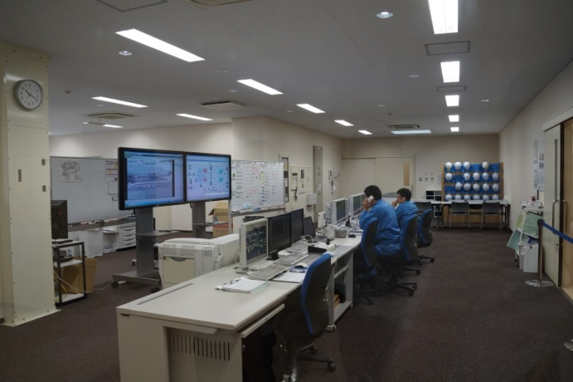
6. Public-Private Partnerships
(4) PFI: Private Finance Initiative
Examples of PFI projects:
BOO (Build Own Operate)project for development of power-generating facilities (cogeneration system) in water treatment plants in Tokyo
BTO (Build Transfer Operate) project for development of sludge treatment facilities in water treatment plants in Aichi prefecture
Stagnating economic environment and the critical financial deficits of national and local governments
Act on Promotion of Private Finance Initiative (PFI Act) in 1999
Development of public facilities through the utilization of private finance, management abilities and technical capabilities within the law and guidelines
Kawai Purification Plant by PFI Scheme, (BTO) Yokohama City

Slide 28
7. Lessons Learned (1)
(Governance of Water Utilities) Water utilities are managed as independent public enterprises. They are responsible for their own human resources management, having the ability to improve staff competence. The job and qualification of the technical administrator is clearly defined and the utilities take the responsibility for all technical matters and for managing the operations effectively.
(Supervision by the Local Government) While the water utility is independent in its operations, the local assembly maintain the oversight responsibility through the approval of annual budgets and business plans. An advisory committee supports the utility’s management by providing opinions and recommendations.
(Business Planning and PDCA Cycle) The business plan guides the utility’s staff towards a goal to promote more effective operation. By following the PDCA cycle from a plan to check, the utility also reinforces the operational system.

Slide 29
7. Lessons Learned (2)
(Training) In addition to subsidies and the development of technical guidelines/ standards, human resources development has been essential to the establishment and operation of water supply systems across the country. Research institutions and universities provide formal training to develop the required expertise. It is necessary for utilities to establish internal training systems and utilize external training programs for sustainable human resources management.
(Regional Collaboration) When constructing water supply systems, sustainability of operation and management after construction needs to be considered. Small-scale utilities built during the implementation of nationwide water supply coverage generally face difficulties with cost recovery and staff shortage. Consolidation and collaboration of operations across a region are the ways to improve the economies of scale and are promoted utilizing the national subsidies.

Slide 30
7. Lessons Learned (3)
(Private Sector Involvement) The municipalities maintain the ownership of the utilities because of the importance of ensuring that the public health objectives such as water quality are achieved water utilities of municipalities implemented all works by themselves at first. After that, the private sector began to be involved first in the construction of facilities, then gradually in design, meter reading and operation of water treatment plants.
(Regulatory Framework) As the private sector is getting more involved in the water supply business, qualification system, standards and regulations are established to maintain the quality of products and services without compromising competitiveness. A transparent system for supervision is also needed to ensure compliance to regulations on quality of service in the delivery of safe, affordable drinking water. The roles and responsibilities of public and private partners (risk sharing) must be always clearly stated in the contract.

