Slide 1
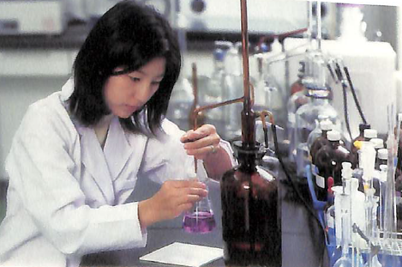
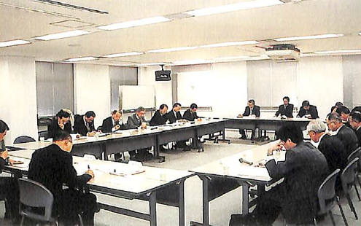
Collaboration among Water Utilities:
Japan Water Works Association
No. C1 Ver. 1
Committee, examination, inspection and training of JWWA
[Online] Available: http://www.jwwa.or.jp/jigyou/kensyu.html

Slide 2
Contents
      Introduction
      Establishment of Japan Water Works Association
      Activities of Japan Water Works Association
      Financial Structure of Japan Water Works Association
      Other Organizations in Water Supply Sector
      Lessons Learned

Slide 3
1. Introduction
History of Japan Water Works Association (JWWA)

Slide 4
2. Establishment of Japan Water Works Association
        (1) History of JWWA Activities
Water supply started;
1887 Yokohama City
1891 Nagasaki City
1895 Osaka City
1898 Hiroshima City
1898 Tokyo City
：
Construction
of water supply systems is promoted.
Construction of modern water supply systems started.
Facilities were designed by foreign engineers.
Little know-how about operation and management
No advice from the national government
Discussion among water utilities
In 1904, the 1st Federation of Water Authorities
(on standard methods for the examination of water quality)
Annual meetings were held to discuss about topics on operation and engineering.
In 1932, Incorporated Association ”Water Works Association” approved by Minister of Interior

Slide 5
2. Establishment of the Japan Water Works Association
Attendees at the 11th meeting of the Federation of Water Authorities (1913)
JWWA, Federation of Water Authorities, One Hundred Years' History of Japan Water Works Association (2004).

Slide 6

2. Establishment of Japan Water Works Association
(1) History of JWWA Activities
1914 Standard for cast iron pipe in waterworks
Predecessor of JWWA standard
1932 Incorporated Association ”Water Works Association” approved by Minister of Interior
Renamed as Japan Water Works Association later
1932 Publication of Journal of Japan Water Works Association
Mainly academic research, case reports and information exchange
1934 Inspection Service started
Turned into main income resource later
1954-1971 Petition for national subsidy
Petitions for national subsidy, reform of system and bond floatation, etc.
Training for technical administrators of waterworks and other programs are added later
1958 Training Programs started
1997 Quality Certification Service started
Based on deregulation measures introduced by the state government

Slide 7


3. Activities of Japan Water Works Association
(2) Committees
Management Standing Committee
Research and development concerning waterworks management
Engineering Standing Committee
Research and development concerning waterworks technology
Water Quality Standing Committee
Research and development concerning water quality management
Special task forces
Established as necessary
Other committees such as publication and inspection
Committees are the foundation of JWWA’s expertise.
Members are assigned mainly from large water utilities.

Slide 8

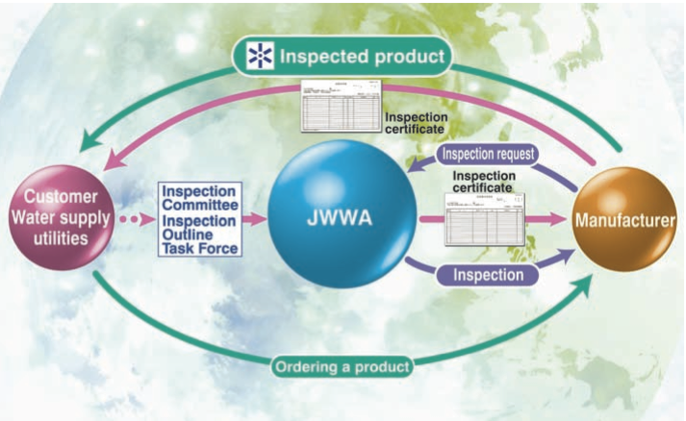
3. Activities of Japan Water Works Association
(3) Product Inspection Service
Inspection by JWWA
Standards for materials and equipment
Improving efficiency of inspection
Inspection by each water utility
JWWA, "Profile Public Interest Incorporated Association Japan Water Works Association," http://www.jwwa.or.jp/jigyou/kaigai_file/JwwaProfile2015.pdf

Slide 9
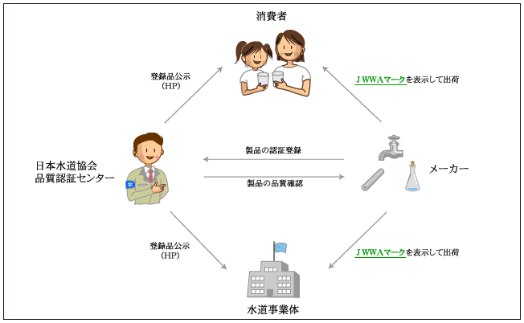

3. Activities of Japan Water Works Association
(4) Quality Certification Service
Customers
Products with certification mark
Public announcement through website
Apply for registration
Suppliers
Water service devices
Water treatment chemicals
JWWA
Get certification
Products with certification mark
Public announcement through website
Water utilities
Quality Certification Center of the JWWA, Business outline,
http://www.jwwa.or.jp/Center/02gyom/main02_1.html

Slide 10
3. Activities of Japan Water Works Association
(5) Training programs
Management courses
Training for director generals (Executive Managing Director)
Water utility management
Practical training for collection of unpaid water bills
Technical courses
Training for technical administrators of waterworks
Training for water supply engineers
Training for water leak prevention
Practical training for water purification plant operation

Slide 11
3. Activities of Japan Water Works Association
(6) International Activities
1955
Joined International Water Supply Association (IWSA)
1978
Established the agency office of the 12th World Congress of IWSA
・Established JWWA’s International Committee
・Joined the Asia-Pacific Group (ASPAC) of IWSA
・Cooperative research with American Water Works Association (AWWA)
1987
Represents the International Water Association (IWA) in Japan since the establishment of the IWA
1999
・JICA’s training programs
・Overseas training and Senior Technical Experts for Developing Countries
・Establishing Waterworks Associations and Friendship Associations

Slide 12
3. Activities of Japan Water Works Association
(7) Design Criteria for Water Supply Facilities
Guidelines for Water Supply Facilities Standards 1958
Guidelines for Water Supply Facilities Standards 1966
Design Criteria and Guidelines for Water Supply Facilities 1977
Design Criteria and Guidelines for Water Supply Facilities 1990
Design Criteria for Water Supply Facilities 2000
Design Criteria for Water Supply Facilities 2012
Revised every decade
The latest information at the time of publication
Easy access to the latest information for the small and medium scale utilities
Nationwide standardization of water supply facilities

Slide 13

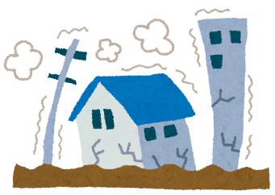
3. Activities of Japan Water Works Association
(8) Water Supply Facilities Maintenance Manual
Water Supply Facilities Maintenance Manual 1953; the first edition
Revised five times
Water Supply Facilities Maintenance Manual 2006; the latest edition
(undergoing it’s sixth revision)
Standardization of maintenance
Accordance with :
Introduction of outsourcing to a third party
Reinforcement of water quality management
Diversity of water treatment
(9) Seismic Design and Construction Guidelines
Seismic Design and Construction of Water Supply Facilities 1953 ; the first edition
Revised four times
Seismic Design and Construction Guidelines for Water Supply Facilities 1997; the latest edition
(undergoing revision after the 2011 Great East
Japan Earthquake and 2016
Kumamoto earthquakes)
Standardization of seismic design and construction
Incorporating lessons learned from the Great Hanshin/Awaji Earthquake in 1995

Slide 14

3. Activities of Japan Water Works Association
(10) Disaster Response
Supporting activities by water utilities in various places
Report on emergency response in earthquake and disasters 1996
The Great Hanshin/Awaji Earthquake in 1995
Chuetsu Earthquake in 2004
Manuals of emergency response in earthquake and disasters 2008
Noto Earthquake in 2007
Chuetsu Offshore earthquake in 2007
The Great East Japan Earthquake in 2011
Being revised based on experience from the recent earthquakes
Kumamoto Earthquake in 2016

Slide 15
3. Activities of Japan Water Works Association
“Suido Ikka” (Waterworks Family)
Unite the members of waterworks
Dedicated to the promotion of waterworks
JWWA Headquarter
7 Branches
Regional Branch
Regional Branch
Information on the damage
Prefectural Branch
near to
disaster area
Prefectural Branch
far from
disaster area
Prefectural Branch
far from
disaster area
Request for assistance
Disaster-stricken Water Utility
Coordination of assistance
Water Utility
Water Utility
Water Utility
Water Utility
Water Utility
Assistance

Slide 16
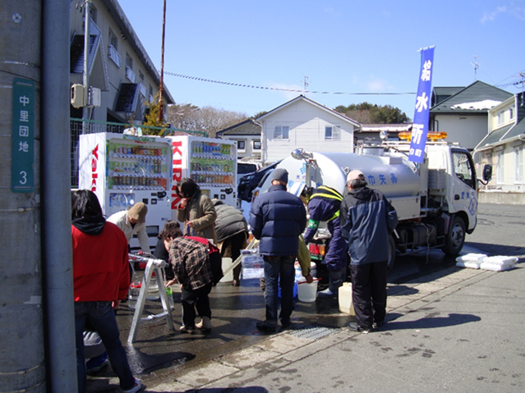
3. Activities of Japan Water Works Association
Emergency Response for the Great East Japan Earthquake by JWWA(1)
The Great East Japan Earthquake
March 11, 2011 at 14:46
Magnitude 9.0 centered around the Iwate, Miyagi and Fukushima
Tsunami in large area
Suspension of water supply ; 2.56million households
Water tanker in Iwate prefecture
Assistance in emergency
Water utilities; 550
Water tankers; 13,500
Total supporters; 41,000
Set up of Relief headquarters at JWWA
↓
Reorganized as the Great East Japan Earthquake Reconstruction Support Headquarters
Information
Restoration support
Total supporters; 3,500
Repair of breaks and leaks
Arrangement

Slide 17
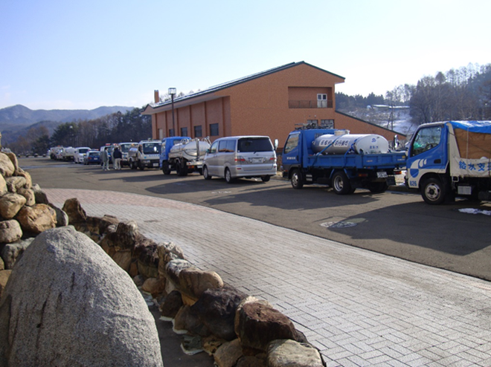
3. Activities of Japan Water Works Association
Emergency Response for the Great East Japan Earthquake by JWWA(2)
The Relief Headquarters
Reconstruction Support Headquarters
Arrangements for dispatching water tankers
Collection of information on extent of damage
Communication and coordination with Ministry of Health, Labour and Welfare and water-related organizations
Collection of information on extent of damage
Communication and coordination with Ministry of Health, Labour and Welfare and water-related organizations
Vehicles gathered from various regions in front of the Iwate Prefectural Branch

Slide 18
4. Financial Structure of Japan Water Works Association
(1) Membership Fees
Amount of annual membership fee depends on scale of water utility.
・Fixed fee 43,000 JPY
・Variable annual membership fee depends on annual revenue water. (diminishing system)
Annual revenue water 1 million m³ (10,000 in population); 73,000 JPY
Annual revenue water 30 million m³ (300,000 in population); 420,000 JPY
The largest utility (Tokyo) ; 5,500,000 JPY
Total number of utilities; 1,482
Water supply utilities; 1,388
Utilities for bulk water supply; 94
The number of JWWA members; 1,361
=92% of the total utilities

Slide 19
4. Financial Structure of Japan Water Works Association
(2) Changes in Revenue Sources
Founded in 1932.
2-4 million JPY in present value
Inspection Services started in 1935.
Approximately 9million JPY
Deregulation of inspection services was decided in 1996.
5.7 billion JPY
Decrease in inspection services caused by revision of the rules for inspections.
In 2014,
3 billion JPY

Slide 20
5. Other Organizations in the Water Supply Sector
Japan Small Scale Water Works Association
Support for Small Scale Public Water Works; Publishing handbook for national subsidy
Japan Water Research Center
Information collection, research and development activities, public promotion and others about the waterworks technology
Federation of Japan Water Industries, Inc.
Technical collaboration among private companies
Japan Water Plumbing Engineering Promotion Foundation
Promotion of water plumbing engineering
Japan Finance Organization for Municipalities
Joint financing for bond floatation
Nihon Suido Shimbun
Suidou Sangyou Shimbun
Specialized newspaper concerning water supply, semi-weekly

Slide 21
      6. Lessons Learned (1)
  (Cooperation among Water Utilities) JWWA was founded through discussions among water utilities on water quality, and operation and management of water supply. Cooperation among members plays a critical role in sharing knowledge and experience and mutual support in case of disaster response.
  (Communication between Government and Utilities) JWWA plays an important role in facilitating communication between the national government and water utilities, e.g. it disseminates and draws its members’ attention to national policies and lobbies for government support on behalf of the utilities.
  (International Activities) JWWA participates at the International Water Association (IWA) board meetings in coordination with the Japan Society on Water Environment. JWWA contributes to overseas training, dispatches experts and supports establishment of waterworks associations in developing countries.

Slide 22
      6. Lessons Learned (2)
  (Materials and Equipment Quality) JWWA develops standards for materials and equipment, and guarantees their high quality level with its inspection and quality certification services.
  (Publication of Guidelines) JWWA publishes the “Design Criteria for Water Supply Facilities,” “Water Supply Facilities Maintenance Manual,” and “Seismic Design and Construction Guidelines for Water Supply Facilities” to provide the latest information to water utilities. These publications have contributed to stable operation of water supply nationwide even in rural areas.
  (Disaster Response) Natural disasters occur frequently in Japan. JWWA organizes disaster response activities and makes valuable and significant contribution to effective emergency response and restoration of damaged utilities.

Slide 23
      6. Lessons Learned (3)
  (Financial Structure) JWWA’s revenue comes from membership fees and revenue generating services such as inspection and certification, which contribute substantially to its sound financial foundation. The income generating services contribute to the improvement of the water supply industry. However, the income from these services is declining because of recent regulatory changes. The revenue sources of the association need to be diversified in order to mitigate the risk caused by changes of regulations and business environment.

