Slide 1
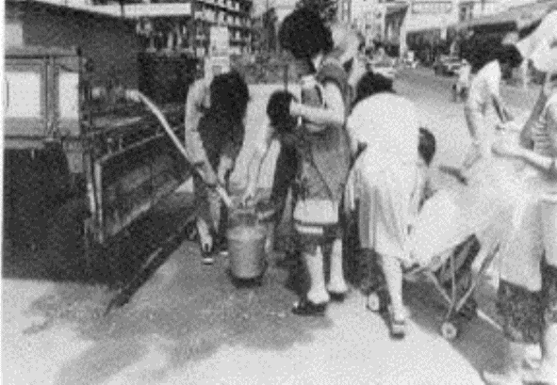
Water Resources Development:
Yodo River System, Okinawa Prefecture and Fukuoka City
Water tanker for the drought of 1978
Source: Fukuoka City Waterworks Bureau, "Waterworks Technologies of Fukuoka City; Overcoming Water Shortages"
http://www.city.fukuoka.lg.jp/data/open/cnt/3/1796/1/English.pdf
No. C2 Ver. 1

Slide 2
Contents
      Introduction
      Background of Water Resources Development
      Case 1: Yodo River System Water Resources Development
      Case 2: Securing Water Resource in Okinawa Prefecture
      Case 3: Water Resources Development and Developing Fukuoka into a Water-Wise City
      Lessons Learned

Slide 3
1. Introduction
Water source
Surface water
Rivers
25.5% (3.91 billon m³/year)
Dam reservoirs
47.3% (7.25 billon m³/year)
Lakes
1.4% (0.22 billon m³/year)
Riverbank infiltration
3.6% (0.54 billon m³/year)
Ground water
Shallow wells
6.6% (1.01 billon m³/year)
Deep wells
12.7% ( 1.95billon m³/year)
Others
2.9% (0.45 billon m³/year)
Total 100.0% (15.33 billon m³/year)
Breakdown of water sources in Japan(2014)
Source : Japan Water Works Association http://www.jwwa.or.jp/shiryou/water/water02.html

Slide 4
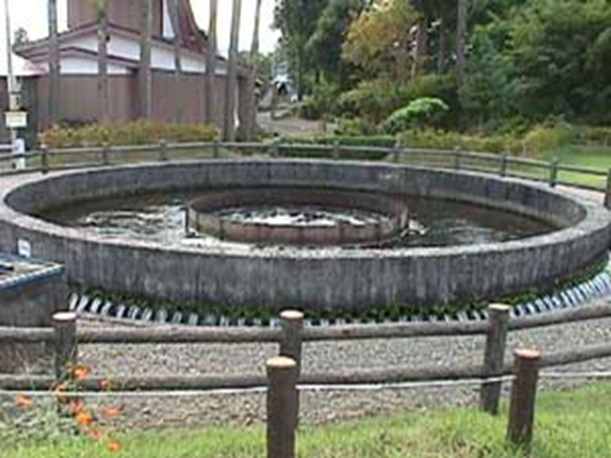
2. Background of Water Resources Development
Early Japanese society depended on rice crops so it was a serious problem to allocate water resources to drinking water use
  (1) Water Rights
Conflict with agricultural water use
Early understanding of the importance of well-ordered water allocation
1896 Former River Act →The concept of licenses for water use
Cylindrical Siphon to allocate water equally, built in 1938 at Rokugou town, Akita Prefecture
http://www.pref.akita.jp/fpd/tuchi/nanataki.htm
1961 Maturity of water rights with enactment of Act on Advancement of Water Resources Development

Slide 5
2. Background of Water Resources Development
  (2) Comprehensive River Development
  In Japan, in order to increase the capacity for water supply to meet increasing demand, water resources development was implemented centering on multipurpose dams under the Comprehensive River Development Project, which took a holistic approach to water use and flood control.
1930s
River Water Control Plan
Flood control, Irrigation and Power generation
1937
River Water Control Project
Target the seven rivers
1951
Comprehensive River Development Project
Develop the relevant laws
1962
Japan Water Agency inaugurated
Basic Plan for Water Resources Development created

Slide 6
2. Background of Water Resources Development
  (3) High Economic Growth and Drought in Urban Areas
1950-1970s Rapid increase in the demand for municipal water supply because of the rapid growth of population and economy
Frequent water shortages
  Water resource development (multipurpose dams etc.)
  Water saving
  Smooth adjustment of water allocation during drought
  Support for upstream reservoir areas from downstream users

Slide 7
2. Background of Water Resources Development
  (4) Act on Advancement of Water Resources Development and Water Resources Development Public Corporation
1961
Act on Advancement of Water Resources Development
【 Purpose 】
Comprehensive water resources development
Rationalization of water use
【 Role 】
Designation of priority river basins
Determination of the Basic Plan for Water Resources Development
Installation of the advisory committee
Designation of responsible organizations to implement the basic plans
The establishment of Water Resources Development Public Corporation (later renamed to the Japan Water Agency)
1962

Slide 8
2. Background of Water Resources Development
(5) Bulk Water Supply
  In Japan, the bulk water supply project provided the large-scale development of water resources for bulk treated water supply to large regional areas. The project contributed to securing water sources and reducing investment costs.
It was difficult for small water utilities to secure water sources.
High cost
Unstable sources
Disparity of water sources among utilities
Consolidation of the whole utilities was difficult.
Long process
Conflict of interests
Principle of municipal management
Prioritize the securement of water sources
→ The start of Bulk Water Supply Utilities

Slide 9
2. Background of Water Resources Development
Sharing of cost for securing water resources
The advantage of Bulk Water Supply Utilities
Reduction in maintenance costs
Stabilization of water resources
Bulk water purchase contracts are for long-term fixed amounts which limits the ability to pass on any cost benefits for water saving to end users.
The disadvantage of Bulk Water Supply Utilities
Scaling-down of end user utilities
→ Decrease in technical capabilities and shortfall in human resources

Slide 10
2. Background of Water Resources Development
(6) “New” Water Sources
Promotion of efficient use of water
Water resources development in Japan
Improving efficiency of waterworks by reducing water leakage etc.
Raising awareness for using water wise
Efforts in areas where drought occurs frequently:
          Rainwater harvesting for non-potable water
          Water recycling for non-potable water
          Seawater desalination

Slide 11
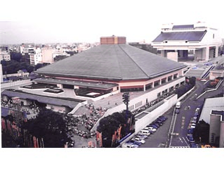
2. Background of Water Resources Development
Rainwater Harvesting in Sumida City, Tokyo
1981 Start rainwater harvesting in “Ryogoku Kokugikan” the Sumo Stadium
Flush toilet
Car wash
Watering
Rainwater storage tank
filtration
Flush toilet
Lifting pump
Overflow water
Rainwater storage tank
Impregnation vessel
【 Purpose 】
Effective use of rainwater
Water supply in the event of a disaster
Urban flood control measures

Slide 12
3. Case 1: Yodo River System Water Resources Development
(1) Background on Development of Yodo River System
The majority of water used upstream is discharged back to the Yodo River and used again by multiple downstream users.
Catchment area 8,240km²
Population in the basin about 12 million
Lake Biwa
Kyoto city and many regional cities
Kyoto City
Kobe City
High-density water use for various purposes
Osaka Bay
Pioneering role in comprehensive development for flood control and water use
Osaka City
Water use in the Yodo River Basin
Ministry of Land, Infrastructure and Transport Yodogawa River Office, "Water use of the Yodo River,"
http://www.yodogawa.kkr.mlit.go.jp/know/data/use/index.html

Slide 13
3. Case 1: Yodo River System Water Resources Development
(2) Securing Water Resources for Downstream Water Utilities
1942
Yodo Basin Flood Control Basic Plan
  Flood control and water use were considered separately
Yodo Basin Water Resource Development Basic Plan
Yodo Basin Consolidated Master Plan 1st stage（1943～1952）
  Reallocate flood control capacity to water resources
1952
Rapid demand growth
Yodo Basin Water Resource Development Basic Plan (full plan) （1962）
  Using amount required for maintaining normal river function
  Construction of dams
1962
Still demand exceeds resource
1972
Lake Biwa Comprehensive Development Plan (1972）
  Not only water use and flood control but also water quality management and conservation of aquatic environment

Slide 14
3. Case 1: Yodo River System Water Resources Development
  To secure water sources to meet water demands and control floods, Act on Special Measures concerning Development of Lake Biwa was enacted in 1972. Under the law stakeholders made a compromise deal.
Lake Biwa
Normal water level
Lake Biwa
Normal water level
Withdrawal must be limited - 1.5 meters below the normal level
Possible to withdraw
- 2.0 meter below the normal level
conflict
The proposal of Lake Biwa Comprehensive Development Project
The objection from Shiga Prefecture, local authority of Lake Biwa
  - 2.0 m below normal level: Estimated water level for water control and utilization
  Water intake below - 1.5 m : Requires the approval of the Ministry of Construction
  Such efforts successfully secured water resources to meet the demand in the large cities located downstream such as Osaka and Kobe. In the 1990s, the water demand reached a peak, and since then, water demand in those cities has been stable.

Slide 15
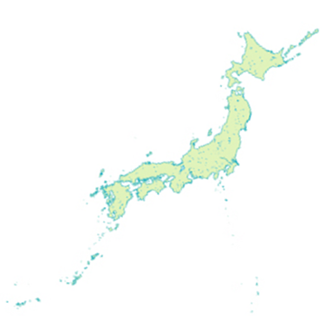
4. Case 2: Securing Water Resource in Okinawa Prefecture
  (1) History of Okinawa Prefecture and its Water Shortage
Per capita water resources potential is only 60% of the national average.
Steep short rivers
Small watersheds
Scarce water resources
Japan
Frequent water service suspension until 1994
Various activities
There has been no water service suspension related to water resource shortage since March 1994.
Okinawa

Slide 16
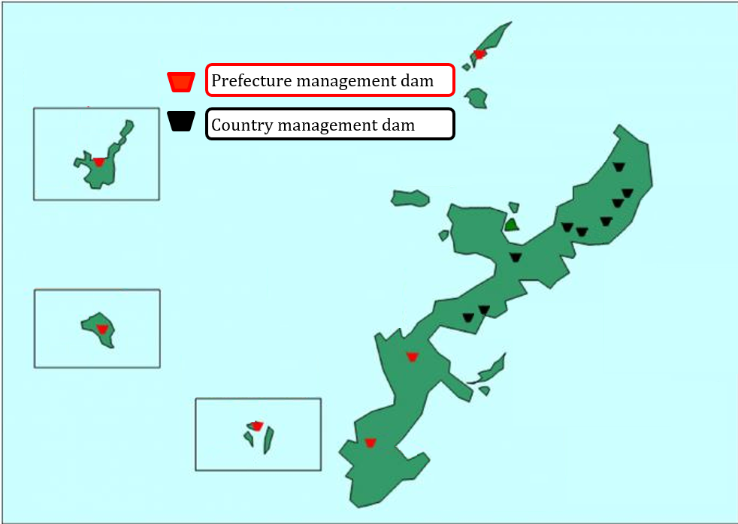
4. Case 2: Securing Water Resource in Okinawa Prefecture
  (2) Dam Development
The River Act, enacted in 1964, stipulated that the rivers in Okinawa should be governed by the prefecture.
Iheya Is.
In 1971, Act on Special Measures for the Promotion and Development of Okinawa was enforced and it included a special provision of the River Act to allow the state government to construct dams, in order to promote water resources development in Okinawa.
Ishigaki Is.
Kume Is.
Okinawa Is.
Zamami Is.
1974 Completion of Fukuchi Dam;
Construction of another nine dams in the north
Dams in Okinawa Prefecture
Okinawa Prefectural government,
http://www.pref.okinawa.jp/site/doboku/damu/kanri/ken-damu.html

Slide 17
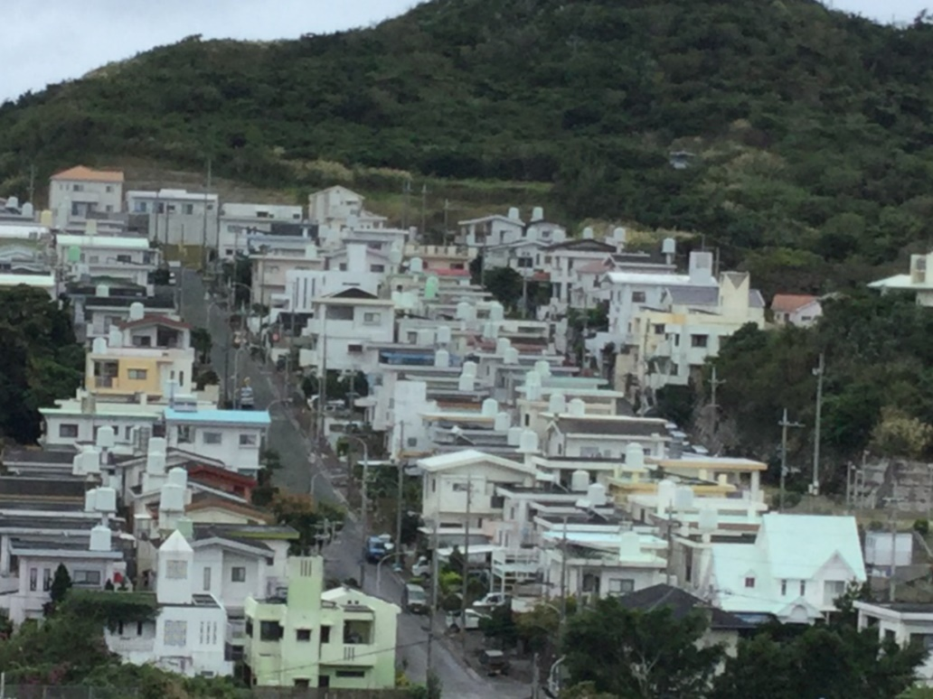

4. Case 2: Securing Water Resource in Okinawa Prefecture
Countermeasure against frequent droughts
Residents installed rainwater reservoirs on the rooftop
Rooftop tanks were used to store tap water and rainwater until stable water resources were developed.
  (3) Rainwater Utilization
The custom of installing a storage tank still remains even now.
Rooftop tank in Okinawa Prefecture

Slide 18
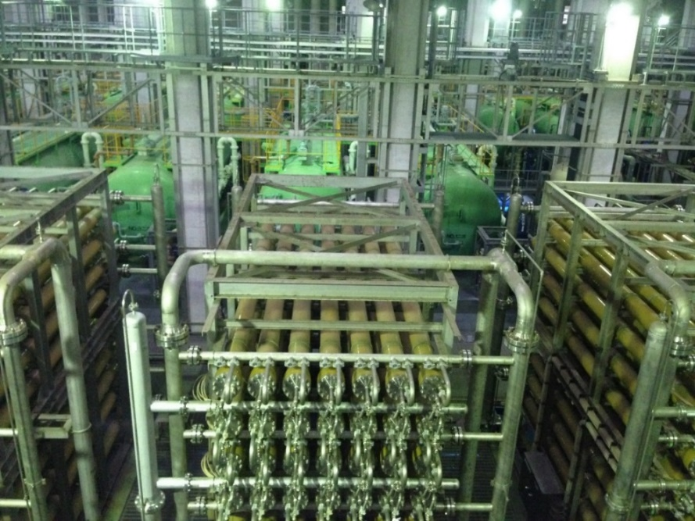
4. Case 2: Securing Water Resource in Okinawa Prefecture
  (4) Seawater Desalination
  The development of a seawater desalination system, which was planned in the time when Okinawa suffered from repeated drought, was completed in 1996.
1980 – 1990s Repeated drought
40,000m³/day
Seawater desalination plant
Completed in 1996
Today, dam construction has been completed and demand has stabilized. The desalination plant does not run at its full capacity. But this system ensures stable water supply even in an emergency situation such as serious drought.
Seawater Desalination Facility
in Chatan Water Treatment Plant

Slide 19

4. Case 2: Securing Water Resource in Okinawa Prefecture
  (5) Promoting Water Conservation in Times of Drought
High awareness of the people to prepare for interruptions in water service
Repeated drought
  【 Methods of calling for water conservation in times of drought 】
The message of water saving on sign boards along the roads
Daily announcement of water levels of dams in the newspaper
Call for water saving by radio and television

Slide 20
5. Case 3: Water Resources Development and Water Conservation-Conscious City; Fukuoka
  (1) History of Various Water Resources Development
Fukuoka City was chronically suffering from shortage of water source.
Water restriction continued 287 days under severe drought in 1978.
Japan
Only small rivers in the area
Population growth and increased water demand
Fukuoka City

Slide 21
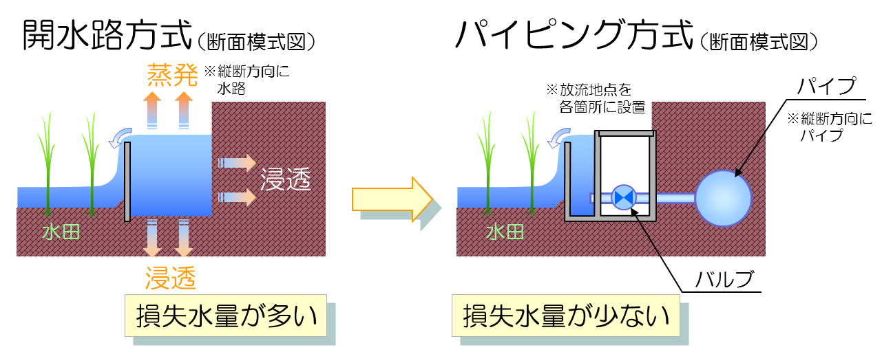
5. Case 3: Water Resources Development and Water Conservation-Conscious City; Fukuoka
  (1) History of Various Water Resources Development
Open-channel Type
(cross section)
Iron Pipeline Type
(cross section)
Evaporation
Iron Pipe
Percolation
Water-filled Paddy
Water-filled Paddy
Percolation
Valve
Much Water Loss
Less Water Loss
Efficient Use of Agricultural Water

Slide 22
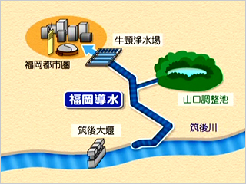
5. Case 3: Water Resources Development and Water Conservation-Conscious City; Fukuoka
  (1) History of Various Water Resources Development
Conveyance from Chikugo River, which flows outside of Fukuoka City, to mitigate the shortage of water resources was realized by understanding and corporation with residents and related entities in watershed.
Water Treatment Plant
Fukuoka metropolitan area
Fukuoka Water Conveyance
Regulating reservoir
Chikugo Ozeki Weir
Chikugo River
Conveyance from outside of the watershed
Fukuoka District Waterworks Agency, http://www.f-suiki.or.jp/facility/ushikubi-placement/placement-shikumi/

Slide 23
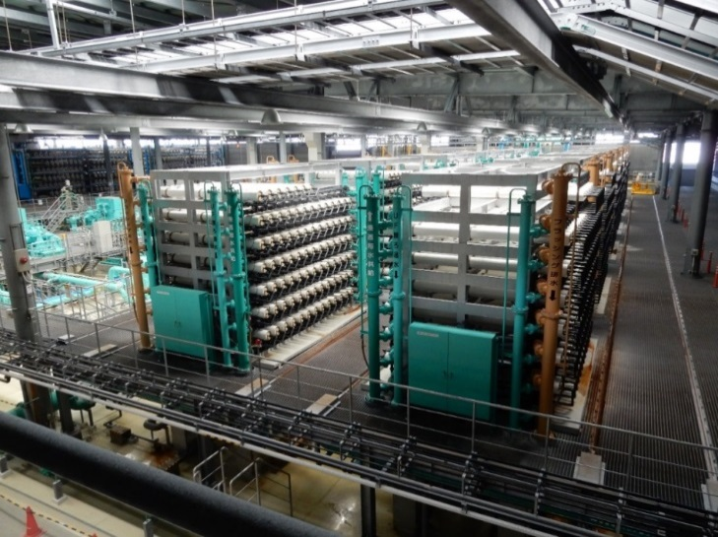
5. Case 3: Water Resources Development and Water Conservation-Conscious City; Fukuoka
  (1) History of Various Water Resources Development
Uminonakamichi Nata Sea Water Desalination Center
2005 in service
Capacity of facility is 50,000 m³/day.
Fukuoka City receives 16,400 m³/ day.
Uminonakamichi Nata Sea Water Desalination Center

Slide 24
5. Case 3: Water Resources Development and Water Conservation-Conscious City; Fukuoka
  (2) Water Conservation-Conscious City
Water-Wise City
Non-revenue water rate: 3.9% in 2015
Water Consumption: 194 L/person/day (the lowest among large cities in Japan)
Promotion of Water Reuse
Introduce of Water Distribution Control System
Proactive Promotion of Leakage Reduction
Improvement of Water Distribution System
Public Relation Activities, etc.
Diffusion of Water Saving Device

Slide 25
6. Lessons Learned (1)
  (Comprehensive River Development) While securing water resources is a top priority for utilities, the use of river water must be well planned and controlled in a fair and equitable manner. The Japanese system takes great efforts in this regard, by allocating water rights and implementing comprehensive river development. The Water Resources Development Public Corporation (now Japan Water Agency) balances the needs for flood control and water utilization.
  (Multipurpose Dam) Dam development is expensive and must be carried out with a multi-purpose concept to be cost effective. This requires cost sharing and coordination among government organizations and dam reservoir users.
  (Bulk Water Supply) Water utilities can cooperate to utilize Bulk Water Supply as their water source. They also benefit from integrated management by joining efforts from resource development to water distribution to end users.

Slide 26
6. Lessons Learned (2)
  (Other Means to Secure Water Resource) Dam construction takes a long time to complete; therefore, other means to secure water resource must be implemented at the same time. The combined efforts in rainwater utilization, leakage reduction, reuse and water saving campaign have all helped to make lower water consumption in Fukuoka City to than the national average. Seawater desalination is much more expensive than the use of surface water, so it is still only a supplemental method to obtain additional water resources.

