Slide 1
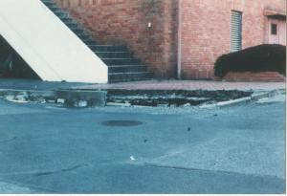
Sustainable Groundwater Use and Prevention of Land Subsidence:
Osaka City and
Saitama Prefecture
Original ground elevation
Elevation after land subsidence
No. C3 Ver. 1
Depression caused by land subsidence https://www.pref.saitama.lg.jp/a0505/901-20091202-17.html

Slide 2
Contents
      Introduction
      Land Subsidence and Preventive Measures
      Case 1 : Osaka City
      Case 2 : Saitama Prefecture
      Lessons Learned

Slide 3
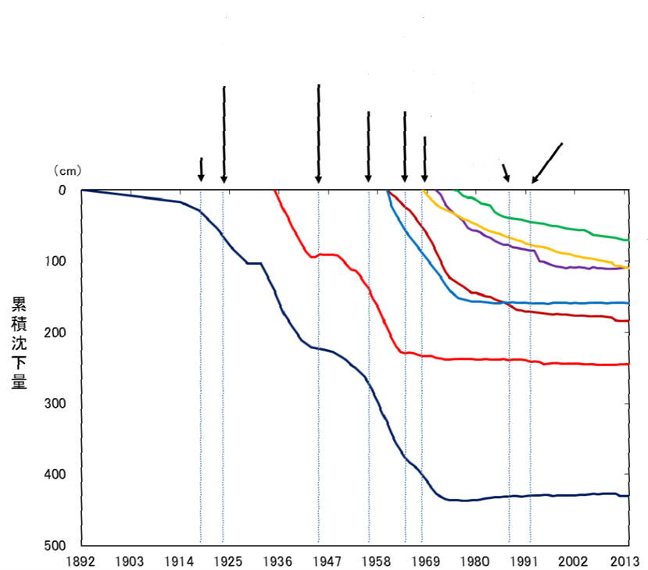
1. Introduction
(1) Beginning of borehole drilling in various regions
(5) Enactment of “Building Water Act”
(2) Great Kanto Earthquake
(6) Enactment of “Basic Law for Environmental Pollution Control”
(3) World War II
(7) Guideline on Countermeasures for Prevention of Land Subsidence
( Chikugo Saga plain and Nobi Plain )
(4)Enactment of “Industrial Water Act”
(8) Guideline on Countermeasures for Prevention of Land Subsidence
( Northern part of Kanto Plain )
(1) (2) (3) (4) (5)(6) (7) (8)
Cumulative subsidence
Legend Tokyo Osaka Northern part of Kanto Plain Nobi Plain
  Kujukuri Plain Chikugo and Saga Plain Niigata
Changes in land subsidence in Japan 1892-2013
Ministry of the Environment, http://www.env.go.jp/water/jiban/gaikyo/gaikyo26.pdf

Slide 4
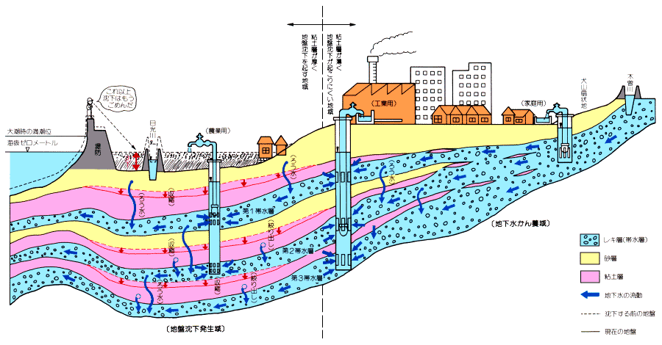
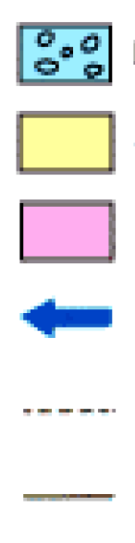
2. Land Subsidence and Preventive Measures
Land subsidence in this area is likely to occur because the clay layer is thick.
Land subsidence in this area is not likely to occur because the clay layer is thin.
( Groundwater recharge area )
Gravel layer (Aquifer )
Sand layer
Clay layer
Flow of groundwater
Ground before the subsidence
Current ground
(Area of excessive pumping)
How excessive pumping of groundwater can cause land subsidence
Aichi prefectural government, "Outlines of land subsidence," http://www.pref.aichi.jp/soshiki/mizu/0000035197.html

Slide 5
2. Land Subsidence and Preventive Measures
(1) Causes of Land Subsidence
Land subsidence may be accelerated by increased water demand and excessive groundwater pumping.
Increase of industrial water demand
Development of pump technology
Advances in borehole drilling technology
1923 The first recognition of land subsidence
(Surveying after the Great Kanto Earthquake )
Increasing use of groundwater
Lowering of groundwater level
Shrinkage of clay layer
1950s Recognized as a social problem
Land subsidence

Slide 6
2. Land Subsidence and Preventive Measures
(2) Industrial Water Act and Building Water Act
In Japan, the key countermeasures against land subsidence are regulations to control groundwater pumping. Two laws to control groundwater withdrawal targeting factories and buildings have been effective in stopping land subsidence.
  【 Countermeasures against land subsidence 】
  1956
  1962
Industrial Water Act
Regulation for controlling groundwater withdrawal for industrial water use in designated areas
Act on the Regulation of Pumping-up of Groundwater for Use in Buildings
(Building Water Act)
Regulation for controlling groundwater withdrawal for buildings

Slide 7
2. Land Subsidence and Preventive Measures
The Industrial Water Act is designed to ensure a reliable supply of water for industry, conserve groundwater and contribute to the prevention of land subsidence. When the Act was drafted there was a debate about how to regulate wells and it was decided as follows:
Regulate newly drilled wells only
Exempt small household wells (smaller than 21 cm² in cross-sectional area of a discharge outlet of a pump)
Do not regulate the distance between wells
Supply alternative sources from publicly owned water supply systems
The prefectural governor has the authority to order additional restrictions on groundwater withdrawal to protect the groundwater source in the case of emergencies.
Officials designated by ministers in charge or prefectural governors have the authority to conduct on-site inspections.

Slide 8
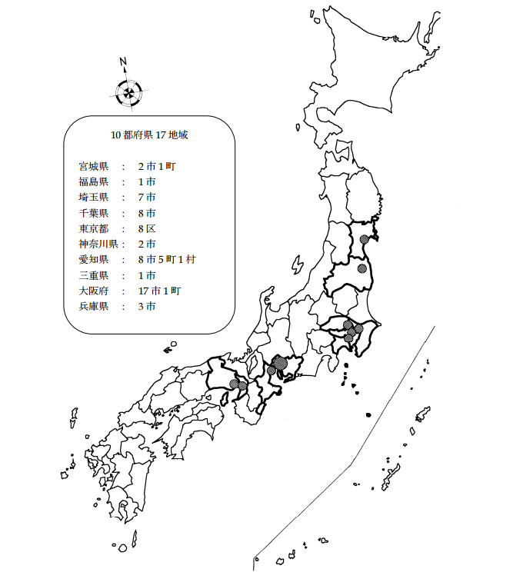
2. Land Subsidence and Preventive Measures
The Industrial Water Act regulates the groundwater pumping in the region where the excessive pumping had caused land subsidence and industrial water systems are/will be constructed as alternative water sources.
Criteria for designated regions
Occurrence of subsidence, etc.
Large demand for industrial water
Industrial water supply systems are/will be constructed as an alternative water source.
17 regions in 10 prefectures
Position of a strainer of a well and a cross-sectional area of a discharge outlet of a pump
Designated regions
Factories have one year to change from groundwater sources to an industrial water supply system once it becomes available.
Designated regions targeted by the Industrial Water Act
Ministry of Economy, Trade and Industry, “Overview of groundwater protection,” 2009, http://www.meti.go.jp/policy/local_economy/kougyouyousui/chikasuitaisakunogaikyo21fy.pdf

Slide 9
2. Land Subsidence and Preventive Measures
The Act on the Regulation of Pumping-up of Groundwater for Use in Buildings(Building Water Act) is designed to prevent land subsidence. Withdrawal of groundwater to supply a building in a designated region (some parts of Osaka, Tokyo, Saitama and Chiba prefectures) requires approval from a prefectural governor if the well is above a certain scale.
Other ordinances by many local governments (311 cities, towns or villages of 27 prefectures out of 47, as of March 2015) have also been enacted to regulate groundwater withdrawal, reflecting local conditions. These local ordinances complement the broader national laws that target the significant large-scale land subsidence that has occurred in some regions of Japan.

Slide 10
2. Land Subsidence and Preventive Measures
Prevention of Land Subsidence through the Industrial Wastewater Regulation
The Water Pollution Control Act enacted in 1970 inadvertently contributed to decreasing the volume of groundwater withdrawn.
Discharge standards restrict the concentration of pollutant load in the effluent
Meaningless approach to achieve the standards by diluting with water.
Reduction in the amount of wastewater and introduction of wastewater treatment
(Large consumers)
Water saving and promotion of reuse
Reduction of water intake for industrial water
Reduction in the amount of groundwater withdrawal
(Unexpected benefit)
Effect of the Water Pollution Control Act (1970)

Slide 11

2. Land Subsidence and Preventive Measures
(4) Comprehensive Preventive Measures: Guidelines for Prevention of Land Subsidence
  【The comprehensive countermeasures 】
  Regulation to prevent over pumping
  Ensure alternative water source
  Prevention of disasters
  Restoration after damage
Guidelines for Prevention of Land Subsidence
Especially intense land subsidence;
3 regions
Establishment of coordination mechanism among the relevant ministries and agencies
Conservation of groundwater
Comprehensive measures in response to actual situation of the region

Slide 12
2. Land Subsidence and Preventive Measures
(4) Comprehensive Preventive Measures: Guidelines for Prevention of Land Subsidence
The monitoring of land subsidence and ground water levels is important to formulate appropriate regulations and analyze their impact.
Construction of nationwide broad-based observation network
Regular monitoring of the effects of regulation and alternative water supply
Hydrogeology
Land subsidence
Quantity of groundwater usage
Groundwater level
Groundwater quality
Information disclosure on the Ministry of the Environment website
Usage of groundwater
Land subsidence situation

Slide 13

2. Land Subsidence and Preventive Measures
(5) Monitoring of Groundwater Level and Land Subsidence
Land subsidence has almost stopped in Japan, but the ground levels shall never come back to the levels before land subsidence took place.
Monitoring points for land subsidence
Early countermeasures are important to prevent land subsidence from causing
serious problems.
Ministry of the Environment , Monitoring points directory
http://www.env.go.jp/water/jiban/directory/index.html

Slide 14
2. Land Subsidence and Preventive Measures
In Japan, the land owner has right to use groundwater defined by the Civil Code. This caused difficulties for implementing groundwater regulation.
Establishment of the Basic Act on Water Cycle in 2014
Groundwater is regarded as a precious public commodity.

Slide 15
3. Case 1 : Osaka City
(1) History of Groundwater Use and Land Subsidence
Land subsidence became a serious social issue.
Damage to buildings by uneven settlement
Inundation by storm surge
1930 - 1940s
ca. 1945
Decrease in economic activity due to war. Land subsidence temporarily halted.
ca. 1950
Resumption of land subsidence
The first recorded occurrence of land subsidence in Konohana Ward, Osaka City
The cumulative amount of land subsidence
＝ More than 270cm (by 1964)

Slide 16
3. Case 1 : Osaka City
(2) Industrial Water Supply
Start of industrial water supply system, before legislation is enacted
1954
1956
Enactment of the Industrial Water Act
Establishment of the Osaka Coastal Industrial Water Supply Authority to accelerate the supply of water distribution system for Industry.
Establishment of the Osaka Coastal Industrial Water Supply Authority to accelerate the supply of water distribution system for Industry.
1959
1968
A ban on groundwater withdrawal
Land subsidence has been almost stopped today.

Slide 17
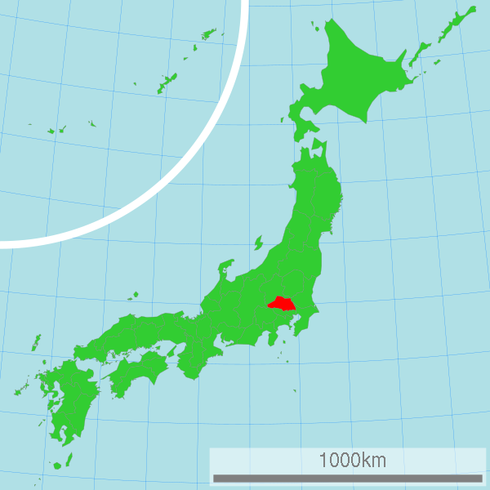
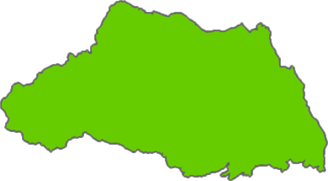
4. Case 2 : Saitama Prefecture
(1) History of Groundwater Use and Land Subsidence
Soft geological formations extend into the eastern part of Saitama Prefecture. This is a contributing factor to serious land subsidence.
Monitoring stations at 36 places in the prefecture
Real-time observation of land subsidence and groundwater levels
Setting the maximum volume of groundwater abstraction
Location of Saitama Prefecture

Slide 18
4. Case 2 : Saitama Prefecture
  1935 Monitoring of land subsidence started by Ministry of the Environment.
  → Cumulative subsidence in Saitama Prefecture Koshigaya City ＝ About 150 cm
  ( Since 1935 )
  Pumping of groundwater has been drastically reduced.
  Still, land subsidence proceeds at 1 – 2 cm/year even now.
BUT

Slide 19
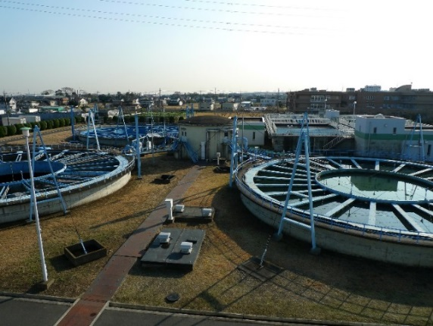

4. Case 2 : Saitama Prefecture
(2) Industrial Water Supply
ca. 1955
Factories increased in the southern area of Saitama Prefecture.
Increased use of groundwater
Problem of land subsidence
Kakinoki purification plant
Saitama Prefecture Bureau of Public Enterprise started supplying industries with water in 1964.
Supply area: 6 cities,
153 business sites
Supply amount: 195,280 m³/day
Tariff: 22.53 yen/m³

Slide 20
5. Lessons Learned (1)
  (Monitoring) Land subsidence can occur naturally or can be caused by excessive groundwater pumping. It is essential to monitor ground level and groundwater level continuously in areas where land subsidence occurs. It is also important to understand the relationship between groundwater usage and land subsidence so that the use of groundwater can be regulated.
  (Alternative Water Sources) The prevention of land subsidence can be greatly augmented by developing alternative water supplies such as industrial water supply.
  (Regulations) The Industrial Water Act, the Act on the Regulation of Pumping-up of Groundwater for Use in Buildings and local ordinances in some prefectures and cities provide the effective legislative framework for controlling groundwater use.

Slide 21
5. Lessons Learned (2)
  (Stakeholder Involvement) It was effective to arrange the discussions for all the stakeholders including government authorities implicated in the regulation of groundwater usage and work together to find solutions for groundwater depletion and land subsidence.
  (Prevention in the entire Groundwater Basin) Preventive measures for land subsidence need to be implemented comprehensively in the entire region which constitutes the groundwater basin. Groundwater monitoring and regulations for groundwater pumping have been implemented in the whole region in order to limit groundwater withdrawal and to prevent further land subsidence.

