Slide 1
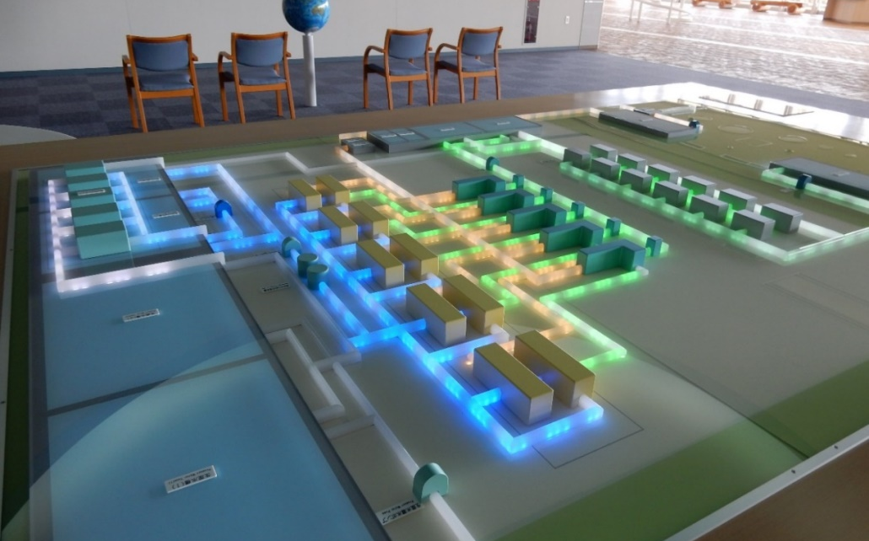
Block Distribution System for Equitable, Efficient and Resilient Distribution:
Yokohama City and Fukuoka City
No. C4 Ver. 1
Model of block distribution system
(Fukuoka City Waterworks Bureau)

Slide 2
Contents
      Introduction
      Block Distribution System in Japan
      Case 1 : Yokohama City
      Case 2 : Fukuoka City
      Lessons Learned

Slide 3
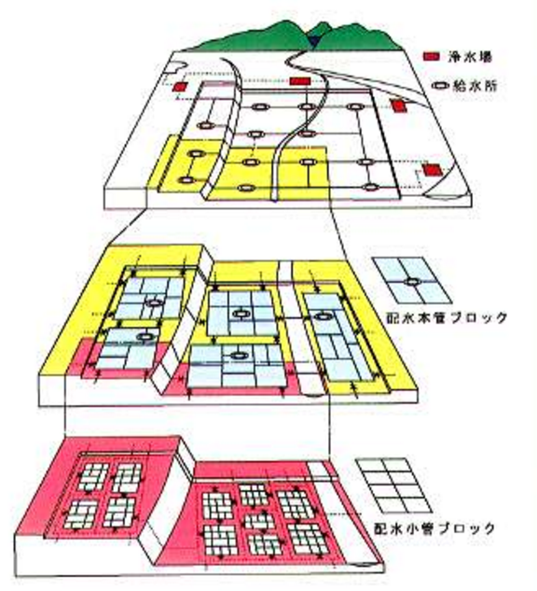
1. Introduction
Water treatment plant plant
Treated water transmission pipeline networks
Distribution reservoir
Main distribution pipeline networks
Block of main distribution pipelines
Small branch distribution pipeline networks
Block of small distribution pipelines
Concept of treated water transmission and distribution system
Source: Bureau of Waterworks Tokyo Metropolitan Government,
https://www.waterworks.metro.tokyo.jp/suidojigyo/torikumi/kadai/step21/05.html

Slide 4
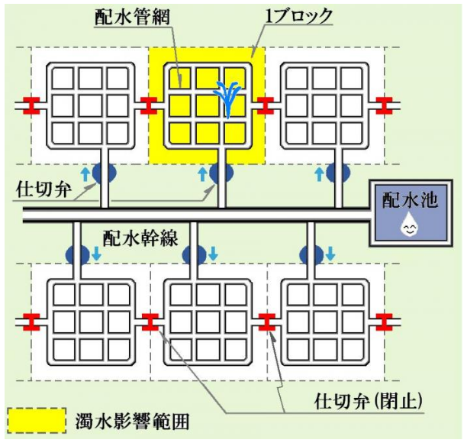
2. Block Distribution System in Japan
(1) General Features
  Both District Metered Area (DMA) and Block Distribution System (BDS) can be defined as a discrete area of a water distribution network.
  While the aim of DMA is to reduce and control leakage, BDS has been developed and utilized in Japan for the following purposes :
Distribution piping network
Single block
Distribution
reservoir
Gate valve
Main distribution pipelines
Optimization of water pressure
Flow measurement in smaller blocks and quick adjustment of supply route
Isolation of water mains and alternation of supply route
Early detection of leakage
Gate valve（ Closing ）
Range of influence of turbid water
Overview of block distribution system
Source : Sapporo City

Slide 5
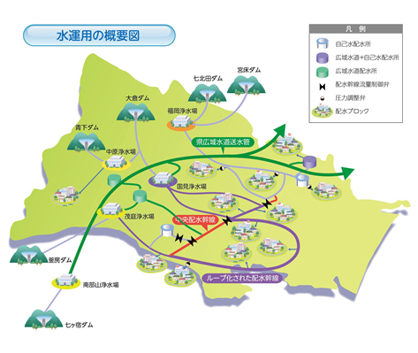
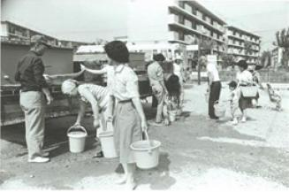
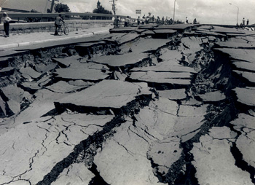


2. Block Distribution System in Japan
(2) Background and History
Yokohama
  The first water utility to use a block distribution system
Unorganized & intricate piping
Failure to manage distribution
Organize pipelines and make block a distribution system
Fukuoka
Niigata
Sendai
Prolonged serious drought
→ Advanced water resource management and water supply operation
Liquefaction caused by earthquakes
→ Localized suspension of the water service
Large difference in height in water supply districts
→ Equalization of water pressure
Source : Fukuoka City Waterworks Bureau
http://www.city.fukuoka.lg.jp/mizu/keikaku/machi/0060_3_2_3.html
Source : Niigata City
http://www.city.niigata.lg.jp/shisei/koho/kohoshi/shiho/backnumber/h26/shiho140511/1_01.html
Source : Sendai City Waterworks Bureau
,https://www.suidou.city.sendai.jp/03_suisitu/16.html

Slide 6
3. Case 1 : Yokohama City
(1) Background and Purpose
Water intake from the Kanagawa Water Supply Authority to meet the increasing demand was decided in 1964.
To prepare the project it was necessary to;
  Know the capacity of existing distribution pipelines
  Decide where to locate new distribution pipelines
  However, existing distribution systems at that time were not well organized due to financial difficulty.
Simultaneous study for water consumption and water supply conditions in each town was implemented.
Design of block distribution system

Slide 7
3. Case 1 : Block Distribution System in Yokohama
(2) The Effect of Block Distribution System
Boundary of block areas
Hilly areas (pumping system)
Flat areas (gravity system)
Reservoirs in water treatment plants
Distribution reservoirs
Block distribution system in Yokohama City
Source : Yokohama Waterworks Bureau,
http://www.city.yokohama.lg.jp/suidou/kyoku/suidoujigyo/jigyogaiyou.html

Slide 8
3. Case 1 : Block Distribution System in Yokohama
(2) The Effect of Block Distribution System (Cont’d)
  Introduction of the block distribution system
  Pipeline information database
  Network information using computerized system
  and advanced mapping system
  Easy pressure control by utilization of elevation
  Easy distribution volume control by valves in the network
  Reduction of water service suspension time for repairs and maintenance
  Improvement of pipeline system
  Easy maintenance in daily operation

Slide 9
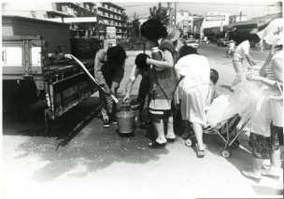
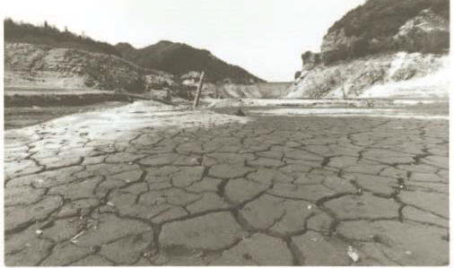
4. Case 2 : Fukuoka City
(1) Background and Purpose
【 Drought in1978 】
Water restrictions up to 287 days
Drought was so severe that emergency water was brought from a distance using ships and trains.
Water-saving
urban development
Parched Dam during Period of Abnormally Low Rainfall in 1978
Water Trucks Dispatched during the Severe Drought

Slide 10
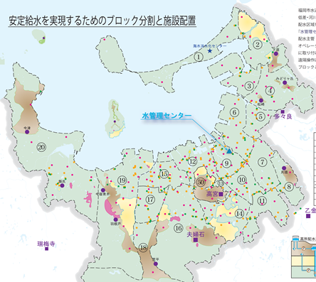
4. Case 2 : Fukuoka City
1978 Serious drought
Reduction of downtime in daily water supply
Reduction of supply restrictions during drought by multiple water sources
Uniform distribution throughout the city
Detection of water leakage through advanced monitoring
Block segmentation and facility placement toward the realization of a stable water supply
Water Management Center
1981 Establishment of the Water Management Center and 21 distribution blocks
21 distribution blocks in Fukuoka City

Slide 11
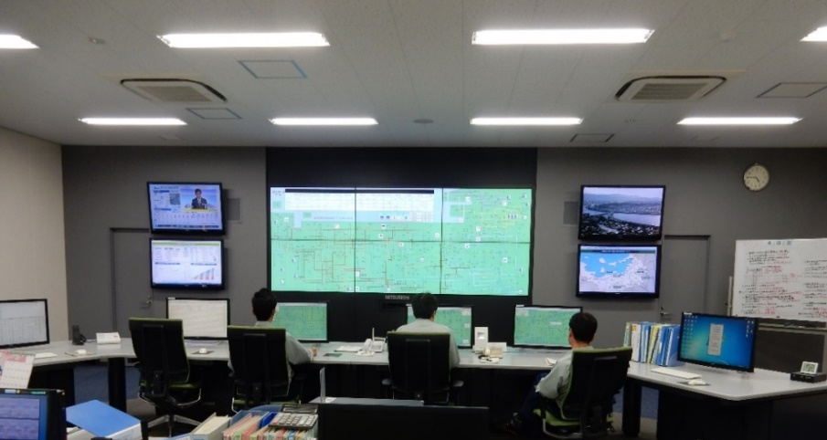
4. Case 2 : Fukuoka City
Function of the Water Management Center
Adjustment of flow rate and allocation from different water treatment plants
Leakage reduction by controlling water pressure
Reduction of labor for valve exercising during droughts
Early detection of abnormal conditions and quick measures by remote control
The Water Management Center, Fukuoka City Waterworks Bureau
Opening and closing of 180 electric valves
Manual remote operation from the Water Management Center
Efficient operation based on information collection and analysis

Slide 12
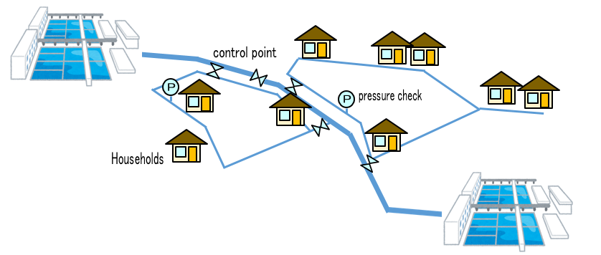
4. Case 2 : Fukuoka City
(2) The Effect of Block Distribution System
Reduction of Leakage
Minimization of service suspension
Reduced leakage volume
4,000-5,000 m³/day
Lowered leakage incidents
30%
Mutual back up between treatment plants when distribution is disrupted by accidents, construction, or repair at a certain point

Slide 13
5. Lessons Learned（1）
  (Block Distribution System) The system is used by most Japanese water utilities. It is very effective in reducing leakage and maintaining stable supply by: (1) optimizing water pressure in distribution pipelines, (2) measuring flows in small areas to allow early detection of abnormal conditions, (3) identifying the location of broken pipes quickly, and (4) allowing operators to make immediate adjustments to the distribution route and switch to a backup supply.
  (Large and Small Blocks) Large blocks allow switching between water sources and water treatment plants. Small blocks are discrete areas within a large block for switching distribution route during maintenance of the network.
  (Yokohama System) The block distribution system in Yokohama City drastically modified the disorganized water supply network and improved operation and maintenance by introducing a computerized system. The system makes it easier to identify broken distribution mains and provide a backup supply to minimize suspension of service.

Slide 14
5. Lessons Learned（2）
  (Fukuoka System) The block distribution system in Fukuoka City established to deal with severe droughts is characterized by the advanced linkage between water sources and distribution reservoirs, switching of water sources by remote control of valve operation, and reduction of leakage in block units. The block system together with the Water Management Center and advanced mapping system is very effective in leakage reduction.
  (Topographic Considerations) The implementation of block distribution systems based on topographical characteristics (including the location of water sources and treatment plants) contributes to efficient water supply operations.

