Slide 1
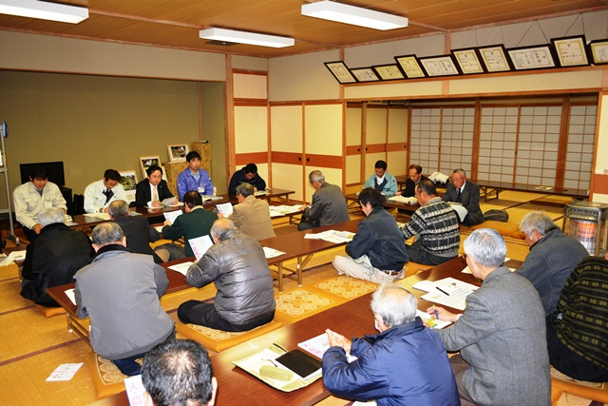
Water Tariff Design with Understanding of Customers:
Kyoto City
Public meeting to explain water tariff revision in Source: Ikusaka Village in Nagano Prefecture
http://blog.village.ikusaka.nagano.jp/sontyo/index.php?blogid=254&archive=2013-01
No. C5 Ver. 1

Slide 2
Contents
      Introduction
      Water Tariff Revision Process
      Case : Kyoto City Water Tariff Revision
      Lessons Learned

Slide 3
1. Introduction
In Japan, tariff revenue can cover all the costs at large utilities but not at small-scale utilities.
Source: Created from the data of The Ministry of Internal Affairs and Communications “Survey of Financial Status of Local Public Enterprises, FY 2014”
Cost recovery in water supply business by size of operation (2014)

Slide 4
1. Introduction
Water tariffs are revised periodically to reflect changing conditions.
Source: Created from the data of Japan Water Works Association “The Outline of Water Supply (6th ed.)”2015
Water Tariff Revisions from 1970 to 2014

Slide 5
1. Introduction
Self-supporting accounting system and
fully distributed cost method
as defined by
Local Public Enterprise Act
Water Tariff Setting Manual guides the calculation of appropriate tariff level
Advisory committee
and
public consultation allow external input
Periodic revision of water tariffs

Slide 6
2. Water Tariff Revision Process
(1) Preparation of a fiscal plan
(2) Discussion by an advisory committee & public consultations
(3) Preparation of revised water tariffs
(4) Discussion at the local assembly and adoption
(5) Public notification
(6) Report to the Ministry of Health, Labour and Welfare (or Governor of the prefecture)

Slide 7
2. Water Tariff Revision Process
(1) Preparation of fiscal plan
The Fiscal plan should indicate whether the existing tariffs would cover the O&M and capital costs (OPEX and CAPEX) for the next 3 to 5 years.
Components | Contents | Criteria
Demand & Supply Plan | Securing water source, water demand analysis, etc. | Water service coverage ratio, population served, number of connections, etc.
Facility Plan | New construction, expansion, rehabilitation, etc. | Annual amount of water distributed (daily maximum & average) and amount of revenue water..
Funding Plan | Capital income including bond issues, national subsidies and grants, transfers from the general account, contributions for construction, etc. | Amount of bond issued and repayment, amount of grant and subsidy, other income, etc.
Operation Plan | Operation & maintenance of facilities, staff allocation, outsourcing, etc. | Operation & maintenance cost including outsourcing cost, etc.

Slide 8
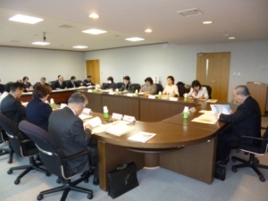
2. Water Tariff Revision Process
(2) Discussion by advisory committee & public consultations
An advisory committee is established to examine the tariff system and public consultations are held to seek customers input.
Advisory committee ensures:
accountability and information disclosure (utility has to make the case for revision);
objectivity in the decision-making process;
use of expert advice from members;
incorporation of customers’ inputs from representatives in the committee.
Advisory committee on waterworks management in Koriyama City
Source:https://www.city.koriyama.fukushima.jp/481000/jogesuido/shingikai.html

Slide 9
2. Water Tariff Revision Process
(3) Preparation of revised water tariffs
  Water Tariff is revised based on Fully Distributed Cost Method.
  Calculation period : 3 ー 5 years
  Calculation of total cost:
Total Cost
＝
Total Tariff Revenue
Total Cost
＝
Operating Cost
＋
Capital Cost
Operating Cost
＝
Personnel Cost
＋
Chemical Cost
＋
Power Cost
＋
Repair Cost
＋
Bulk Water Cost
＋
Depreciation Cost
＋
Cost for retirement of fixed assets & stock losses
＋
Other Maintenance Costs
Capital Cost
＝
Interest Payment
＋
Capital Maintenance Cost
Capital Maintenance Cost
＝
Asset Price
×
Capital Maintenance Rate

Slide 10
2. Water Tariff Revision Process
(3) Preparation of revised water tariffs (Cont’d)
  Calculation steps based on the Water Tariff Setting Manual

Slide 11
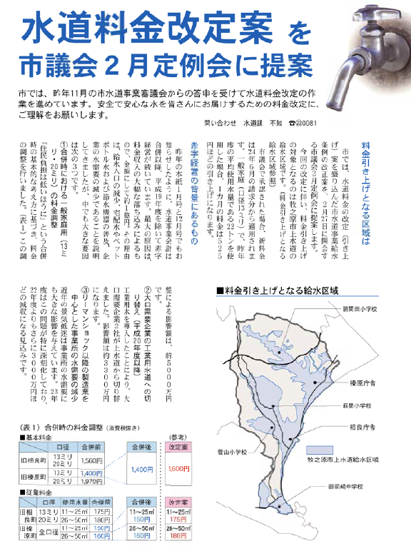
2. Water Tariff Revision Process
(4) Discussion at local assembly
Makinohara City bulletin announcing submission of proposed tariff revision to the local assembly for approval.
Source:http://www.city.makinohara.shizuoka.jp/ftp/01gt01/koho/201202/201202_04_05.pdf

Slide 12
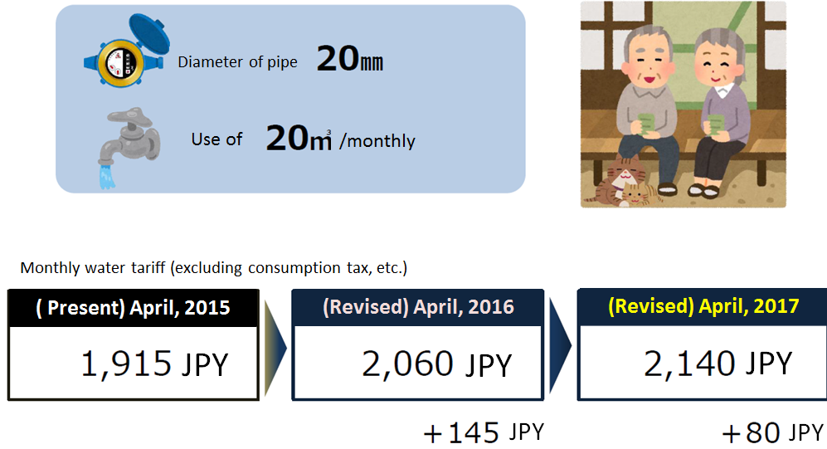
2. Water Tariff Revision Process
(5) Public notification
  The public is informed of the new tariffs.
Source: Suita City, http://www.city.suita.osaka.jp/var/rev0/0096/0282/11641310928.pdf

Slide 13
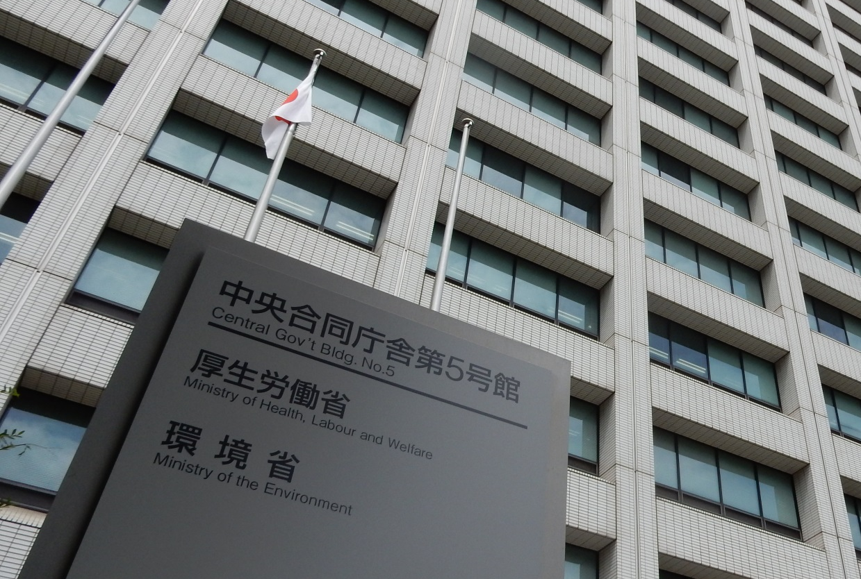

2. Water Tariff Revision Process
(6) Report to supervising authority
The water utility reports the change in tariffs to the Ministry of Health, Labour and Welfare (or the Governor of the prefecture).

Slide 14
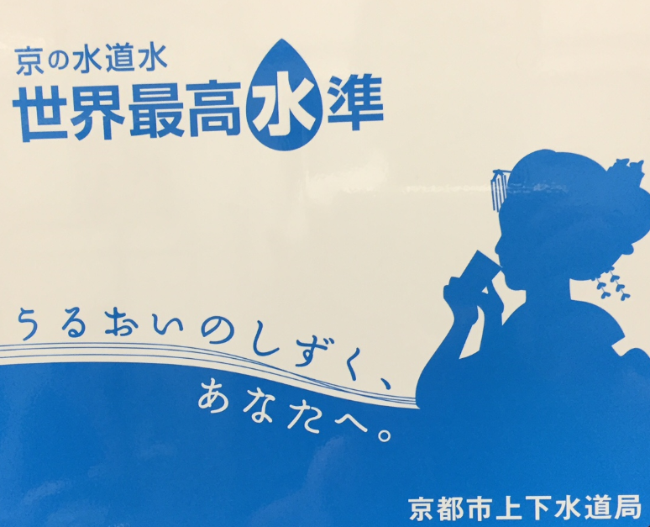
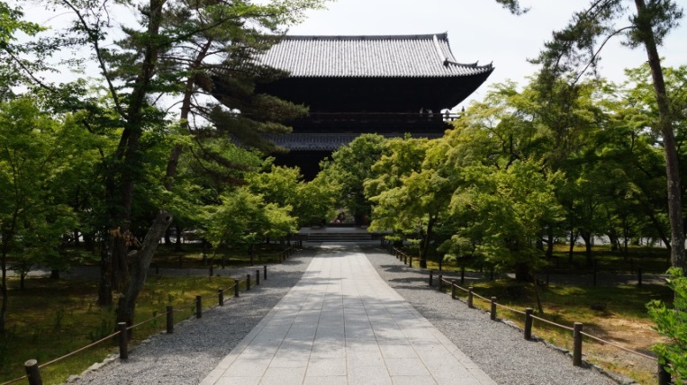
3. Case Study : Kyoto City
(1) Background
FY2012
Source: Kyoto City Waterworks Bureau’s website
http://www.city.kyoto.lg.jp/suido/page/0000008776.html
Poster commending the superior water quality of Kyoto City

Slide 15
3. Case Study : Kyoto City
(1) Background (Cont’d)
Preparation of Water Vision and medium-term business plan
Cumulative deficit forecasted to occur
Maintain existing tariffs and rely on other means to balance budget until FY 2012
Source: Kyoto City Waterworks Bureau “Kyoto City Waterworks’ Medium-Term Management Plan (2008 – 2012),” December, 2007

Slide 16
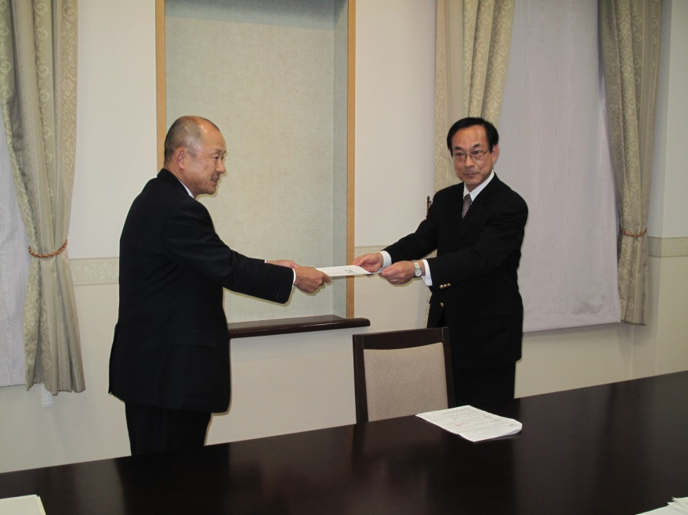
3. Case Study : Kyoto City
(2) Advisory committee on water tariff revision
    Period: 2011.11– 2012.11
    Members:
    Academic experts
    Tax accountant
    Representative from women's group
    Representative from chamber of commerce
    Representative from social welfare workers’ group
    Representative from Japan Water Works Association
    Representative from public
Submission of the recommendations from the Advisory committee
Source:http://www.city.kyoto.lg.jp/suido/page/0000132114.html

Slide 17
3. Case Study : Kyoto City
(3) Public Survey
Objective: To input citizen’s opinions into discussions of the Advisory Committee
Period: April to May, 2012 (1 month)
Questionnaire: Asked following 6 points
Differences among fixed rates based on diameters of pipes
Minimum volume water (20m³/two months) included in the fixed rates
Increasing-block system and the rates
Number of blocks in the increasing-block system
Measures against groundwater users who connect to large diameter pipes and pay much less for piped water
Payment methods
Collected: 1,200 answers

Slide 18
3. Case Study : Kyoto City
(3) Public Survey - Results

Slide 19
3. Case Study : Kyoto City
(3) Public Survey - Results (Cont‘d)

Slide 20
3. Case Study : Kyoto City
(4) Issues Identified & Recommendations by the Committee
Issues |  | Recommendations
Minimum volume of water | More than 1/3 of households use less than 10m³/month (monthly water volume covered by the fixed rates). | Reduce the minimum volume by half.
Block tariff system | The number of blocks and the volume in each block do not correspond to the water consumption pattern. | Sub-divide small volumetric blocks into more narrow bands and consolidate large volumetric blocks into larger bands.
Fixed cost | Along with the reduced water demand, it would be difficult to cover the fixed cost in future. | Increase the amount of fixed costs allocated to the fixed rate.
Rate increment | Difference between the highest and the lowest unit price of the volumetric rate is bigger than other major cities | Reduce the rate difference within the water tariff structure, bringing the rate levels closer to those of other cities.

Slide 21
3. Case Study : Kyoto City
(4) Issues Identified & Recommendations by the Committee
(Cont’d)
Issues |  | Recommendations
Groundwater use | Groundwater users pay much less for water and are not sharing the financial burden equitably with other users. | Raise the fixed rate and increase the amount of fixed water for customers with large pipe diameter and reduce unit price of volumetric rate.
Credit card payment | Customers are interested in using credit card to make payments. The commission charge to the utility for credit card payment is more expensive than bank transfer fees. | Introduce credit card payment. Split the difference with the customers by giving them a discount as an incentive for payment using bank transfer.
Connection charge | Income generated by the connection charges would decrease. | Introduce capital maintenance cost.
Capital maintenance cost | Capital maintenance costs are not included in the calculation of water tariffs. | Include capital maintenance costs when setting water tariffs.

Slide 22
3. Case Study : Kyoto City
(4) Comparison of Old and New Tariff s Schedule
 | Diameter /Block | Old Tariffs |  | Revised Tariffs
 |  | Price (JPY) | (Minimum volume) | Price (JPY) | (Minimum volume)
Fixed Rate (Minimum Charge) | 13/20mm | 870 | 10m³ | 920 | 5m³
 | 25mm | 1,690 |  | 1,900 | 10m³
 |  |  |  | 2,780
 |  |  |  | 18,300 | 50m³
 | 40mm | 2,470
 | 50mm | 9,250 |  | 35,910 | 100m³
 |  |  |  | 71,600 | 250m³
 | 75mm | 15,470
 | 100mm
 | 150mm |  |  | 134,260 | 500m³
 | 200mm |  |  | 281,520 | 1000m³
Volumetric Rate (Volumetric Charge) (/m³) | 6ｍ³ | 0 |  | 10
 | 11m³~20m³ | 162 |  | 177
 | 21m³~30m³ |  |  | 180
 | 31m³~100m³ | 189 |  | 208
 | 101m³~200m³ | 206 |  | 226
 | 201m³~500m³ | 223 |  | 243
 | 501m³~5,000m³ | 262 |  | 284
 | 5001m³~10,000m³ | 301 |  | 326
 | 10,000m³~ | 339
Source: Kyoto City Waterworks Bureau

Slide 23
3. Case Study : Kyoto City
(5) Effect of Tariff Revision (FY2013-FY2017)
Unit: Million JPY
 |  |  | Before cost-saving | After cost-saving |  | After water tariff revision
 |  |  |  |  | Effect |  | Effect
Revenue |  |  | 142,043 | 142,165 | 122 | 152,982 | 10,817
 | Water tariff |  | 129,594 | 129,594 | 0 | 140,804 | 11,210
 | Others |  | 12,449 | 12,571 | 122 | 12,178 | -393
Expenditure |  |  | 150,136 | 144,395 | -5,741 | 144,550 | 155
 | Personnel cost |  | 33,991 | 30,191 | -3,800 | 30,191 | 0
 |  | Salary | 28,656 | 26,501 | -2,155 | 26,501 | 0
 |  | Retirement allowance | 5,335 | 3,690 | -1,645 | 3,690 | 0
 | Maintenance costs |  | 38,788 | 36,600 | -2,188 | 36,587 | -13
 | Depreciation |  | 55,725 | 55,725 | 0 | 55,725 | 0
 | Interest payment, etc. |  | 16,703 | 16,703 | 0 | 16,335 | -368
 | Consumption tax, etc. |  | 4,929 | 5,176 | 247 | 5,712 | 536
Net profit or loss |  |  | -8,093 | -2,230 | 5,863 | 8,432 | 10,662
Earned surplus |  |  | 0 | 0 | 0 | -8,134 | -8,134
Accumulated profit or loss in the end of FY2017 |  |  | -8,391 | -2,528 | 5,863 | 0 | 2,528
No accumulated loss
Source: Kyoto City Waterworks Bureau

Slide 24
3. Case Study : Kyoto City
(6) Public Notification
“Revised Water and Sewerage Tariffs to Start October, 2013.”
Source: http://www.mhlw.go.jp/seisakunitsuite/bunya/topics/bukyoku/kenkou/suido/newvision/chiikikondan/04/suishin_kondan_04-4.pdf

Slide 25
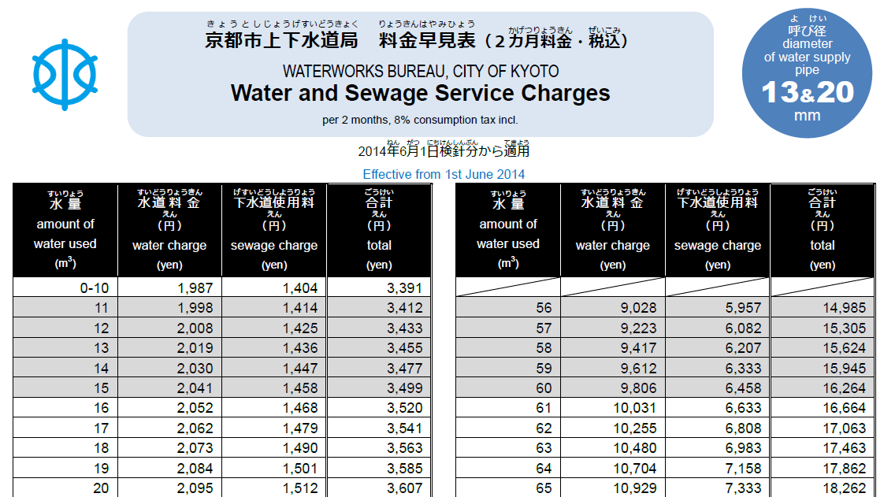
3. Case Study : Kyoto City
(6) Public Notification (Cont’d)
New Tariff Table - Effective from 1st June 2014
Source: Kyoto City Waterworks Bureau

Slide 26
3. Case Study : Kyoto City
Water Tariff Revision Process
Advisory Committee
Met 7 times (including public consultation)
Submission of report to local assembly
Public Outreach
(TV, radio, explanatory meeting, city bulletin, leaflets, etc.)
Local assembly
Submission of the bill on water and sewerage tariff revision
↓
Passage of the bill
Revised Water Tariffs

Slide 27
4. Lessons Learned (1)
(Cost Recovery) Water tariffs are set based on the principle of the fully distributed cost method as stipulated by acts in Japan. The Water Tariff Setting Manual provides guidance on the standardized method for the calculation of water tariffs based cost recovery.
(Bases of Tariff Revision) The water utility releases financial and operational information, showing the facilities replacement costs and funding sources. This is necessary if it were to continue to provide sustainable, reliable, and safe water supply in the medium and long term.
(Utility’s Efforts) It is also necessary to explain the utility’s management efforts (control on staff size, cost savings with outsourcing, measures for unpaid water tariffs, asset management, etc.).

Slide 28
4. Lessons Learned (2)
(Understanding of Customers) Tariff revision must have the support of the local government and residents. It is important to forecast the financial conditions in a credible manner and explain the need for the rate increase convincingly. The discussions by the advisory committee and public consultations are useful opportunities to engage the public and gather customer input. The utility’s business and fiscal plans must be well understood and supported by the customers. It is desirable that tariffs are revised for customers’ benefit (improved service and fairness).

