Slide 1
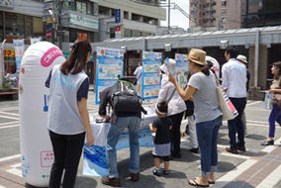
Water Supply Service with Customers’ Voices:
Osaka City,
Tokyo Metropolitan,
Chiba Prefecture,
Yahaba Town
Water tasting challenge by Bureau of Waterworks, Tokyo Metropolitan Government
Source: http://www.metro.tokyo.jp/INET/CHOUSA/
2015/07/60p76400.htm
No. C6 Ver. 1

Slide 2
Contents
      Introduction
      Customer Relations
      Case 1: Customer Service through Daily Operation
      Case 2: Public Outreach and Information Disclosure
      Case 3: Customer Service Center
      Case 4: Customer Feedback / Questionnaire Survey
      Case 5: Customer Participation
      Case 6: Seminars at Schools
      Lessons Learned

Slide 3
1. Introduction
Old days, simple issue
Nowadays, diversified
Need to collaborate with citizens
Source: Ministry of Health, Labour and Welfare, http://www.mhlw.go.jp/stf/shingi/2r98520000027cq9.html

Slide 4
2. Customer Relations
  (1) Rights and Responsibilities of Water Utilities and
  Customers Stipulated in the Water Supply Act
  Article 14 (Rules of Water Supply) : A water utility shall develop regulations and share details of water supply contract with its customers including water tariff, customer’s cost burden of service connection installment (construction cost), and condition of water supply.
  Article 15 (Obligation to Provide Water Supply ): A water utility cannot reject any application for service without a valid reason and is obliged to provide safe reliable water supply service.
  Article 18 (Request for Inspection): A customer has the right to ask the water utility for water quality testing and inspection of water supply equipment. The water utility shall respond to such requests in a timely manner and inform the customer of the results.
  Article 24-2 (Information Disclosure): A water utility shall notify customers of the results of water quality tests, and other information about the water supply services in accordance with the orders of the Ministry of Health, Labor and Welfare.

Slide 5
2. Customer Relations
  “Ordinance for Enforcement of the Water Supply Act” gives customers the right to know:
Safety of the water supply, including the results of water quality tests.
Operation of water supply services.
Costs for water supply services including the construction and maintenance of facilities.
Fees and charges for customers including water tariff.
Management and maintenance plans for service connections and water tanks.
Earthquake resistance of water supply facilities and on-going improvements.
Results of additional temporary water quality tests.
Emergency response plan for water supply in case of natural disasters or incidents that may compromise water quality.

Slide 6
2. Customer Relations
  (2) Relationship between a Water Utility and Customers
Improve Public Health
Customers
Water Supply Service
Meet Basic Needs
Good Living Conditions
water supply contract
Water Tariffs
Water Utility
Sound Management
Monopoly

Slide 7
2. Customer Relations
(3) Need for Two Way Communications
Information Disclosure
Accountability & Transparency
Better Understanding & Appreciation
Water Utility
Customers
Emphasis on Customer Service
Satisfied?
Dissatisfied? Requests?
Customer Feedback

Slide 8
3. Case 1: Customer Service through Daily Operation
  Customer Service Improvement in Osaka City
Period | Customer Service Initiatives
Before World War II | Customer service manuals for service connection technicians, meter readers and tariff collectors in order to improve their service delivery.
1949 | Start of service vehicles travelling around the city to work sites to conduct repairs on connections or broken pipes.
Late 1980s | Change in operational philosophy: customers are not just residents receiving government services but are valued clients of a business enterprise.
1988 | Began with training managers to improve business demeanor. Managers then trained their staff on customer friendly service. Produced many internal instructors as a result.
1989 | Founded the task force on customer service improvement, to engage all personnel in customer friendly practices throughout the organization.

Slide 9
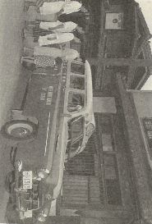
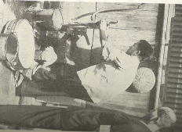
3. Customer Service through Daily Operation
  Customer Service Improvements in Osaka City (Cont’d)
水道サービスカー
Service vehicle conducting repairs around the city
Staff repairing a tap
Source: Osaka Municipal Waterworks Bureau “One Hundred Years' History of Osaka Municipal Waterworks” 1996

Slide 10
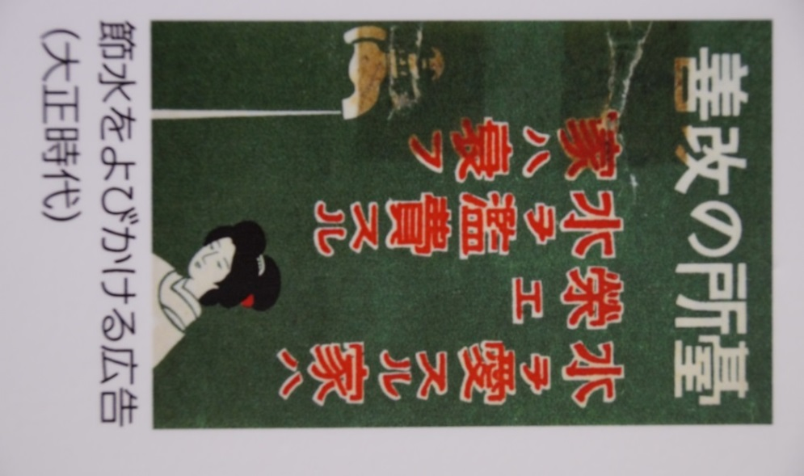
4. Case 2: Public Outreach and Information
Disclosure
Example of a Poster
A poster for water-saving (1912～1926,
Nagoya City)
“Make your kitchen better: A household that values water prospers.
A household that wastes water suffers.”
Source: Nagoya City Waterworks and Sewerage Bureau

Slide 11
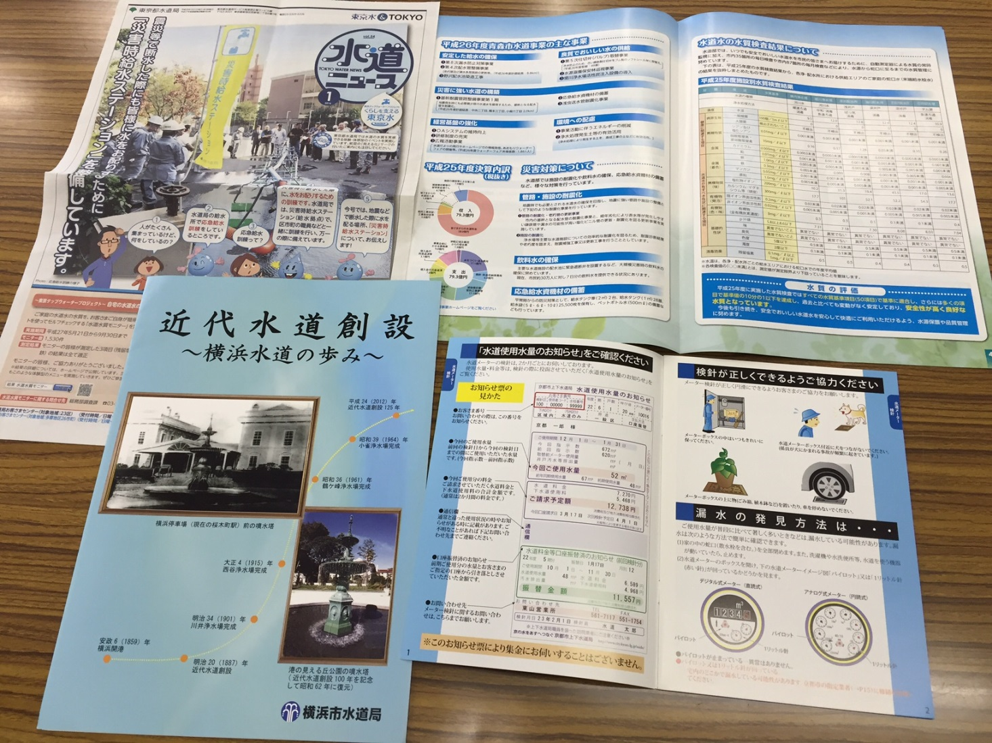
4. Case 2: Public Outreach and Information
Disclosure
Example of Brochures
Easily to understand
with pictures and data.

Slide 12
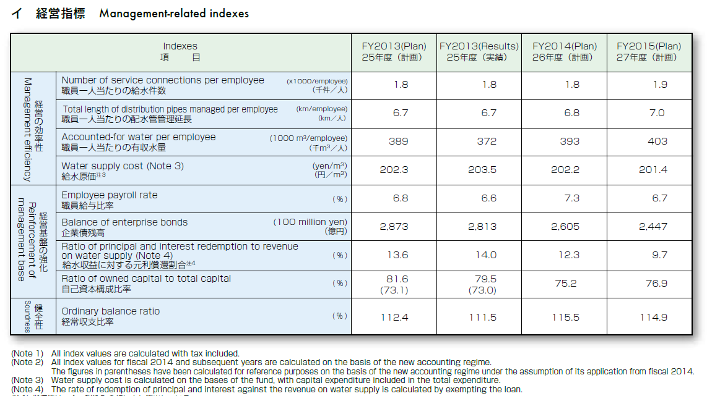
4. Case 2: Public Outreach and Information
Disclosure
Example of Brochures (Cont’d)
Easily to understand with performance indicators
Source: Bureau of Waterworks, Tokyo Metropolitan Government
http://www.waterworks.metro.tokyo.jp/eng/supply/

Slide 13
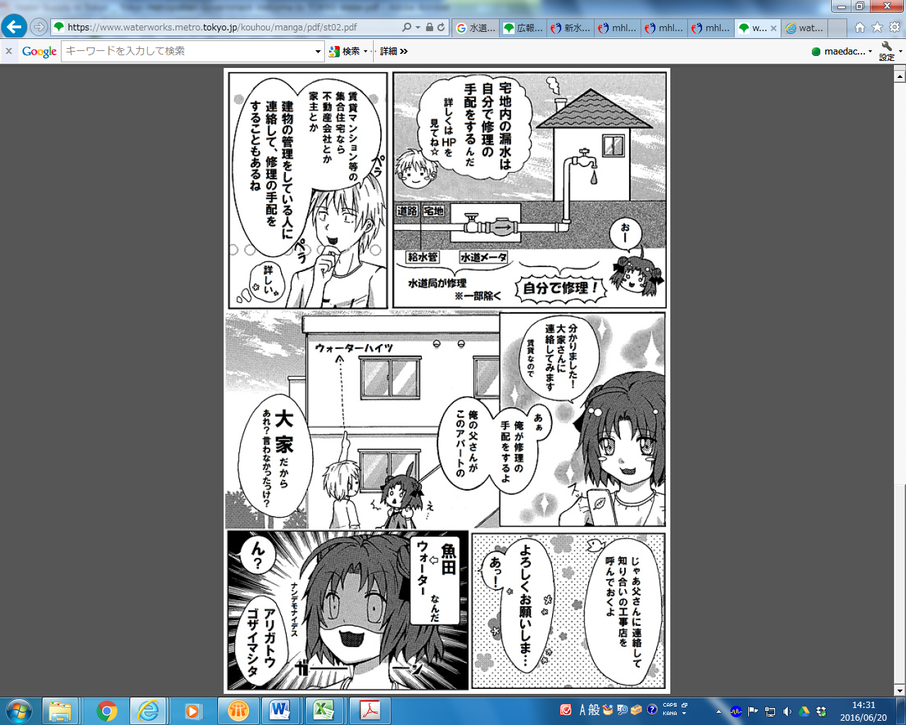
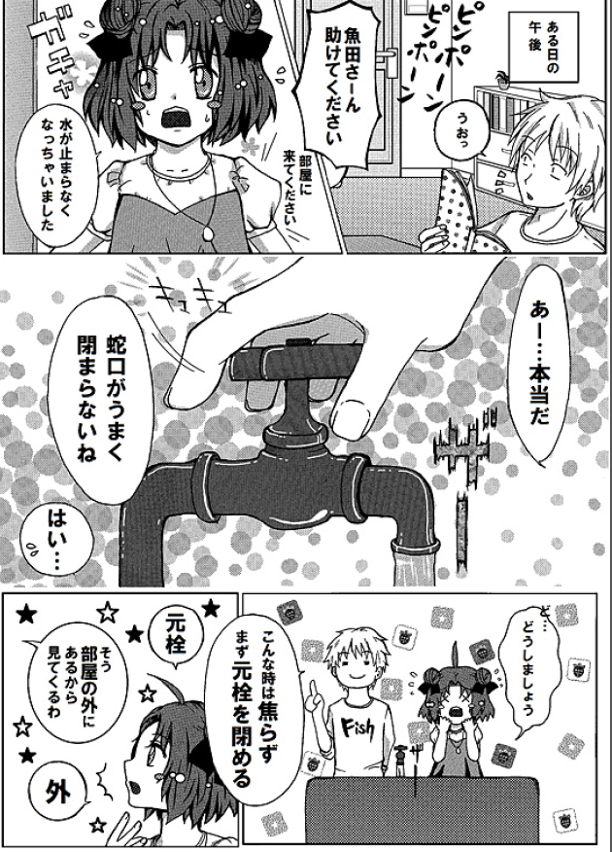
4. Case 2: Public Outreach and Information
Disclosure
Example of Brochures (Cont’d)
Message – A homeowner is responsible for fixing the service pipe from the meter to the tap.
Getting customers’ attention in water supply matters
by cartoon (manga).
Source: Bureau of Waterworks, Tokyo Metropolitan Government
https://www.waterworks.metro.tokyo.jp/kouhou/manga/pdf/st02.pdf

Slide 14
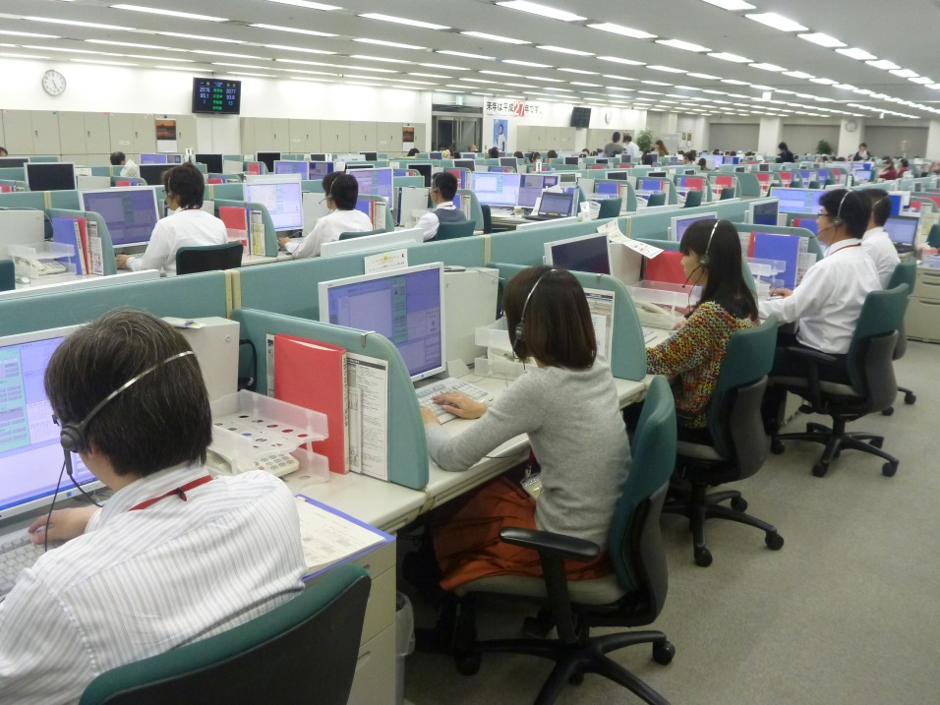
5. Case 3: Customer Service Center
  Customer Service Centers of Tokyo Metropolitan Government
Deal with complaints, enquiries, applications and disconnection requests.
Organize customer information to facilitate a timely response.
Respond to reports of leakage and broken water mains 24/7.
Inside of the Customer Service Center
Source: Bureau of Waterworks, Tokyo Metropolitan Government http://www.waterprofessionals.metro.tokyo.jp/pdf/wst_06.pdf

Slide 15
5. Case 3: Customer Service Center
Customer database;
Key to quick response to enquires, customer’s satisfaction and reliability of a water utility.
Unpaid bills
Receipt confirmation
Customer claims
Water consumption
Billed amount
Receipt amount, etc.
Name
Address
Tel. no.
Customer Database
Source: Training material of Nihon Suido Consultants., Co. Ltd..

Slide 16
6. Case 4: Customer Feedback /
Questionnaire Survey
  Customer Satisfaction Survey & Feedback by Chiba Prefecture
Improvement of the service through customer feedback
Source: Chiba Prefectural Waterworks Bureau

Slide 17
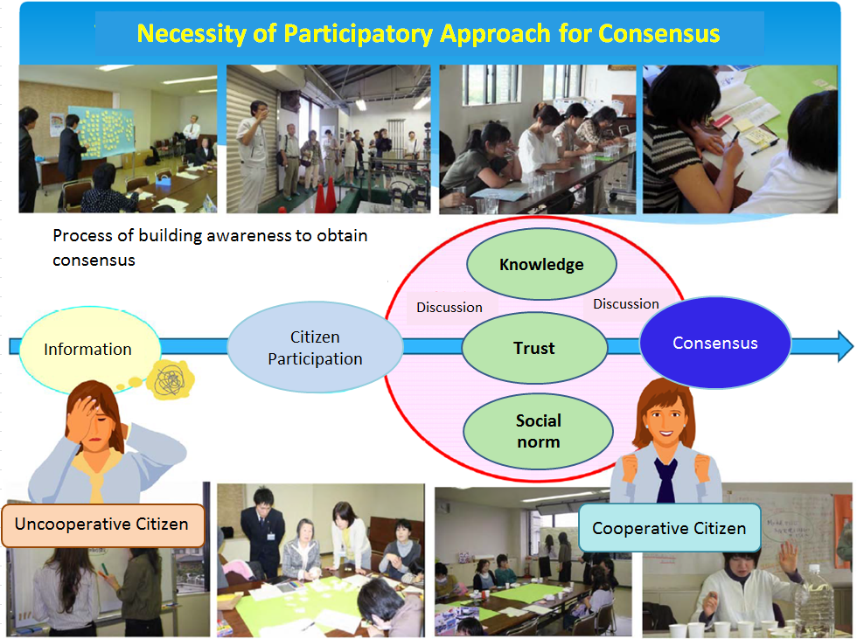
7. Case 5: Customer Participation
  Yahaba Waterworks Supporters in Yahaba Town
Well-informed customers ⇒ knowledgeable supporters who will understand the need for
future waterworks.
Source: http://www.hit-u.ac.jp/kenkyu/file/27forum3/YOSHIOKA.pdf

Slide 18
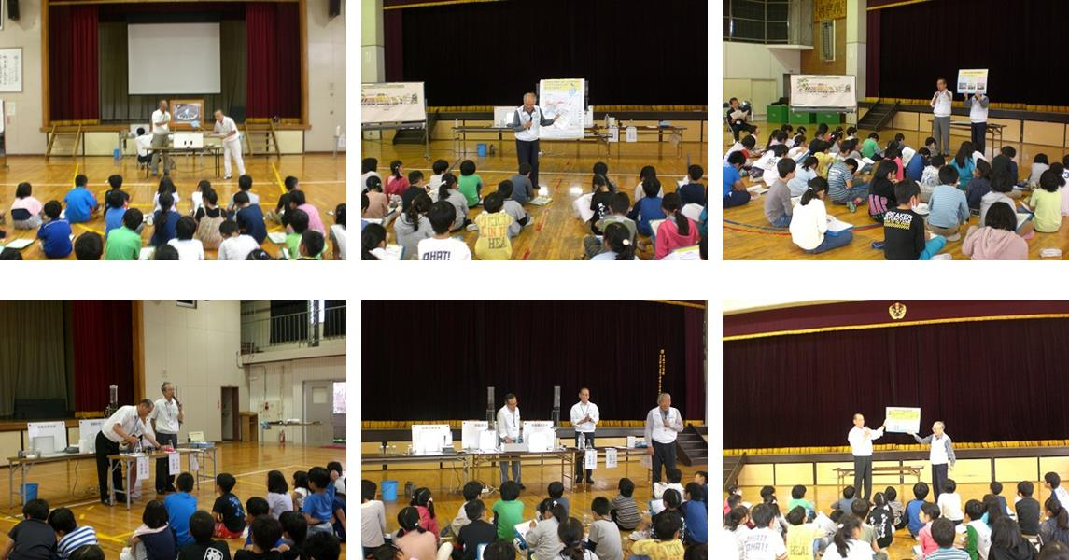
8. Case 6: Seminars at Schools
  Seminars by Chiba Prefecture
Utility staff teach students about water supply and sewerage systems and how these contribute to their health and living conditions. Students also visit a water treatment plant.
Picture story shows, water purification experiments, quiz, etc.
Source: Chiba Prefectural Waterworks Bureau

Slide 19
9. Lessons Learned (1)
(The Water Supply Act and Relationships between a Utility and Customers) Water utilities are required by the Water Supply Act to supply safe drinking water and provide information to their customers. The water supply contract between the utility and its customers sets out the relationship between the two parties. Customers pay for services and the revenue generated covers the expenses. Improving customer service can lead to sound and effective management of the water supply business.
(Customer Database) As waterworks are natural monopolies, customers have the right to hold the utilities accountable and continually challenge them to deliver better service. It is essential for utilities to organize and keep their customer databases up to date. A well-run database with reliable and accurate customer information allows utilities to respond to requests and enquiries in a timely manner, thus fostering customers’ trust in the business.

Slide 20
9. Lessons Learned (2)
(Information Disclosure and Public Involvement) Water utilities are obliged to provide business and financial information on a regular basis and make such information easily accessible. Well-informed customers tend to understand and support proposed initiatives and contribute to sustainable management of the business. Water utilities must continue to improve their services by listening to public opinions and respond to the needs of their customers.
(Management Centered on Customer Service) Japanese water utilities are well-regarded for high service standards, advanced technical capabilities and well-organized operations. The most critical take-away lesson from these successes is the basic premise of good customer service in providing safe drinking water. Emphasizing customer satisfaction is an effective way for water utilities to continue to improve the management of the water supply business.

