Slide 1






Theme2-1
MANAGEMENT PLANNING
FORMULATING THROUGH COORDINATION AMONG SECTORS & REGIONS WITH LONG-TERM PERSPECTIVES

Slide 2
Contents
      Introduction
      National Development Plan and Water Resources Management Plan
      Development of River Systems that Require Water Resources Development over Wide Area
      Adaptation Planning to Climate Change
      Contribution to Society through Water-Resources Development
      Lessons Learned

Slide 3
1. Introduction
How to conduct water resources management properly
Water resources management is critical for achieving a robust, sustainable, and inclusive society and achieving quality growth.
A long-term perspective is needed.
Coordination with other sectors’ development is necessary.
This theme describes
How Japan positioned and coordinated the water sector in National Comprehensive Development Plan.
How Japan promoted the project from a long-term perspective.
Challenges for these measures.

Slide 4
2. National Development Plan and Water Resources Management Plan
(1) Consistency between National Development Plan and Water Resources Management
Projects for water resources development and management require a very long time from planning to construction and operation.
The effects and impacts are also long-lasting.
Project plans should be consistent with policies such as National Development Plans, SDGs, climate change strategies.

Slide 5
2. National Development Plan and Water Resources Management Plan
(1) Consistency between National Development Plan (NDP) and Water Resources Management
Source: “Maintenance System of Social Infrastructure,” Committee on Overseas Activities, Japan Society of Civil Engineers (Ed.), 1997
Consistency between Public Works and Macroeconomic Planning

Slide 6
2. National Development Plan and Water Resources Management Plan
(2) Linkage with National Development Plans
Specific Regional Comprehensive Development Plans for Post-war Reconstruction
Development of power, food and industry
Land conservation and disaster prevention
The Council for the Study of Comprehensive River Development and surveys for 24 rivers
The National Agricultural Water Use Project on 4 rivers
The Specific Area Comprehensive Development Plan

Slide 7
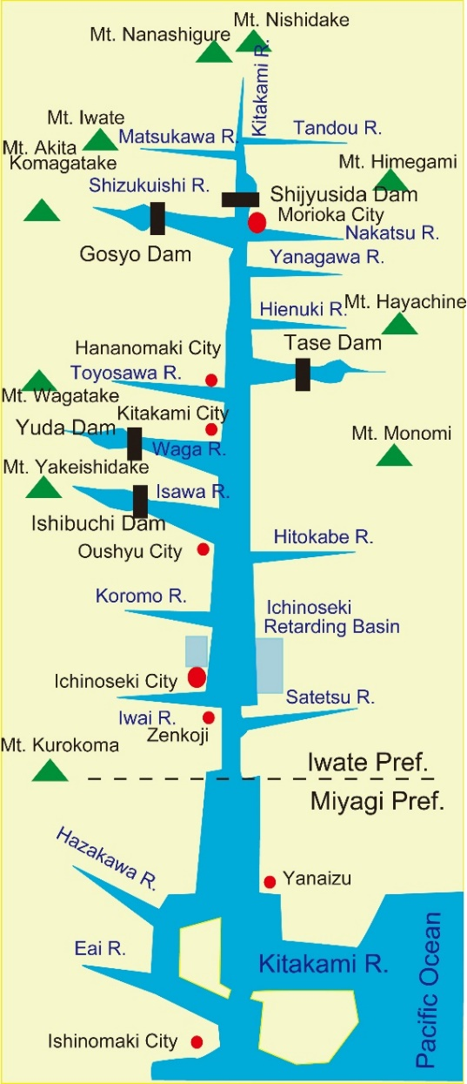
2. National Development Plan and Water Resources Management Plan
(2) Linkage with National Development Plan
Specific Regional Comprehensive Development Plans for Post-war Reconstruction
The Kitakami River Development Plan
Needs for flood protection and power generation
Five multipurpose dam were constructed
40-50% of the prefecture's electricity in 1975-1984 supplied by hydropower
Expansion of farmland and increased food production
Flood damage was reduced
Land use along the Kitakami River increased
Source: Prepared based on the website of Kitakami River Dam Integrated Management Office, MLIT
Location of Five Large Dams

Slide 8
2. National Development Plan and Water Resources Management Plan
(2) Linkage with National Development Plan
2) National Comprehensive Development Plan (NCDP)
Important issues for NCDP
Urban concentration of population and Urban-rural disparities in income
Balanced development in the country, National land safety, and Harmonization of socioeconomic activities and natural environment
Development goals
1. Building a national land structure
4. Efficient investment
2. Ensuring equity
5. Spatial support for industrial policy
3. Reducing overcrowding
6. Effective use of resources
7. National land conservation

Slide 9
2. National Development Plan and Water Resources Management Plan
(2) Linkage with National Development Plan
2) National Comprehensive Development Plan (NCDP)
1st NCDP (1962)
New NCDP (1969)
3rd NCDP (1977)
4th NCDP (1987)
Grand Design for the 21st Century (1998)

Slide 10
2. National Development Plan and Water Resources Management Plan
(2) Linkage with National Development Plan
3) Required Timing for the National Comprehensive Development Plan
NCDP is required when sustained or high economic growth is expected, to prevent or mitigate external diseconomies:
External Diseconomies
Regional disparities
Congestion
Resources and environmental conservation

Slide 11
2. National Development Plan and Water Resources Management Plan
(2) Linkage with National Development Plan
4) Long-Term Flood Protection Plan
since 1870s
Flood protection projects based on modern flood protection plans
1910
First Long-term Flood Protection Plan
The Special Account for Flood Protection Fund was established
1921
The Second Flood Protection Plan
The Third Flood Protection Plan
Small- and medium-sized rivers were funded by government subsidies and bonds
1933
The Erosion and Flood Protection Emergency Measures Act
Long-term Flood Protection Plan
The Special Account for Flood Protection
1960
2008
Special Account for Social Capital Improvement Projects

Slide 12
2. National Development Plan and Water Resources Management Plan
(3) National Water Resources Management Plan
1) Water Plan
The National Comprehensive Water Resources Plan (Water Plan) was developed in line with the NCDP.
a guideline for various comprehensive measures concerning water resources
Water Plan including:
1. The long-term water demand outlook for the nation
2. The basic goals for the development of water resources
3. The basic goals for the conservation of water resources
4. The basic goals for the use of water resources

Slide 13
2. National Development Plan and Water Resources Management Plan
(3) National Water Resources Management Plan
1) Water Plan
Long-term Water Demand and Supply Plan (1978)
Water Plan 2000 (1987)
Water Plan 21 (2000)

Slide 14
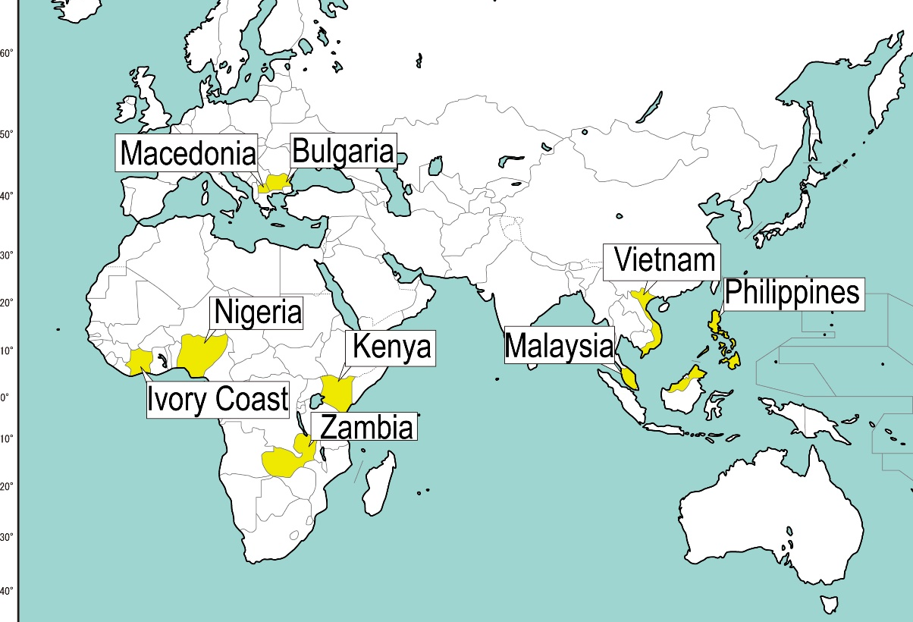
2. National Development Plan and Water Resources Management Plan
(3) National Water Resources Management Plan
2) JICA’s National Master Plans for Water Resources Development
Target countries provided with National Water Resources Development Plans, prepared with JICA Technical Cooperation
Source: Prepared based on “Study on Approach for Integrated Water Resources Management – Review of the JICA Master Plan of National Water Resources Management – Final Report,” July 2011, JICA

Slide 15
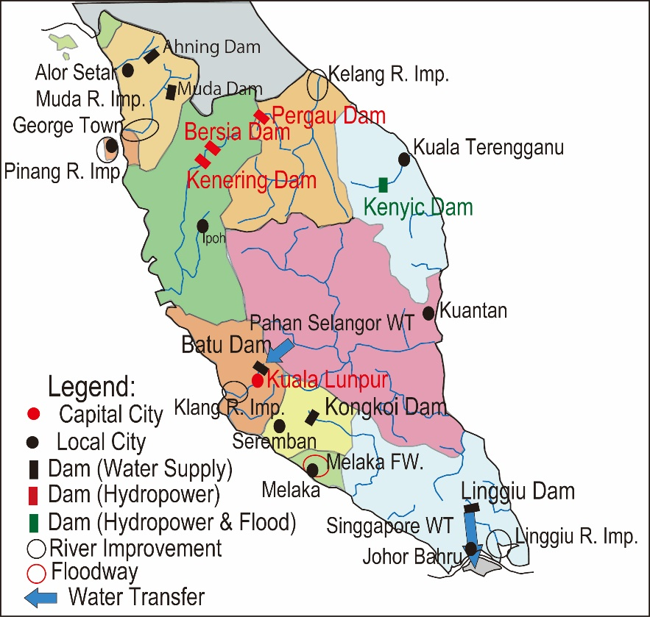
2. National Development Plan and Water Resources Management Plan
(3) National Water Resources Management Plan
2) JICA’s National Master Plans for Water Resources Development
National Water Resources Development Plan in Malaysia
Major Water Resources Facilities Developed in the Malay Peninsula
Source: Prepared based on “Study on Approach for Integrated Water Resources Management – Review of the JICA Master Plan of National Water Resources Management – Final Report,” July 2011, JICA

Slide 16
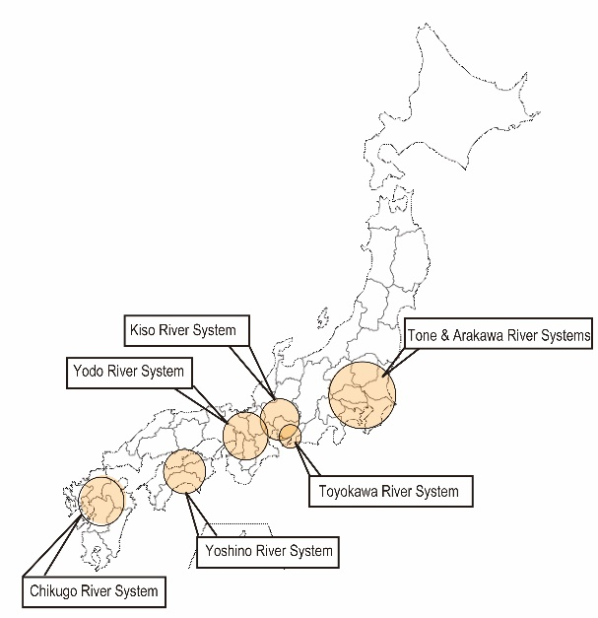
3. Water- Resources Development Plans for Important River Basins
Background:
Water supply measures are necessary in wide area.
Water Development Promotion Act:
The Basic Plan for Water Resources Development (the Full Plan) for designated river systems
Source: Prepared based on website of MLIT
Location of River Systems for Water-Resources Development over Wide Area

Slide 17
3. Water- Resources Development Plans for Important River Basins
Source: MLIT Website
Flow of Procedures for Formulating the Basic Plan for Water Resources Development

Slide 18
4. Adaptation Planning to Climate Change
(1) River Basin Disaster Resilience and Sustainability by All
Change of Rainfall, Discharge and Frequency of Flood due to Climate Change
Climate Change Scenario | Amount of Rainfall | Discharge | Frequency of Flood
At 2 degrees rise | About 1.1 times | About 1.2 times | About 2 times
At 4 degrees rise | About 1.3 times | About 1.4 times | About 4 times
Source: Proposal for Flood Protection Planning in the light of Climate Change, Revised Edition, MLIT, April 2021
A comprehensive and multi-layered approach for the entire basin
2020,7 “Water-related Disaster Measures in Light of Climate Change”
1) Three Important Points of Measures
1. Resilience of the Land
2. Sustainability
3. Inclusivity

Slide 19
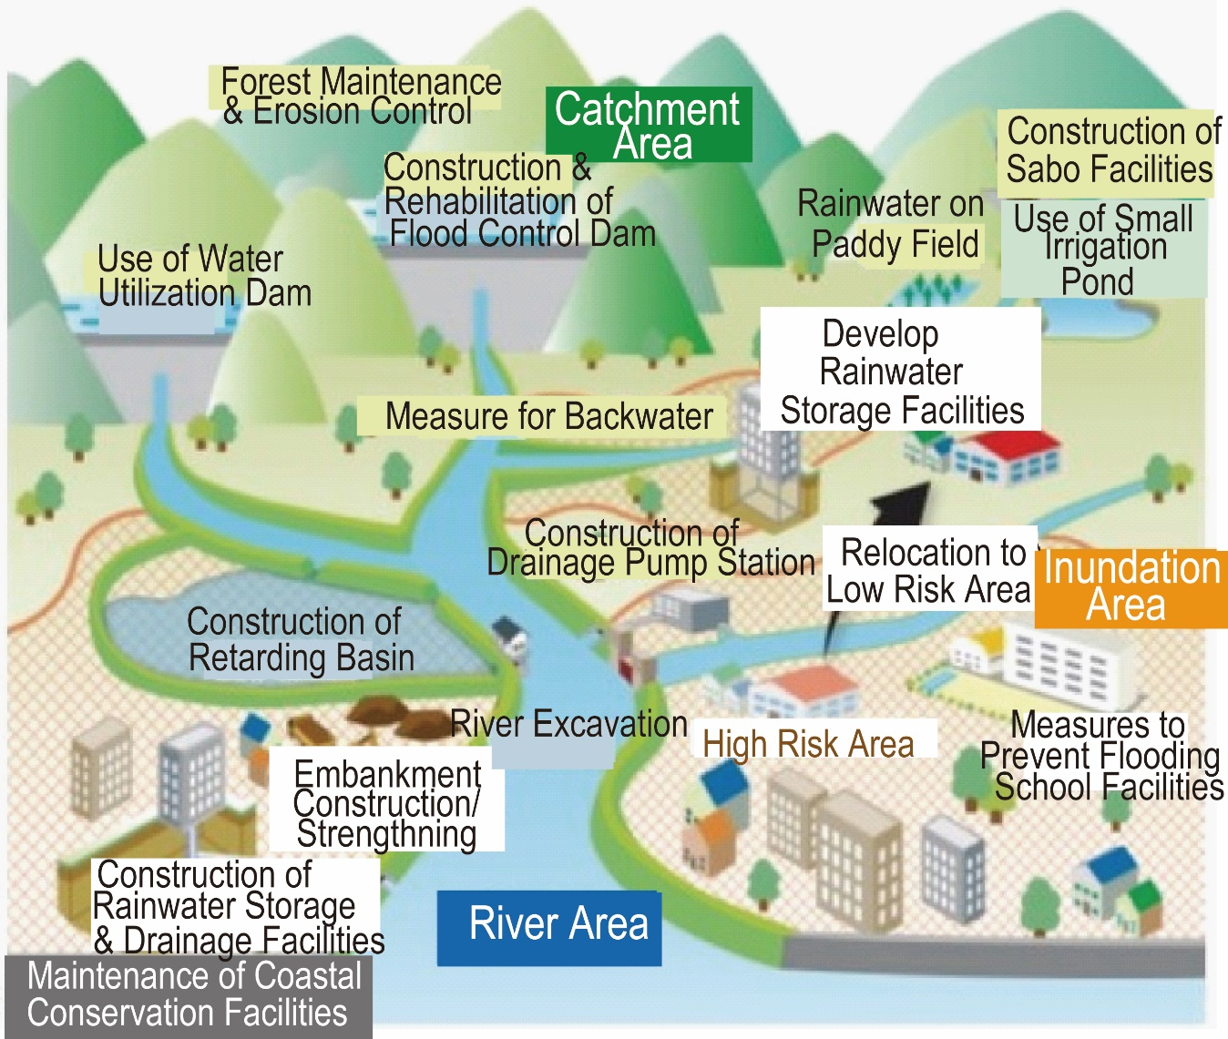
4. Adaptation Planning to Climate Change
(1) River Basin Disaster Resilience and Sustainability by All
Source: MLIT Website
Source: MLIT Website
Image of “River Basin Disaster Resilience and Sustainability by all”

Slide 20
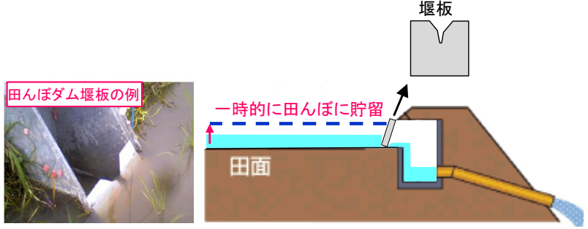
4. Adaptation Planning to Climate Change
(1) River Basin Disaster Resilience and Sustainability by All
  Example
  Use of Paddy fields (Rice field dams)
  Use of Water-utilization dams
Weir plate
Temporary storage above
normal water level
Weir plate
Field Surface
Source: Cabinet Office
Rice Paddy Dam

Slide 21
4. Adaptation Planning to Climate Change
(2) Shift from Development Promotion to Risk Management
The water resources policy is shifting from “Promoting water resources development” to “Stable water supply”.
Basic Principles:
To manage risks surrounding water supply
To comprehensively ensure the security level of water supply
Method:
To utilize existing facilities
To coordinate hard and soft measures

Slide 22
5. Contribution to Society through Water Resources Development
(1) Effects of Water Resources Development in Japan
1) Flood Protection Effect
Source: Water resources in Japan (2008) MLIT
Actual Flood Protection by Dams and Estimated Damage Reduction

Slide 23
5. Contribution to Society through Water Resources Development
(1) Effects of Water Resources Development in Japan
2) Water Use Effect
Industrial Water
Industrial water contributed to the large increase in the shipment value of industrial products.
Source: Industrial statistical survey
Growth of Shipping Value of Industrial Products

Slide 24
5. Contribution to Society through Water Resources Development
(1) Effects of Water Resources Development in Japan
2) Water Use Effect
Domestic Water Supply
In 2005, 74% (15.9 billion m³) of the domestic water was supplied by dams and other water resources facilities.
The supply from the dam is about 2.7 times the one in 1975
Source: “The Role of Dams and Hydropower” Japan Commission of Large Dam
Effect of Dams on Domestic Water Supply

Slide 25
5. Contribution to Society through Water Resources Development
(1) Effects of Water Resources Development in Japan
2) Water Use Effect
Irrigation Water
Cropped areas and rice harvests increased until around 1970.
Irrigation water contributed greatly to the irrigation development.
Source: Crop Statistics
Trends in Paddy Rice Yield

Slide 26
5. Contribution to Society through Water Resources Development
(1) Effects of Water Resources Development in Japan
3) Reduction of Disparity and Poverty
Urbanization rapidly progressed after WWII.
Gini coefficient by “original income” rose in 1980-2000. It became stagnant after 2000.
The one after the income redistribution remained almost constant at about 0.36-0.37, with no further change in income disparity beyond 2000.
Sources: “Population Census”, Ministry of Internal Affairs and Communications, “Income Redistribution Survey”, Ministry of Health, Labor and Welfare and data in “Income disparity in Japan – Factors for Increasing Disparity,” Yugami Kazufumi, JIL Labor Policy Report Vol. 3, 2003.
Ratio of Urban Population to Total and Gini Coefficient

Slide 27
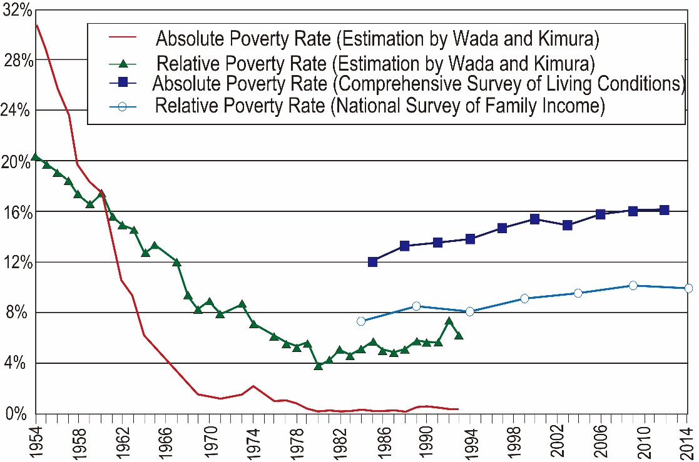
5. Contribution to Society through Water Resources Development
(1) Effects of Water Resources Development in Japan
3) Reduction of Disparity and Poverty
Disparity and poverty ratios in urban area were reduced and productivity in rural area was improved.
Wada-Kimura’s poverty line was set at average consumption per capita of welfare-recipient households in 1960.
The other two surveys set the poverty line at 50% of the median of equivalized disposable income.
Source: Did Japan become an Unequal Society?: Japan’s Income Disparity in Comparative Historical Perspective,” Moriguchi Chiaki, Economic Studies Vol. 68, No. 2, Apr. 2017.
Lowering Trends in Poverty Ratios in Japan

Slide 28
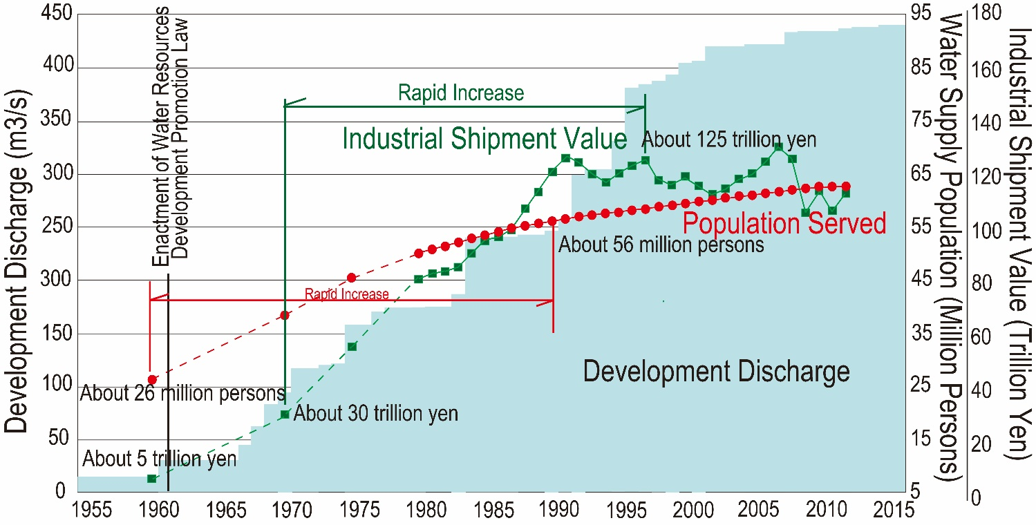
5. Contribution to Society through Water Resources Development
(2) Development Effect in the River System under the Full-Plan
Supported the growth of population and industrial shipments.
The household income increased and per capita water use increased.
Source: “Explanatory material for the Concept for the Formulation of the Next Basic Plan for Water Resources,” MLIT
Volume of Water Developed, Industrial Shipment Value and Population Served with Water in the Full-Plan River System

Slide 29
6. Lessons Learned (1)
  (1) Consistent planning could guide disaster risk reduction and water resource management, leading to quality growth.
  Water resources management is essential in achieving resilient, sustainable, and inclusive quality growth. Poor management of water resources causes improper utilization and may exacerbate the risk of floods, droughts, and deterioration of water quality. This may affect the nation's growth. Japan could manage water resources effectively based on national land development plans, national water management plans, and long-term flood protection plans. the government should include water resources management in national development plans in coordination with other sectors. Also the governments should position water resources management plans above the ministry-level plans as a “higher-level plan”.
  (2) To address issues in the water sector, water resource management plans should be prepared based on scientific data, clarifying the goals, effects, and inputs.
  To support the implementation of the water policy, the plans should be prepared based on sound evidence. If the plan looks a single list of projects, implementing agencies face difficulties in securing resources and budgets.

Slide 30
8. Lessons Learned (2)
  (3) To obtain commitment to the budget required to implement the water policy and planned projects, a long-term plan may be prepared to support implementation.
  Since water resource projects are by nature long-term projects, a multiyear commitment is required to steadily promote projects rather than allocating budgets year by year. The Japanese government has formulated long-term plans for flood protection and water resource management. A special account for these projects was then established, independent of the general account.

Slide 31
8. Lessons Learned (3)
  (4) A review system should be created and maintained to continually review the relevance of projects.
  Socioeconomic changes and technological progress may affect water demand and the relevance of planned projects. At the end of Japan's high economic growth period, the reuse of industrial water and water-saving efforts led to a large gap between predicted and actual demand. A long-term sector plan, like the flood protection plan in Japan, tends to cause rigid allocation of financial resources, which makes it difficult for the project to adapt timeously to economic trends and fiscal conditions.

Slide 32
8. Lessons Learned (4)
  (5) To cope with an increase in the flood flow due to climate change, a “River Basin Disaster Resilience and Sustainability by all” approach should be considered.
  Conventional structural measures such as levees and dams alone cannot cope with the increasing severity of flood damage under climate change. Relevant organizations in the river basin should cooperate in reducing flood risks and be engaged in multi-layered measures, such as land use plans, relocation from risk areas, urban facilities, and storing flood water in paddy fields and irrigation ponds.

