Slide 1





Theme 6
River Management
Managing Land and Water Sustainability

Slide 2
Contents
      Introduction
      Purpose of River Management and Management Entity
      River Initiatives
      Lessons Learned

Slide 3
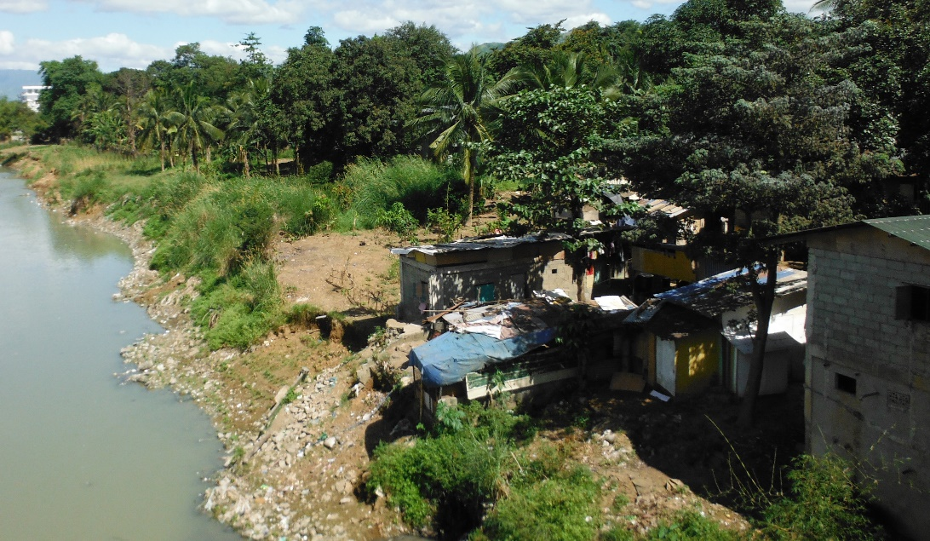
1. Introduction
Source: Project Research Team
Houses built along river course. These have high risks of flood damage on one hand and hinder the river capacity to carry flood flows on the other hand.
Notes:
along

Slide 4
2. Purpose of River Management and Management Entity
(1) Purpose and Administration
In Japan, the purpose of river management is to maintain and improve rivers in an appropriate condition from a wide range of perspectives.
Flood Protection: Prevent disasters caused by floods, tsunamis, storm surges, etc.
Use of River: Use rivers properly and maintain normal function of flowing water.
Normal function flow
Inland navigation
Fishery
Tourism
Water purification
Salinity intrusion control
Prevention of river-mouth clogging
Protection of facilities
Conservation of groundwater
Animal and plant protection
Water supply
River Environment: Conserve the river environment.

Slide 5
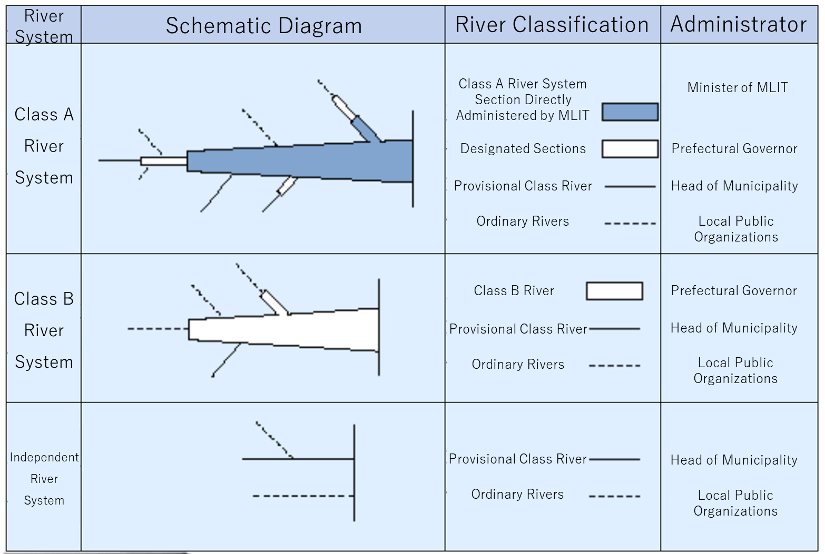
2. Purpose of River Management and Management Entity
(1) Purpose and Administration
Source: Website of Yamato River Office, Kinki Regional Development Bureau, MLIT
River Management Classification

Slide 6
2. Purpose of River Management and Management Entity
(2) Regulations on River Use
River Areas
Levee-protected Land
Levee-protected Land
Source: MLIT
River Area

Slide 7
2. Purpose of River Management and Management Entity
(2) Regulations on River Use
River Areas
The River Area is defined as where:
river water flows continuously;
river management facilities are situated;
the land for managing integrally with these areas.
Permission from the River Administrator is required for certain actions within the River Area.
The River Administrator in Japan is Minister of MLIT for Class A rivers and Prefecture Governors for Class B rivers.
The RMOs undertake the river management.

Slide 8
2. Purpose of River Management and Management Entity
(2) Regulations on River Use
2) Actions Requiring Permission
New acquisition, change and renewal of water use (occupation of flowing water);
Exclusive and continuous use of the river area (occupation of land);
Collection of river products such as gravel and wood;
Construction and reconstruction of structures such as bridge and weir;
Excavation of land;
River flow transportation of timbers and passage through navigation lock.

Slide 9
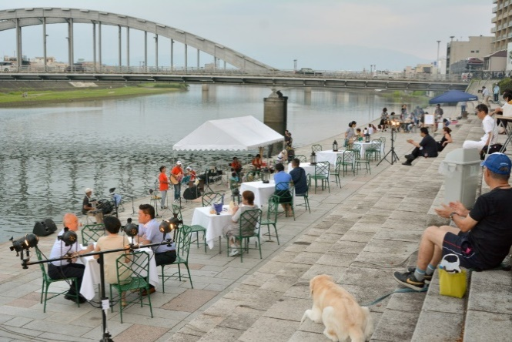
2. Purpose of River Management and Management Entity
(2) Regulations on River Use
3) Occupation of Land in the River Area
Authorized Occupation Activities
Roads
Railway
Infrastructure such as water supply and sewerage pipes, power transmission lines, gas pipelines
Welfare facilities such as parks and green spaces, golf courses
Sites for flood protection facilities
Source: Landscape, General Incorporated Association
River Space provided to the public (Kano River)

Slide 10
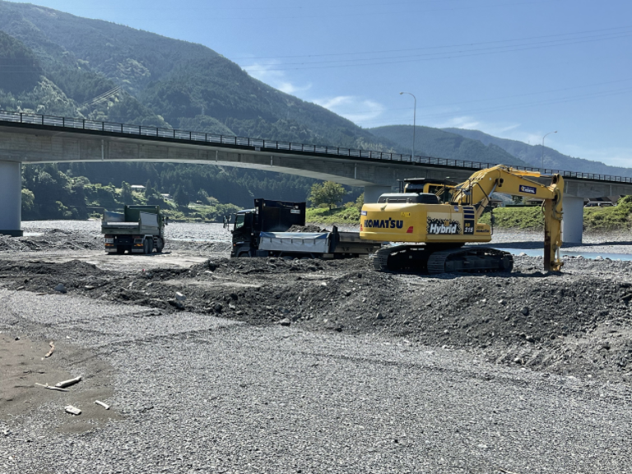
2. Purpose of River Management and Management Entity
(2) Regulations on River Use
4) Products in River
Source: ISHIGAMIJARI LLC.
Gravel Mining

Slide 11
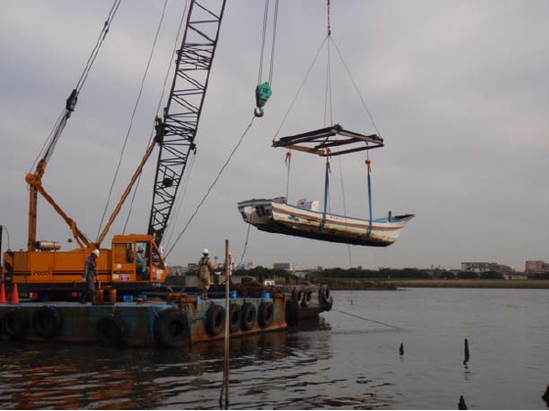
2. Purpose of River Management and Management Entity
(2) Regulations on River Use
5) Penalty and Enforcement
Source: Keihin River Office, Kanto Regional Development Bureau, MLIT
Removal of Illegally Moored Vessels

Slide 12
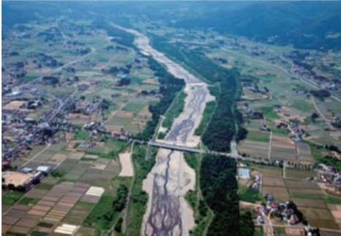
2. Purpose of River Management and Management Entity
(3) Management of River Structure
1) River Management Facilities
River Management Facilities:
Dam
Weir
Sluice gate
Levee
Bank protection
Groundsill
Riverine buffer zone
Source: Fukushima Office of Rivers and National Highways, Tohoku Regional Development Bureau, MLIT
Example of Riverine Buffer Zone as Green Belt

Slide 13
2. Purpose of River Management and Management Entity
(3) Management of River Structure
2) Permitted Structure
Organizations must obtain permission from the RMO for construction/reconstruction of structures such as bridges and weirs.
The RMO examines the appropriateness of purpose, technical feasibility, effects/impacts on flood protection, water use and river environment.
The structures should comply with technical criteria and standards.
These structures can be used only when it passes the inspection by the RMO.
The River Law includes “Special Provisions” for Dams to meet strict requirements (Theme 8 Dam Management).

Slide 14
2. Purpose of River Management and Management Entity
(3) Management of River Structure
3) Maintenance
Stipulated in the River Law
River Administrator should maintain and repair the river management facilities to keep these in sound conditions.
Officials of the River Administrators (branch offices of national government and civil engineering offices of prefecture governments) should routinely monitor the River Areas for unusual situation and illegal river use.

Slide 15
2. Purpose of River Management and Management Entity
(4) Disaster Management
Flood Risk
When flood is expected to occur, the RMO should:
set up an alert team and conduct flood-fighting measures;
announce flood forecast in cooperation with the Meteorological Agency;
notify the relevant organizations , if the Danger Water Level is exceeded.
Extraordinary Drought
In the event of extraordinary drought:
Information should be provided to water users to promote mutual coordination among all relevant users.
If discussions are not converging, necessary mediation should be conducted.

Slide 16

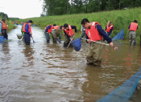
2. Purpose of River Management and Management Entity
(5) Collaboration with Private Sector
Collaboration with the local community is prerequisite for the river management.
Activities of River Collaboration Organizations
Source: MLIT
Joint cleaning of channels
Fish investigation

Slide 17
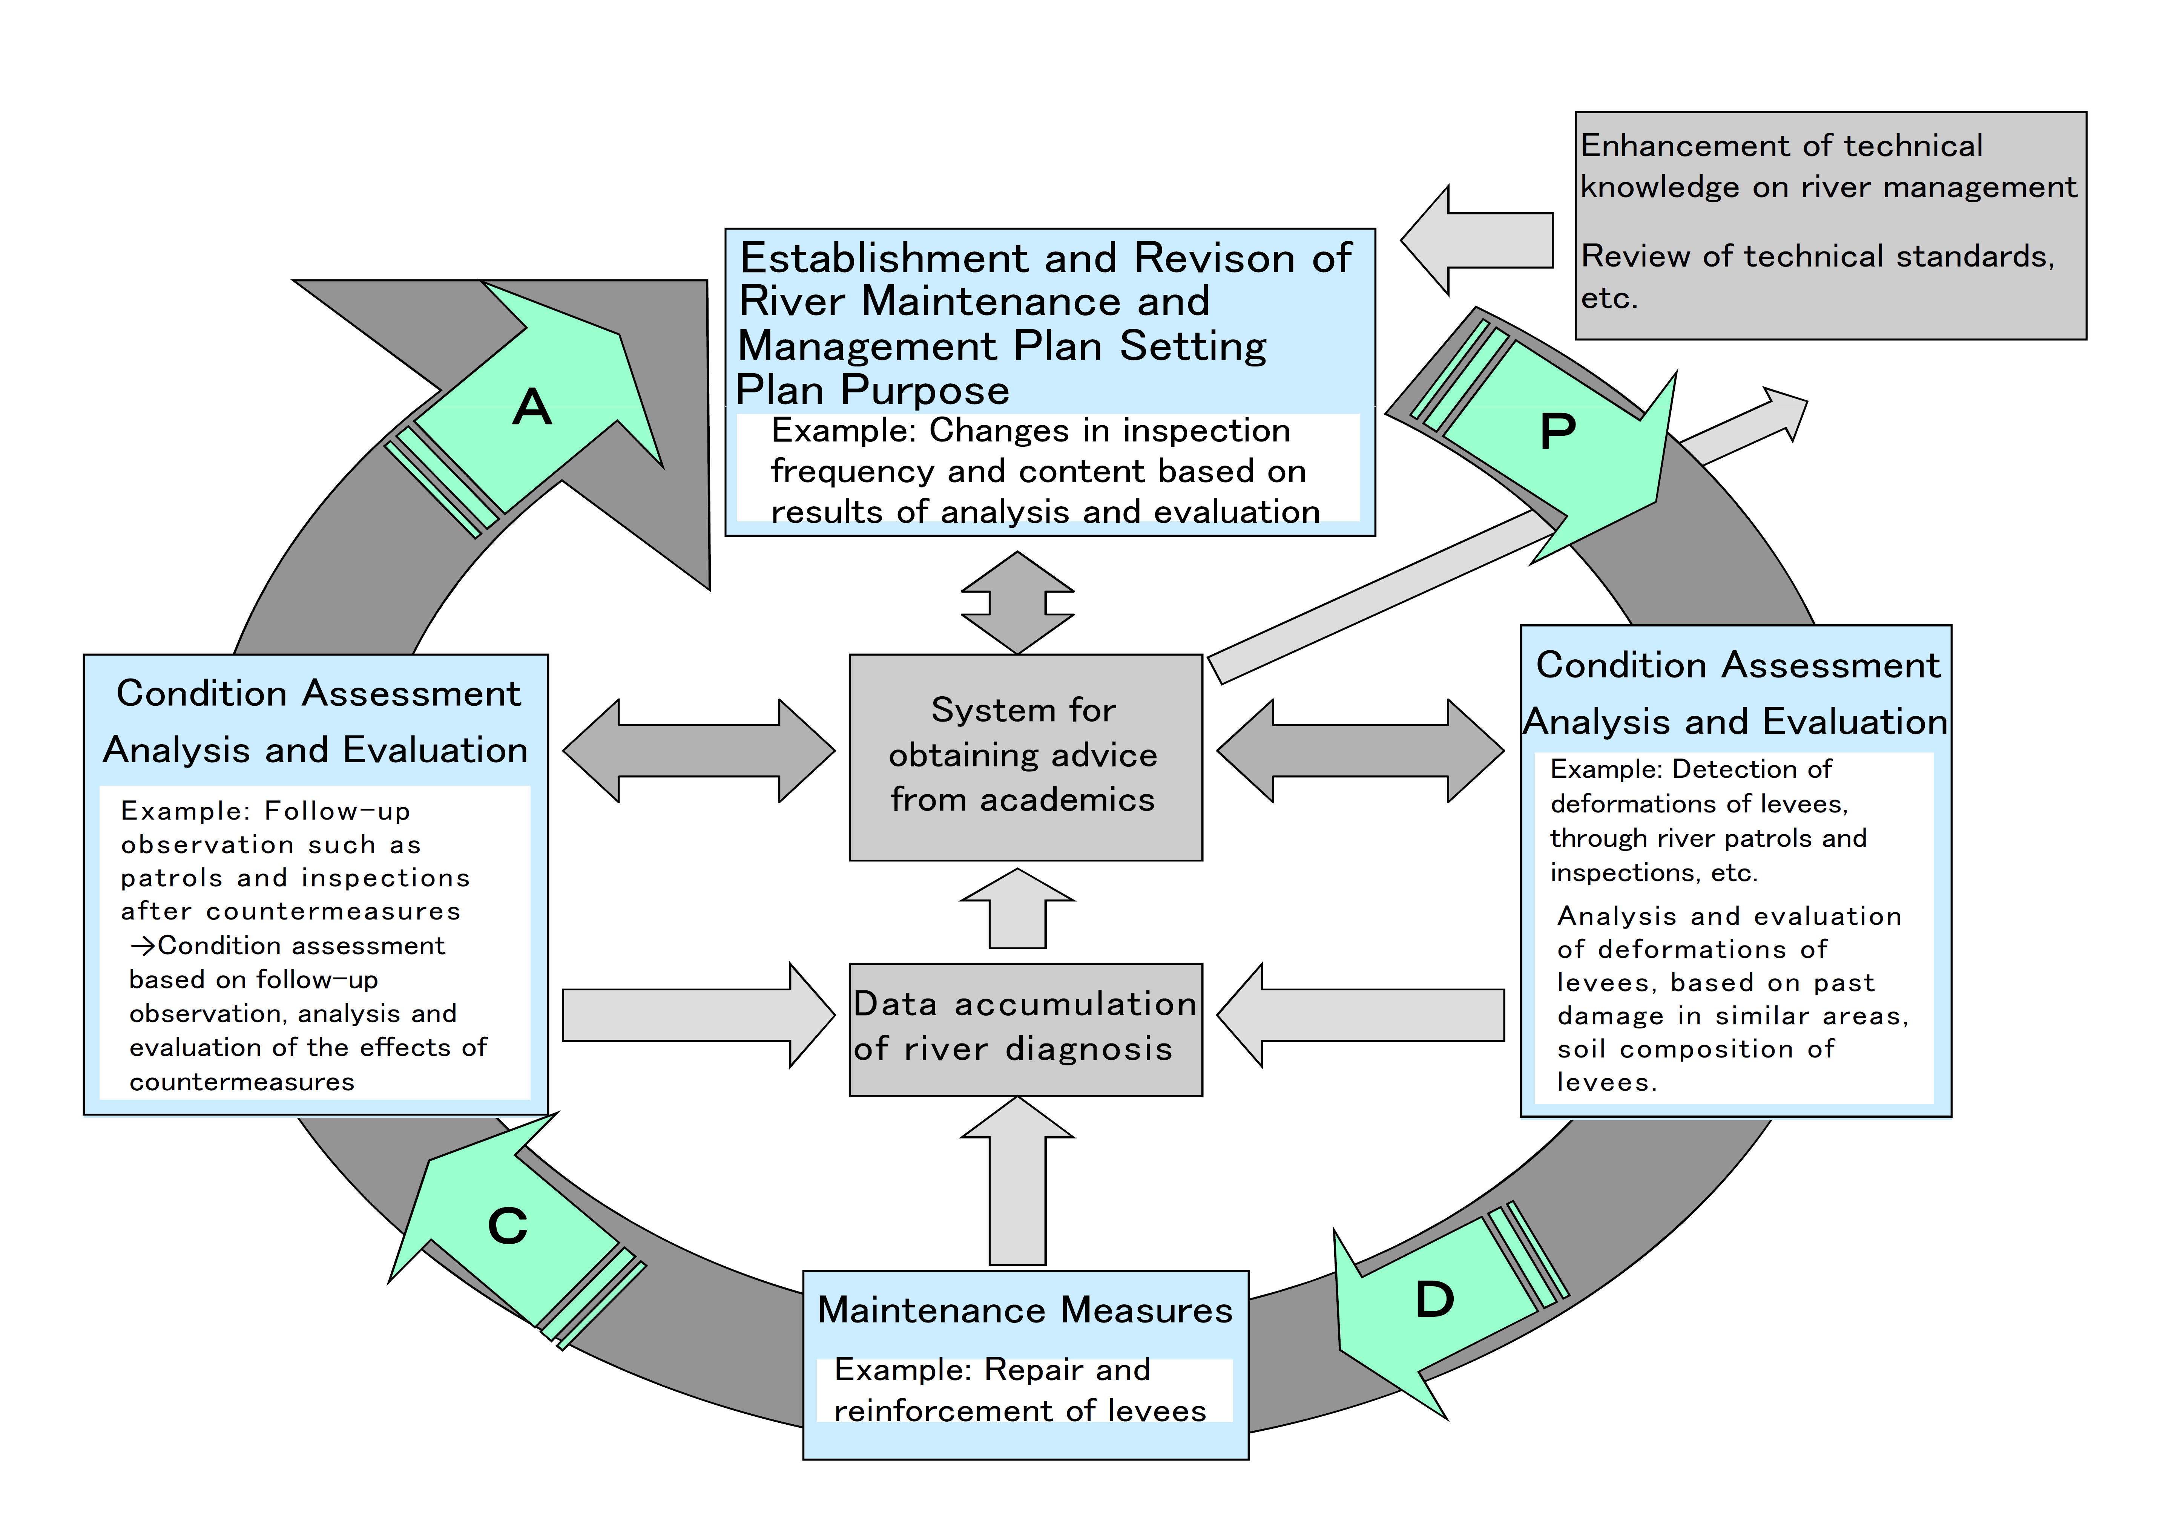
3. New Initiatives
(1) Extending Lifetime of River Management Facilities
With the PDCA cycle maintenance system, reduction and leveling of total costs are made possible
Source: MLIT
Cycle Maintenance and Management System

Slide 18
3. New Initiatives
(2) Collaboration with Relevant Offices
1) Comprehensive Sediment Management Plan
Source: Chubu Regional Development Bureau, MLIT
Comprehensive Sediment Management Plan for Hino River Erosion Control and Afforestation

Slide 19
8. Lessons Learned (1)
  The mechanisms of managing rivers need to be established.
  In Japan, the RMO designates river areas that regulate various activities; organizations must obtain permission from the RMO to construct structures and conduct activities. As river water is a public good, water users require RMO permissions; the RMO formulated technical guidelines and standards detailing the permissions process. In Japan, when the prefectural government carried out river management, it was difficult to solve conflicts between upstream and downstream or left and right riverbanks. In response, the management responsibility was altered such that the national government manages major rivers, which is particularly useful for rivers flowing through multiple prefectures.
Notes:
also

Slide 20
8. Lessons Learned (2)
  River management should adapt to changing social conditions.
  As river management becomes more complex with societal development, management goals should be established flexibly. The unique natural conditions in Japan have meant flood protection has consistently been the main focus of river management. The country needs to adapt to effects caused by climate change. Also, sediment management, quality of structure, and leisure activities became more important issues. Restoration of nature requires a long time, and in the worst case, it may be irreversible.
  Systematic maintenance is required to ensure long-term quality of river structures.
  Systematic maintenance is essentially required to ensure the quality of structures. Therefore, inspections, maintenance, and repairs must be continued at the operation and maintenance stages. These activities extend the longevity of river structures. The use of ICT may also prove to be effective for economic and efficient maintenance.

Slide 21
8. Lessons Learned (3)
  Climate change and environmental problems should be addressed through cooperation with communities and inter-governmental coordination.
  The frequency and severity of large-scale floods and droughts are increasing worldwide due to climate change. These issues cannot be dealt with solely through using facilities, and river conservation cannot be conducted by the RMO alone. Cooperation with local communities and inter-governmental coordination are essential to cope with these issues; as such, a relevant mechanism should be established.

