Slide 1
The Project for Capacity Development on Road Maintenance in the Independent State of Papua New Guinea
Work Plan
May 2014
INGÉROSEC Corporation
ORIENTAL CONSULTANTS Co., Ltd.

Slide 2
Project Purpose
DoW's capacity (institution, management, techniques) for implementing gravel road maintenance by the in-house workforce and equipment is strengthened in the target provinces. The project will not interfere with business operations of private companies.

Slide 3
Pilot project Schedule
First year (November 2013 – December 2014)
Pilot Project: 1st in Morobe and 2nd in Western Highlands
Second year (January 2015 - December 2015)
Pilot Project: East Sepik and West new Britain
Continuation of Morobe and Western Highlands
Third year (January 2016 - December 2016)
Pilot Project: Continuation of 4 provinces
Fourth year (January 2017 - October 2017)
Pilot Project: Continue by DoW own

Slide 4
Activity-1:Support for Improving the Capacity of DoW Staff
Implementation of a baseline survey
Conduct the baseline survey for operators mechanics and civil engineers in each provinces to understand ability of staff in DoW.
Development of a training plan & training materials for DoW staff
No | Training Style | Period | TARGET | OBJECT
1 | Class Room | 1 ~ 2 Week | Civil Engineer | Survey, Measurement, Design
 |  |  | Operator | Equipment operation, Maintenance
 |  |  | Mechanics | Equipment maintenance, Inspection, Repair
 |  |  | Foreman/Operator | Construction planning, Construction, Inspection. Quantity
2 | Test Construction (Hands-on Training) | 1 ~ 2 Week | Civil Engineer | Survey, Measurement, Design
 |  |  | Operator | Equipment operation, Maintenance
 |  |  | Mechanics | Equipment maintenance, Inspection, Repair
 |  |  | Foreman/Operator | Construction planning, Construction, Inspection. Quantity
3 | Construction | 3 ~ 4 Month | Civil Engineer | Survey, Measurement, Design
 |  |  | Operator | Equipment operation, Maintenance
 |  |  | Mechanics | Equipment maintenance, Inspection, Repair
 |  |  | Foreman/Operator | Construction planning, Construction, Inspection. Quantity

Slide 5
Activity-1:Support for Improving the Capacity of DoW Staff
Hands-on training for operators, mechanics and engineers
Test construction will be implemented as a Hands-on training.
TOT training for DoW technical instructors
Training of Trainer targets to improve ability of trainers in NRC for Mechanics. Since the number of trainers is limited, collaborative work for classroom and hands-on training with training coordinator in NRC will be operated instead of TOT.
Implementation of endline survey
Endline survey will be conducted at the end of year to evaluate effectiveness of training using the questionnaire of baseline survey.

Slide 6
Activity-2:Support for Improving the Capacity of Management by the In-house Workforce
Understand the road conditions in the target provinces
Confirm information and the situation of the target roads in each provinces and plan the pilot project.
Selection of pilot sites
A pilot site will be selected in each province in accordance with the following criteria.
Criteria to be observed without fail 1), 2), 3), 5), 7)
Criteria to be observed as much as possible 4), 6), 8), 9)

Slide 7
Activity-2:Support for Improving the Capacity of Management by the In-house Workforce
Criteria of Pilot site selection
Pilot sites will not interfere with business operations of private companies
Pilot sites will not be covered by assistance of other donors
Pilot sites will be unpaved roads under the management of the DoW
Pilot sites will not include rehabilitation from large-scale disasters or large-scale works such as the opening of new roads
The pilot project cost will be borne by the DoW
Pilot sites will be easily accessible from the capital of each province and safe enough for JICA experts to perform their work
Pilot sites will not cause any trouble with neighboring communities
Each pilot site will be within an interval of 10 to 20km
Pilot sites will be selected in a manner which enables outcomes of the pilot project to be easily promoted to outside
Proposals of pilot sites

Slide 8
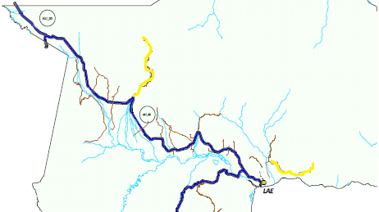
Activity-2:Support for Improving the Capacity of Management by the In-house Workforce
Pilot site in Morobe
1. Bukawa Road
2. Leron Wantoat road
2.) 62km
1.) 25km
Lae city

Slide 9
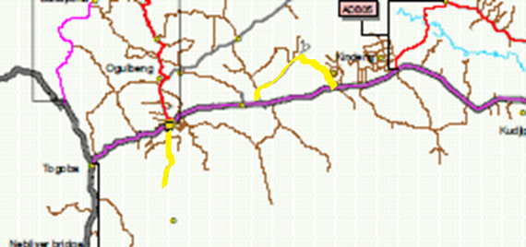
Activity-2:Support for Improving the Capacity of Management by the In-house Workforce
Pilot site in Western Highlands
1. Kuta Road
2. Balg to Baisu Avi Road
Mt.Hagen city
2.) 11km
1.) 7km

Slide 10
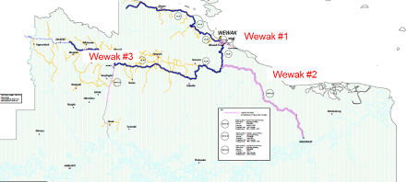
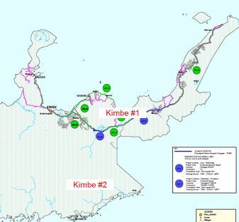
Activity-2:Support for Improving the Capacity of Management by the In-house Workforce
Pilot site in East Sepik
To be selected in the 1st year
Pilot site in West New Britain
To be selected in the 1st year

Slide 11
Activity-2:Support for Improving the Capacity of Management by the In-house Workforce
Preparation for the pilot project
Road maintenance construction
Designing and determination of the coverage of the pilot project for effective maintenance and management
Consideration of feasibility of the pilot project cost and budget for effective maintenance and management
Plan for procurement of equipment necessary for the pilot project
Personnel plan in respect to operators and mechanics for the pilot project
Option | Construction | Description of work
① | Reshaping and Earthwork of Gravel Road / Roadside drainage | Road survey, Finishing stake of roadside
 |  | Reshaping and Earthwork of Gravel Road (Grader, Bulldozer, Hydraulic shovel)
 |  | Surface compaction (Roller)
 |  | Inspection
 |  | Record of usage of construction quantity, personnel, machine, fuel, material
② | Embankment and Regraveling | Reshaping and Earthwork (Grader)
 |  | Road survey, Finishing stake of roadside
 |  | Transportation, spreading of banking material and crushed stone (Dump, Loader, Grader, Bulldozer, Hydraulic shovel)
 |  | Thickness measurement of banking material and crushed stone
 |  | Surface compaction of banking material and crushed stone (Roller)
 |  | Inspection, measurement
 |  | Record of usage of construction quantity, personnel, machine, fuel, material

Slide 12
Activity-2:Support for Improving the Capacity of Management by the In-house Workforce
Workshops for local residents near pilot sites
Implementation of the pilot project
Areas | communities adjacent to pilot sites and those that use pilot sites in everyday life as residential roads.
Participants | the entire communities concerned (if the number of residents is large, they will be narrowed down from the entire communities in a balanced manner in consultation with their representatives.)
Objectives | the workshops will give account of the backgrounds, purposes and implementation plans of the Project and pilot project for smooth implementation.
Road coverage of the pilot project, by improvement work
Work schedule, by work item
Arrangement plan for construction machines and materials
Construction cost spending plan
Quality control plan
Safety control plan

Slide 13
Activity-2:Support for Improving the Capacity of Management by the In-house Workforce
OJT for DoW officers
The capacity of DoW officers will be enhanced in OJT conducted in the pilot project and DoW will have initiative
Calculation of unit prices related to maintenance and management work
No | ITEM
1 | Record of workdays and weather
2 | Number of workers of each construction work item (Attendance record)
3 | Record of operating time of equipment and fuel consumption of each construction work item
4 | Record of material usage of each construction work item
5 | Record of production volume of each construction work item
6 | Record of test results of each construction work item
7 | Unit price of each work item (Number of workers x labor unit price^{*1} + operating time x Equipment unit price^{*2} + fuel usage x fuel unit price^{*3} + material usage x material unit price^{*4} / production volume)

Slide 14
Activity-3:Support for Efficient Operation of Equipment
Confirmation of road inventory and road maintenance and management plans
In order not to overlap the operations of other donor projects and private sector, road inventories and road maintenance plans must be carefully examined.
Assistance to formulation of equipment deployment plan to arrange and use road maintenance and management equipment
For efficient use of equipment to be newly procured, assistance will be given to the DoW.
In addition, new equipment can be used other than pilot project as long as there is no impact on the implementation of the pilot project.

Slide 15
Activity-3:Support for Efficient Operation of Equipment
Survey and analysis of training materials and manuals of the PTD
The Consultant already obtained and started to analyze some of the PTD training materials and manuals, and analyze more.
Assistance to revisions to training materials and manuals related to road maintenance and management equipment
The assistance will be given to work on the revisions of training materials and manuals.
Revision and analysis of PTB trust account
Assistance for the work to set out equipment rental unit fees will be given after thorough consultation and confirmation with the PTD and other relevant departments

Slide 16
Activity-4:Support for Public Relations Activities Related to Maintenance
Assistance to inclusion of the project activities and outcome in DoW reports, and posting thereof on the website
Assist to publish project information and outcomes on the annual report and website of DoW, therefore conduct cooperation work preparing project reports for those.
Assistance for PR activities through mass media
Assist public relation through mass media to gain good reputation for DoW project and made positive chain reaction.
Invite mass media to the pilot project site in each province and JCC at the end of the year.

Slide 17
Other Activities
Training of C/P in Japan
The first session (2 week) in Japan is planned to be held in February 2015 and 4 participants will be determined by the performance of the first year.
Continuous gathering of security information
Information about security around project sites will be continuously gathered to operate the pilot projects safely and to be successful.

