Slide 1
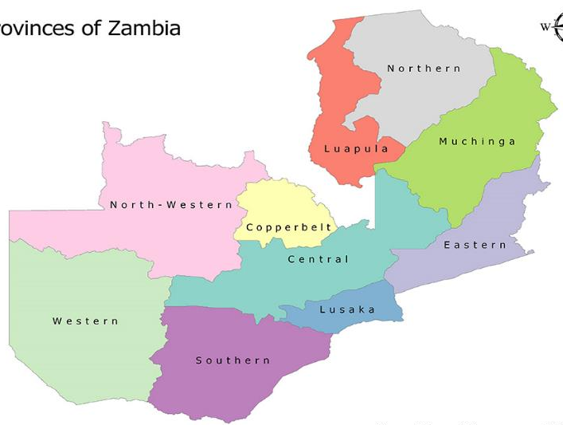
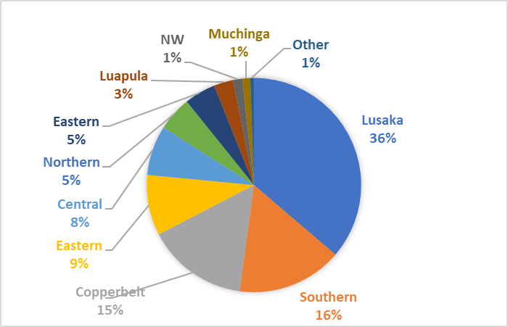
Overview of JICA Volunteer Program
Mar. 2025
History of JOCV (Japan Overseas Cooperation Volunteers)
Related Policy or Strategy in Respective Field
April. 1970 | Exchange of Notes, between Two Government concerning the dispatch of JOCV (Japan Overseas Cooperation Volunteers). Opened JICA Zambia office and placed the first 6 JOCVs (Judo).
April. 2001 | Launched Senior JOCV Program
July. 2016 | Amended the Exchange of Notes in 1970 (JOCV shall bear claims, if any arises on their duty).
March. 2020 | Evacuated 66 JOCVs due to COVID19.
April. 2021 | The first group of JOCVs Back to Zambia.
As of March 2024 | Serving 30 JOCVs 1,652 JOCVs Served from 1970
Education
８NDP：Improving the provision of ECE. Improving the accessibility and the quality of Primary and Secondary Education. Promotion of STEM education.
Agriculture
8NDP：To promote and strengthen efficient and effective management of agricultural production and productivity in order to ensure sustainable household food and nutrition security, and increased incomes.
Health
8NDP：Strengthening prevention and control of infectious and non-communicable diseases, improving access to quality health care. Stable food security and nutritional enhancement. Strengthening of integrated medical information systems (Smart Care Plus).
Vocational Training and Business Administration
8NDP：Contribution to a diversified economic system transformation as well as environmentally friendly social development. To develop qualified skills and vocational knowledge in line with entrepreneur development. To develop Innovation and research skills accelerating technology transfer.
Developmental Agenda
Education：Increment of the enrolment rate. Improvement of the progression/pass rates from Grade 7-8 and 9 to 10. Promotion of STEM education.
Agriculture：Maize-based production and diversity (promotion of rice, mushroom, & tree growing)
Health：Expand primary health care in the community.
Vocational Training, Business Administration：Development and stability of industrialization, Job creation
Related GOZ ／Other Donor
Related Organization
Ministry of Finance and National Planning：MoFNP signed Exchange of Notes concerning JOCV. Issuance of JOCV’s acceptance letter.
Ministry of Education：Accepted 43% of JOCVs so far. (Science Education, Primary Education, Physical Education, ICT.)
Ministry of Agriculture：Agricultural-related volunteers (Home Arts & Life Improvement, Food crops & Rice Culture, Livestock and Dairy processing, etc.), which account for about 15% of the total. They provide guidance to local people to contribute to income generation and food security.
Ministry of Health： Accepted 13% of JOCVs so far (Infection control, Public Health, Hospital Administration). Conducts all aspects of the operation of medical facilities nationwide.
Ministry of Technology and Science：Approximately 10% of JICA Volunteers dispatched in Zambia have been accepted by MOTS. They have been engaged in Automobile maintenance, Electricity & Electronics, Clothing, Metalworking etc., to develop, promote and evaluate technology and innovation.
Other Donors:
Peace Corps：Back to Zambia in March 2022. about 300 volunteers Serving as of March 2024 in Education, Agriculture and Health sector.
VSO：Back to Zambia September in 2022. 9 volunteers serving in Lusaka and Luapula. In the field of the Reproductive health, Youth development etc.
JOCV map (Provincial)
48
86
250
20
23
124
151
78
599
262

Slide 2
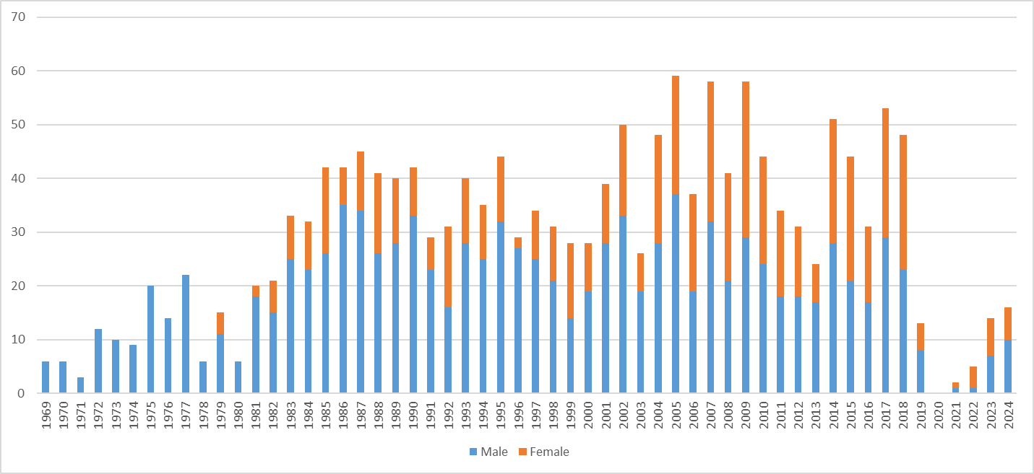
Overview of JICA Volunteer Program
Mar. 2025
Cooperation Policy
Past cooperation （Since 1970）
Cooperation Policy
To dispatch volunteers with focusing on two pillars “Industrial Revitalization” and “Improvement of Infrastructure and Social Services to Support Economic Activities” based on the Country Development Cooperation Policy of the government of Japan.
Program for Social Development
Quality of Education：Primary Education, PC instructor, special education
Fostering Healthy Communities：Public Health, Community Development
Strengthening Agricultural Sector
and Improving Productivity and Value Addition
Agricultural development support ：Animal Husbandry, Food Crops and Rice Culture, Community Development, etc.
Environment conditioning toward diversified industries
Business management improvement for SME (Small Medium Entrepreneurs) : Business management, Tourism etc.,
Industrial human resource development through vocational trainings : Automobile maintenance, Metalworking
Social Issue / Culture/ Cross Cutting Issue
Supporting ex-refugee sector: Administration service, vegetable growing
Japanese Education: Japanese education teacher.
1970s
Inaugurated JOCV program and six Judo JOCVs started to serve at Zambia Police. JOCVs were dispatched to the governmental body such as telecommunication service, Civil Aviation Bureau, and contributed to Human resource and Infrastructure development.
In late 70’s, started to send in agriculture and veterinary field. JOCVs dedicated, shared their knowledge and technical skills even amidst many difficulties in shortage of supplies and human resources.
1980s
Many JOCVs served at University and Vocational Training Center, aiming at developing skills of leaders and managers. Begun to dispatch JOCVs to Provincial and District office, Hospitals and Schools to contribute to rural area development too.
UNZA School of Veterinary Medicine was established in 1986 backed up many JICA experts and JOCVs. Experts provided a theory class and JOCVs worked on the practical aspect to train future domestic veterinaries. This school is one of the famous in Africa and its professors and lectures are ex- students of JOCVs.
1990s
About 100 JOCVs served in Education field to mitigate shortage of teachers in rural areas. In Vocational Training field, Automobile maintenance JOCVs worked actively supporting the human resources development to sustain the expanding economic activities.
JOCVs contributed to increased Agricultural field cultivation/production to promote local development. A group was dispatched in Mongu and Sefula. JOCVs served in formulating farmer groups/cooperatives and water management associations, introducing and formalizing their terms and agreement. This contributed to widen the rice field and improve productivity tremendously with making use of 200ha Irrigation system, training centers and market facility, provided by Japanese Grant-Aid. Mongu rice is one of the famous brands in Zambia nowadays all thanks to the JOCVs contributions.
2000s to date
60% of dispatchment is in Education and Vocational Training field. JOCVs have worked in collaboration with the JICA technical cooperation scheme project focusing on the quality of education such as material development, providing leaner-centered approach, and promoting STEM education.
Started Senior JOCV program in 2021 to meet/respond to the advanced dynamic needs. Their expertise and experience have been used to improve teachers’ skills in Education field and supporting management in the various business administration field.
Started to send new variety of field such as computer technology JOCVs to government line organizations/ministries, youth activity in the community schools or children’s house, infection disease control in NGO to meet diversified needs in 21st century
Ratio of JOCV Technical Field
Dispatchment Number Shift

Slide 3
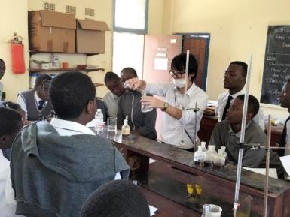
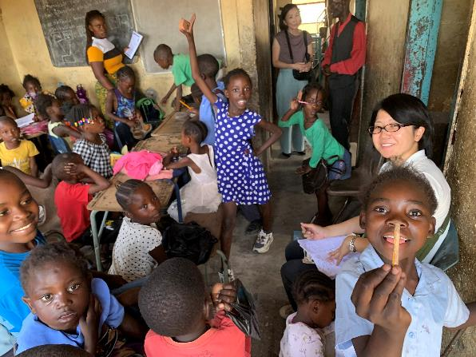
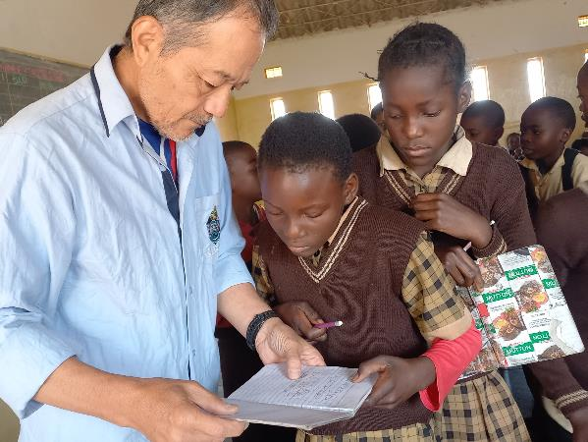
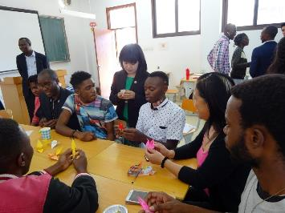
Overview of JICA Volunteer Program
Mar. 2025
JOCV Activities in Various Field
Education
Science Education
Working Organization：
Secondary School, Teacher’s Collage
Technical Field ：
Science, Mathematic Education
Supporting Community Schools, Children’s House
Working Organization：
Community School, NGO
Technical Field ：
Youth Activity, Primary Education
Outline：
Teaching Science (Chemistry, Biology and Physics) with many Visual-Aids Materials, introducing experiments with making use of the local materials at Secondary schools. Participating to the “Jugyo-kenkyu (Reflection and analyses for improving class management and teaching materials).
Outline：
Supporting community schools’ children to improve the accessibility of education and providing primary and social and emotion education. Not only the above, supporting management such as an income generation activity for the sustainability.
Primary Education
Working Organization：
Primary School, Basic School
Technical Field ：
Primary Education
Japanese Language Education
Working Organization：
University of Zambia（UNZA）
Technical Field :
Japanese Education
Outline：
Managing class and providing Science and Mathematics education at primary level for better understanding in those fields. They contribute to improved students’ performance through introducing a learner-centered approach activity and Visual-Aids materials.
Outline：
Conducting and supporting Japanese language education courses (Credit course and Non-Credit course to the public) at UNZA. It is the only institution to provide public Japanese language course in Zambia and is expected to be a center of offering Japanese cultural information.
写真

Slide 4
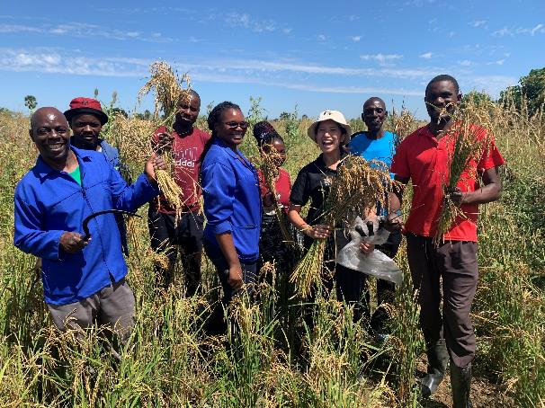
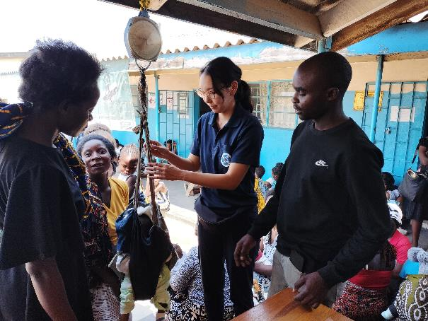
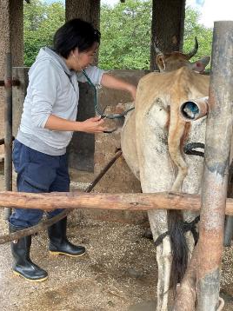
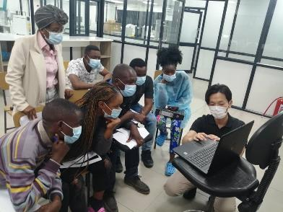
Overview of JICA Volunteer Program
Mar. 2025
JOCV Activities in Various Field
Agriculture・Health
Agriculture
Working Organization ：
District Agricultural Offices
Technical Field ：
Home Arts & Life Improvement,
Food Crops & Rice Culture,
Vegetable Glowing
Primary Health Care in the Community
Working Organization ：
District Health Office
Rural Health Center
Technical Field ：
HIV/AIDS and Infection control,
Public Health,
Community Development
Outline：
Support was provided to District Agricultural Offices in an effort to solve issues faced by local farmers/residents (e.g. nutritional guidance and advice on how to improve crop productivity.
Outline：
To resolve issues in the health field
in rural areas, such as HIV/AIDS
infection control, volunteers
provide support for regular health
check-ups and workshops.
Animal Husbandry
Working Organization ：
District Veterinary Offices, Universities, Colleges,
Research & Training Centers, etc.
Technical Field ：
Animal Husbandry, Veterinary Medicine,
Aquaculture, Livestock & Daily Products Processing,
Etc.
Improving the Health Care Environment in Urban Areas
Working Organization ：
General Hospitals in Lusaka
and Local
Technical Field ：
Hospital Administration
Outline：
In conjunction with JICA technical
cooperation project, the team will
provide support for the
implementation of workshops and
on-the-job training on kaizen
methods.
Outline：
The program targets local livestock farmers and provides livestock production and improvement, as well as communicable disease control and treatment. Creating a disease-free environment leads to improved crop, and livestock productivity/ yield and income.

Slide 5
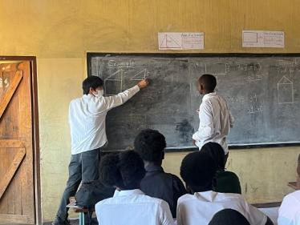
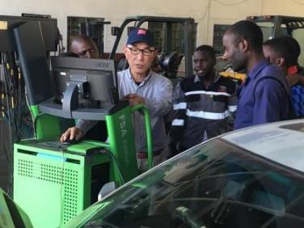
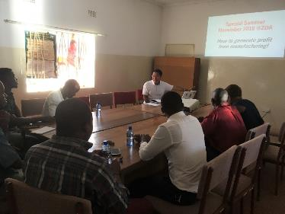
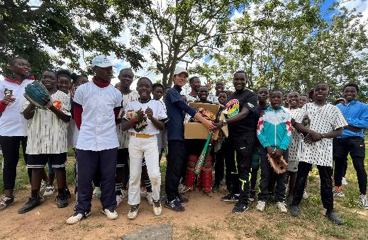
Overview of JICA Volunteer Program
Mar. 2025
JOCV Activities in Various Field
Vocational Training・Business Administration
Others
Industrial human resource development through vocational trainings
Hiroshima University and JICA Cooperation program in Science and Mathematics field
Working Organization ：
University, Vocational Schools.
Outline：
Participating in the JOCV program as a part of post graduate school program. They have served in improving the quality of education with their academic background and experiences as teachers.
The expectation of this program is 1. Human resource development in the international cooperation field, 2. Improving the Science and Mathematics Education, 3. Long-Term Personnel development model collaborating with JOCV program.
写真
Technical Field ： Clothing, Automobile maintenance, PC technology, etc.
Outline：
More than 100 JOCV have been engaged since 1970 covering various fields. Majority of them have been working as instructors for the purpose of technical transformation. PC instructors have currently increased after 1990. The JOCVs have been contributed to employment support or income generation for youth and women thorough skill development.
Business management improvement for SME
“Smile for All in the World” Program
Working Organization ：
Government Office, Chamber of Commerce
Outline：
“Smile for All in the World” program purveys items requested by related groups in assigned countries or locations of JICA volunteers; those items are collected from the potential donors in Japan and sent to the locations through the program. The picture on the right shows a donation of sports equipment and educational materials to an orphanage.
●Donated items in the past, Volleyballs, tambourines, mathematics sets, abacuses, etc.
Technical Field：
Business management, Tourism, Design
Outline：
36 JOCVs have been engaged from 2002. JOCV contributed to the improvement in management of working places in business management field. JOCV in tourism, design or others have contributed to the promotion of local fascinations in varied ways.

