Slide 1
Psycho-Education for Patients and Family Members
Session 2: Triggers and Cravings (2)
Notes:
Slide 2-1—Triggers and Cravings (2)
In the last session, we have learned about the conditioning and the addictive process.
This session continues to look at the additive process and then gives you techniques to stop cravings.

Slide 2
The Addictive Process
Introductory phase
Maintenance phase
Disenchantment phase
Disaster phase
To be covered today
Notes:
Slide 2-2—Addictive Process (Review)
We already have learned about the conditioning and the introductory/maintenance phases of the addictive process.
This session covers the disenchantment phase and disaster phase in the additive process.

Slide 3
Question:
How does the balance between positives and negatives change if Shabu is continuously used beyond the maintenance phase?
Notes:
Slide 2-3—Question
Ask participants how the balance between positives and negatives change Shabu is continuously used beyond the maintenance phase.

Slide 4
Addictive Process - Disenchantment Phase
Positives and Negatives of Shabu Use
Negatives
Positives
Withdrawal depression
Paranoia
Tweaking
Relationship disruptions
Family distress
Impending job loss
Sociability
Occasional euphoria
Relief from fatigue
Relief from stress
Notes:
Slide 2-4—Positives and Negatives of Shabu Use (Disenchantment Phase)
During the disenchantment phase, the scales tip from the positive to the negative.
The consequences of drug and alcohol use are severe, and the person’s life becomes unmanageable.
At this point the rational decision is to stop using, but the cortex part of the brain is no longer in control.
Thinking, evaluating, and decision making may appear to be happening, but behavior is not always based on rational thinking.
People may resolve sincerely to quit using yet may find themselves out of control at the first thought of drugs and alcohol, at the first encounter with someone they used with, at the availability of cash, or with other potent triggers.

Slide 5
Addictive Process - Disenchantment Phase
Conditioning Process During Addiction
Triggers
Fatigue
All friends
Stress
Boredom
Anxiety
Free time
Sexual arousal
Loneliness
Responses
Continual thoughts of Shabu
Strong physiological arousal
Psychological dependency
Strong cravings
Frequent use
Strength of Conditioned Connection: Strong
Notes:
Slide 2-5—Conditioning Process During Addiction (Disenchantment Phase)
At this point people usually cross the line into addiction, continuing to use in spite of serious negative physical and social consequences.
Triggers in this phase produce a strong physiological response that drives people to acquire and use drugs and alcohol.

Slide 6
Addictive Process - Disenchantment Phase
Development of Obsessive Thinking
Food
Shabu
Shabu
TV
Shabu
Girlfriend
Job
Shabu
Family
Parties
Shabu
Shabu
Notes:
Slide 2-6—Development of Obsessive Thinking (Disenchantment Phase)
During the disenchantment phase, the frequency of drug and alcohol thinking increases, crowding out most thoughts about other aspects of life.

Slide 7
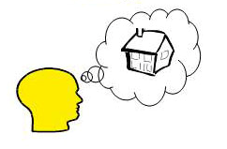
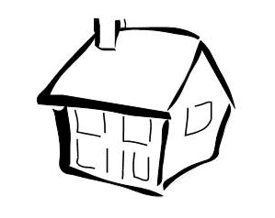
Addictive Process - Disenchantment Phase
Development of Craving Response
Thinking of Using
Mild Physiological Response
Entering Using Site
Heart rate
Breathing rate
Energy
Adrenaline effects
Powerful Physiological Response
Use of Shabu
Shabu Effects
Heart rate
Breathing rate
Energy
Adrenaline effects
Heart
Blood pressure
Energy
Notes:
Slide 2-7—Development of Craving Response (Disenchantment Phase)
In this phase, the craving response is powerful.
People feel an overpowering physical reaction in situations further and further removed from drugs or alcohol.
The craving response is almost as powerful as the actual physical reaction to drugs and alcohol.

Slide 8
Addictive Process – Disaster Phase
Positives and Negatives of Shabu Use
Negatives
Positives
Weight loss
Paranoia
Loss of family
Seizures
Severe depression
Unemployment
Bankruptcy
Relief from fatigue
Relief from stress
Relief from depression
Notes:
Slide 2-8—Positives and Negatives of Shabu Use (Disaster Phase)
In the disaster phase, the drug and alcohol use is often automatic.
People cannot restrain themselves from using drugs or alcohol.
People’s behavior in the phase is much like the behavior of addicted laboratory animals that use drugs until they die.

Slide 9
Addictive Process – Disaster Phase
Conditioning Process During Addiction
Triggers
Any emotion
Day
Night
Work
Free time
Responses
Obsessive thoughts about Shabu
Powerful autonomic response
Powerful physiological dependence
Automatic use
Persistent paranoia
Strength of Conditioned Connection: OVERPOWERING
Notes:
Slide 2-9—Conditioning Process During Addiction (Disaster Phase)
In this phase, addicted persons are using either daily or in binges, which most likely are interrupted only by physical collapse, hospitalization, or arrest.
The constant overpowering craving from the limbic system overwhelms the cortex.

Slide 10
Development of Obsessive Thinking
Addictive Process – Disaster Phase
Shabu
Shabu
Shabu
Shabu
Shabu
Shabu
Shabu
Shabu
Shabu
Shabu
Shabu
Notes:
Slide 2-10—Development of Obsessive Thinking (Disaster Phase)
Thoughts of drug and alcohol use dominate the person’s consciousness.

Slide 11
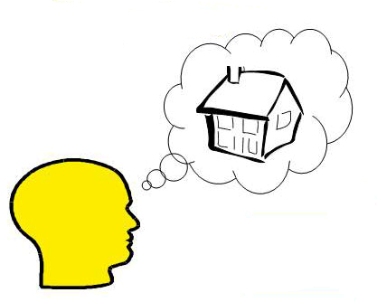
Addictive Process – Disaster Phase
Development of Craving Response
Thoughts of Shabu-Using Place
Powerful Physiological Response
Heart rate
Breathing rate
Energy
Adrenaline effects
Notes:
Slide 2-11—Development of Craving Response (Disaster Phase)
In the disaster phase, cravings can create powerful physiological effects that even can begin to mimic the initial physiological effects of actually ingesting the drug.

Slide 12
Question:
Prior to using substance, in what order do the following three events occur?
Thought
Craving
Trigger
Notes:
Slide 2-12—Question
Ask participants about the order of the occurrence of the following three events: Thought, Craving, and Trigger.

Slide 13
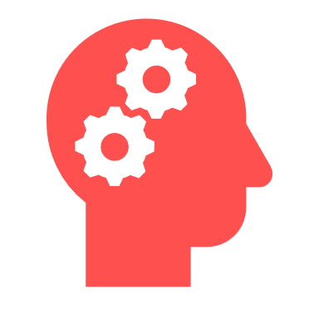
Trigger
Thought
Craving
Use
Notes:
Slide 2-13—Trigger–Thought–Craving–Use
Craving can be activated by external triggers.
Triggers can cause thoughts, which can turn into cravings and lead to use.

Slide 14
STOP!
Trigger
Thought
Craving
Use
1-14
Notes:
Slide 2-14—Interruption
The earlier this chain of events is interrupted, the more likely relapse will be avoided.
An effective technique for coping with triggers and cravings is thought stopping.

Slide 15
Thought Stopping
Visualization
Rubber band snap
Relaxation
Calling someone
Notes:
Slide 2-15—Thought Stopping
Thought stopping interrupts the usual process that culminates in using or drinking.
The usual reaction to thoughts about using “argue” with the developing thought/craving. The argument usually results in the addiction winning.
Arguing precedes negotiation, compromise, justification, and, possibly, relapse.
Thought stopping ends this process before relapse begins, usually stopping cravings in their tracks.
If thought stopping works, but the thoughts frequently keep coming back, people in recovery may have to change their immediate environments or engage in tasks that require full concentration.
Thought stopping techniques include
Visualization
Relaxation
Rubber-band snap
Calling someone

Slide 16
Thought Stopping
Visualization
Notes:
Slide 2-16—Visualization
When people experience thoughts of using drugs or alcohol, they can visualize a switch or lever and imagine actually moving it from ON to OFF to stop the drug- or alcohol-using thoughts.
It is important to have another thought ready to replace the drug- or alcohol-using thoughts.
It should be a pleasurable or meaningful thought and one that does not involve drug or alcohol use.

Slide 17
Thought Stopping Rubber-band Snap
Notes:
Slide 2-17—Rubber-band Snap
The rubber-band behavioral technique helps people in recovery “snap” their attention away from thoughts of using drugs or alcohol.
People who are addicted simply put a rubber-band loosely around their wrists.
When a craving or using thought occurs, people snap the rubber-band lightly against their wrists and say “NO” (either aloud or not, depending on the situation) to the drug- or alcohol-using thought.
As with visualization, people need to have another thought ready to replace the drug- and alcohol-using thoughts.
This technique works best if people leave the rubber-band on all the time.

Slide 18
Thought Stopping
Relaxation
Notes:
Slide 2-18—Relaxation
Cravings often create feelings of hollowness, heaviness, and cramping in the stomach.
These feelings often can be relieved by breathing in deeply (filling the lungs with air) and slowly breathing out three times in a row and by focusing on relaxing the body as much as possible for a few minutes.
This process can be repeated as often as necessary whenever the feelings return.

Slide 19
Thought Stopping Calling Someone
Notes:
Slide 2-19—Calling Someone
Talking to another person provides an outlet for feelings and allows people to “hear” their own thinking process.
Recovering people should carry the phone numbers of supportive people with them always, so they can call whenever support is needed.

Slide 20
Question:
What are other possible ways to stop the thought of using?
Notes:
Slide 2-20—Question
Ask participants about other possible ways to stop the thought of using.

