Slide 1
Psycho-Education for Patients and Family Members
Session 9:
Families and Recovery (1)
Notes:
Slide 9-1—Families and Recovery (1)
In this session, we are going to talk about the people who are most important to you.
When a family is coping with a loved one who abuses stimulants, life can be frustrating and chaotic. The person who is using can behave self-destructively; the family members can resort to desperate measures just to cope.
Often, it’s hard for all involved to understand how they got to this point. How did things get this bad? Evaluating a situation when you are in the middle of it can be difficult.
In this session we will look at how people become dependent on a substance and how they and their families recover from dependence. The hope is that by better understanding the processes of dependence and recovery, family members will be better able to provide support.

Slide 2
Who Makes Up a Family?
Members of your immediate family (parents, siblings, partner, children)
Extended family
Friends
Colleagues from work
Mentors
Anyone who will support recovery
Notes:
Slide 9-2—Who Makes Up a Family?
It is important to think of family in the broadest possible terms.
Family includes immediate family and extended family, friends, mentors, partners, colleagues from work—all of these people are part of your family when it comes to treatment. If someone you are close to is supportive, that person is part of your family.

Slide 3
Question:
Answer if the following statements are TRUE or FALSE.
  Shabu is a chemical substance. Addiction is caused by responses of the body to the chemical.
  Addiction is a form of wrongdoing and not a medical problem.
  Addiction can be overcome by willpower.
Notes:
Slide 9-3—Question
Ask participants if the three statements are true or false (the answers are: 1-True, 2-False, 3-False).

Slide 4
What Is Addiction?
Addiction is a physical and emotional response to chemicals we put in our bodies.
Addiction is a medical disorder.
It is not helpful to think of addiction in terms of morality and willpower.
Notes:
Slide 9-4—What Is Addiction?
Addiction is a complicated physical and emotional process that takes place in the brain. As a result of drug use, the brain changes and people engage in behavior that affects themselves and their families.
Addiction is a medical disorder. It is counterproductive to recovery to think of addiction as representing a personal failing, a lack of willpower, or a moral downfall.

Slide 5
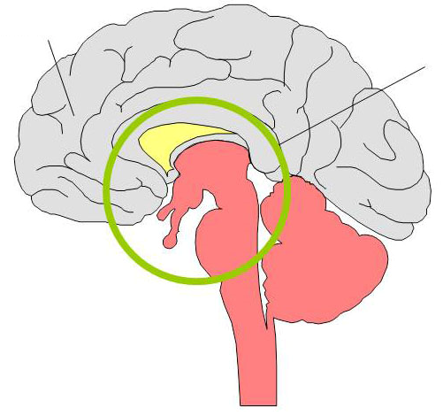
Development of Addiction
Prefrontal Cortex
Limbic System
Notes:
Slide 9-5—Development of Addiction
The development of addiction involves two different areas of the brain: the prefrontal cortex and the limbic system.
The prefrontal cortex is the intelligent, rational, thinking part of the brain. It is the decisionmaker, the brain’s computer. The prefrontal cortex constantly directs our behavior and evaluates both the positives and negatives of any situation to make a decision.
The limbic system is made up of smaller parts of the brain below the prefrontal cortex. The limbic system’s involvement in emotion and motivation drives addiction. Each dose of a sub­stance—especially stimulants—activates the limbic system. Eventually, the system becomes overactivated to the point where normal, rational restraints on behavior are lost.
One way to understand the process of addiction is as a struggle between the rational part of the brain (the prefrontal cortex) and the emotional part of the brain (the limbic system).
For most people who use Shabu, the rational part of their brain keeps their Shabu use in check at first. However, with continued use, Shabu’s effects on the parts of the brain that govern emotion and motivation begin to override reason and clear thinking.

Slide 6
Development of the Craving Response
Cognitive process—Prefrontal cortex
Conditioning process—Limbic system
Obsessive thinking
Prefrontal Cortex
Limbic system
Notes:
Slide 9-6—Development of the Craving Response
Craving is the physical and emotional desire for a drug.
Three separate processes converge to create a craving for a drug:
The cognitive process (at the prefrontal cortex)
The conditioning process (at the limbic system)
Obsessive thinking
The cognitive process is how the rational part of the brain (the cortex) copes with substance use.
The conditioning process is the involvement of the emotional part of the brain (the limbic system) in addiction.
Obsessive thinking is the struggle between the rational and emotional responses to substance use.

Slide 7
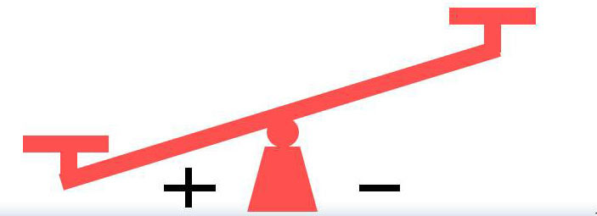
Cognitive Process
Beginning Stages of Addiction
Negative Aspects
Employment disruption
Relationship concerns
Financial problems
Positive Aspects
Depression relief
Confidence boost
Boredom relief
Sexual enhancement
Notes:
Slide 9-7—Cognitive Process (Beginning Stages of Addiction)
The cognitive process is taking place in the prefrontal cortex in the brain.
In the beginning stages of addiction, Shabu use occurs occasionally, often at a party or on a special occasion.
Use gradually increases, but the rational part of the brain is in control and decides that using Shabu is justifiable because of the supposed benefits it provides.
The positives seem to outweigh the negatives. The facts that Shabu is illegal and extra money is spent to buy it do not carry as much weight.

Slide 8
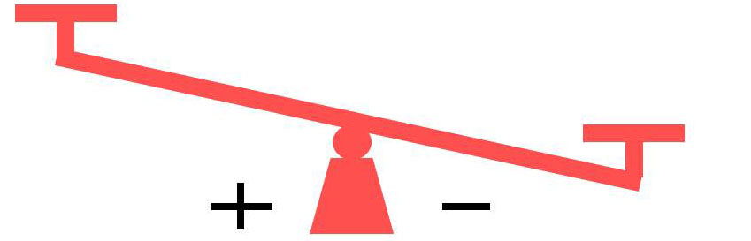
Cognitive Process
Disenchantment Stage of Addiction
Positive Aspects
Negative Aspects
Social currency
Occasional euphoria
Relief from lethargy
Nosebleeds, infections
Financial jeopardy
Relationship disruption
Family distress
Impending job loss
Conflict with law and legal issues
Notes:
Slide 9-8—Cognitive Process (Disenchantment Stage of Addiction)
The person who continues to use Shabu eventually becomes disenchanted, as the negative consequences of Shabu use clearly outweigh the positives.
Some people are able to stop using when it becomes apparent that Shabu use is damaging their lives. Those who can’t stop are addicted.
A powerful hunger for Shabu becomes stronger than the rational part of the brain.
The rational decision not to use and willpower are not enough to deter the craving for Shabu that has taken root in the emotional part of the brain. The rational, decision-making process is severely impaired, and the addicted brain’s demands are imperative.

Slide 9
Conditioning Process
Mild to Moderate Mental Connection
(between Shabu and Pleasure)
Triggers
  Parties
  Friday nights
  Friends
  Extra money
  Intimate situations
  Depression
  Paranoia
  Weight gain
Responses
  Thoughts of Shabu
  Mild physiological arousal
  Eager anticipation of use
  Cravings as use approaches
  Occasional use
Notes:
Slide 9-9—Conditioning Process (Mild to Moderate Mental Connection)
While the cognitive process is taking place in the prefrontal cortex, a parallel progression of events takes place in the limbic system of someone who is using Shabu. This is the conditioning process.
Conditioning is a type of learning that occurs by association. Every time people take Shabu, they strengthen a mental link between the drug and its pleasurable effects. This link conditions the brain to want more Shabu.
At first, Shabu use is so infrequent that there is no automatic response to the people, places, or situations associated with Shabu.
Over time, this link becomes stronger and more general, so that not only taking Shabu, but think­ing of things associated with the drug (money, a dealer’s house, certain friends) can induce cravings for Shabu.
At first, purchasing and using the drug activate the brain’s emotional and motivational centers in the limbic system. This results in euphoria and physiological arousal: increased breathing and heart rate, adrenaline effects, and increased energy.
The brain begins to form a mild to moderate mental connection between Shabu and pleasure.

Slide 10
Conditioning Process
Strong Mental Connection
(between Shabu and Pleasure)
Triggers
  Weekends
  Friends
  Stress
  Boredom
  Anxiety
  Unemployment
  Loneliness
Responses
  Continual thoughts of Shabu
  Strong physiological arousal
  Strong cravings
  Frequent use
Notes:
Slide 9-10—Conditioning Process (Strong Mental Connection)
As the mental connection between Shabu and the pleasure it produces grows stronger, things other than the drug itself increasingly trigger craving, and the craving becomes stronger.
A person who continues using Shabu will feel a strong physical response to Shabu.
In the later stages of addiction, the mental connection between Shabu and the pleasure becomes strong and thinking about Shabu will set off powerful cravings. For a person who is dependent on Shabu, thinking about Shabu or about using Shabu produces a powerful arousal similar to actual effects of Shabu.
Triggers initiate an automatic craving to use Shabu, and this feeling drives people to find and take Shabu.

Slide 11
Conditioning Process
Overpowering Mental Connection
(between Shabu and Pleasure)
Triggers
  Any feeling
  Day
  Night
  Unemployment
  Work
Responses
  Obsessive thoughts about Shabu
  Powerful response
  Intense cravings
  Automatic use
Notes:
Slide 9-11—Conditioning Process (Overpowering Mental Connection)
Soon, triggers proliferate, and the mental links between the triggers and drug use become over­powering. Addiction—the loss of rational control to the emotional part of the brain—has set in.
As the addiction becomes severe, the mental connection between Shabu and the pleasure becomes overpowering and people use either daily or in binges that are interrupted only by physical collapse.
The rational brain is totally overwhelmed by the constant, powerful craving from the addicted brain. People who are addicted cannot be stronger than the conditioned response that has been forged in the brain.

Slide 12

Development of Obsessive Thinking
Early Use
SHABU
SHABU
SPORTS
FOOD
BOYFRIEND
FAMILY
WORK
SHABU
SCHOOL
EXERCISE
ALCOHOL
GIRLFRIEND
Notes:
Slide 9-12—Development of Obsessive Thinking (Early Use)
When a person starts using Shabu, very little time or thought is invested in it. Shabu use is just a small part of the person’s life.
If the person keeps using, decisions about whether to use, where to get money to buy drugs, and how to conceal the evidence of using begin to take more time and thought.
These thoughts of using intrude more and more because the links formed in the emotional part of the brain between Shabu and enjoyment have begun to exert their influence.

Slide 13
Development of Obsessive Thinking
Continued Use
SHABU
SHABU
SHABU
SHABU
SHABU
SHABU
SHABU
SHABU
SHABU
SHABU
SHABU
SHABU
Notes:
Slide 9-13—Development of Obsessive Thinking (Continued Use)
With continued use, thoughts about Shabu crowd out other aspects of life. For the most part, the emotional part of the brain is given over to addiction and Shabu dominates the person’s thoughts.
People using Shabu become so obsessed with Shabu that their relationships may begin to crum­ble. There is little room in their lives for a relationship with anyone or anything except Shabu.
This overwhelming preoccupation does not mean that family members mean less to people than Shabu does. It means that the brain changes caused by Shabu make the desire to use Shabu all but irresistible.

Slide 14
Progressive Phases of Addiction
Introductory
Maintenance
Disenchantment
Disaster
Notes:
Slide 9-14—Progressive Phases of Addiction
Now we turn to the family members’ responses as they watch the person they care about become dependent on Shabu. We can trace family members’ responses through four progressive stages of addiction:
Introductory
Disenchantment
Maintenance
Disaster

Slide 15
Question:
What are typical responses to a Shabu using family member at the following addiction phases?
  When his/her family first becomes aware of the drug problem.
  After addiction progresses and he/she is totally overpowered by the drug.
Notes:
Slide 9-15—Question
Ask about typical responses to a Shabu using family member at the Introductory and Disaster phases of addiction.

Slide 16
Family Members’ Response to
Shabu Use
Introductory Phase
Unaware of problem
Confusion regarding occasional odd behaviors
Concerned about occasional neglect of responsibilities
Notes:
Slide 9-16—Family Members’ Response to Shabu Use (Introductory Phase)
During the introductory phase of a person’s Shabu use, family members are probably not affected very much. They may be completely unaware of the Shabu use.
Family members may see behaviors that stem from occasional Shabu use but not associate them with a drug problem.
Family members may wonder why the person occasionally neglects responsibilities and fails to meet obligations.

Slide 17
Family Members’ Response to
Shabu Use
Maintenance Phase
Are aware of the problem
Attempt to solve the problem by themselves
Take on all responsibilities
Seek help from others
Notes:
Slide 9-17—Family Members’ Response to Shabu Use (Maintenance Phase)
Often, during the maintenance phase of a person’s addiction, family members realize that a problem exists and attempt to solve it.
Family members may give financial assistance. They may make up excuses for thoughtless behavior that results from Shabu use. They even may try to take on all the responsibilities for earning money, taking care of the family, keeping up friendships, and maintaining the household.
These efforts help only temporarily because the real problem is the Shabu use and its consequences.
The problems continue to mount as long as the Shabu use continues. Family members want to help, so they pick up the slack for their loved one who is using.
This behavior does more harm than good. It helps the person stay addicted by covering up the consequences of Shabu use. Such activities give the person more time, energy, and money to continue using and cover up the fact that Shabu use must stop.

Slide 18
Family Members’ Response to
Shabu Use
Disenchantment Phase
Avoidance of problem
Blaming the person who is using
Blaming selves
Guilt and shame
Mistrust
Notes:
Slide 9-18—Family Members’ Response to Shabu Use (Disenchantment Phase)
By the time the person reaches the disenchantment phase of addiction, family members often are angry and have given up trying to solve the problem.
Recognizing that none of the attempted solutions is working, family members try to ignore what is going on.
When they are unable to avoid being confronted with the consequences of the person’s behav­ior, family members tend to blame either the person who is using or themselves.
The person’s dependence on Shabu makes all members in the family feel guilty and ashamed of what is happening and of their inability to control the situation.

Slide 19
Family Members’ Response to
Shabu Use
Disaster Phase
Separation
Internalization of bad feelings
Resignation and hopelessness
Establishment of unhealthful family rules
Notes:
Slide 9-19—Family Members’ Response to Shabu Use (Disaster Phase)
During the disaster phase, family members often end up separating from the person who is using to save themselves. As a result of the emotional and physical separation, family members feel a sense of failure and hopelessness.
When family members stay with the person, they learn to behave and think in ways that preserve the peace but often are not healthy for individual or family well-being.
Children in such an environment learn ways of behaving that can interfere with their ability to have healthy relationships later in life.

Slide 20
Benefits of Family Involvement
Participation by family members is associated with better treatment compliance and outcome.
Family members gain a clearer understanding of recovery.
Family members and the person in recovery understand their respective roles and goals.
Family members and the person in recovery get support in the recovery process.
Notes:
Slide 9-20—Benefits of Family Involvement
It is important for family members to be involved in treatment. Studies show that treatment works better when at least one supportive family member is engaged in the treatment.
Family members who participate in treatment have a better understanding of what the person in recovery is going through. They also learn about the stages of recovery so that they can antici­pate the difficulties the person in recovery will face and be aware of problems that may arise.
The person in recovery is responsible for quitting Shabu and working on recovery. But family members who have been interacting with the person in recovery during the progression of the drug dependence have been affected by the process and need to make changes of their own to undo the damage that has been done.

