Slide 1
Sesyon 1:
Triggers/Mga Tukso at Cravings/Giyang (1)
Sayko-Edukasyon para sa mga Pasiyente at sa Miyembro ng Pamilya
Notes:
Slide 1-1—Triggers and Cravings
This presentation begins with an overview of addiction and dependence.
It then focuses on the development of addiction and cravings and the relationship of environmental and internal triggers for craving.
Understanding this process allows both patients and families to view substance use disorders in a new, more understandable way and to see what is behind much of the advice given to patients in treatment.
In short, triggers lead to cravings, and cravings lead to using drugs or drinking alcohol.
Common sense suggests that being around people, places, or situations that have resulted in past substance use can increase the chances of using or drinking again.
The influence that triggers have on the brain makes the advice to avoid triggers more than just a good idea; there is no other reliable way to avoid cravings and relapse.

Slide 2
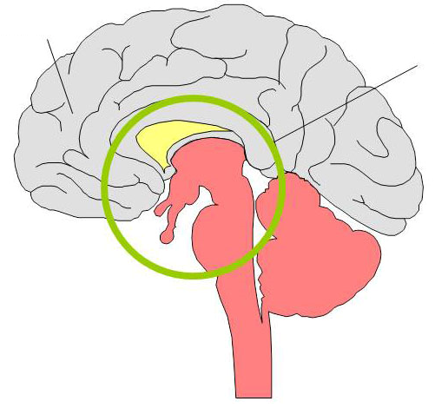
Mga Pagbabago sa Utak
Prefrontal Cortex
Limbic System
Ang mekanismo ng pagkalulong ay isang biyolohikal na kaganapan.
Notes:
Slide 1-2—Changes in the Brain
Addiction is a neurobehavioral disorder. To understand what this means, we must look at two important areas of the brain: the prefrontal cortex and the limbic system.
In a healthy brain, the prefrontal cortex, or outside portion of the brain, is responsible for rational thinking. It is the decisionmaker, the onboard computer of the human being.
Underneath the cortex is a much older, more primitive part of the brain’s anatomy, the limbic system.
To a greater or lesser degree this lower part of the brain is involved in all forms of addiction. It is where the pleasure and reward system is located and where most, if not all, survival mecha­nisms originate.
Pleasure is a powerful biological force for survival. If you do something pleasurable, the brain is wired in such a way that you tend to do it again.
Unlike the cortex, the limbic system is not under conscious, or voluntary, control. The powerful effects of drugs and alcohol on this and other parts of the brain can lead to addictive use, lessening normal, rational restraints on behavior.
Prolonged drug use changes the brain in fundamental and long-lasting ways. These changes are a major component of the addiction itself.
Accepting addiction as a complicated relationship between the brain and behavior is a step toward recovery.

Slide 3

Kasanayan (Conditioning – training or learning procedure ng utak)
Notes:
Slide 1-3—Conditioning
The part of the brain affected by mood-altering substances is the same part of the brain that makes us seek food when we are hungry and water when we are thirsty and is responsible for our sexual drive.
Hunger, thirst, sexual desire, and the need for nurturing are natural cravings. Satisfying these cravings promotes our survival as individuals and as a species. When a craving is not satisfied (e.g., when a person has not eaten for a long time), satisfying the craving overpowers all other concerns.
When long-term drug or alcohol use occurs, the brain can become rewired and adapt to these substances as if survival depends on them.
There is a demonstration that reflects the power of drugs on the brain and behavior:
If you release a caged mouse and it has the option to run into a well-lighted area or a dark area, it always will run into the dark.
Mice and other small rodents have been conditioned to seek out the dark automatically, because darkness protects them from predators. This ingrained survival mechanism evolved over millions of years in this species.
If the mouse is given doses of cocaine in the lighted area, the mouse will go into the lighted area each time it is released from its cage. This classic experiment demonstrates “conditioned place preference,” reversing the conditioning that took place over millions of years.

Slide 4
Tanong:
Magbigay ng halimbawa kung paano nako-kondisyon or natuturuan ang utak (conditioning).
Notes:
Slide 1-4—Question
Ask participants to give some examples of “conditioning”.

Slide 5
I.P. Pavlov (1849–1936)
Notes:
Slide 1-5—Pavlov
To understand the relationship of triggers to craving, it is important to understand a bit about a process called conditioning.
I.P. Pavlov, a Russian scientist, received the Nobel Prize for a series of experiments he conducted on the physical processes of digestion.
These experiments were continued by some of his students, and the conclusions from these experiments became known as the principles of classical conditioning.

Slide 6
Ang Aso ni Pavlov
Notes:
Slide 1-6—Pavlov’s Dog
Pavlov would feed the dogs and ring a bell at the same time.
The dogs saw and smelled the food that then stimulated, or triggered, a part of their brain, causing them to produce saliva and secrete stomach acid in anticipation of eating.
In a relatively short time, Pavlov and his colleagues rang the bell without the presence of food, and the dogs still produced saliva and stomach acid as if food were present.
The dogs connected the sound of the bell, the trigger, with anticipation of eating and responded (involuntarily) physically to the powerful trigger, or stimulus, of the bell.
Once a dog had been conditioned in this way, no matter how smart or well trained the dog was, it continued to produce fluids at the sound of the bell. It had no choice; the only way that Pavlov’s dogs could avoid drooling was by avoiding the bell.
The dogs had developed a conditioned response to the bell.
The human brain responds in much the same way to conditioned drug and alcohol triggers that produce cravings.
Drugs and alcohol produce changes in the brain, which result in feelings of pleasure. Events that people experience or surroundings that people are in when they use are like Pavlov’s bell; they cause people to experience cravings (like the dogs’ physical response to the bell, salivat­ing) even when they are not using. The brain may even trigger physical reactions that are simi­lar to those initially created by the drug itself.
For example, if participants were to think about sucking on a lemon, they probably would pucker their lips without even meaning to. This response is based on their experiences of tasting a lemon in the past.
This sort of response to drug triggers occurs regardless of whether a person intends to use. The dependent person can prevent his or her brain’s reaction only by avoiding triggers.
Triggers and cravings are hallmarks of addiction.

Slide 7
Mga Tanong:
Ano ang “pagkalulong”? Paano mo ito ilalarawan o ipapaliwanag?
Ang “pagkalulong” ba ay isang sakit?
Ano ang mga pag-uugali na kaakibat ng pagkalulong sa droga?
Notes:
Slide 1-7—Question
Ask participants the following questions:
What is “addiction”? How do you define it?
Is “addiction” a disease?
What are some of the behaviors characterized by drug addiction?

Slide 8
Kahulugan ng Pagkalulong
Isang pangunahin, pangmatagalan, neuro-biyolohikal na sakit na may genetic, sikososyal (psychosocial), at pangkapaligirang (environmental) na kadahilanan sa pagbuo at pagpapakita ng mga sintomas. Ito ay hindi lamang sintomas ng isa pang sakit/karamdaman o “disorder”, bagkus, ito mismo ay isang sakit o karamdaman
Ang pagkalulong ay maoobserbahan sa sumusunod na mga pag-uugali: - kawalan ng abilidad na kontrolin ang paggamit ng droga, hindi mapigilang paggamit, patuloy na paggamit sa kabila ng mga pinsalang dulot nito, at matinding pagnanais na gumamit o “cravings”/giyang.
    Graham, A.W.; Schultz, T.K.; Mayo-Smith, M.F.; Ries, R.K.; and Wilford, B.B. eds. Principles of Addiction Medicine, Third Edition. Chevy Chase, MD: American Society of Addiction Medicine, Inc., 2003.
Notes:
Slide 1-8—A Definition of Addiction
The slide shows a definition of addiction developed by the American Society of Addiction Medicine.
“Primary” means that addiction is not just a symptom of another disease or disorder; it is a disease in and of itself.
“Chronic” means that the disease continues over time and can be treated but not cured. Examples of other chronic diseases include diabetes and heart disease.
The definition states that genetic, psychosocial, and environmental factors may influence the development and manifestations (symptoms) of the disease.
“Genetic” means that some people are born with certain susceptibilities to becoming addicted to drugs or alcohol.
“Psychosocial and environmental factors” means that a person’s emotional, mental, and social life as well as his or her family, peers, living situation, employment or school situation, and other life circumstances can affect whether addiction develops and how it develops.
These psychosocial and environmental factors are important to consider when looking at a person’s triggers for drug or alcohol use.

Slide 9
Addictive Process/Proseso ng Pagkalulong
“Introductory”/Panimulang bahagi
“Maintenance”/Pagpapanatili na bahagi
“Disenchantment”/Pagkabagot na bahagi
“Disaster”/Pagkabigo na bahagi
Notes:
Slide 1-9—The Addictive Process
The rest of this session looks at the process of developing addiction over time, focusing on craving and the triggering of craving.
The process of addiction can be looked at in terms of four phases: the introductory phase, the maintenance phase, the disenchantment phase, and the disaster phase.
During each phase, people experience increasing levels of obsessive thinking, craving responses, use, and consequences resulting from their substance.
Although the slides are methamphetamine specific, the process of addiction is virtually the same for other addictive drugs and alcohol.

Slide 10
Tanong:
Ano ang mga positibo at negatibong dulot ng paggamit ng Shabu?
  Nang nagsisimula kang gumamit?
  Pagkaraan ng matagal at patuloy na paggamit?
  Bigyang diin o mag-focus sa mga pagkakaiba nung nagsisimula na gumamit at pagkatapos ng matagal at patuloy na paggamit.
Notes:
Slide 1-10—Question
Ask participants what are positives and negatives of Shabu use.
Highlight the differences between when they start using and after a long-term continuous use.

Slide 11
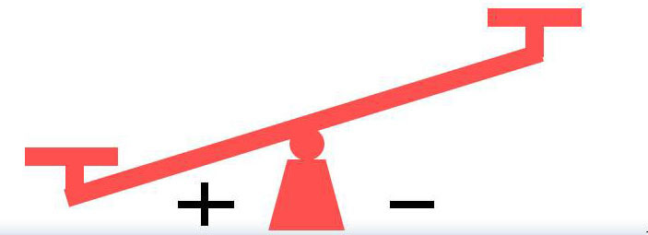
Proseso ng Pagkalulong – Panimulang Bahagi
Mga Positibo at Negatibong Epekto ng Paggamit ng Shabu
Mga Positibo
Kaginhawahan mula sa
  Pagkalumbay
  Pagkabalisa
  Kalungkutan
  Hindi pagkakatulog o insomnya
Labis na kaligayahan o kaluguran
Pagiging “high”
Labis na sigla
Pagtaas ng kompiyansa sa pakikipagtalik at pakikisalamuha
Pagtaas ng gilas sa trabaho
Pagtalas ng kakayahan sa pag-iisip
Mga Negatibo
Paglabag sa batas
Magastos
Maaring maging sanhi ng pagliban sa trabaho
Notes:
Slide 1-11—Positives and Negatives of Shabu Use (Introductory Phase)
Shabu (or another drug or alcohol) use is relatively infrequent during the introductory phase of the process of addiction.
Use may be limited to a few times a year, by chance, or on special occasions.
The positives of drug or alcohol use appear to outweigh the negatives.

Slide 12
Lakas ng Nakondisyon na Koneksyon: Banayad
Proseso ng Pagkalulong – Panimulang Bahagi
Proseso ng Pagkasanay (Conditioning) sa pagkalulong
Mga Tukso/Triggers
Mga tao, lugar
Mga kasiyahan
Mga espesyal na okasyon
Iba pang kaganapan
Mga Tugon
Kasiyahan sa pakiramdam dulot ng Shabu
Gumagamit ngunit hindi madalas
Notes:
Slide 1-12—Conditioning Process During Addiction (Introductory Phase)
Unknowingly, persons who use drugs or alcohol are conditioning their brains every time they use, but they experience only a mild association between people, places, or events and drug or alcohol use.

Slide 13

Pagbuo o pag-develop ng Masidhi at palagiang Pag-iisip na Gumamit
Proseso ng Pagkalulong – Panimulang Bahagi
Pagkain
Laro
Eskwelahan
Telebisyon
Kasintahan
Libangan
Trabaho
Shabu
Pamilya
Kasiyahan
Ehersisyo
Notes:
Slide 1-13—Development of Obsessive Thinking (Introductory Phase)
During this phase, drug or alcohol use is only one small component of a person’s overall thought process.

Slide 14

Pag-develop ng Pagtugon sa “Cravings” o Giyang
Proseso ng Pagkalulong – Panimulang Bahagi
Pagpasok/pagpunta sa isang lugar o pwesto
Mga Epekto ng Shabu
Paggamit ng Shabu
Pulso
Paghinga
Adrenalin
Sigla
“Tama” ng Shabu
Notes:
Slide 1-14—Development of Craving Response (Introductory Phase)
The craving response is the combined experiences of drug or alcohol triggers activating the limbic system and the continuing thoughts about using drugs or alcohol associated with these triggers.
During this introductory phase, the limbic system is activated directly by Shabu and physiological arousal increases.

Slide 15
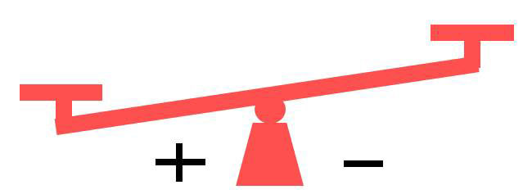
Proseso ng Pagkalulong – “Maintenance”/Pagpapanatili na Bahagi
Mga Positibo at Negatibong Epekto ng Paggamit ng Shabu
Mga Positibo
Lunas sa depresyon
Pagtaas ng kumpiyansa sa sarili
Kaginhawahan sa pagkabagot
Pampahusay sa sex
Nababawasan ang pagkamahiyain
Mga Negatibo
Pagkagambala sa trabaho/pag-aaral
Mga alalahanin sa relasyon
Problemang pinansiyal
Simula na umasa ang katawan sa epekto ng droga
Notes:
Slide 1-15—Positives and Negatives of Shabu Use (Maintenance Phase)
During the maintenance phase of the addictive process, the frequency of drug or alcohol use increases to perhaps monthly or weekly.
The scales begin to lean away from the positives.

Slide 16
Proseso ng Pagkalulong – “Maintenance”/Pagpapanatili na Bahagi
Proseso ng Pagkasanay (Conditioning) sa pagkalulong
Mga Triggers
Mga kasiyahan
Paglabas tuwing Biyernes ng gabi
Mga kaibigan
Alak
Katuwaan
Mga sekswal at mapusok na sitwasyon
Mga Tugon
Pag-iisip sa Shabu
Sabik na paghihintay sa paggamit ng shabu
Banayad na physiological arousal
Pagdaan ng pananabik sa napipintong paggamit
Panaka-nakang paggamit
Lakas ng Nakondisyon na Koneksyon: Katamtaman
Notes:
Slide 1-16—Conditioning Process During Addiction (Maintenance Phase)
Conditioning is progressing. The people, places, and things associated with drug and alcohol use have become triggers.
Exposure to these triggers causes thoughts about drug and alcohol use.
These thoughts produce moderate physiological reactions leading to a drive to find and use drugs and alcohol.

Slide 17
Pag-develop o Pagbuo ng Masidhing Pag-iisip na Gumamit
Proseso ng Pagkalulong – “Maintenance”/Pagpapanatili na Bahagi
Pagkain
Eskwelahan
Shabu
Telebisyon
Kasintahan
Libangan
Trabaho
Shabu
Pamilya
Kasiyahan
Ehersisyo
Notes:
Slide 1-17—Development of Obsessive Thinking (Maintenance Phase)
Thoughts of drug and alcohol use occur more frequently.

Slide 18
Proseso ng Pagkalulong – “Maintenance”/Pagpapanatili na Bahagi
Pag-develop o Pagbuo ng “Cravings”/Giyang o Pagnanais gumamit
Pagpasok o pagpunta sa isang lugar o pwesto
Pagtugon ng Katawan
Paggamit ng Shabu
Epekto ng Shabu
Pulso
Paghinga
Epekto ng Adrenaline
Sigla/Lakas
“Tama” ng Shabu
Pulso
Presyon ng dugo
Sigla/ Lakas
Notes:
Slide 1-18—Development of Craving Response (Maintenance Phase)
A mild physiological arousal occurs in situations closely associated with drug and alcohol use.
As the person encounters drug and alcohol triggers, the limbic system is activated, and drug and alcohol cravings occur.
When drugs and alcohol finally are ingested, a concurrent physiological state occurs.

Slide 19
Ang Proseso ng Pagkalulong
“Introductory”/Panimulang bahagi
“Maintenance”/Pagpapanatili na Bahagi
“Disenchantment”/Pagkabagot na Bahagi
“Disaster”/Kasawian or Kabiguan na Bahagi
Tatalakayin sa susunod na sesyon
Notes:
Slide 1-19—Addictive Process (Review)
Today, we have learned about the introductory phase and maintenance phase of the addictive process.
The next session looks at the disenchantment phase and disaster phase in the additive process.

