Slide 1
Overview & progress of Ethio-SHEP Project
Presented to 4th , Joint Coordination Committee (JCC) meeting
20th , May 2021, Capital hotel@Addis Abeba

Slide 2
Description of the project
Ethio-SHEP is a five-year Technical Cooperation project which promotes Market-Oriented Agriculture for small holder farmers. The project targets Amhara and Oromia Regions and is jointly implemented by Ethio-SHEP project team, MoA, OBoANR and ABoA.
Title | The Project for Smallholder Horticulture Farmer Empowerment through Promotion of Market-Oriented Agriculture（Ethio-SHEP）
Duration | Jan 2017～Jan 2023（6 years）
Counterpart Organization | - Federal MoA (Horticulture Development & Technology Transfer Directorate) - Amhara Bureau of Agriculture (ABoA) - Oromia Bureau of Agriculture and Natural Resources (OBoANR)
Target Area | Amhara and Oromia Regions - Four zones (Two from each region) - 14 woredas (seven from each region)

Slide 3
1. Objective of Ethio-SHEP intervention
Capacity building of the target farmers through series of practical activities.
Increase the income of the target farmers from the Horticulture production.
Contribute to strengthen the existing extension to be more effective Market-Oriented & Demand-driven extension service using SHEP approach.
Farmers to change their mind set from “Grow and sell”(Subsistence farming) to “Grow to sell” (“Producing for market” “Realizing “Farming as business”)
Notes:
Market-oriented agriculture vs Production-oriented agriculture
Grow and sell: producing first and marketing second,,
Grow to sell: making efforts to produce marketable and better quality for market
Start with market and end with market

Slide 4
3. Essential SHEP 4 steps
Essential 4 steps | SHEP Activities
1. To share the goal with farmers | /Selection of Target Beneficiaries(farmer groups) /Sensitization WS
2.Farmer’s awareness is raised. | /Participatory Baseline Survey /Market Survey /Market linkage Forum(Input & Output)
3.Farmers make decisions | /Crop selection, /Crop calendar making etc
4.Farmers acquire skill | /Demand Driven In-Field Training for Farmers(Basic Cultivation skill, Post harvest handling etc)
Follow up and monitoring (Including Participatory End-line survey)
Farmer’s Relatedness
Farmer’s Autonomy
Farmer’s Competence
Notes:
Ethio-SHEP approach carefully laid out the activities to increase farmers’ motivation throught a series of capacity development training.

Slide 5
Picture based Horticulture extension materials (Kamishibai) in two local languages

Slide 6
Peoples reached by the project
Through participating in various SHEP activities, such as, field days and exchange visits, periodic monitoring, sensitization workshops, technical trainings for farmers and experts, market linkage forums and market survey, baseline and end line surveys …etc., the project reached 35,775 people during the 4 cycles of intervention as detailed below:
22,661 farmers (M= 17,528, F= 5133) of which 1171 direct beneficiaries
12,518 counterparts (government staff)
596 participants from private sector, unions, universities

Slide 7
….people reached by the project
Stakeholders | 1st cycle |  | 2nd cycle |  | 3rd cycle |  | 4th cycle |  | Total
Farmers | M | F | M | F | M | F | M | F | M | F
 | 2708 | 781 | 5559 | 1732 | 9026 | 2530 | 235 | 90 | 17528 | 5133
CPs | 1636 |  | 3567 |  | 7203 |  | 112 |  | 12518
Private sector, Unions, Universities | 81 |  | 190 |  | 325 |  | 0 |  | 596
Total |  |  |  |  |  |  |  |  | 35,775

Slide 8
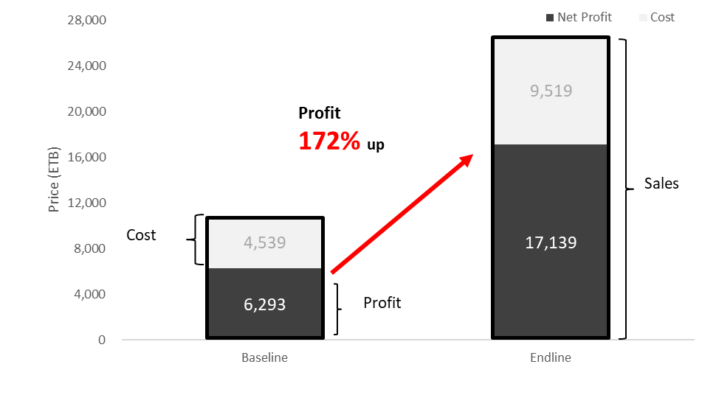
Results of the 1st and 2nd year groups
Notes:
Both in Amhar and Oromia, in total net profit was increased 172% from 6293 to 17139 ETB. Farmers doubled their input cost from 4000 to 9000ETB to buy improved seed, fertilizer and pesticides.

Slide 9
Notes:
Assessment on technology adoption; Host farmers were asked 21 questions on General Horticultural Crops Production & Post-Harvest Handling Technique

Slide 10
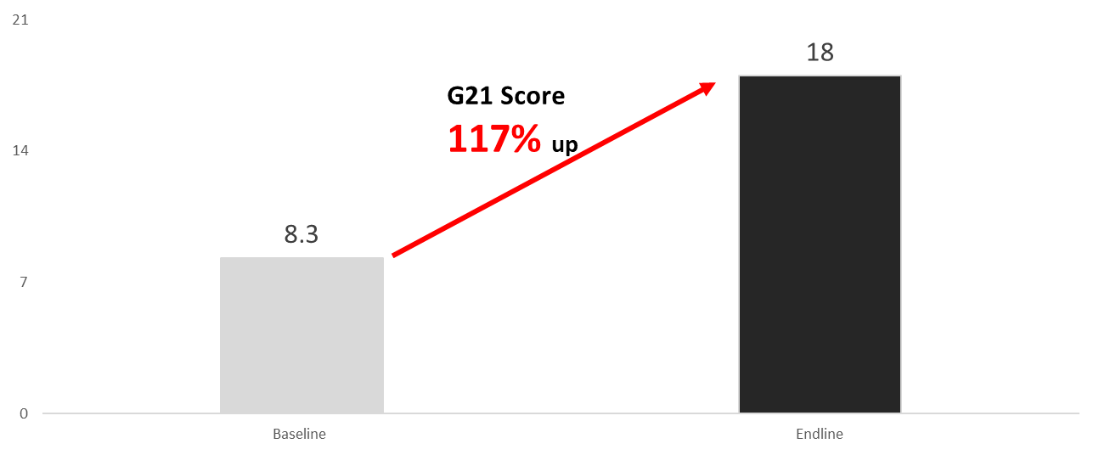
G21 Score for 1st and 2nd year target group
Notes:
G21 score increased more than two times from 8.3 to 18.0 points, which is 117 % increase after the project 2 year’s intervention (Figure 2).
This G21 score increase is due to providing demand-driven extension services by the project together with our counterparts
Ethio-SHEP project also encourage farmer to farmer learning through exchange visit to high production area as well as field day program. In this program, we observe constructive discussion made by farmers asking, clarifying their farming techniques.

Slide 11
Voice from Farmers
“Last year I was lucky to be nominated by the group as one of the participants for the exchange visit to Ziway Meki area organized by the project and I observed the same Ethiopian farmers are doing different cultivation techniques and getting the huge profits from Horticulture production , I was really motivated so after I came back home, I shared what I observed in Meki with my husband and this year we worked together and applied in our farmland with our locally available materials like staking and proper spacing management etc .
Ofcourse woreda & kebele experts also supported us technically, and some of the other member farmers also started to apply several practices from Meki area, I hope we can get good result for this year.”
(Farmer fromGibe ketchema kebele at seka chokorsa woreda,Jimma zone )

Slide 12
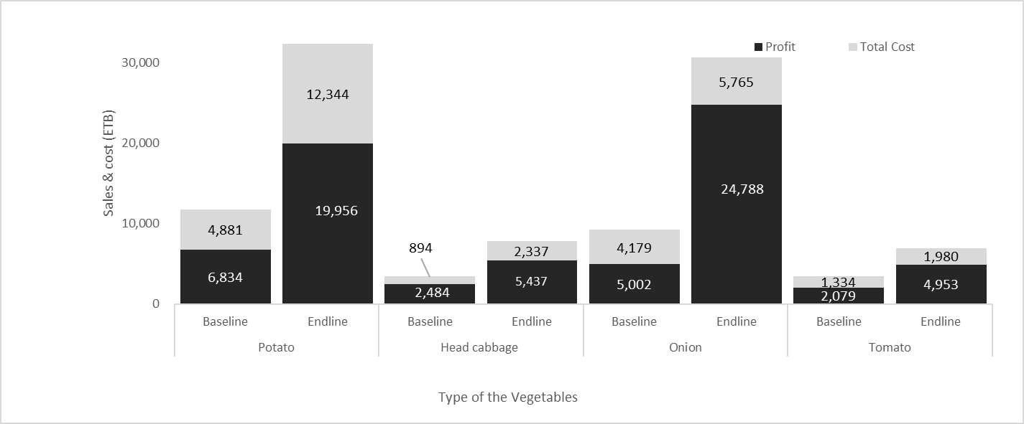
Profit and cost for potato, head cabbage, onion and tomatoes
Notes:
Onion shows the highest profit margin with 81%, increased from 5,002 to 24,788 ETB after the project intervention.
The income from onions are 5 times higher than the baseline survey. This can be explained by increasing productivities from 8,690 to 12,839 kg/ha. In addition to that, sales unit price (ETB/kg) for onion nearly tripled from 5.2 to 14.1 ETB (Figure 5). One of the reasons for this significant increase might be the farmers shifted their production schedule earlier than neighboring farmers to target peak price (Figure 4). Moreover, in order to increase farmers' production techniques, the project conducted continuous field follow-up and field day program to enhance farmer to farmer learning. Impact of the field day program was explained by the farmers who participated in this program.

Slide 13
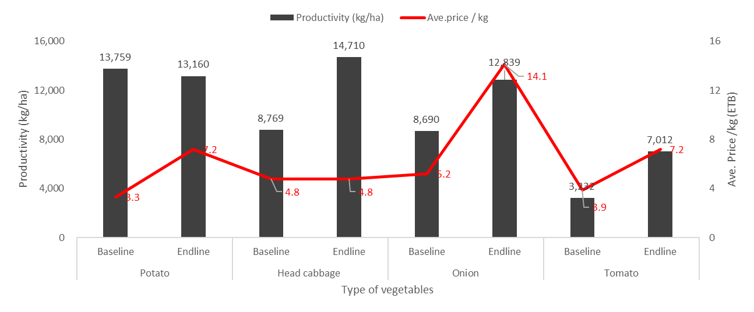
Productivity and average price, ETB/kg
Notes:
This can be explained by increasing productivities from 8,690 to 12,839 kg/ha.
In addition to that, sales unit price (ETB/kg) for onion nearly tripled from 5.2 to 14.1 ETB (Figure 5). One of the reasons for this significant increase might be the farmers shifted their production schedule earlier than neighboring farmers to target peak price (Figure 4).
Moreover, in order to increase farmers' production techniques, the project conducted continuous field follow-up and field day program to enhance farmer to farmer learning. Impact of the field day program was explained by the farmers who participated in this program.

Slide 14
Follow Up Support by MoA officials and experts

Slide 15
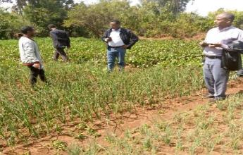
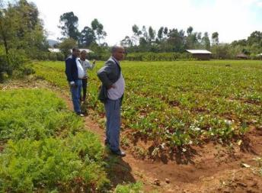
Higher official visit of project sites
His excellency ,Mr Wondale and Mr Abdella, conducted field visit in Zufari kebele in Banja woreda,24th January 2021 and discussed with host farmers, As and woreda experts.
Notes:
Officials from the MoA, discussed with regional and woreda and kebele representatives and gave directions. The high official visit of project site initiated CPs at regional, zonal and woreda level feel more ownership and give more attention.

Slide 16
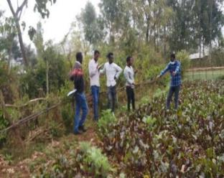
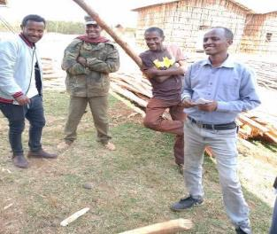
HDTT team visiting field activities in Zufari kebele in Banja woreda
The team discussed with woreda officials and farmers and learnt that:
Training was given for farmer groups
Market survey organized at zufari kebele market
Experience sharing was conducted between farmers’ groups
Scaling up of Ethio-SHEP best practices were demonstrated (on carrot and beetroot) to neighboring farmers established as one group of eight members

Slide 17
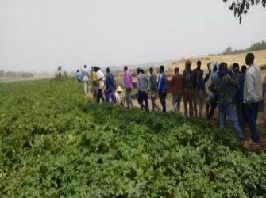
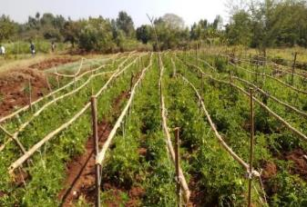
HDTT team visited Jabi,Dembecha and S/Achefer woreda
Visited field activities of various vegetable crops and demos
Discussed with Farmers, kebele and woreda focal persons
Participated in field day in S/Achefer woreda
HDTT team compiled field assessment report and final report and shared to JICA and SHEP project

Slide 18
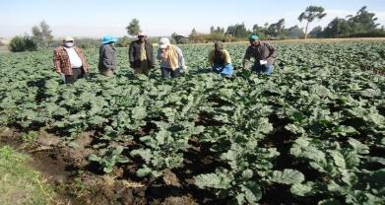
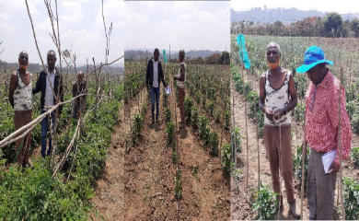
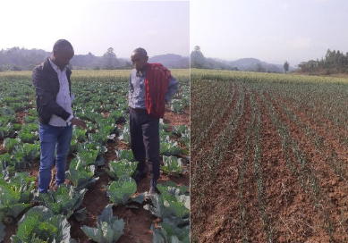
Follow up support
HDTT team conducted field visit and discussed with woreda officials, focal persons and kebele DAs and gave technical back up in 7 woredas of Arsi and Jimma zones

Slide 19
Major Achievements
According to the result of Baseline and End line survey conducted by external consultants ,2021 shows:
Achievements | Factors contribute
Farmers' mindset is changed towards “farming as business” | Due to the Ethio-SHEP step-by-step approach (ex. Market survey, crop selection, crop calendar making)
Farmers start communicating with trader before harvesting. | During market survey, famers built the relationship with traders.
Farmers’ relationship with wholesalers improved. | Farmers start communicating with trader several times rather than once during harvesting.
Farmers income from horticulture significantly increased | Due to adjusting crop calendar to target high price season.
Employment creation observed | Vegetable production is labour intensive, so farmers start hiring local labour (particulary for onion, garlic production)

Slide 20
Challenges
Challenges | How to overcome
Frequency of monitoring and field support for target groups were reduced due to COVID-19 | Project provided PPE to all target woredas, so that will enhance their follow-up activities.
Access to reliable input/seeds suppliers critical and bottle neck | Facilitate linkage with not only private sectors but also cooperative/unions (ex. Zangana union) to get improved varieties
Less documentation and report flow from kebele to upper levels | Planning to strengthen their reporting system with Monitoring & Evaluation directorate.
Need to be identified more best practices and scale up activities done by our counterparts. | Following up Ethio-SHEP best practice with Extension directorate.

