Slide 1
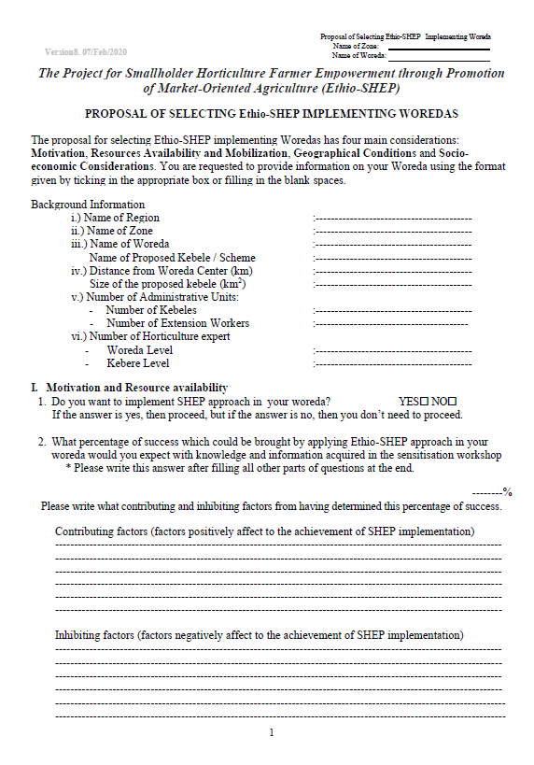
70 %

Slide 2
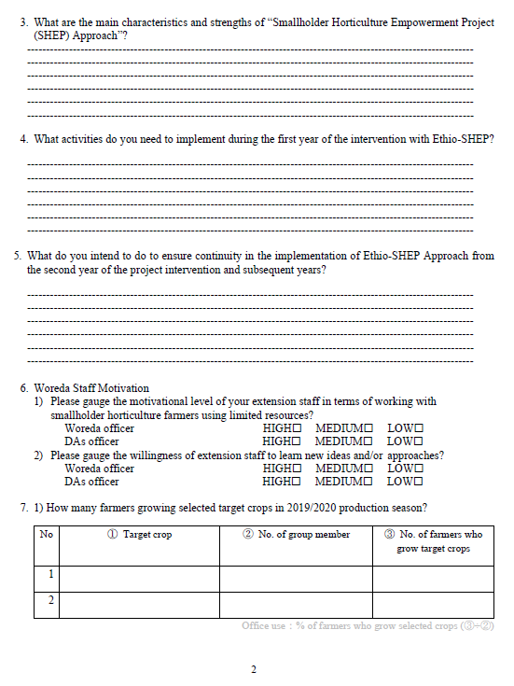
Asking general understanding of SHEP apprach
Motivation of Woreda and DAs
Potato
28
15
Pepper
28
11
Carrots
32
8

Slide 3
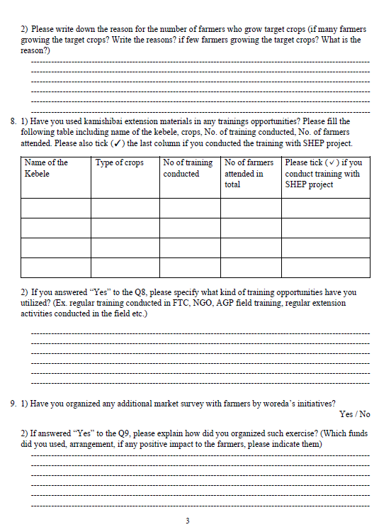
Write down the reason why many/few faremers growing the target crops
Have you used Kamishibai?
Aguta
Potato
1
32
✔
Wenjele
Tomato
2
50

Slide 4
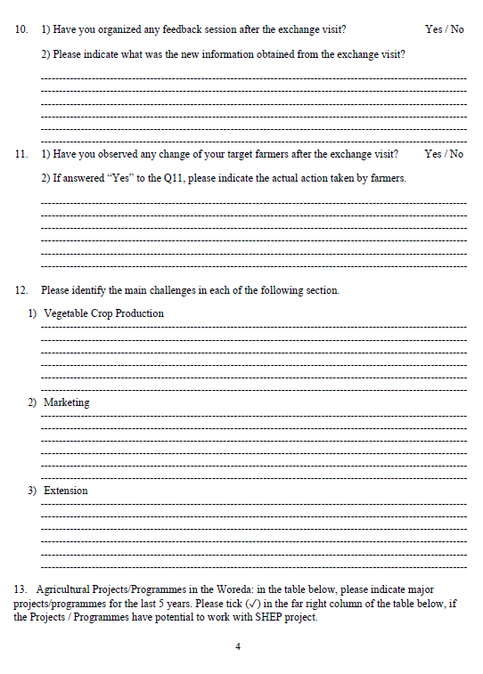
Farmers start practicing staking for tomatoes

Slide 5
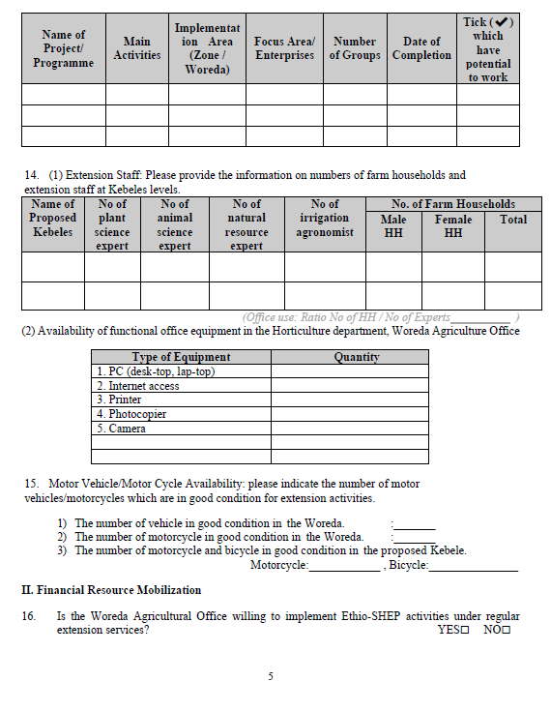
AGP
Canal construction
Jabi
Cereal
17
Mar.2022
✔
Killty
1
0
1
1
80
20
20
1
1
1
0
1
1
2
0
0
✔

Slide 6
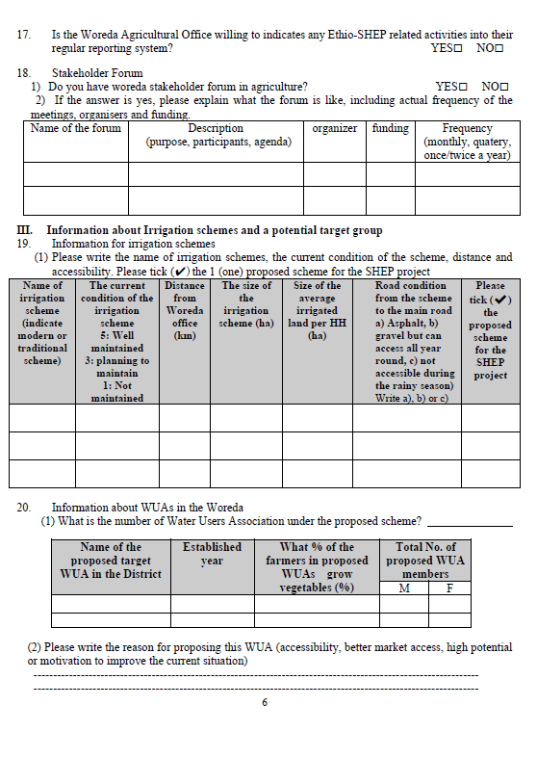
✔
✔
AEBLC
Progress report
Woreda
AGP
Twice a year
Wako
3
13
17
0.25
b
✔
7
Wako
2005
70
26
13

Slide 7
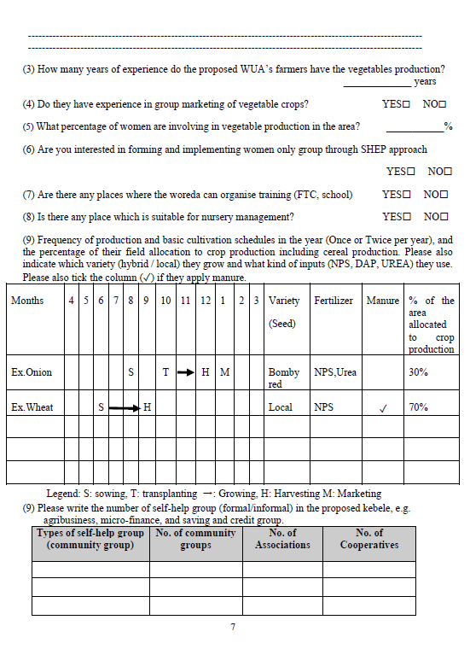
3
✔
30
✔
✔
✔
Onion
S
T
H
M
Adama
NPSB,
UREA
✔
25％
Cabbage
S
T
H/M
Copenhagen
NPS
25％
Potato
S
H/M
Belete
NPS
50％

Slide 8
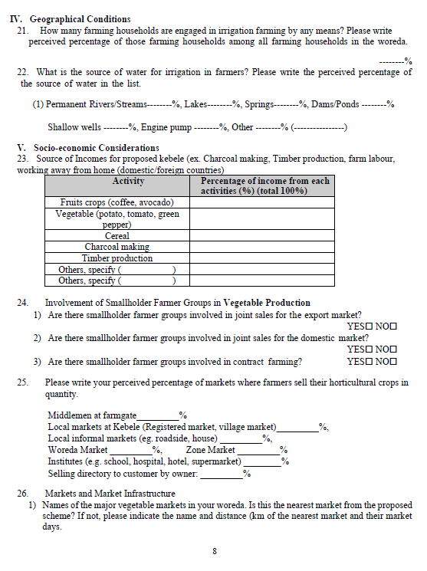
30
Socio-economic factor and
their potential
50
20
30
5
60
30
0
0
Daily labour
5
✔
✔
✔
50
30
10
5
5

Slide 9
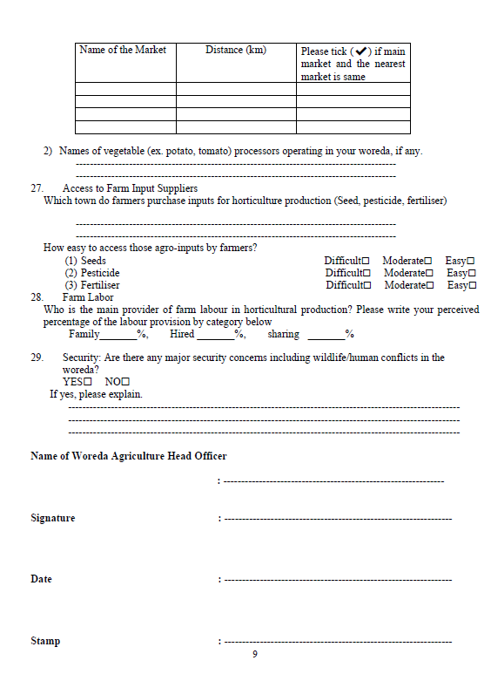
Injibara
20
✔
Siba
3
✔
✔
✔
80
10
10
✔
Don’t forget to write your signature!!

