Slide 1


General Introduction of
Ethio-SHEP Project
Presented to Participants of Ethio-SHEP ToT
The project for Smallholder Horticulture Farmer Empowerment Through Promotion of Market Oriented Agriculture (Ethio-SHEP)

Slide 2
1. Basic Information of Ethio-SHEP
Project Title: The Project for Smallholder Horticulture Farmer Empowerment through Promotion of Market-Oriented Agriculture(Ethio-SHEP)
Duration: Jan2017~Jan 2023 (6 Years)
Main Counterpart Organization:
  Federal MoA (HDTTD)
  Amhara Bureau of Agriculture (ABoA)
  Oromia Bureau of Agriculture and Natural Resource(OBoANR)

Slide 3
2. Project outline
Project overall goal: The SHEP approach for Market-Oriented agriculture is promoted by the Ethiopian Government.
Project purpose : The SHEP approach which leads to increasing farmers income from horticulture is proposed for future scaling-up through effective implementation.

Slide 4
3. Objective of Ethio-SHEP intervention
Promotion of Market-Oriented Agriculture for small holder farmers in Ethiopia by using the SHEP approach.
Capacitate the target farmers through series of SHEP activities.
Farmers to change their mind set from “Grow and sell” to “Grow to sell”
(Realizing “Farming as business”)
Eventually increase the income of the target farmers from the Horticulture production !

Slide 5
4. Expected outcome of Project Activities
Output 1:Capacity on extension service delivery based on the SHEP approach is developed.(Capacity building)
Output 2: Effective extension services based on the SHEP approach are delivered to the target farmers.(Effective extension service delivery)
Output 3: The SHEP extension packages which consist of the standard package for core SHEP target groups and the simple packages for various training opportunities are developed and proposed. (Development of various extension packages for scale-up)

Slide 6
5. Expected target group of Ethio-SHEP intervention
Commercial farming
SHEP Target groups
Small holder horticulture farmers who are starting to Shift from Subsistence farming to farming as business
Subsistence farming

Slide 7
6. What is SHEP?
Stands for “Smallholder Horticulture Empowerment and Promotion(SHEP)” Approach
Developed in Kenya through technical cooperation project in 2006
Focuses on “Market-Oriented Agriculture” Changing farmers’ mind from “Grow and Sell” to “Grow to Sell”

Slide 8

7. SHEP Concept
Promoting “Farming as a Business”
Developing and motivating people by effective activity designs and “Tips”
Sharing information among market actors & farmers for improving efficiency of local economies(Mitigating the asymmetry of information)
Raising internal motivation for continuous activities implementation
(Self-Determination Theory)
~Three psychological needs to motivate people~
Market Info
（(Variety,price,season, required quality etc)
SHEP
Family Budgeting
Market Survey by Farmers
Autonomy
People need to feel in control of their own behaviors and goals
Sharing market Information
Competence
People need to gain mastery of tasks and learn different skills
Stakeholders forum
Decision making by farmers
Producer Info
（Farm location, Production potential ,etc)
Relatedness
People need to experience a sense of belonging and attachment to other people
Market Actors
・Retailers ,Middleman
・Agriculture inputs companies(Seed Fertilizer etc)
・Agriculture product processers
Producer
Filling Information Gaps
X
Considering Motivation of the actors

Slide 9
8. Essential SHEP 4 steps
Essential 4 steps | SHEP Activities
1. To share the goal with farmers | /Selection of Target Beneficiaries(farmer groups) /Sensitization WS
2.Farmer’s awareness is raised. | /Participatory Baseline Survey /Market Survey /Market linkage Forum(Input & Output)
3.Farmers make decisions | /Crop selection, /Crop calendar making etc
4.Farmers acquire skill | /Demand Driven In-Field Training for Farmers (Basic Cultivation skill, Post harvest handling etc)
Farmer’s Relatedness
Farmer’s Autonomy
Farmer’s Competence

Slide 10
9. What SHEP can do with farmers
(Type of support)
SHEP mainly focuses on capacity building for experts and farmers on production and marketing on horticulture through:
Baseline survey (to review current farm management)
Market survey (to know market info directly from stakeholders)
Support Crop selection process based on market information, etc.
Linking farmers with market actors (agro-dealers, wholesalers and traders)
Providing technical support on basic production skills
Promotion of Record keeping

Slide 11
10. What SHEP does not do with farmers
Does not construct /maintain irrigation scheme.
Does not provide inputs (seeds, fertilizer from project).
Does not provide farm tools.
Does not provide cash support.
Does not provide per diem when trainings at kebele.
No interference on current water distribution/ Management/ issues.

Slide 12
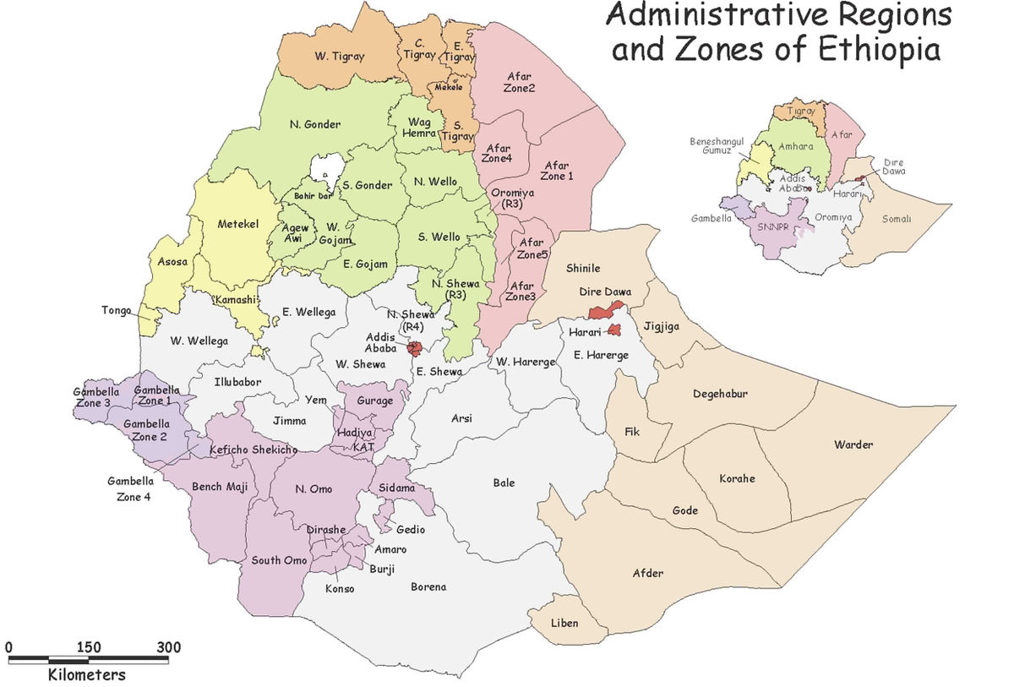



11.Target Areas
Amhara region
-West Gojam zone
South Achefer woreda
Jabi Tehanin woreda
Dembacha woreda
-Awi zone
Ankasha woreda
Guagusa woreda
Ayu Guagusa woreda
Banja woreda
Oromia region
-Arsi zone
Degelu Tijo
Tiyo
Lude Hetosa
-Jimma zone
Kersa woreda
Seka Chokorsa
Dedo woreda
Mana woreda

Slide 13
12.Target Group in Amhara
Zone | Woreda | Kebele | Year of Target | 2017 | 2018 | 2019 | 2020
West Gojam | Jabi Tehinan | Weynema | 2017 | 1 | 2 | CP
 |  | Arbite | 2018 |  | 1 | 2 | CP
 |  | Jiga | 2019 |  |  | 1 | 2
 | South Achefer | Ashare | 2017 | 1 | 2 | CP
 |  | Kilti | 2018 |  | 1 | 2 | CP
 |  | Guta Adbi | 2020 |  |  |  | 1
 | Dembecha | Yechereka | 2019 |  |  | 1 | 2
 |  | Sazuri Dimela | 2020 |  |  |  | 1
Awi | Ankesha | Den Zuria | 2017 | 1 | 2 | CP
 |  | Souste Tirba | 2018 |  | 1 | 2 | CP
 |  | Bekafita | 2020 |  |  |  | 1
 | Guagusa Shukudad | Aguta | 2017 | 1 | 2 | CP
 |  | Wonjela | 2018 |  | 1 | 2 | CP
 |  | Shinkurta | 2020 |  |  |  | 1
 | Ayu Guagusa | Chibachibasa | 2019 |  |  | 1 | 2
 | Banja | Zufari | 2019 |  |  | 1 | 2

Slide 14
12.Target Group in Oromia
Zone | Woreda | Kebele | Year of Target | 2017 | 2018 | 2019 | 2020
Arsi | Degalu Tijo | Chare(Pilot) | 2015~ | 1 | 2 | CP
 |  | Kogo | 2017 | 1 | 2 | CP
 |  | Gedo | 2018 |  | 1 | 2
 |  | Mankula | 2020 |  |  |  | 4
 | Tiyo | Katar 3 | 2017 | 1 | 2 | CP
 |  | Bosha 2 | 2018 |  | 1 | 2
 |  | Abosera Alko | 2019 |  |  | 1
 |  | Chafe Misoma | 2020 |  |  |  | 4
 | Lude Hetosa | Shaya | 2019 |  |  | 1
Jimma | Kersa | Birbirsa | 2017 | 1 | 2 | CP
 |  | Gibe | 2018 |  | 1 | 2
 |  | Kitimbile | 2020 |  |  |  | 4
 | Seka Chokorsa | Deti Duke | 2017 | 1 | 2 | CP
 |  | Gibe Ketchema | 2018 |  | 1 | 2
 | Dedo | Waro kolobo | 2019 |  |  | 1
 |  | Ofolle | 2020 |  |  |  | 4
 | Mana | Somodo | 2019 |  |  | 1

Slide 15
Major SHEP Activities

Slide 16
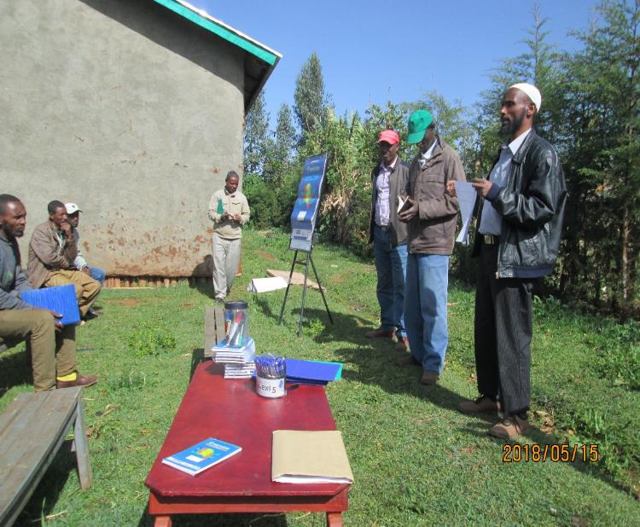
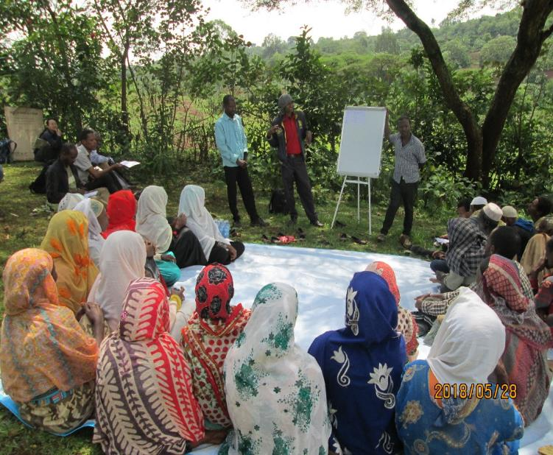
1. Sensitization Workshops
Objective: To create awareness on SHEP approach activities, implementation modality, select target farmers

Slide 17
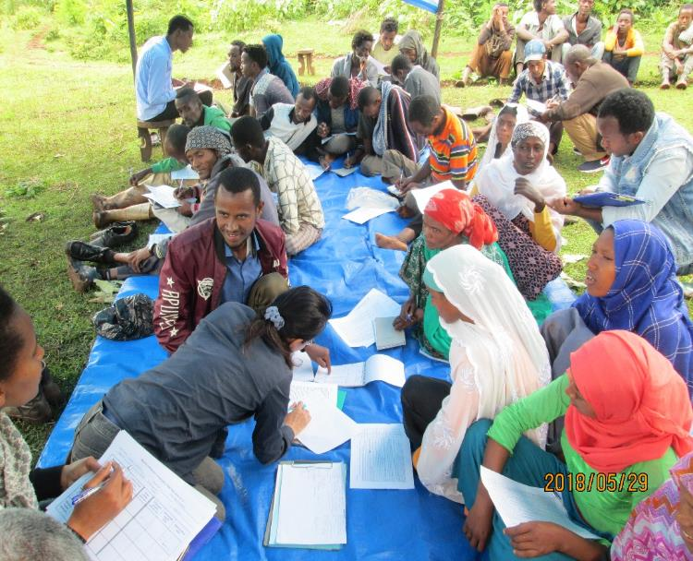
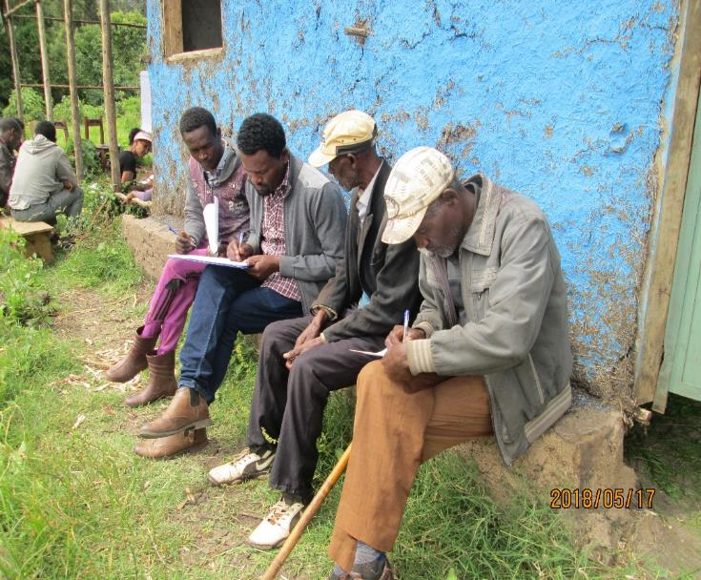
2. Baseline Survey
Objective: To collect data on farmers experience on horticulture production and marketing. Farmers (with support by experts) fill the questionnaire by themselves.

Slide 18
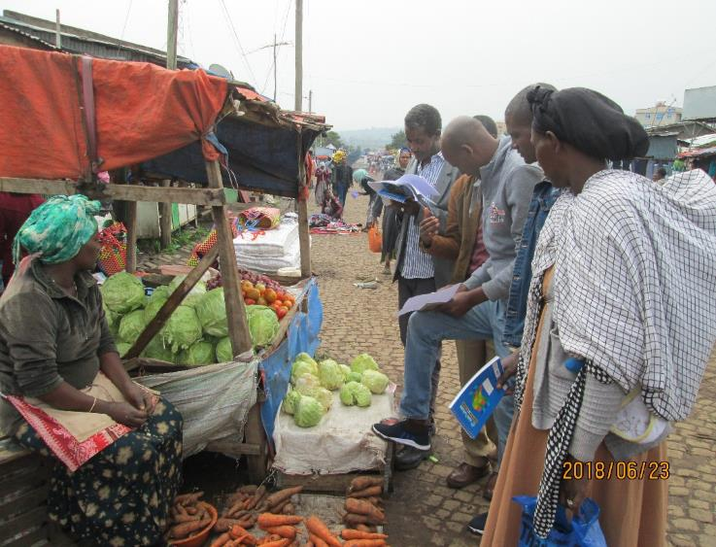
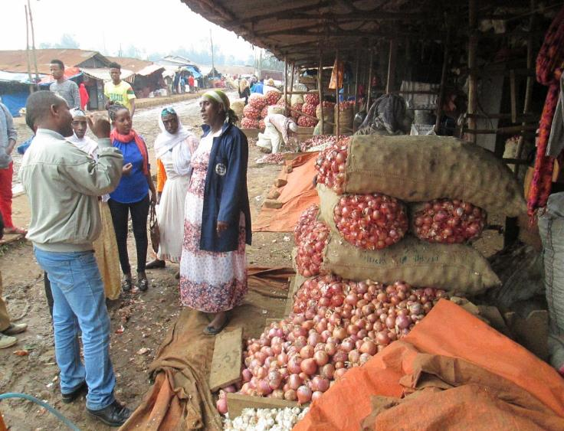
3. Market surveys
Objective: To study market situation around target areas before crop selection.
To give chance for farmers to :Identify buyers and competitors, Crop type, Price fluctuation, Peak Demand time, Sources of production, Quality requirement etc

Slide 19
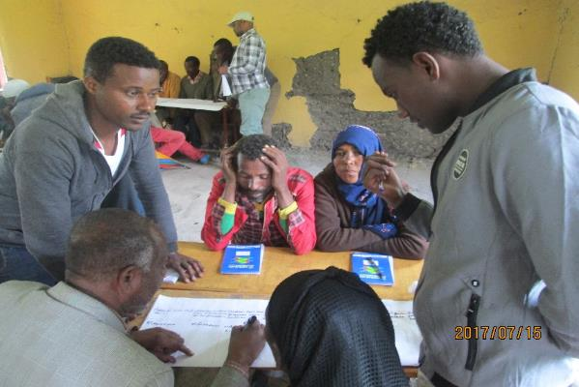
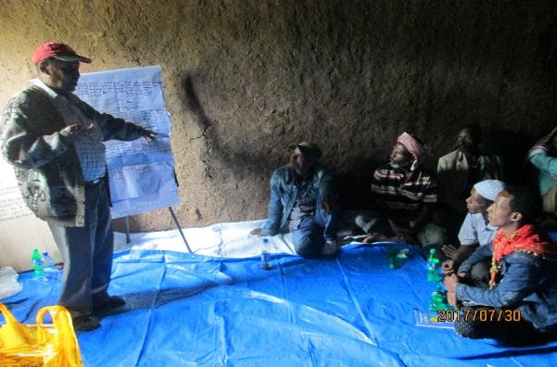
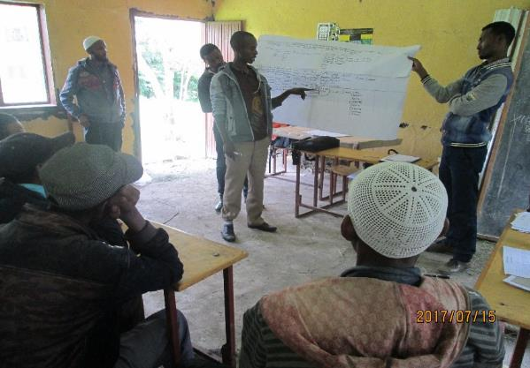
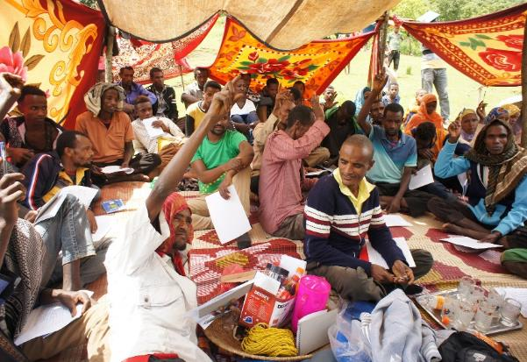
4. Crop Selection
Objective: Select two(2) priority crops based on market survey results & previous experience, agro ecology etc
Discussion
Voting

Slide 20
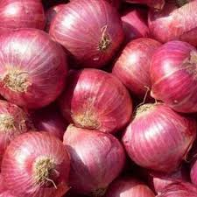
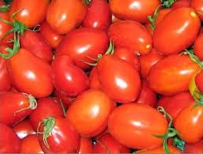

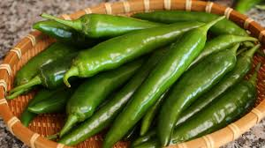
(4-1). Crops Selected

Slide 21
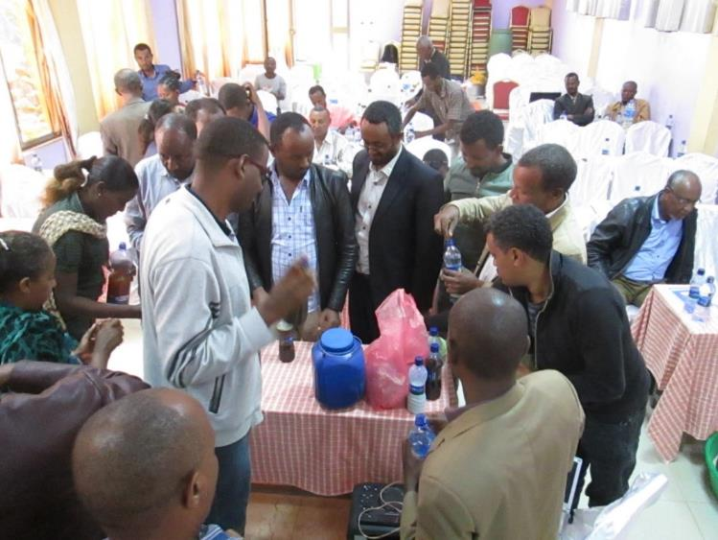
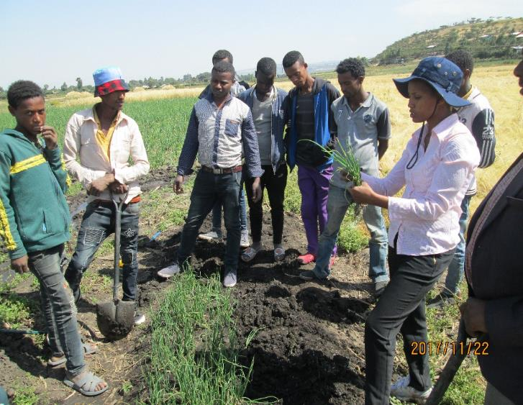
  5.1. Technical Training for Target farmers and experts
Objective: Provide basic techniques on production of selected crops
Ex) ToT technical training for experts
In-field technical training for farmers
Demonstration (Optional)

Slide 22
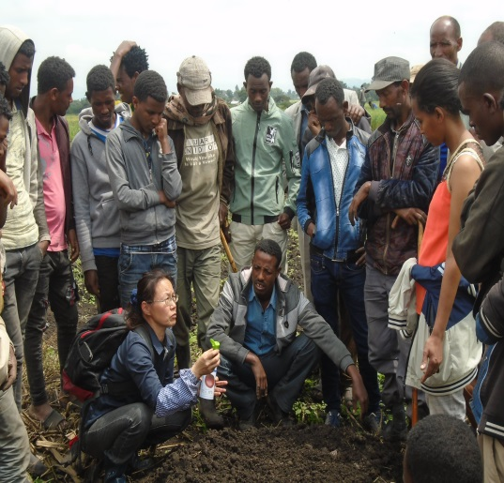
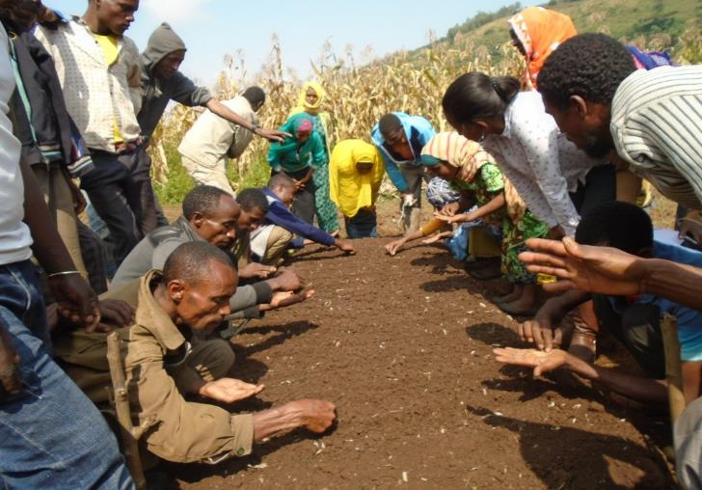
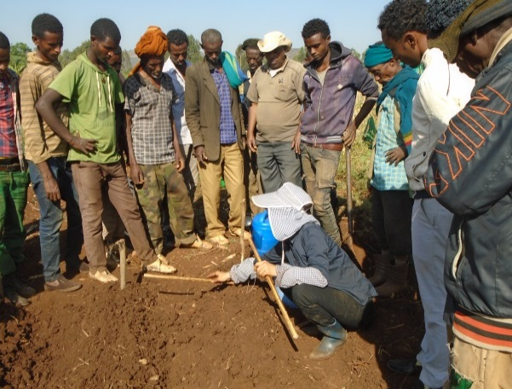
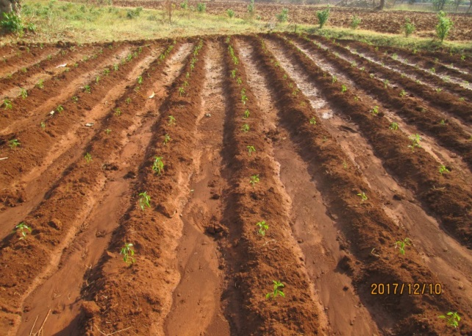
5-2 Basic production techniques,

Slide 23
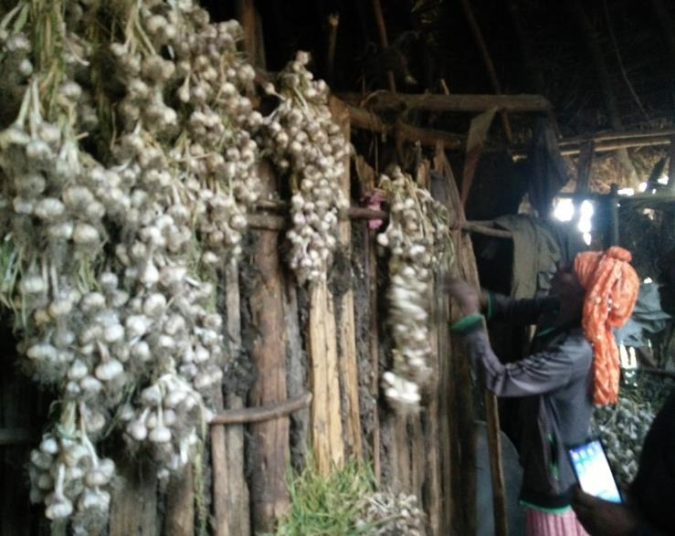
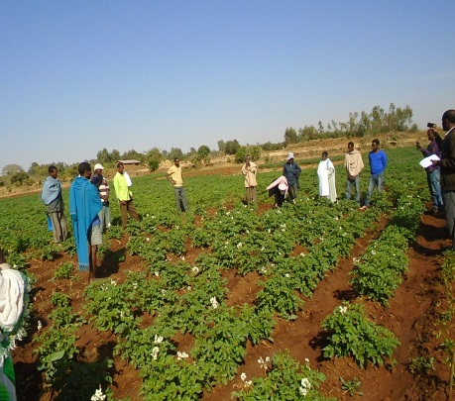
5-3. Post-harvest ,,
Objective: provide basic techniques on post harvest management on the crops selected by target groups
Participants: target farmers and experts from region, Zone, woreda and kebele agriculture offices attended the training

Slide 24
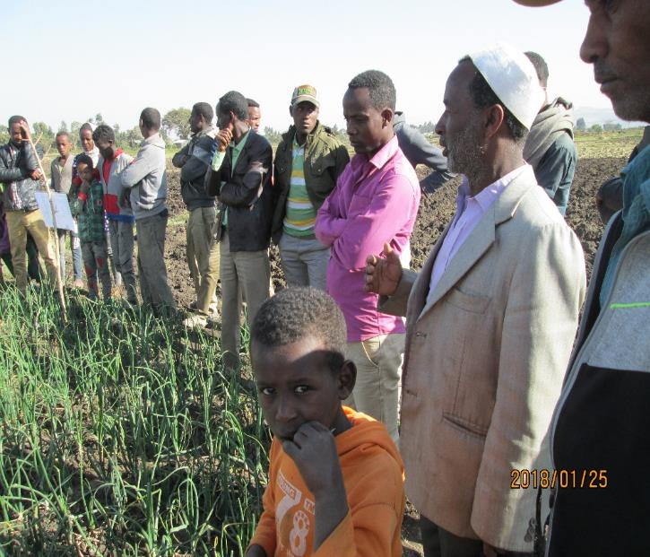
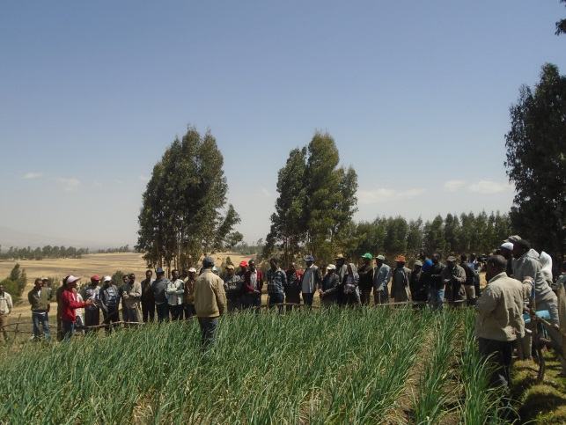
5-4. Field Day program
Objective: To review the performance of demonstration activities, share the experience with neighboring farmers
Notes:
Different size of font in a table is disturbing information catch up. Photo size also should be same in case of parallel formation, like this

Slide 25
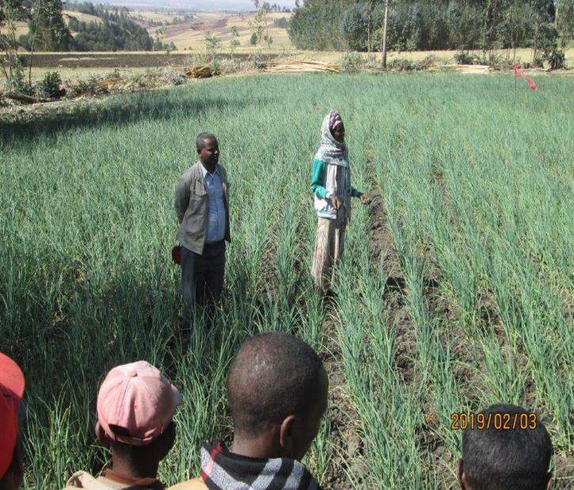
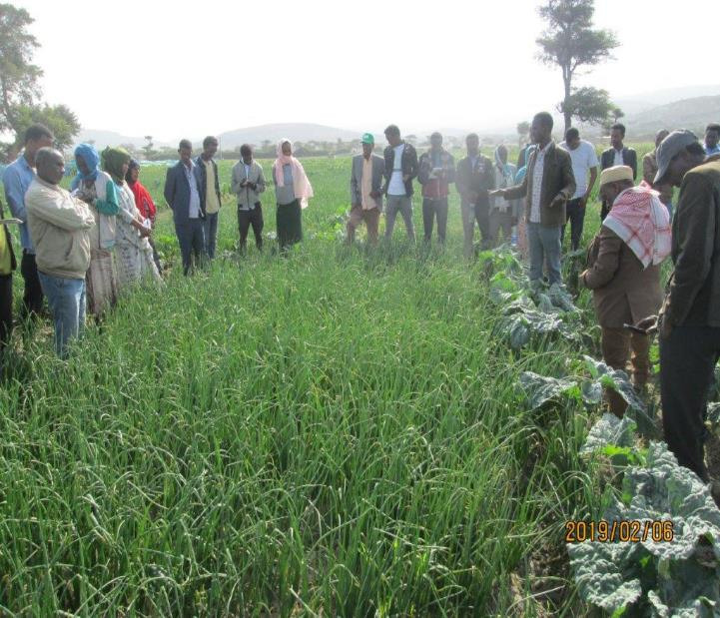
5-5. Exchange visit program
Objective: To visit and learn from the Horticulture advanced area and share with the group members for the next action,,,
Notes:
Different size of font in a table is disturbing information catch up. Photo size also should be same in case of parallel formation, like this

Slide 26
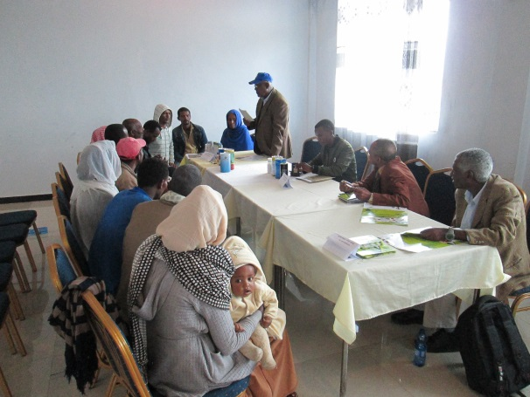
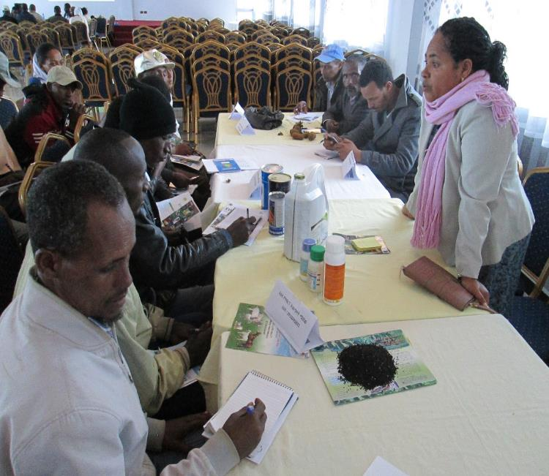
  6. Market Linkage Forum (Input)
Objective: To facilitate input access for target farmers before sowing/planting
Participants: Representative farmers, Private input suppliers, government offices, unions, Coops, MFIs, SACs

Slide 27
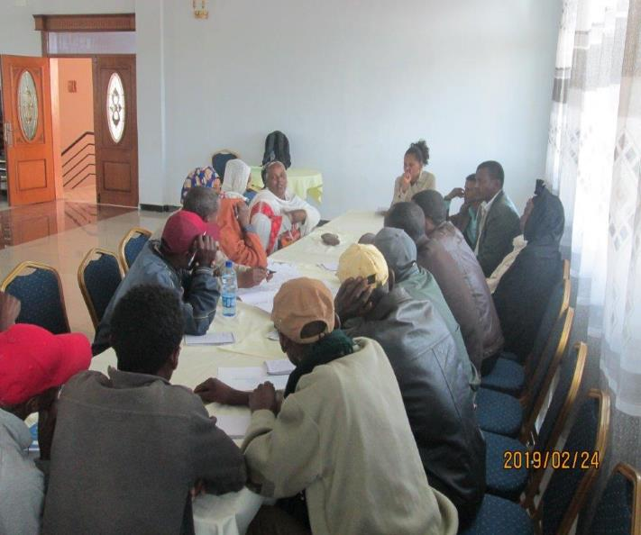
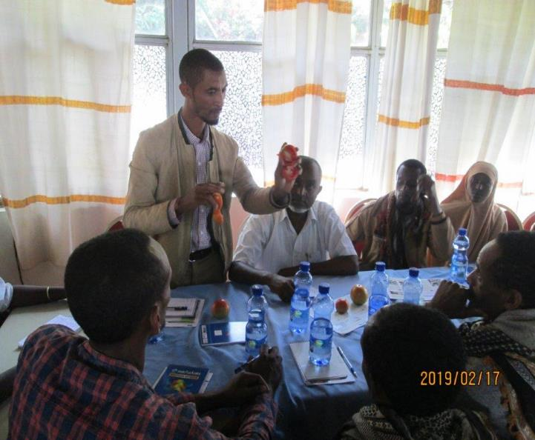
7. Market Linkage Forum(Output)
Objective :To create linkage for target farmers with traders and other buyers.
Participants: Representative farmers, government offices
( Agriculture, Trade, Cooperative, Administration offices), Cooperatives, Unions, Retailer,Traders, Agro-processing company etc,,

Slide 28
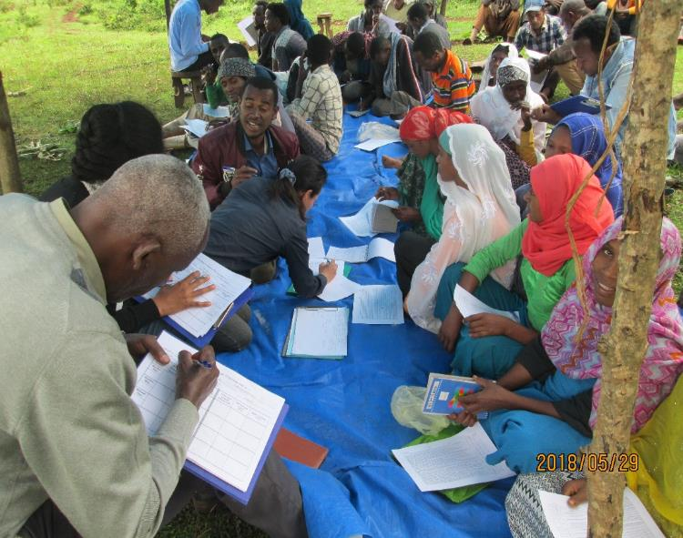
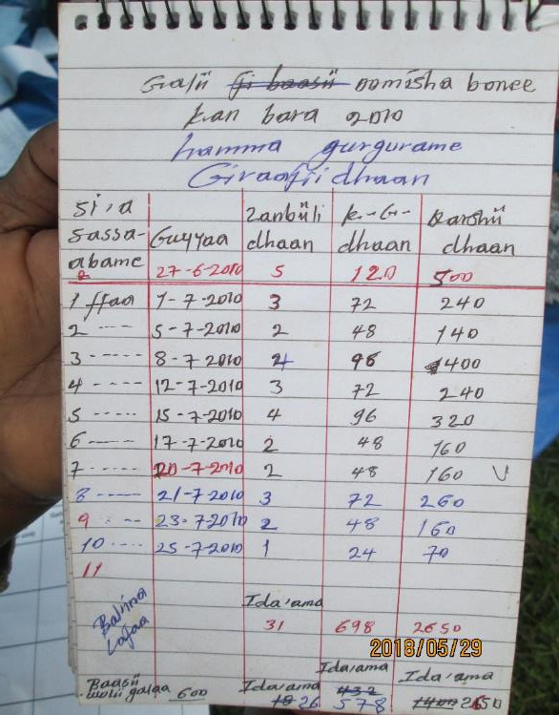
8. End-line survey
Objective :To conduct the same format of Baseline survey and assess the change and impact of the project intervention.
To start to plan the action for next season

Slide 29
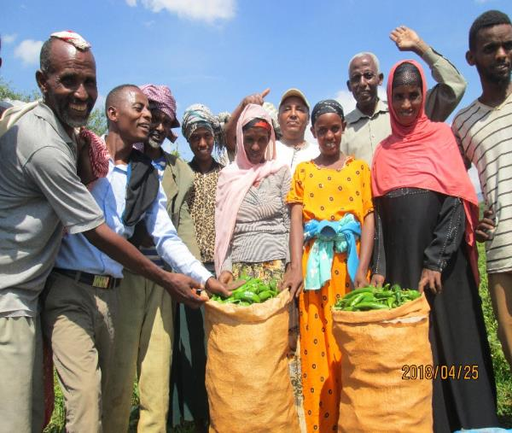
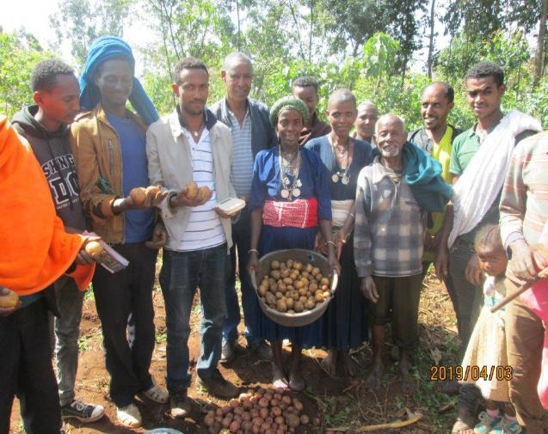
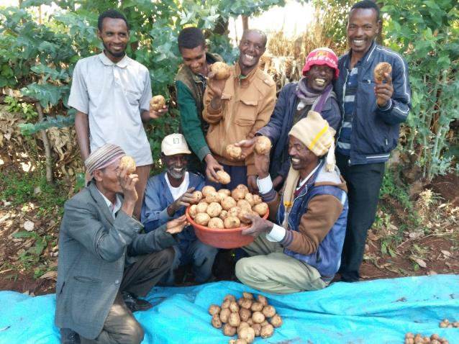
Make change on the ground through SHEP approach !!
By farmers
For farmers
With Community
SHEP Farmers will have business mind set and skill to successfully survive in Horticulture sector.

