Slide 1
Why Gender Matters in Ethio-SHEP
The Project for Smallholder Horticulture Farmer Empowerment Through Promotion of Market-oriented Agriculture in Ethiopia
13 June 2019

Slide 2
Contents of the Presentation
Women in Ethiopia
Why are the gender perspectives important in agriculture?
What does Ethio-SHEP expect to achieve by integrating gender perspectives into the project activities?
How can Ethio-SHEP tackle with gender issues?

Slide 3
1. Women in Ethiopia
Let’s understand women’s situation in Ethiopia by answering quiz!
<Education>
Overall in Ethiopia, 63% of adult men are able to read and write. How many % of adult women are able to read and write?
A: 37% B: 47% C: 57%
Source: Ministry of Agriculture and Natural Resources, Ethiopia. 2017. Gender Equality Strategy for Ethiopia’s Agriculture Sector.
Notes:
Answer: B 47% Less than half.

Slide 4
<Time Use >
In the highlands, men spend an average of 12 hours a day working during peak farm seasons. What about women?
A: 8 hours B: 12 hours C: 16 hours
Source: Ministry of Agriculture and Natural Resources, Ethiopia. 2017. Gender Equality Strategy for Ethiopia’s Agriculture Sector.
<Agriculture: Labour Force >
In Ethiopia, over 80% of the total labour force is in the rural areas and largely dependent on farming. How many % of rural labour force do women occupy?
A: 37% B: 47% C: 67%
Source: Ministry of Agriculture and Natural Resources, Ethiopia, UN Women, UNDP and UN Environment. 2018. The Cost of the Gender Gap in Agricultural Productivity in Ethiopia.
Notes:
Time use Answer: C 16 hours
Labour force Answer: B 47% almost half

Slide 5
< Agriculture: Horticulture>
How many % of horticultural operations are done by women?
A: 45% B: 60% C: 75%
Source: Ministry of Agriculture and Natural Resources, Ethiopia. 2017. Gender Equality Strategy for Ethiopia’s Agriculture Sector.
<Agriculture: Household Food Production>
How many % of household food production is produced by women?
A: 50% B: 70% C: 85%
Source: Ministry of Agriculture and Natural Resources, Ethiopia, UN Women, UNDP and UN Environment. 2018. The Cost of the Gender Gap in Agricultural Productivity in Ethiopia.
Notes:
Horticulture Answer: C more than 75%
Food production Answer: b 70%

Slide 6
< Agriculture: Access to Extension Services>
64% of MHH have access to extension services. What about FHH ?
A: 33% B: 51% C: 64%
Source: Ministry of Agriculture and Natural Resources, Ethiopia. 2017. Gender Equality Strategy for Ethiopia’s Agriculture Sector.
<Agriculture: Land Ownership>
How many % of women hold their own land ownership?
A: 19% B: 29% C: 39%
Source: Ministry of Agriculture, Ethiopia. 2011. Guidelines for Gender Mainstreaming in Agricultural Sector.
Notes:
Extension services Answer: B 51% (No data for wife of MHH)
Land ownership Answer: A 19% (18.6% avarage) (Amhara: 17.8%, Oromia: 17.3%, Tigray: 29.9%(highest), Dire Dawa: 11.7% (lowest)

Slide 7
<Agriculture: Land Size>
What is the average land holding size for FHH?
A: 0.6ha B: 0.9ha C: 1.3ha
Source: Ministry of Agriculture and Natural Resources, Ethiopia, UN Women, UNDP and UN Environment. 2018. The Cost of the Gender Gap in Agricultural Productivity in Ethiopia.
<Family Decision-making>
*Need to find data
Notes:
Land size Answer:B 0.9ha (0.86ha) (For MHH, the answer is C 1.3ha (1.31ha))
Family decision-making: Please let me know if you know some data. Just for your information, in Malawi, only 36% of wives participate in decision-making in family budgeting although they contribute 70% of agricultural labour.
As you maybe aware, even though women’s contribution to agriculture activity is significant, there are gaps between men and women (=gender gaps) in terms of resources, opportunities, (decision-making), and women tend to be subordinate to men in all spheres of their life.

Slide 8
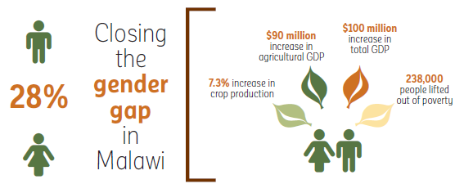
2. Why Gender in Agriculture
According to a joint study conducted by Ministry of Agriculture and Natural Resources, UN Women, UNDP and UN Environment, closing 10.6% of gender gap in agricultural productivity in Ethiopia could result in increase of total GDP, along with other positive development outcomes, such as reduced poverty and greater food security, as shown on the figure.
$221 million
$257 million
more than 1,323,000
1.4%
10.6%
Ethiopia
Source: Ministry of Agriculture and Natural Resources, Ethiopia, UN Women, UNDP and UN Environment. 2018. The Cost of the Gender Gap in Agricultural Productivity in Ethiopia.
Notes:
Now let’s look at why gender perspectives are important in agriculture.
Through the gender quiz we understand that there are gender gaps.
According to the joint study, there is 10.6% of gender gap in agricultural productivity in Ethiopia, which means that female farmers produce 10.6% less than male farmers.
And if we can close this gap, Ethiopia could result in …
1.4% increase in crop production
221$ million increase in agricultural GDP
257$ million increase in total GDP, and
More than 1,323,000 people lifted out of poverty.
Why female farmers produce 10.6% less than male farmers? Because if we look at the agriculture-related field, there are gender gaps, for example, in land size, land ownership, productive and reproductive activities, access to extension services, access to market information, control over farming activities, control over income use and so on.
In order to find what kind of and where gender gaps exist and how to close the gender gaps, we need to have gender perspectives/lenses, which means that we need to always be careful about differences between male and female farmers. Gender perspectives/lenses are very important in Agriculture.

Slide 9

A story of a husband in a farming household
One day I left home in the morning to look for a market for my tomatoes which were ready for harvesting. While I was away busy looking for a market, a buyer visited my home and found my wife. He asked if she could sell the tomatoes to him but since she had no authority whatsoever to make decisions and never knew my plans, she declined.
My search for a market was unsuccessful so I headed home where my wife reported to me the events of the day. I really felt bad and my tomatoes got spoiled since I couldn’t find a place to sell them.
Source: JICA. 2018. SHEP Handbook for Extension Staff: A Practical Guide to the Implementation of the SHEP Approach.
Notes:
I will explain a little bit more about gender gap using an example.
This is a story of a husband in a farming HH.
<Read the story and ask the following questions>
Is this situation familiar to you?
What kind of gender gap do you find where?
What problem occurred due to the gender gap?
How do you think this problem can be solved?

Slide 10


A story of a wife in a farming household
My husband told me “I’ve heard cauliflower is profitable. Let’s plant cauliflower on all of our land”. I opposed to him by saying ”Yes, but just on half of our land, not entire land” because I saw many other
farmers had planted cauliflower already and heard many people saying they wanted to plant cauliflower. I knew by the time we harvest it, the price would go down.
My husband did not listen to me and did what he wanted. We made a huge loss at the end of the season. After this bitter experience, however, my husband started to ask me “What crop do you think is good for this season?”
Source: JICA. 2018. SHEP Handbook for Extension Staff: A Practical Guide to the Implementation of the SHEP Approach.
Notes:
Another story is from a wife.
<Read the story and ask the following questions>
What kind of gender gap do you find and where?
What problem occurred due to the gender gap?
In this household, husband and wife started to jointly make decide on crops.
From the 2 cases, we understand that farming management is closely related to relationship between wife and husband.
There are gender gaps between wife and husband in terms of opportunities, roles and decision-making, and in most cases men are in more preferable position.
Without closing the gender gaps between wife and husband, the family cannot increase productivity as well as incomes because they cannot well manage farming.

Slide 11
3. What Ethio-SHEP to Achieve with Gender Perspectives?
Goal of Ethio-SHEP
Improved smallholder horticultural farmers’ livelihood through self-reliant farming business
Equal partnership between husband and wife
as a farm management unit
Equal Opportunities
Reviewed Gender Roles
Joint Decision-Making
Source: JICA. 2018. SHEP Handbook for Extension Staff: A Practical Guide to the Implementation of the SHEP Approach.
Notes:
Now I explain how gender relates to Ethio-SHEP and what Ethio-SHEP is going to achieve by integrating gender viewpoint into the project.
Goal of Ethio-SHEP:
In order to achieve this goal, equal partnership between husband and wife as a farm management unit is essential.
Equal partnership would be realized by equal opportunities, reviewed gender roles and joint DM.

Slide 12
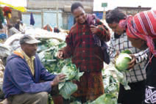
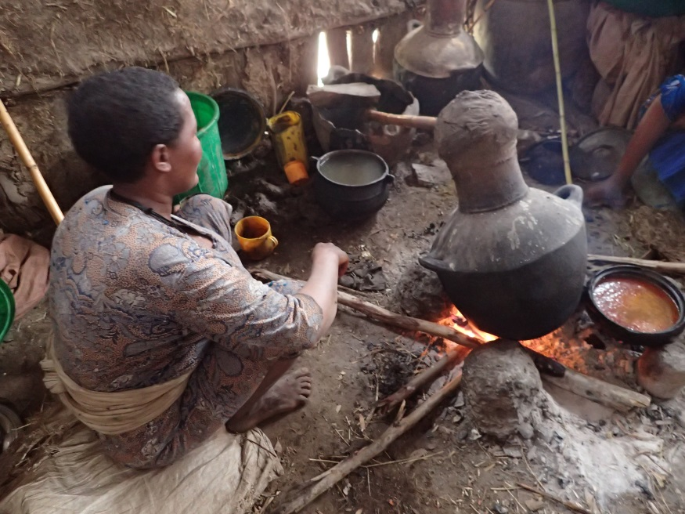
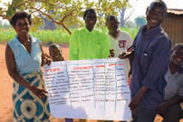
Examples…
Equal Opportunities
Reviewed Gender Roles
Joint Decision-Making
Trainings
Extension Services
Market Information
Farming Activity
Household Activity
Farming Activity
Marketing
Family Issues and Finance
Photos:
(Right and Left) JICA. 2018. SHEP Handbook for Extension Staff: A Practical Guide to the Implementation of the SHEP Approach.
(Middle) from Aya Yamaguchi
Notes:
This slide explains some examples what equal opportunities, reviewed gender roles and joint decision-making are.
<Equal Opportunities> Photo: Female group members participating in market survey.
Equal opportunities mean that husband and wife have equal opportunities in participating trainings, receiving extension services and getting market information.
As we saw in the gender quiz, in spite of the fact that women contribute to 75% of horticultural operations, women have less access to agri extension services. Women need to have the same opportunities with men in agricultural activities.
<Reviewed Gender Roles> Photo: A women in kitchen preparing for local wine.
As I mentioned, women greatly contribute to agricultural activities.
In addition, they are expected to be responsible for household activities.
Women have heavy workload both with farming and household activities.
In order for a family to realize effective farming for increase of productivity and income, wife and husband need to review their roles especially to reduce women’s burden in household activities.
<Joint DM> Photo: Wife and husband developed crop calendar together.
Women largely contribute to agricultural labour force, but they generally do not have opportunities to join in decision-making on farming activities including crop selection, marketing and how to use income generated from farming activities.
This may negatively affect on women’s motivation in farming activities.
Here is a story of a female farmer in Tanzania. ベースライン調査
Equal opportunity is essential, but it is not enough just to provide women with equal opportunities as men. We need to think work sharing between wife and husband to reduce wife’s burden and joint DM between wife and husband.
We need to carefully look at these three points to achieve “equal partnership” between wife and husband.

Slide 13
Success in Kenya with Gender Perspectives: SHEP and SHEP UP
Source: JICA. 2014. Gender Equality and Women’s Empowerment.
Equal Opportunities
Wives started participating in the technical trainings. Then their family income from horticultural farming increased through working hand in hand with their husbands.
Husbands then started to listen to the opinions of their wives on farm management, which means that wives started to take part in the decision-making in farming and act as co-managers of farming.
Reviewed Gender Roles
Husbands realized the advantage of working together with their wives to improve productivity and incomes. Then they gradually began to pay attention to the heavy workload of wives, and started to help wives with domestic duties and childrearing.
Wives could then allocate more time to farming activities due to the mitigation of their heavy workload.
Joint Decision-Making
Husbands used to control incomes. So wives’ motivation for engaging in productive work declined.
But wives started to act as co-managers of farming and took part in family finance, which enhanced their motivation toward the improvement in productivity.
Notes:
Let’s look at what happened in Kenya by integrating gender perspectives in project activities.
<Read the examples on the slide.>

Slide 14
Success in Kenya with Gender Perspectives: SHEP and SHEP UP (cont’)
As a result…
Male and female farmers could increase their incomes because they managed farming activities effectively with a long-term vision.
The growing sense of men and women as co-managers in farming contributed to building trust between a husband and a wife, and improving their relationship.
Average Income of the 2,500 Target Farmers
USD 285/year
(May and June 2007)
USD 589/year
(Oct 2009)
Notes:
In Kenya, through equal opportunities, reviewed gender roles and joint DM, couples could realized equal partnership as a farm management unit.
And as a result, (in short)
Income increased double in 1.5 years (USD 285 = about 8,300 Birr/ USD 589 = about 17,000 Birr)*current exchange rate
Not only increase of income, but also improved relationship between husband and wife.

Slide 15
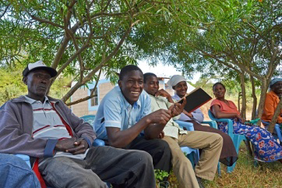
Voice of a male farmer
Previously, I used to count my money in the toilet to avoid being watched over by my wife. After attending the SHEP trainings on gender, I started valuing the role my wife played and started to include her in the management of our income. We are all happy since we now respect each other and also because our livelihood has actually improved a lot from horticultural farming.
Voice of a female farmer
I didn’t know what I worked for. But now I know that I play an important role in increasing our income from farming. I can work with my husband more positively since the more I work, the more I earn an income.
Notes:
Here are the voices of make and female target farmers in Kenya.
<Read the voices of man and woman)
As I explained, gender is a very important viewpoint in achieving Ethio-SHEP goal.

Slide 16
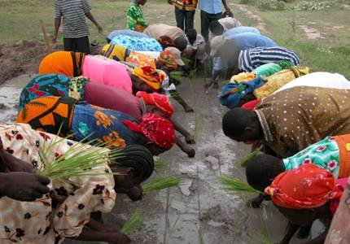
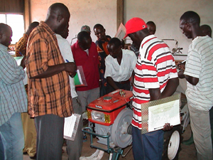
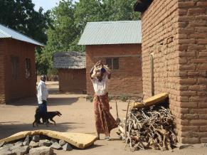
Success in Tanzania with Gender Perspectives: TANRICE2
1. Women in Rice Farming in Tanzania
Women’s contribution to rice farming is significant!
But they have limited opportunities for trainings!
In addition to rice farming, they are responsible for household chores and child rearing!
They do not have a right to decide how to use income from rice farming, and it is not always used for welfare of family!
Notes:
以下、左から、写真の説明
農作業の６割～７割は女性の仕事：女性の主な作業は、種籾準備、田植え、除草、脱穀など。
KATC-1での女性参加率は機械系の研修分野は0％。最も多かった研修分野でも20％程度。
もし、灌漑稲作を導入して改良品種を奨励した場合、それまでおこなったことのなかった苗畑作り、田植え、草取り、鳥追い、灌漑水路の維持管理（水路の掃除、灌漑用水の監視）などで、女性の労働時間は倍増する可能性がある。それに加えて、家事労働には時間がかかる。特に、水汲みや薪集めが重労働になっている。
ベースライン調査を実施したときに、次のことが判明した。 「夫がお金を持っていないときが幸せだ」という妻のコメントがあった。米の収益が上がって収入が増えると、夫は愛人のところに行ったり、飲酒などでお金を使ってしまって、家計の向上につながらない、収入の使い方に関して妻は決定権がない、収入が増えると逆に家庭内の争いや家庭内暴力が増加する。

Slide 17
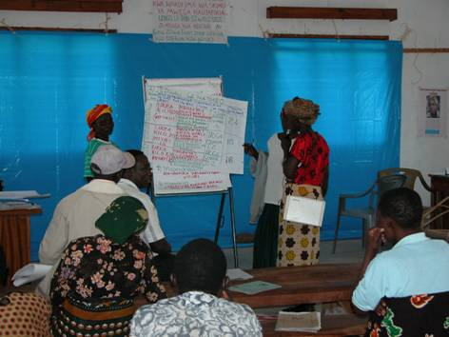
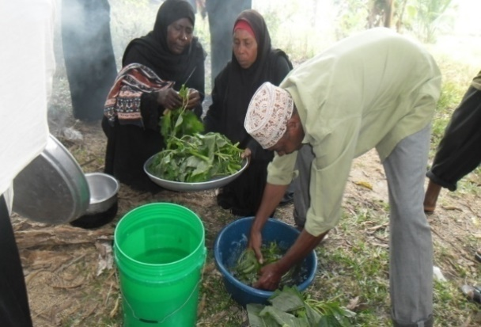
2. Gender Activities of TANRICE2
Equal Opportunities
Reviewed Gender Roles
Joint Decision-making
Training Participation and Presentation
Rice Farming Activity
Household Activity
Rice Farming Activity
Family Issues and Finance
Increase of rice yield and happiness of family
Notes:
このスライドでは、前のスライドを受けて、どうしてTANRICE2がジェンダー活動を実施したのか、その目的を説明。
TANRICE2では、主にこの3点に取り組むことで、収量アップと家庭の平和の実現を目指した。
収量が増えても、 「夫がお金を持っていないときが幸せだ」という妻のコメントがあった。米の収益が上がって収入が増えると、夫は愛人のところに行ったり、飲酒などでお金を使ってしまって、家計の向上につながらない、収入の使い方に関して妻は決定権がない、収入が増えると逆に家庭内の争いや家庭内暴力が増加する。 というようなことがあってはいけないので、家族の幸せも重要！！！

Slide 18
3. Impacts of Gender Activities
<Result>
Improvement of women’s skills and knowledge through training participation
Female Participants
48-49%
Male Participants
51-52%
<Impact>
Increased rice yield
Improved confidence of women
Notes:
それぞれどのような結果を生んだか、2016年と2017年にGTGメンバーが行ったNarrative Impact Assessmentの結果から概要を紹介。 88cases collected.
まずは、研修などの平等な機会に関して。
(Result)
女性農民の研修への参加機会が課題だったので、５０：５０の参加枠を設けた結果、ほぼ達成。
女性も稲作の多くの作業を担っており、研修に参加することで技術・知識の習得・実践
(Impact)
これにより、収量アップにつながった。
また、研修中は、女性の発言機会にも考慮し、女性が積極的に研修に参加できるようにしたことで、女性の自信の向上にも貢献した（N-12)。

Slide 19
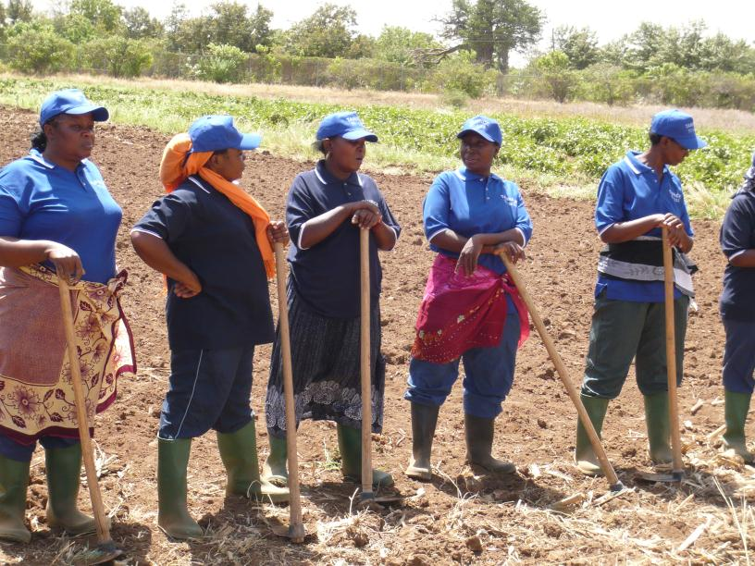
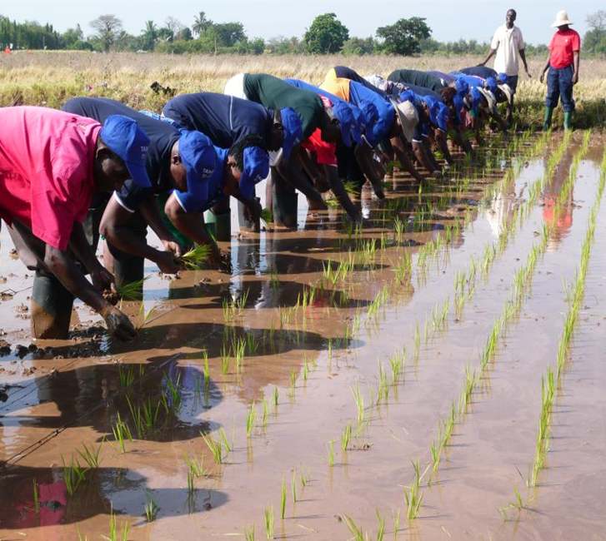
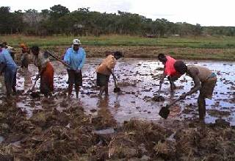
Rice Farming Training Courses
50:50 ratio of male and female participation in training courses

Slide 20

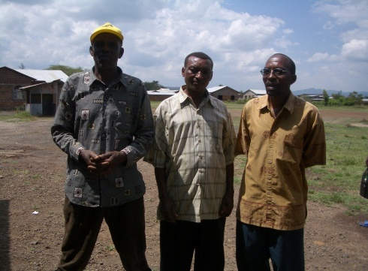
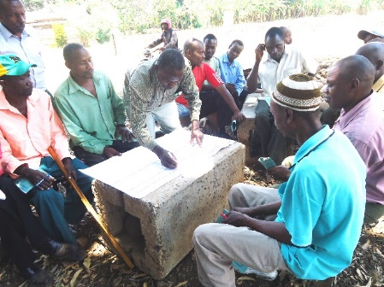
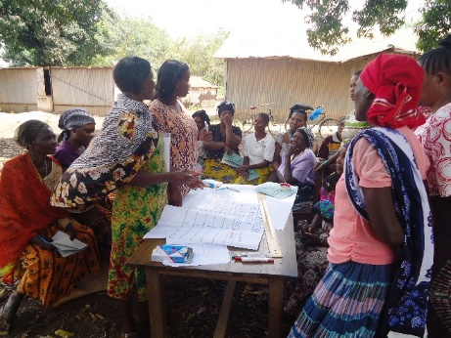
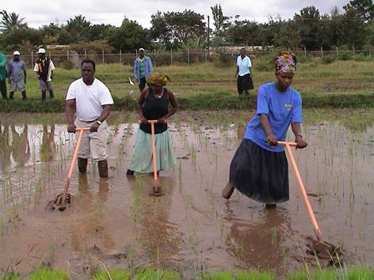
<Result>
Men
Women
<Impact>
Increased rice yield
Strengthened cooperation among family members
Notes:
次に、ジェンダー役割に関して。
（Result)
ジェンダー啓発 gender sensitization 研修参加により、男性は女性の生産活動と再生産活動双方への負担の大きさに気が付いた（写真：SMTブローシャーから） 。
同様に女性も、これまで性別役割分担により担ってきた負担を認識し、積極的に男性（夫や息子など）に協力を求めるようになった（写真：SMTブローシャーから）。
その結果、男性がこれまで女性の役割とされてきた家事（自転車、バイク、牛車を使っての薪集めや水くみ、料理など）・育児や、稲作労働（除草、田植え、収穫後の作業（winnowingやthreshingなど）に協力（写真：田中さん2014年能力強化研修事例紹介プレゼン。Lekitatuの男性たち 「ミルクとカウダン」）。
女性も家事負担が減り、その分農作業に参加（中には、男性の役割とされていた農作業を行う女性も）。
その結果、男女の役割分担意識が薄まり their sense of traditional gender division of labour became weak 、家族で協力して農作業を実施したり、農作業の効率化が実現 realized effective farming（写真：田中さん2014年能力強化研修事例紹介プレゼン。おそらくKATCII時代の簡易除草機の写真）。
（Impact)
これにより、コメの収量アップ。
また、家族が協力して農作業や家事などを行うことで、協力関係が強化された。

Slide 21
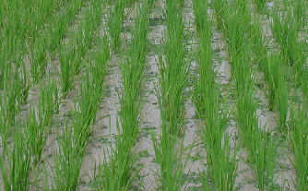
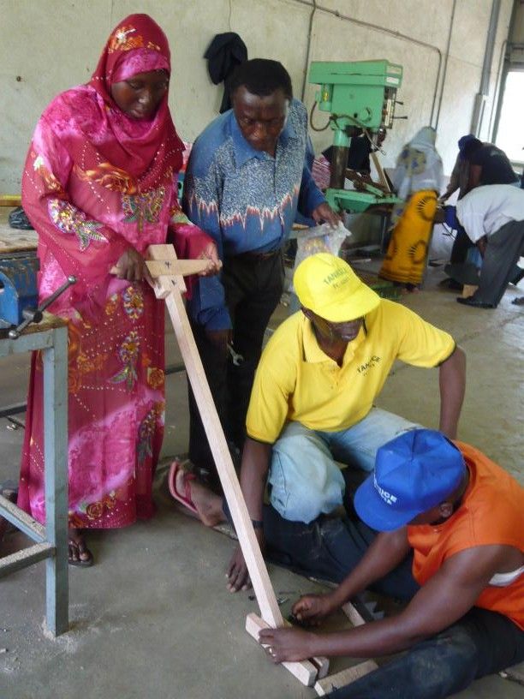
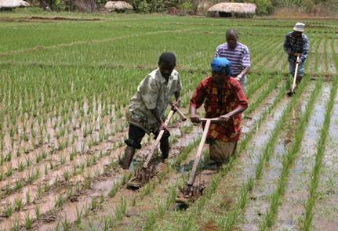
Improvement of Transplanting and Weeding
Notes:
次は、生産活動におけるreviewed gender rolesを促進するために取り組んだ内容。
具体的には、女性の役割＝田植えと除草＝労働負荷の大きな仕事であることを確認し、負担軽減のための作業の効率化。Laborious work／burden
具体的には、バラ植えから正条植えへ straight row planting、そして簡易除草機の導入により、除草作業を効率化。
また、簡易除草機導入により、男性も除草作業への参加（器具＝男性が使用するもの、という考え）。これにより、女性の負担がさらに軽減。

Slide 22
Key farmer under KATI
Family Members: Wife and 3 Children
TANRICE2 Training:
ST (2014), Post Harvest SMT (2015), Gender SMT (2016) and Marketing SMT (2016)
Before
After
2tons/ha in 2014
4.5tons/ha in 2016
5.5tons/ha in 2017
He obtained knowledge and skills of rice production.
He started helping his wife in “women’s work”.
Wife started helped him
in “men’s work”.
“Weeding, fetching water and collecting firewood are women’s work, not men’s work.”
“Cooperation between male and female in rice production is a key to success.”
Notes:
Narrative Impact Assessmentから、研修による稲作技術の習得に加え、ジェンダー啓発研修によって男女の不平等な役割分担について理解し、家事や稲作での妻の仕事をサポートし、妻も稲作で夫の仕事をサポートし、それにより収量が上がった事例紹介（男性）。
教育レベル：Form IV（Secondary education)
以下、概要。詳細はB-M-1のケース（ザンジバル）参照。
ジェンダー啓発研修前は、除草、水くみ、薪集めなど、妻が手伝ってほしいと依頼しても、「それは女性の仕事だからできない」と言っていた。
しかし、ジェンダー啓発研修で学んだことで、これまでは「女性の仕事」とみなしていた風選winnowingや除草、そして水くみ、薪集めも行うようになり、また妻も「男性の仕事」と思っていたland preparationやthreshingを行うようになり、共同で稲作をするようになった。
タンライス2で稲作技術も学んだことに加え、このように夫婦で助け合うことで、コメの収量も上がり、収入も向上した。
また、妻も、それまでは「女性の仕事だから」と断っていた家事を行うようになった夫の変化にハッピー。
(ここからはスライドにはないが・・・）
また、家計管理に関しても、妻と一緒にどのように収入を使うか計画するようになった。
稲作により増えた収入を活用し、子どもの教育費も期限通りに支払えるようになり、牛も購入した。これからセメントブロックの新しい家を建てる予定。

Slide 23
Key Farmer under KATI
Family Members: Husband and 5 Children
TANRICE2 Training:
ST (2014), Gender SMT (2016) and Marketing SMT (2016)
Before
After
2tons/ha in 2014
3.5tons/ha in 2016
4.25tons/ha in 2017
She obtained knowledge and skills of rice production.
She persuaded husband and children to participate in rice farming and household chores.
“No cooperation among family members in rice farming and household chores”
“Now all family members collaborate both in rice farming and household chores .”
Notes:
Narrative Impact Assessmentから、研修による稲作技術の習得に加え、ジェンダー啓発研修によって男女の不平等な役割分担について理解し、夫や子供に稲作や家事を手伝うように伝え、家族で稲作を共同で行うことにより収量が上がった事例紹介（女性）。
子どもの数はトータルで5人だが、インタビュー当時一緒に住んでいるのは3人。
教育レベル：スタンダード4。
以下、概要。詳細はB-M-2のケース（ザンジバル）参照。
ジェンダー啓発研修前は、稲作や家事などで家族の協力はなし。
しかし、ジェンダー啓発研修後、夫や子供たちに、稲作や家事に参加するよう説明・説得。
その結果、今ではすべての家族が、田植え、除草、収穫に参加し、また、夫は薪集めや洗濯を行うようになり、子どもたちも家事を協力するようになった。
タンライス2で稲作技術も学んだことに加え、このように夫婦で助け合うことで、コメの収量も上がり、収入も向上した。
(ここからはスライドにはないが・・・）
また、家計管理に関しても、夫が、農業で得た収入の使い道について自分や子供と一緒に話し合うようになり、とても幸せ。
これまでは、ココナツの葉の屋根のある泥でできた家に住んでいたが、タンライス2に参加したことで、アイロンシートの屋根にセメントブロックの家を建てることができた。また、電気も通す準備もしている。

Slide 24
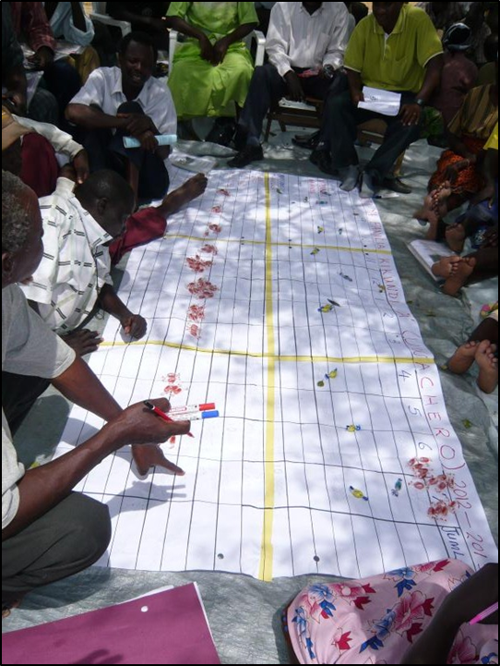
<Result>
Realization of appropriate management of and effective investment in rice farming
Increased opportunities for couples to discuss farming and family issues
Increased opportunities for women to take part in decision-making -> Increased women’s motivation in farming activities
<Impact>
Increased rice yield
Developed trust and understanding among family members
Notes:
最後に、joint DMに関して。
（Result)
ジェンダー啓発研修での男女の役割についての学びに加え、特に家計管理研修により、コメを売るなどにより一年のいつ収入があるか、その収入を家族や稲作のためにどう計画的に・効率的に支出したらよいかや、家庭の収支額や出費の計画について家族で共有・話し合う必要性などを学んだ。
これにより、コメ収入の効果的管理（無駄使いがなくなったなど）・出費（子どもの教育など）や稲作への効果的な投資（肥料や種子など）が可能になった。
また、家計のことだけでなく、農作業や子どものことなどについても夫婦で話し合う機会が増えた。
夫婦で話し合うだけでなく、家計、農作業や子どものことなどについて女性が意思決定に参加する機会が増えた。
また、女性が支出に関する意思決定に参加することで、女性の農業参加へのモチベーションも高まった（N-7)。
（Impact)
コメ収量のアップ
収支に透明性が生まれ、家族での話し合いの機会も増え、家族の間の信頼・相互理解の向上

Slide 25
Intermediate Farmer under KATC
Family Members: Husband and 5 Children
TANRICE2 Training:
MST (2014) and Gender SMT (2015)
Before
After
3.9tons/ha in 2013/2014
7.8tons/ha in 2015/2016
8tons/ha in 2016/2017
She obtained knowledge and skills of rice production.
Couples started sharing rice farming activities.
Couples started planning
rice farming and
expenditures together.
“No sharing of rice farming activities, and no discussion and budget plan for expenditures”
“Knowledge from gender training, especially family budgeting contributed to increased rice productivity and brought transparency and peace in family.”
Notes:
Narrative Impact Assessmentから、研修による稲作技術の習得に加え、ジェンダー啓発研修による男女の役割り分担の変化（生産活動）や、家計管理研修による稲作への効果的な投資が可能になり、それにより収量も上がり、家族の平和につながった事例紹介（女性）。
子どもの数はトータルで5人だが、インタビュー当時一緒に住んでいるのは1人（24歳の息子）。ほかの子どもたちは独立。
教育レベル：小学校卒業
以下、概要。詳細はS-C-1のケース参照。
ジェンダー啓発研修を受けた後、夫にも役割分担に関して情報共有したところ、夫はすぐに反応し、稲作における妻の仕事をサポート（seedling, transplanting, weeding）。（ただし、家事への協力には反応なし）
妻もlevelingやbund makingなどにも参加し、稲作を夫婦で協力して行うようになった結果、稲作に係るコストを抑え、タイムリーに作業を終えることができるようになった。
さらに、家計管理研修の影響で、夫と田植え、施肥、除草などに関する支出の時期や金額を話し合い計画するようになり、稲作が計画通りに進むようになった。
これら（コストを抑え、計画通りの作業）により、収量が増えた。
さらに、夫と、家族に必要な支出の内容や時期や金額を話し合い計画するようになったことで、支出の透明性が生まれ、家族の平和につながった。
(ここからはスライドにはないが・・・）
コメの収量アップにより家族の生計が向上した。
例えば、家に電気を通し、テレビを購入した。

Slide 26

Rice Cultivation Technology
Gender Main-streaming
Realization of increased yield as well as happiness of family
Notes:
3枚のスライドのまとめ。
色のイメージはタンザニア国旗・・・黒はタンザニアの人々を、緑は大地を、青は海を、黄色（金色）は鉱物資源を表している。

Slide 27
4. How Ethio-SHEP tackles with Gender Issues ?
<Question>
1. What are the gender issues in your community related to:
Opportunities
Gender roles
Decision-making
2. What are the causes of the gender issues?
3. What do you think you can do to solve the gender issues in Ethio-SHEP?

Slide 28
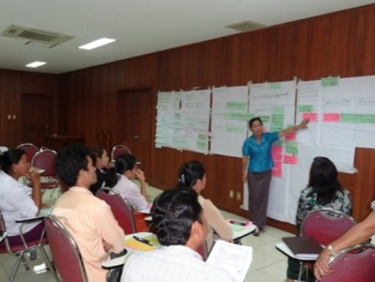
Problem Tree
-Example from Cambodia-
Women in rural areas are not economically empowered.
Women’s agricultural knowledge and skill are limited.
Women’s business management skill is limited.
Women’s access to market info. is limited.
Women have less opportunities for business trainings.
Women have less opportunities for agricultural trainings.
Women’s access to agricultural skill and information is limited.
Women’s educational opportunities are limited.
Family members do not understand importance of women’s participation in trainings.
Local authorities do not understand importance of women’s participation in trainings.
Women are busy with household chores and child rearing.
The number of female extension officers is few.
Women have less opportunit-ies for study tours and workshops.
Women are busy with house-hold chores and child rearing.
Social norms
Source: Result of the workshop conducted in JICA Project on Gender Mainstreaming Phase 2 in Cambodia
Notes:
Problem tree 作った経験ある人？？？聞いてみる。
Why? Because..
一つの問題は様々な要素が原因になっているので、verticallyだけでなくなるべくtry to expand the tree horizontally
・模造紙に書いていくのは、ツリーまで。一つの原因に対して何ができるか？は、一つ選んで発表の時に口頭で共有してもらう。
注： 「ジェンダー規範」にいくまで問題分析で深堀出来たら良い。
注： すべてのroot causeは「ジェンダー」であること、女性はエンパワメントしないと問題解決＝ジェンダー平等にはならないことが分かったと思う。と後で説明する予定なので、結果を見てそこまで解説するか、参加者からこの言葉を言及してもらう。
注： 問題分析で出た課題にどう対応して、その結果どのような成果をもたらしたか、午後タンザニアの案件を事例として紹介するので、そこにも触れる。

Slide 29
Thank you for your attention!

