Slide 1
Gender Analysis
The Project for Smallholder Horticulture Farmer Empowerment Through Promotion of Market-oriented Agriculture in Ethiopia
14 June 2021

Slide 2
Today’s Programme
What is Gender Analysis?
How to Conduct Gender Analysis
How to Utilize Results of Gender Analysis

Slide 3
Sex and Gender
Sex
Gender
Biologically determined
Biological characteristics of men and women are universal and not affected by where you are, how old you are, etc
Socially and culturally constructed
Context-specific, time-specific, and changeable.
Gender determines what is expected, allowed and valued in a woman or a man in a given context.
Also refers the relationships between women and men and girls and boys.
The relationships are not equal, but hierarchic. (women=subordinate, men=superior)

Slide 4
1. What is Gender Analysis?
A tool aiming to reveal differences between women and men of a project target in terms of situations, roles, issues, needs, etc.
Results of gender analysis can be used :
to raise people’s awareness about their differences (farmers, extension officers, government officers, Japanese experts, etc);
to improve project activities to effectively achieve its project purpose.

Slide 5
Basic analysis tools:
Activity Profile
Daily Activity Profile
Access and Control Profile
Gender Action Plan
Exercise with farmers
Famers must be divided into female farmer group(s) and male farmer group(s)

Slide 6
2. How to Conduct Gender Analysis
① Activity Profile
Purpose:
To understand roles and responsibilities of women and men in family in productive, reproductive and community activities.
Productive activity: Work for income and subsistence
Reproductive activity: Domestic work, childrearing, necessary work to support productive activity
Community activity: Activities for community to provide items of collective consumption
Notes:
農村において、それぞれ具体的にどんな活動があると思うか、参加者に聞く、

Slide 7
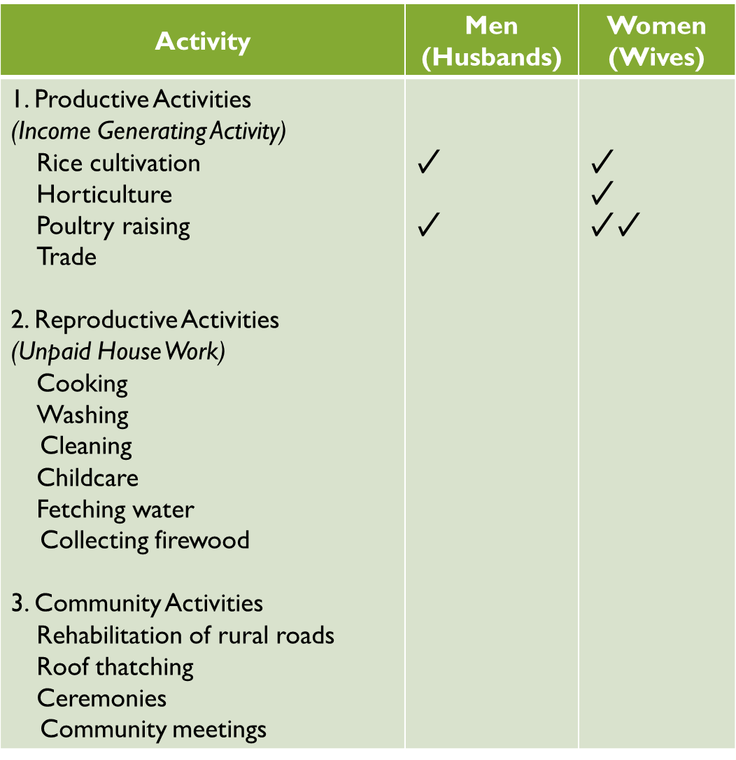
How to do:
Ask women and men in separate groups to identify productive, reproductive and community activities.
Ask them who in the family does which activities and tick (✓) the columns of either women or men who regularly does the activities.
Notes:
productive, reproductive and community activitiesとは？
✓のつけかた：
If both are involved in the activities, tick both.
But if one contributing more, put 2 ticks, and one tick for the other contributing less.
If one is not engaged in the activity listed, leave the column blank.

Slide 8
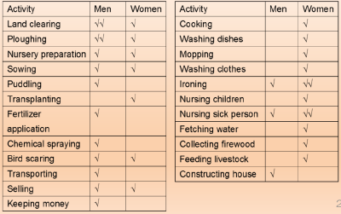
How to interpret:
Activity Profile from a Project on Rice Cultivation
Productive Activity
Reproductive Activity
Source: JICA (2016). Teaching Guidelines: Gender and Agriculture/Rural Development.
Notes:
これは稲作プロジェクトに参加することになった男女農民に、activity profileツールを用いて生産と再生産活動について答えてもらったもの。
生産活動は、稲作活動にフォーカスして、稲作に関してどのような作業があるかを、男女農民に聞いてリストアップしたもの。
再生産活動も同じ。
この部分は、関わるプロジェクト、地域などによって変わっていくもの。
ここから何が読み取れるか？？？
エチオピアではどうか？

Slide 9
Group Work
List up productive, reproductive and community activities that female and male farmers in your community engage in.
* Productive activity: all tasks necessary for horticulture farming.
Tick (✓) the columns of either men or women who regularly does the activities.
Share your group work result with participants.

Slide 10
② Daily Activity Profile
Purpose:
To understand roles and responsibilities of women and men in a family and how many hours they spend in a day for their roles and responsibilities.

Slide 11
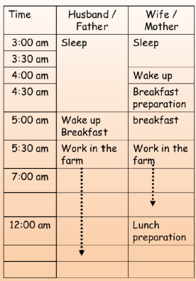
How to do:
Ask women and men in separate groups to make a daily activity calendar of their own with information what they do in a day and how long it takes.
Make daily activity calendars for farming season and off-farming season, respectively, if necessary.
Source: JICA (2016). Teaching Guidelines: Gender and Agriculture/Rural Development.
Notes:
表は男女併記しているが、
Women group illustrate their daily activity calendar only while women do it their own only.

Slide 12
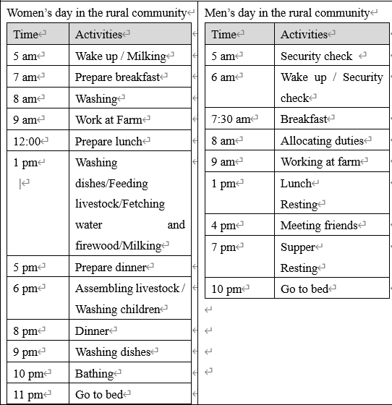
How to interpret:
Example of Daily Activity Calendar
Notes:
これは稲作プロジェクトに参加することになった農民男女別々に、農繁期の過ごし方を描いてもらったもの。
ここから何が読み取れるか？？？
男性は比較的休憩をとる時間がある。
女性は一度の様々な作業をこなしているが、男性は一つの作業に集中できる。
エチオピアではどうか？
研修に参加できそうな時間を判断できる

Slide 13
Another Example of Daily Activity Calendar
Women
Men
Source: JICA Smallholder Horticultural Empowerment Project in Kenya
Notes:
文字を使う代わりに、Drawing でもできる。

Slide 14
Group Work
Illustrate daily activity calendar of your group only.
Share your group work result with participants.

Slide 15
③ Access and Control Profile
Purpose:
To understand who in the family can use resources (=ACCESS), and who in the family manages/owns them and makes decisions about their use, including whether they can be sold (=CONTROL).
Recourses: Anything that can be owned and used to obtain a benefit from it. Eg: land, labour, livestock, machines, tools, income, credit service, training and agricultural extension.
Notes:
✓のつけかた：
If both are involved, tick both.
But if one having more, put 2 ticks, and one tick for the other having less.
If one does not have, leave the column blank.

Slide 16
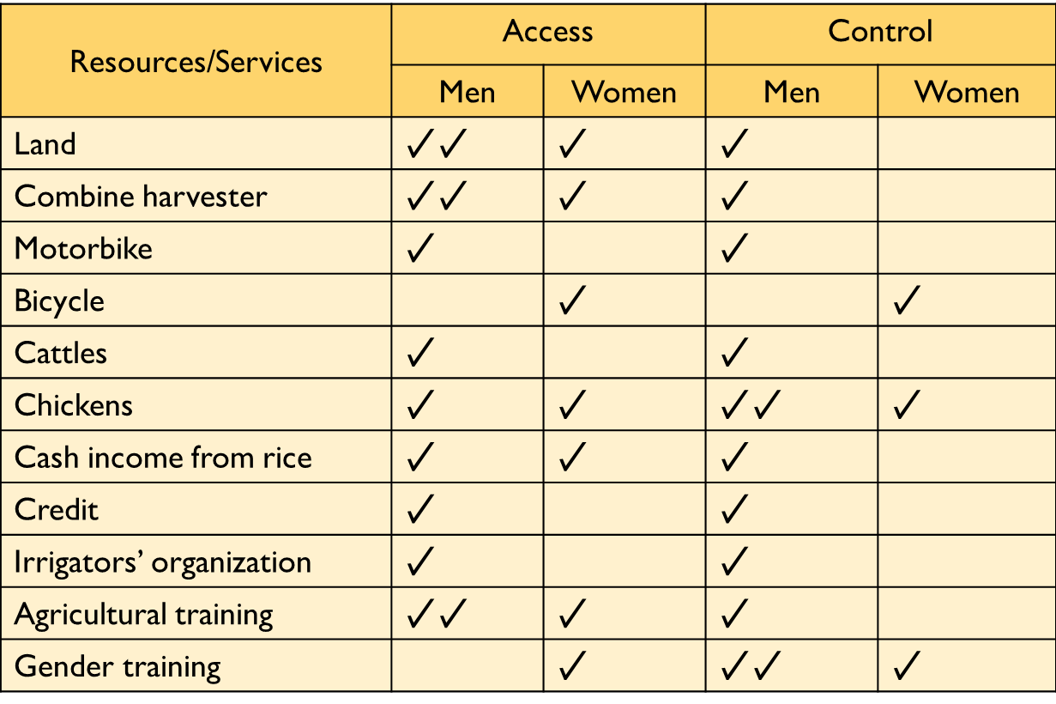
How to do:
Ask women and men in separate groups to identify resources which are crucial in shaping family’s lives and dignity.
Ask them who has access to and control over resources in the family and tick (✓) the columns of either women or men who has access to and control over resources.
Notes:
✓のつけかた：
If both are involved, tick both.
But if one having more, put 2 ticks, and one tick for the other having less.
If one does not have, leave the column blank.
表の読み方の説明

Slide 17
How to interpret:
Access and Control Profile from a Project on Rice Cultivation
Resources/Services | Access |  | Control
Resources | Men | Women | Men | Women
Land | ✓✓ | ✓ | ✓
Farm tools | ✓✓ | ✓ | ✓
Dairy cow | ✓ | ✓✓ | ✓
Poultry | ✓ | ✓✓ |  | ✓
Training | ✓✓ | ✓ | ✓
Notes:
これは稲作プロジェクトに参加することになった農民男女に作成してもらったもの。
Resourcesは、関係するプロジェクトの内容や地域などで変わっていく。
ここから何が読み取れるか？？？
アクセスは平等のよう。鶏は女性が多く、研修は男性が多い。
コントロールはほぼ男性。
土地も乳牛も男性財産であり、女性が何か意見をいうことが難しい状況であることがわかる。
鶏については、女性により決定権があり、どのように処分するのか、女性の意見が通りやすいと思われる。
エチオピアではどう？

Slide 18
Group Work
List up necessary resources for farmers to engage in horticulture farming in your community.
Tick (✓) the columns of either women or men who has access to and control over resources.
Share your group work result with participants.

Slide 19
④ Gender Action Plan
Purpose:
To reduce women’s heavy workload at household by making action plan with family members.
Notes:
✓のつけかた：
If both are involved, tick both.
But if one having more, put 2 ticks, and one tick for the other having less.
If one does not have, leave the column blank.

Slide 20
How to do:
Agree on the participants that objective of this exercise is to reduce women’s heavy workload in the household.
Ask women and men in same groups to identify what is the most tedious work in their households .
Fill the table by discussing as a group
Completion date should be specific.
Objective | Most tedious work | Activities | By when | Resources | Implementer | Monitor
Women’s heavy workload reduced | Fetching firewood | Purchasing of improved cooking stove | May2021 when the sales of horticulture products in the next season is done. | Money (1,000 ETB) Labor to construct it in the kitchen | Each group member | DAs and group leader

Slide 21
Group Work
Draw a table and filling each column by discussing with men and women.
Action plan should be manageable by community members without external support (labour & financial)
After the group work, all the family members need to understand what is the most tedious work for women and how they can overcome such issues by supporting women.

Slide 22
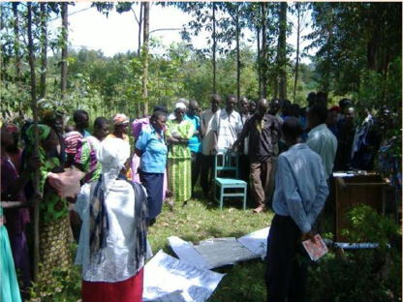
3. How to Utilize Results of Gender Analysis
Share results of female and male group work in plenary to raise people’s awareness (farmers, extension officers, government officers, Japanese experts, etc) about different situations, roles, issues, needs, etc between women and men.
Photo: JICA (2016). Teaching Guidelines: Gender and Agriculture/Rural Development.

Slide 23
Reflect results of female and male group work in project activities to effectively achieve its project purpose.
Project Framework
<Project Purpose＞
Increasing income from vegetable production by realizing market oriented agriculture.
<Activities>
Conduct market survey by farmers
Introduction of basic cultivation techniques.
Results of Analysis
Both female and male farmers engage in vegetable farming.
Women are so busy with reproductive activity as well as productive activity.
Men have more control over resources than women do.
How to reflect?

Slide 24
Thank you for your attention!

