Slide 1
The project for Smallholder Horticulture Farmer Empowerment Through Promotion of Market Oriented Agriculture (Ethio-SHEP)
Preparation & Implementation Process of Sensitization Workshop
Presented to Participants of Ethio-SHEP ToT

Slide 2
Contents of the Presentation
Introduction
Objective
Preparation
Participants
Contents of the sensitization
Implementation
Experiences from Ethio-SHEP intervention

Slide 3
Essential 4 Steps
Essential 4 steps | Activities
1. Sharing goal with farmers. | Sensitization Workshop
2. Farmers’ Awareness is raised. | Participatory Baseline Survey Market Survey
3. Farmers make decisions. | Target Crop Selection (Optional) Market Linkage Forum Crop Calendar Making
4. Farmers acquire skills. | In-field trainings (Optional) Exchange Visit Field Day
Follow-up and monitoring (including Participatory Endline Survey)

Slide 4
1. Introduction
Sensitization Workshop is the first activity among series of activities of the Ethio-SHEP Approach
Sensitization is conducted for farmer group members in target Water Users Association.
Can be conducted before selection of target farmers to select target farmers

Slide 5
2. Objective:
Sensitization Workshop
Farmers are informed that Ethio-SHEP is purely technical assistance and there will be no financial or material assistance directly given to them.
Farmers agree to participate in Ethio-SHEP in order to become self-reliant through developing their technical capacity.

Slide 6
3. Preparation Activities
Prepare program for the Sensitization
Check available venues and convenient time for participants
Invite previous experienced farmers from nearby kebele for the sensitization
Prepare necessary items (stationary, etc.) for the Workshop
Identify facilitators (woreda & Kebele)
Inform farmer group on the date and venue.

Slide 7
4. Participants of the Workshop
Chair of the Water Users Association
Member of the Water Users Association
Member of the group

Slide 8
5. Contents of the Sensitization:
Explain outline of the Ethio-SHEP Approach & Achievements.
Share the planned annual schedule of activities with participants (Market survey, crop selection, Market Linkage Forum, etc.).
Explain about contents of the project, intervention modality, role of farmers.
Agree on selected target farmers for implementation.
Discussion with farmers about any issues for clarification or expectations raised by participants.

Slide 9
6. Contents
What Ethio-SHEP does not do with farmers
Does not construct /maintain irrigation scheme
Does not provide inputs (seeds, fertilizer from project)
Does not provide farm tools.
Does not provide cash support.
Does not provide per diem when trainings at kebele
No interference on current water distribution/ management / issues.

Slide 10
Contents……
What Ethio-SHEP approach does with farmers N.B. capacity building project through:
Baseline survey (to review current situation)
Market survey
Support crop selection using Ethio-SHEP selection technique
Providing opportunity with linking farmers with market stakeholders (Agro-dealers, wholesalers)
Providing technical support on basic production skills.

Slide 11
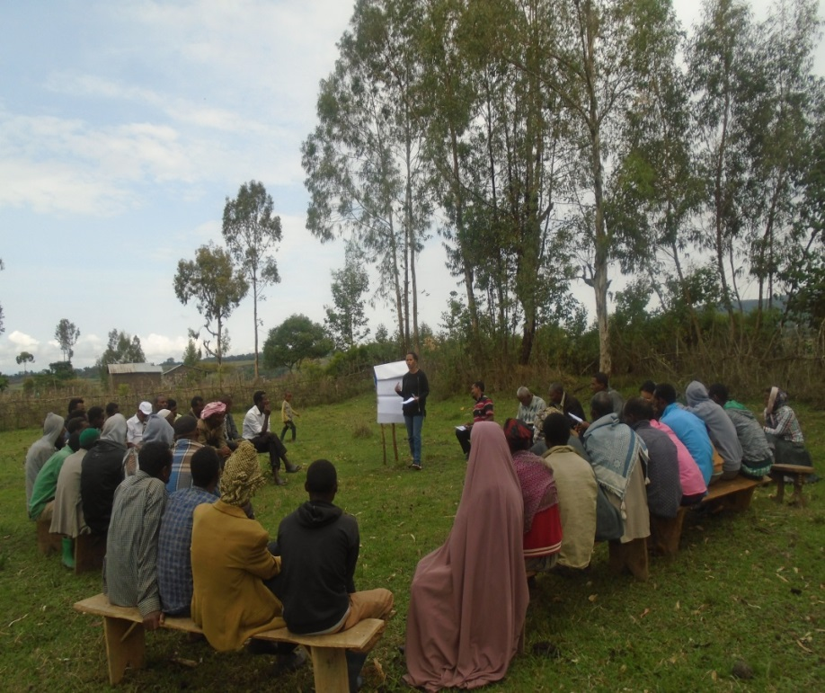
7. Implementation
Duration: Sensitization
workshop is conducted
for half day.
Date: should be
identified depending on the
availability of participants
Venue: should be convenient to participants as well as organizer(s)
FTC, Church place, Mtg hall, outside of the field,etc.

Slide 12
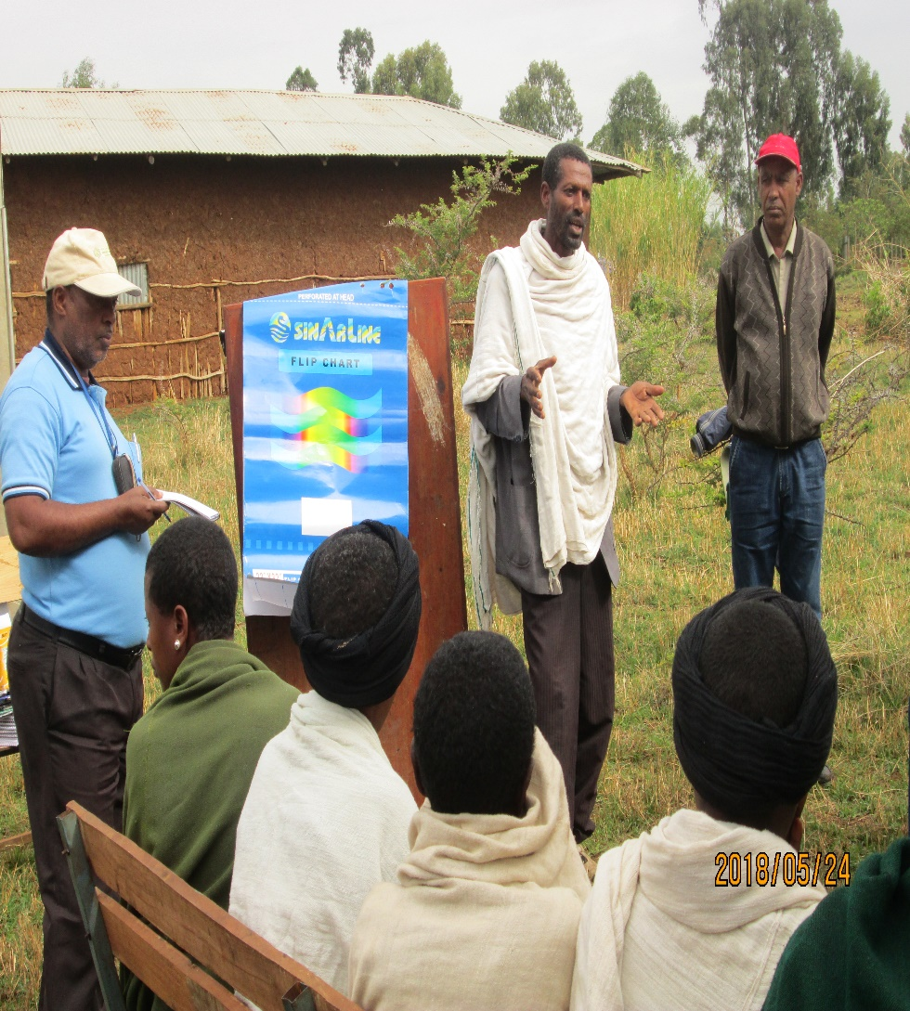
8. Key Implementation Tips
The Sensitization Workshop is an important initial event where the implementers and farmers share SHEP’s vision.
Inviting previous Ethio-SHEP group representatives (male,female) to share their experience provides strong message.

Slide 13
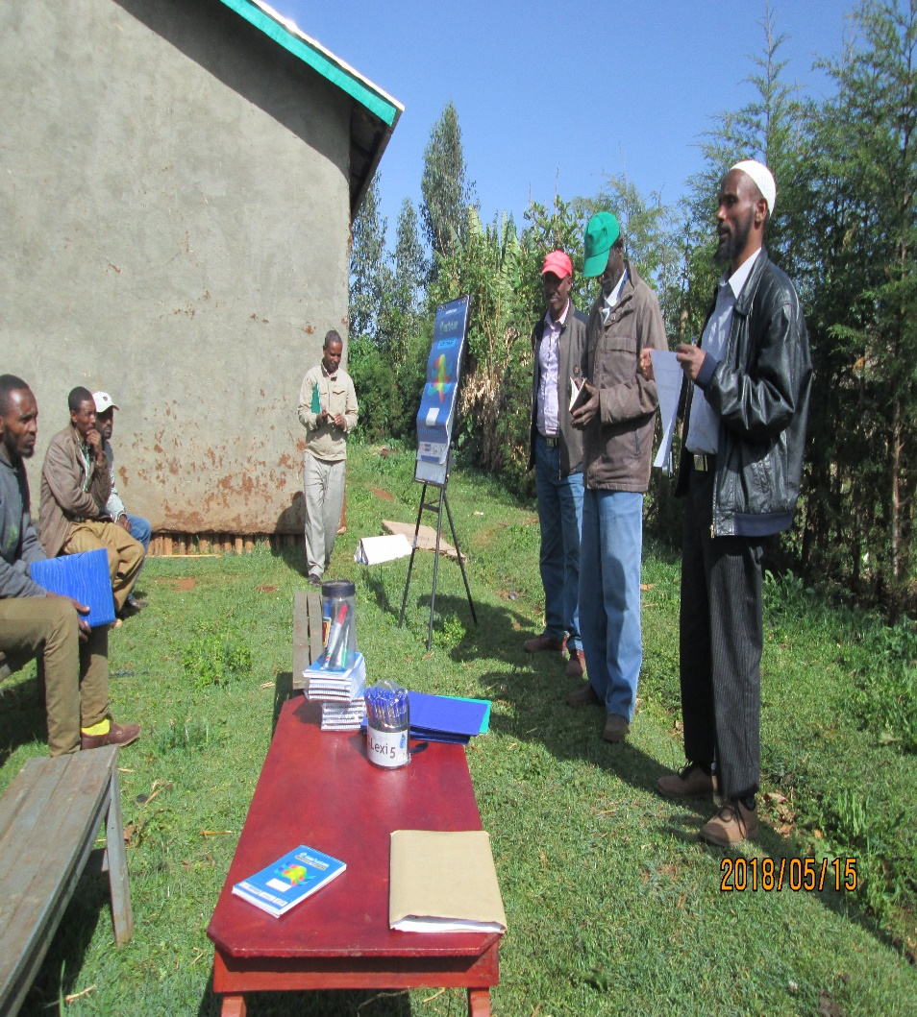
8. Key Implementation Tips
The farmers understand SHEP is purely technical assistance without provision of any financial and material support from the government.
So before the actual intervention, farmers need to have the clear understanding and consensus on the modality among target group .

Slide 14
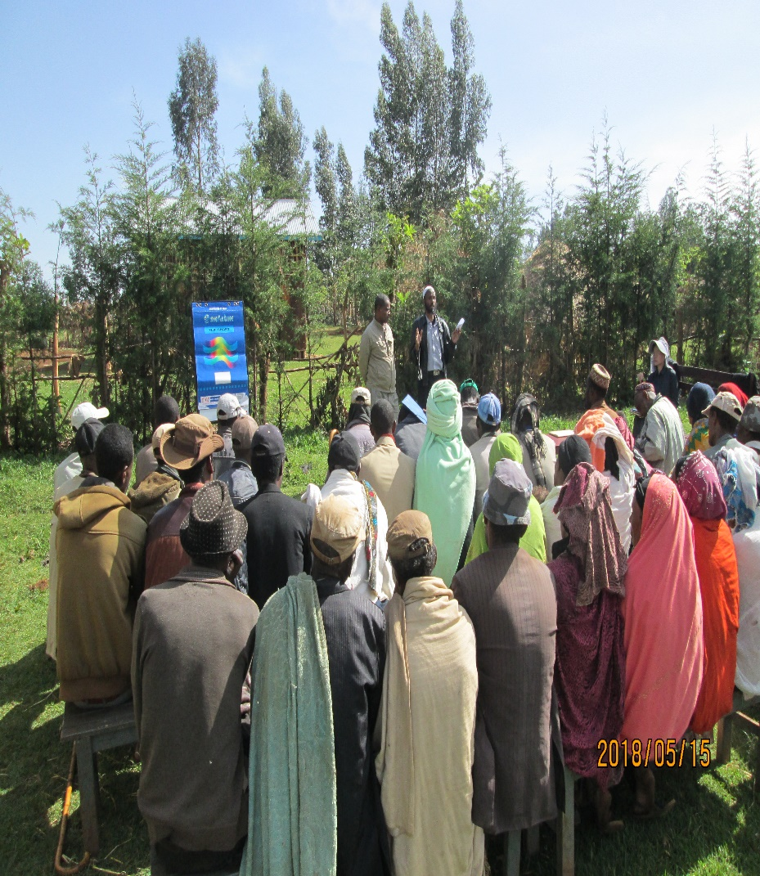
8. Key Implementation Tips
The farmers understand and agree on the vision will be realized only through the farmers’ own initiatives to push forward for market-oriented agriculture.
Farmers need to act proactively for the change.

Slide 15
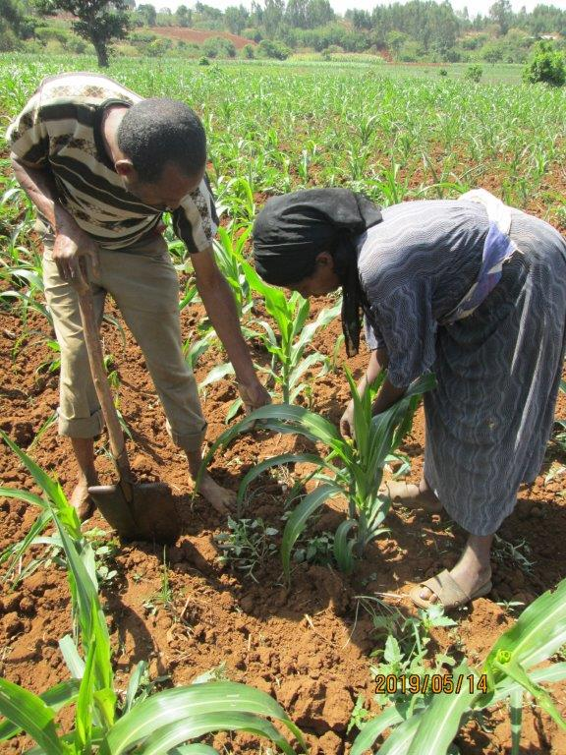
8. Key Implementation Tips
The implementers should emphasize that both male and female members need to equally participate in the trainings.
In addition, emphasizing the “farming as family business”, so joint decision-making by husband and wife as business partner is critical for success.
The implementers should help farmers to engage into discussions on the importance of gender equality and women’s empowerment through Ethio-SHEP activities.

Slide 16
8. Points to be confirmed after activity
The target farmers understand and agree on the intervention modality and upcoming schedule of trainings or events.
The target farmers understand and explain what roles, responsibilities and rights they have as the representatives of the groups and participants of SHEP.

Slide 17
8. Points to be confirmed after activity
The target farmers can envision and explain their goal they will achieve at the completion of Ethio-SHEP training sessions.
The male-female ratio of the participants is balanced.
Discussion on gender equality and women’s empowerment was conducted and the participation of (1) both male and female members and (2) the members and their spouses was encouraged.

Slide 18
THANK YOU
GALATOOMAA
DOMO ARIGATO GOZAIMASU

