Slide 1
The project for Smallholder Horticulture Farmer Empowerment Through Promotion of Market Oriented Agriculture (Ethio-SHEP)
Preparation & Implementation Process of Baseline Survey
Presented to Participants of Ethio-SHEP ToT

Slide 2
Essential 4 Steps
Essential 4 steps | Activities
1. Sharing goal with farmers. | Sensitization Workshop
2. Farmers’ Awareness is raised. | Participatory Baseline Survey Market Survey
3. Farmers make decisions. | Target Crop Selection (Optional) Market Linkage Forum Crop Calendar Making
4. Farmers acquire skills. | In-field trainings (Optional) Exchange Visit Field Day
Follow-up and monitoring (including Participatory Endline Survey)

Slide 3
Contents of the Presentation
Background
Objective
Preparation
Tools of the Baseline Survey
1. Crop Production & Income Analysis Data
(CP&IAD) Sheet
2. General Horticultural Crop Production &
Post- Harvest Handling Techniques
(GHCP&PHHT) 24
5. Implementation
6. Experiences from Ethio-SHEP intervention

Slide 4
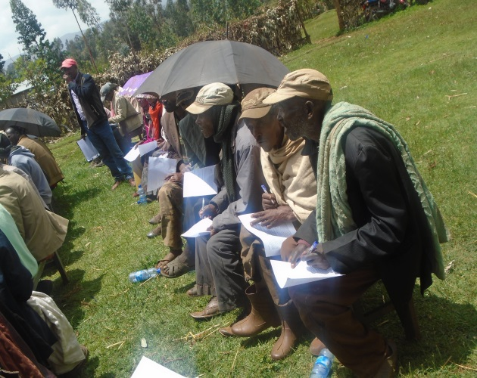
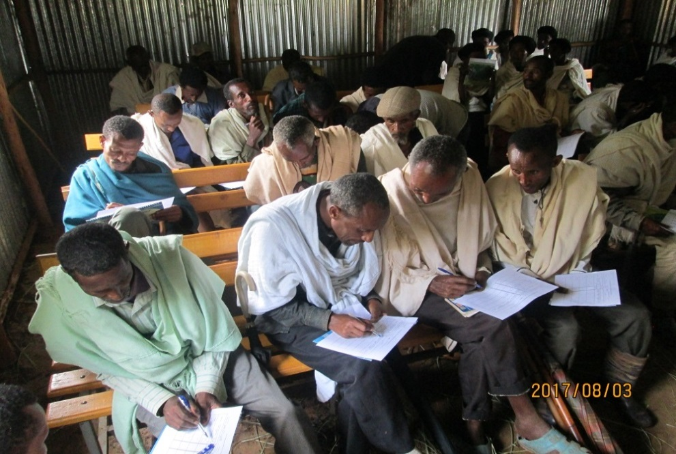
1. Background
Smallholder farmers rarely keep farm records
But, Baseline Survey is essential to determine changes/progress of target groups in order to evaluate achievements.

Slide 5
2. Objective
To collect information about farmers current situation. (level of yield & income) to establish baseline data
To help farmers understand real situation of their horticultural farming (current farm management).
To assess the level of both individual farmers and farmer groups in using basic horticultural production techniques.

Slide 6
3. Preparation and Implementation
Prepare program for the baseline survey by discussing with stakeholders. (farmers representative, woreda, kebele)
Check available venues and convenient time for participants and fix schedule.
Prepare necessary items: presentation materials, Survey Tools, (Translate to local language if necessary), stationaries, etc.

Slide 7
Preparation ….
Send invitation to participants (Farmer group).
Gather target farmers in the venue.
Explain to farmers about the objectives, tools & procedures of Baseline Survey (how to fill the questionnaires)
Distribute tools (questionnaire) for farmers.
Inform farmers to fill the survey sheet by themselves (if they can read and write,,,)
Request literate farmers to support illiterate farmers
Ask experts to follow up and support.

Slide 8
4. Baseline Survey Tool
Baseline Survey Part 1- Crop Production and Income Analysis Data Sheet
Date: / /
Name of woreda: Name of kebele: Name of the Farmer Group:
Name of Farmer: Male/Female: Tel. No.:
Crop Name (Variety) 1 | Field size Unit (Fachasa, ha, Timad) 2 | Harvest Yield (in local unit and KG) 3 |  | Sales Amount (in local unit) 4 |  | Average Price (ETB per local unit) 5 | Total Income (ETB) 6 | Total Production Cost (ETB) 7 | Net Income (ETB) 8
Irrigation crop 1 |  | 1 = kg |  |  |  |  |  | DAP/NPS Urea Chemical Seeds
Irrigation Crop 2 |  | 1 = kg |  |  |  |  |  | DAP/NPS Urea Chemical Seeds
Rain Fed Crop 1 |  | 1 = kg |  |  |  |  |  | DAP/NPS Urea Chemical Seeds
Rain fed Crop 2 |  | 1 = kg |  |  |  |  |  | DAP/NPS Urea Chemical Seeds

Slide 9
4. Baseline Survey Tool
Date: xxxx / xx / xx Example
Name of woreda: xxxxxxxx Name of kebele: xxxxxxxxx Name of the Farmer Group: xxxxxxx .
Name of Farmer: xxxxxxxxx Male/Female: M/F Tel. No.: xxxxxxxxxxxxxx
Crop Name (Variety) 1 | Field size Unit (Fachasa, ha, Timad) 2 | Harvest Yield (in local unit and KG) 3 |  | Sales Amount (in local unit) 4 |  | Average Price (ETB per local unit) 5 | Total Income (ETB) 6 | Total Production Cost (ETB) 7 | Net Income (ETB) 8
Irrigation crop 1 | 3 timad | 1 (qt) = (100) kg 100 qt |  | 90 qt |  | 500 ETB | 45,000 | DAP/NPS: 1,890 ETB / 135kg Urea 1,260 ETB / 90kg Seeds 10,500 ETB/150 kg Chemical 600 ETB / 2 btl Labour 600 ETB Others 300 ETB | 29,850
Potato
Potato
Irrigation Crop 2 | 2 timad | 1 (qt) =( 75 ) kg |  | 180 qt |  | 200 ETB | 36,000 | DAP/NPS 1,680 ETB / 120kg Urea 700 ETB / 50kg Seeds 1,600 ETB / 200g Chemical 1,200 ETB / 3btl Labour 1,000 ETB | 29,820
Head Cabbage |  | 210 qt
Rain Fed Crop 1 | 2 timad | 1 (qt) = (110) kg |  | 11 qt |  | 800 ETB | 8,800 | DAP/NPS 1,600EBT / 100 kg Urea 700 ETB / 50 kg Seeds 1,100 ETB / 50 kg Chemical 1,200ETB / 2 btls Labour 300 ETB | 3,900
Wheat |  | 80 qt
Rain fed Crop 2 |  | 1 = kg |  |  |  |  |  | DAP/NPS Urea Chemical Seeds

Slide 10
4.1. Contents of CP&IAD Sheet
Part 1: Background Information
Date: (Day/Month/Year)
Group Name: ______________
Woreda: _______________
Kebele : _______________
Farmer’s Name: _______________
Male/Female: ________________
Telephone No. ________________

Slide 11
Contents of CP&IAD Sheet Cont’
Part 2: Crop Production Analysis Table
Crop Name and Variety: Indicate name of the Crop and Variety
Area under the Crop: (use any locally available units of measurement but change to ha)
Total Production (Kg): production from the area under the crop, farmers may provide production amount in locally available units, but need to be converted to KG ( Note: unit of measurement is different in each place, so discuss with farmer group and agree on the unit conversion rate to kg)

Slide 12
Contents
4. Total Marketed amount: (in both local unit and KG). Farmers may provide information in local units but need to be changed to KG
5. Average Price per Kg (Birr./Kg): Where unit of sale is not in Kg, convert to KG
6. Total Income (ETB): Average price per Kg (column 5.) multiplied by marketed Produce (column 4.)

Slide 13
Contents
7. Total Cost of Production (ETB) includes:
Cost of seed/planting materials, fertilizers/pesticides,
Labor costs which may include ploughing, disease control (spraying), harvesting etc.
Transportation & marketing costs
8. Net Income (ETB)= Total Income
(Column 6.) minus Total Cost of Production (Column 7.)

Slide 14
5.2. Records to support for baseline survey
Note: Inform farmers to keep record of the following information always
5.1.1. Cost of Inputs
Type of input | Date of Purchase | Quantity | Cost
Seeds | Potatoes (Gudene) July 2021 | 100 kg | 1,800 ETB
Fertilizers
Insecticides

Slide 15
Records ………
5.2.2 Cost of Labor
Type
Farm activity | Date of Implementation | Payment (ETB)
Land Preparation | August 2021 | 3,000 ETB
Nursery Establishment
Transplanting
Weeding
Harvesting
Transportation cost for marketing

Slide 16
Records…
5.2.3. Production & Sales Records
Date of Harvest | Quantity Harvested (kg) | Quantity Sold (kg) | Income (ETB)
20th November, 2021 | 1,200 kg | 900 kg | 12,000 ETB

Slide 17
6. Tools (GHCP&PHHT)
Baseline Survey Part 2. General Horticultural Crop Production & Post-Harvest Handling Techniques (GHCP&PHHT) G-24
This is a tool to assess the level of the target farmers in using basic horticultural crops production techniques
Individual members of them are required to provide information on techniques/skills adopted or not adopted

Slide 18
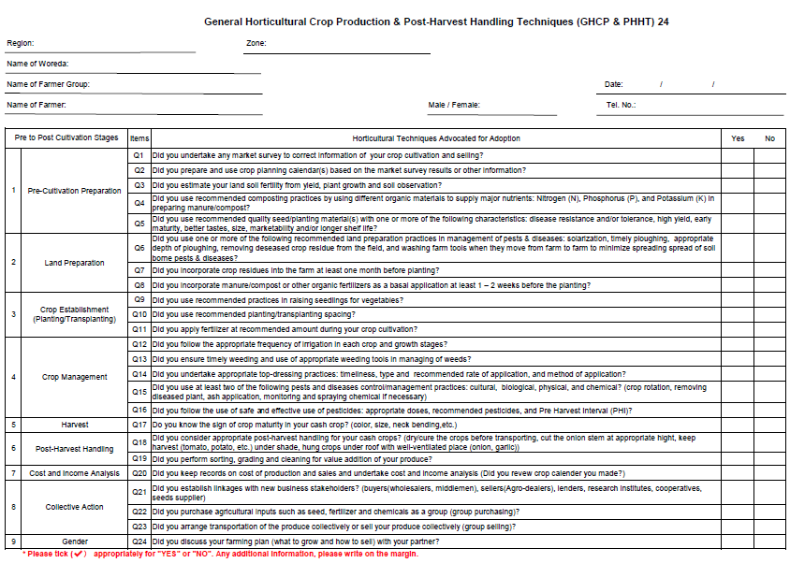
Baseline survey Part 2

Slide 19
6.1. How to Answer the Questions
If your answer is “YES”, simply check “Yes*”
If your answer is “NO”, please check (x )

Slide 20
6.2. Contents of GHCP&PHHT24
Part 1: Background Information
Name of the Farmer Group:
Name of Woreda / Kebele:
Date: dd / mm /2021
Name of Farmer:
Male/Female
Tel. No.

Slide 21
Contents
Par2: This part form has 24 questions organized under the following major categories
Pre-Cultivation Preparation
Land Preparation
Crop Establishment (Planting/Transplanting)
Crop Management
Harvest
Post-Harvest Handling
Group purchase/selling
Gender mainstreaming

Slide 22
7. Remarks
Farmers are likely to over evaluate their skills on GHCP&PHHT24.
We should request farmers to provide honest information on the adopted techniques/skills for GHCP&PHHT24.
Knowing and practicing is different. Some farmer say Yes because they know it, but we are asking whether they practice or not.
Sometime farmer make copy the answer
from nearby farmers.
Special care and support for
illiterate farmers to fill the forms.
This is not a TEST

Slide 23
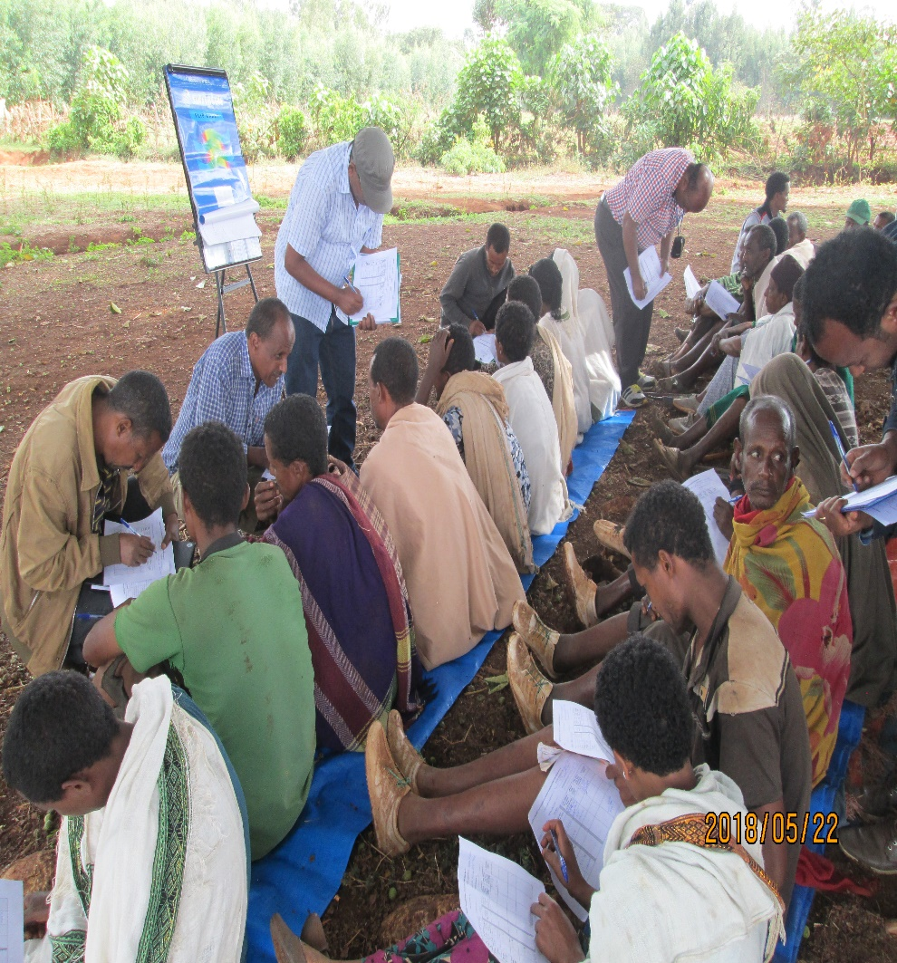
7. Implementation Tips
The survey should be:
more for farmers’ benefit than for implementers’ benefit
Participatory where the target farmers are the main actor of the survey, rather than the extension staff unilaterally collecting information for them

Slide 24
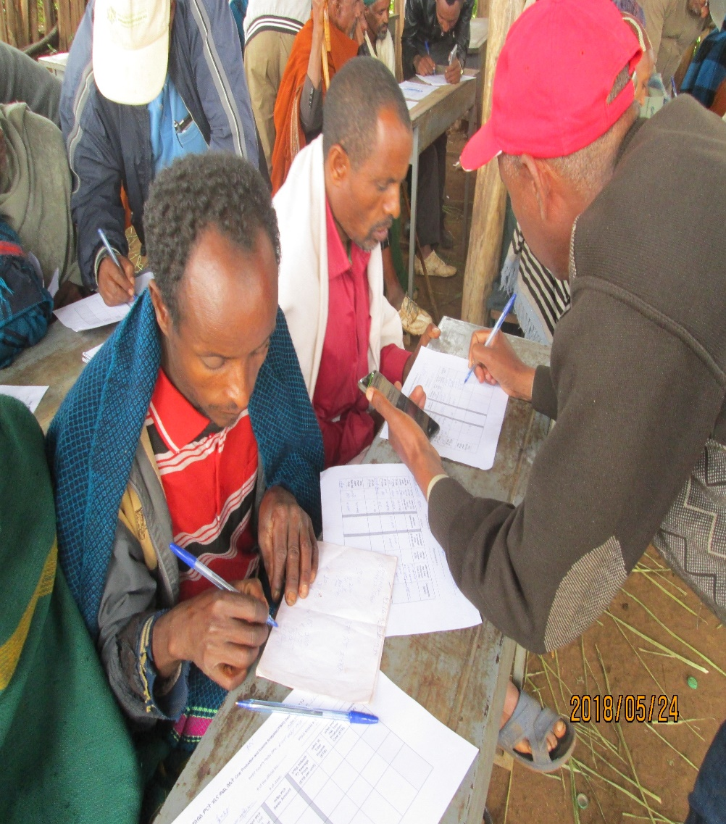
7. Implementation Tips
The extension staff help farmers calculate basic figures such as crop yield, cost, profit, etc. which are important for farm management.
Unit of measurement is different in place to place. Before start collecting data, it is important to discuss with a farmer group and agree on the unit of measurement including quintal, wasera, etc. in their growing crops.

Slide 25
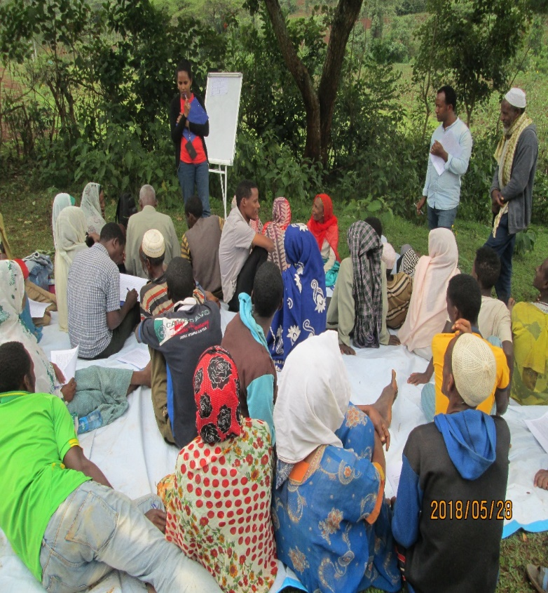
7. Awareness creation
When the farmers finish filling out the forms, facilitator should check their profit and yield. Check the calculation!
After collecting their Baseline survey, compared with other group members and choose farmers who sold at higher price/yield. Let them share with other members why they are better profit/yield than others.
Let the farmers to understand why they have lower income compared with those who earned better profit/yield. (This is the most important process for the farmers to improve their farming practice)

Slide 26
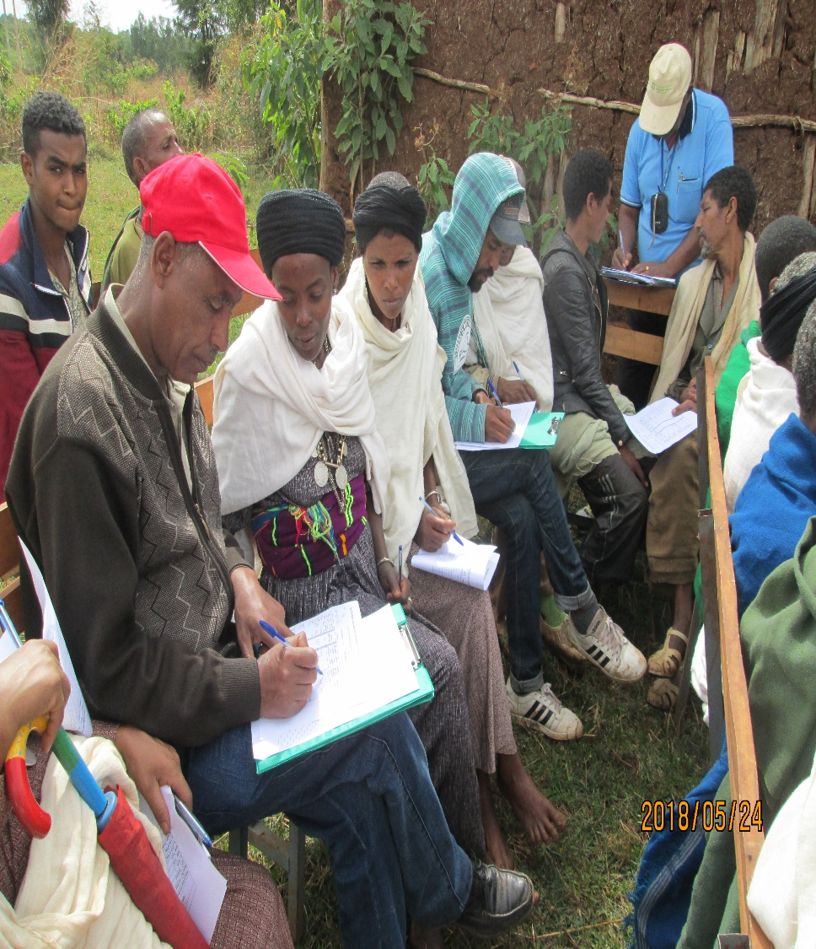
8. Points to be confirmed
The target farmers understand their current production and sales situation and identify gaps that need to be filled.
The target farmers understand their current technical levels in terms of production and marketing and identify gaps that need to be filled.

Slide 27
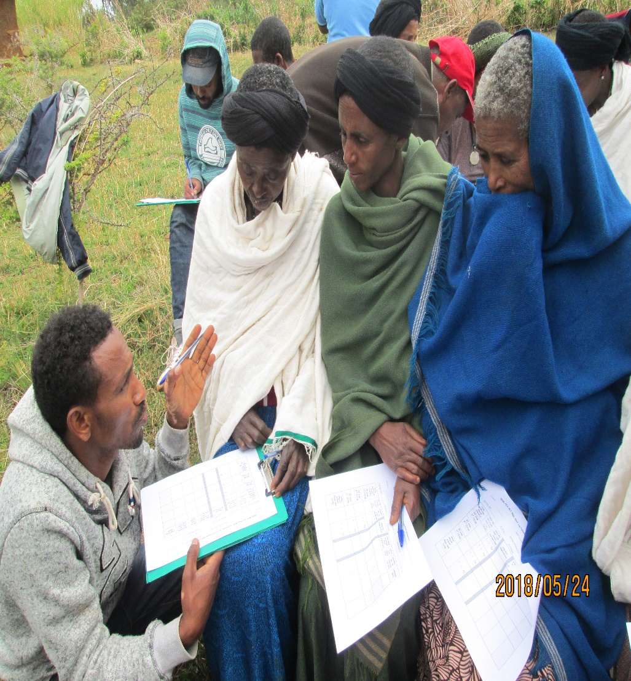
8. Points to be confirmed
The target farmers understand the importance of farm record keeping, both in terms of bookkeeping and farm activity records and become willing to start record keeping.
The male-female ratio of the participants is balanced.
(optional) The members’ spouses are involved.

Slide 28
9. Conclusion
Inform farmers on date and venue of the Baseline Survey
Provide Survey format to the farmers.
Support filling the format especially for illiterate farmers.
Collect survey format and double-check whether they fill out format correctly.
Compare survey format and choose farmers who have higher income/yield.
Ask those farmers to share what is the reason for him/her to achieve higher income/yield.

Slide 29
THANK YOU
DOMO ARIGATO GOZAIMASU

