Slide 1



Japan International Cooperation Agency
Preparation & implementation Process of Market Survey, Crop Selection
Presented prepared
for Ethio-SHEP ToT

Slide 2
Contents of the Presentation
Introduction
Objective
Market Survey
Market Survey Procedure, Results
Implimentation
Implementation tips
Lessons from Ethio-SHEP Experiences

Slide 3
Essential 4 Steps
Essential 4 steps | Activities
1. Sharing goal with farmers. | Sensitization Workshop
2. Farmers’ Awareness is raised. | Participatory Baseline Survey Market Survey
3. Farmers make decisions. | Target Crop Selection (Optional) Market Linkage Forum Crop Calendar Making
4. Farmers acquire skills. | In-field trainings (Optional) Exchange Visit Field Day
Follow-up and monitoring (including Participatory Endline Survey)

Slide 4
Introduction
Ethio-SHEP approach focuses on providing market-oriented extension service for smallholder horticulture farmers to increase their income from horticulture production and marketing.

Slide 5


Objectives
The main objective of this training are:
to learn the importance of the farmer-centered market survey
to provide practical experiences on how to conduct market survey and crop selection.
Building trust between farmers
& market actors
Filling the information gap between farmers and market actors (wholesaler, agro-dealer, middleman) through continuous market survey

Slide 6
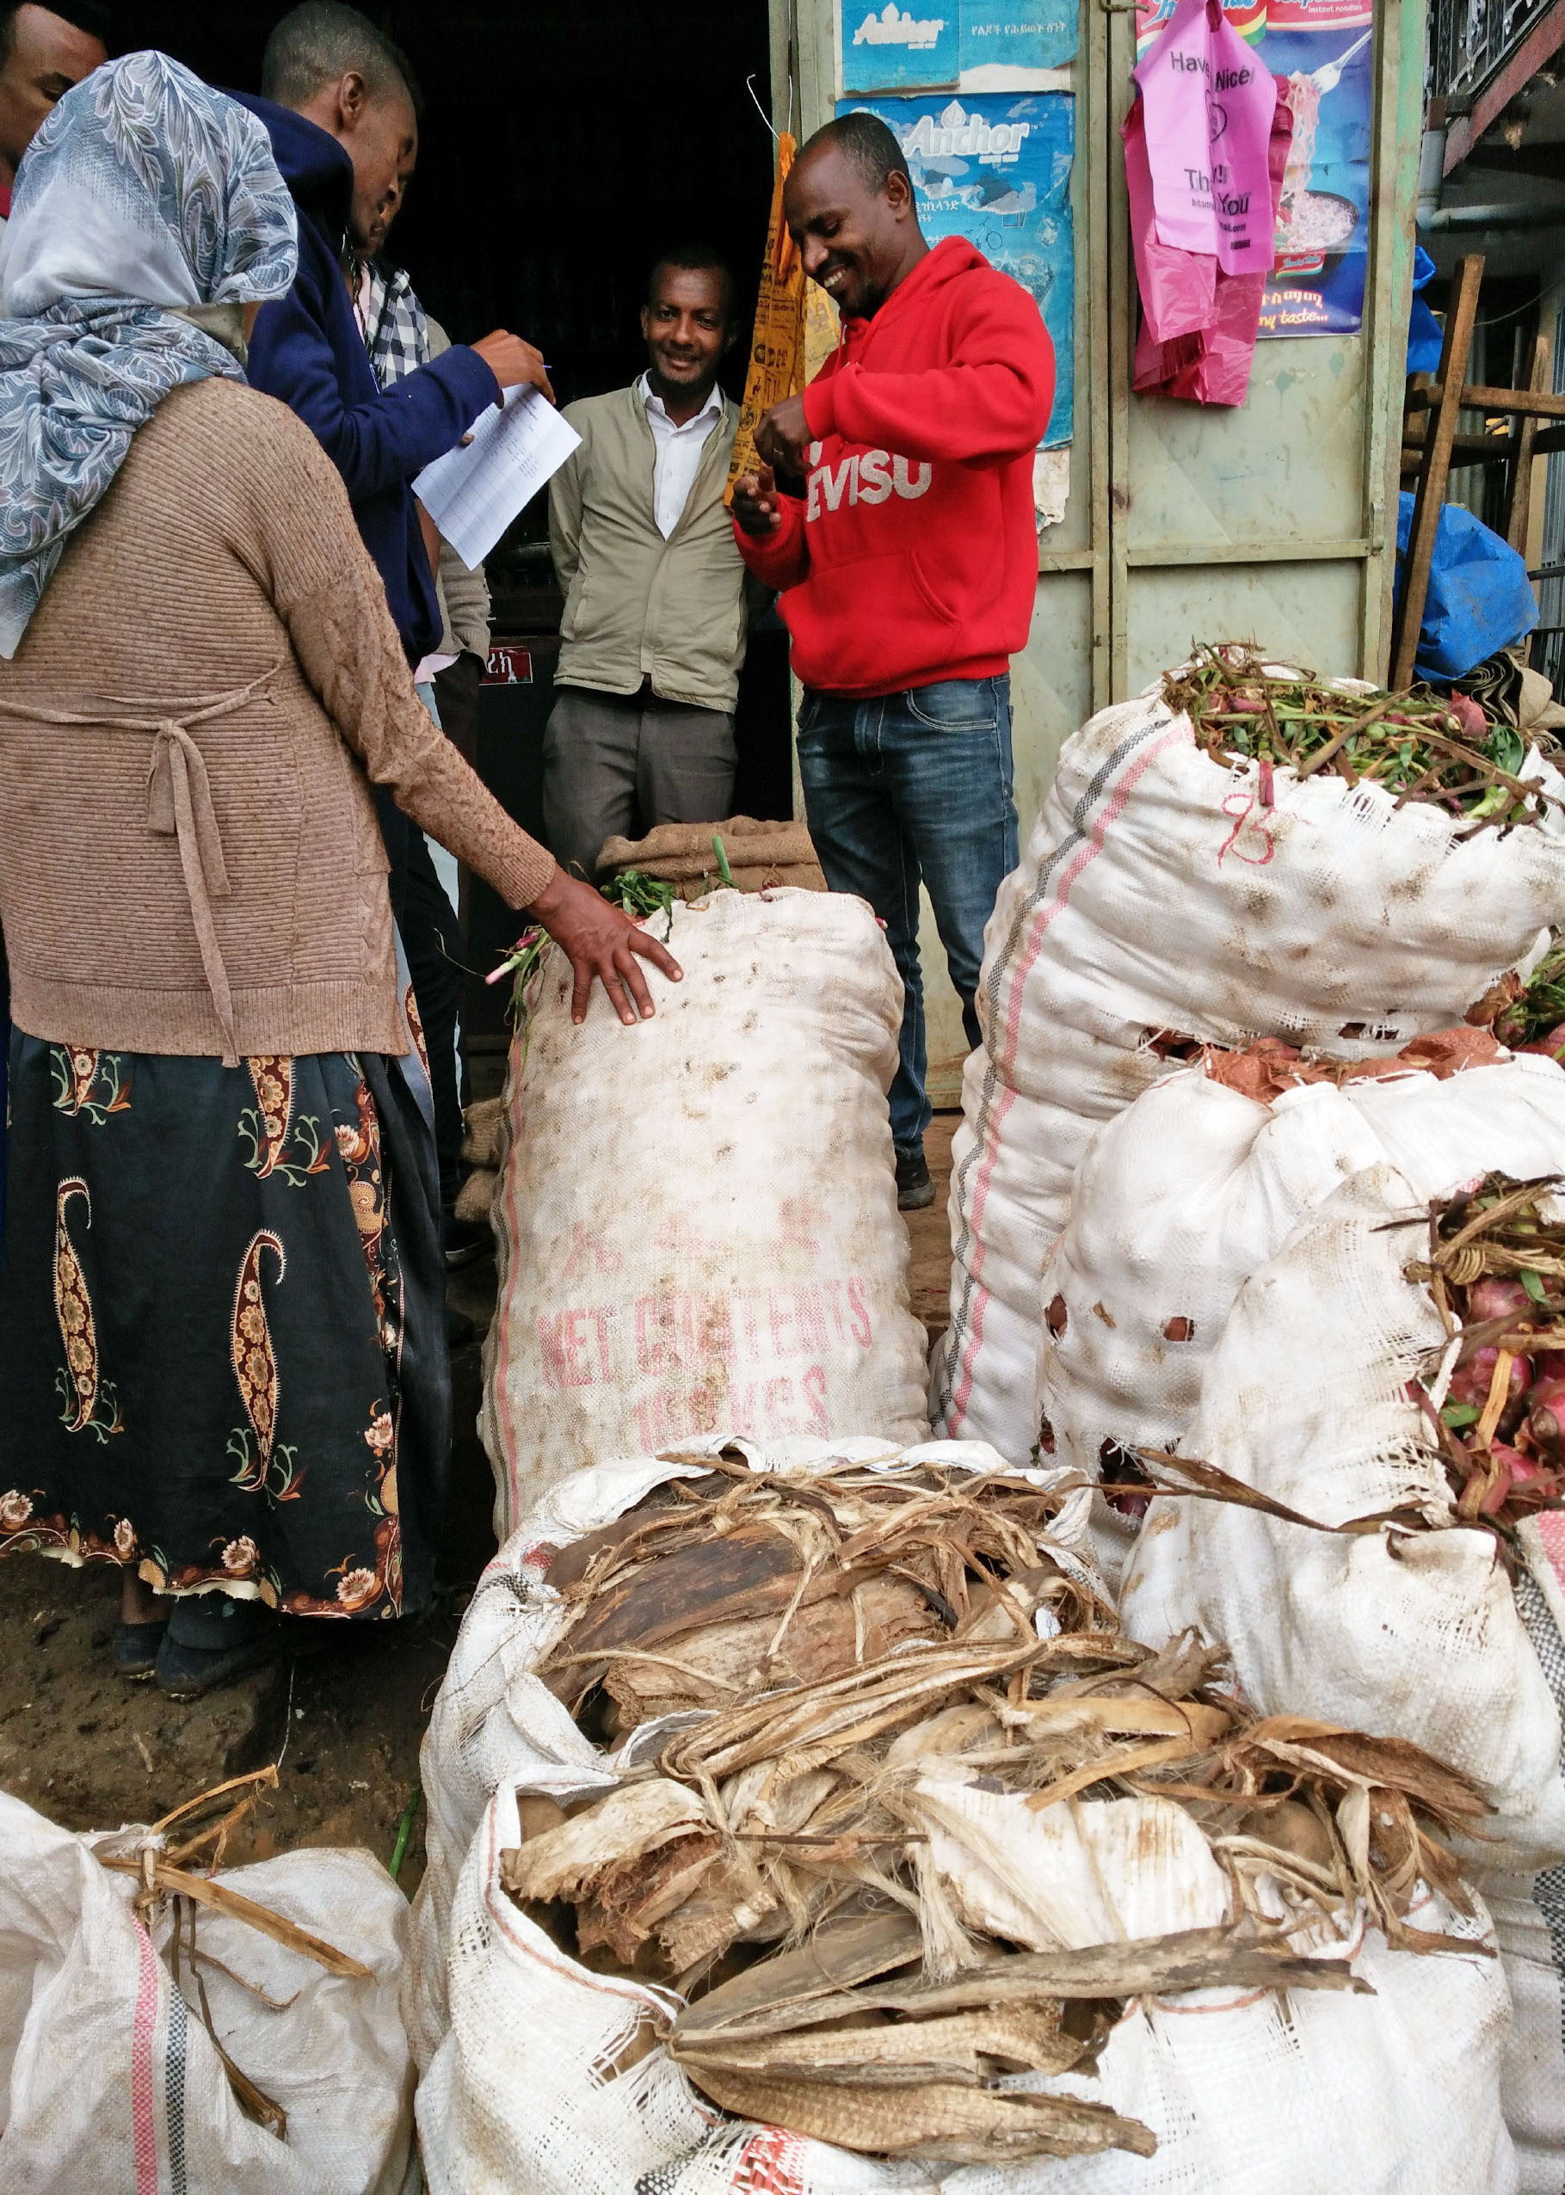
Market Survey
What is Market Survey?
Market Survey is to collect necessary information by farmers about price, high demand season and required quantity, etc.
It is a very important activity to practice Farming as business.
Farmers conducting the Market Survey

Slide 7
Market Survey Cont’
!
Why is Market Survey important?
Market survey should be done by farmers
Gather the information about the market (general information, services, needs & requirements of target produce etc.) and evaluate market conditions (quality, quantity, price etc.) of horticultural produce(it is applicable for any commodities like livestock, cereal etc.)
Make decisions on how to better meet the market & customers demands
Notes:
Market information includes: market day, what time should they bring their crops, where the target crops coming from? Why traders buy from there? Compare the quality and price in the surveyed market and nearby bigger market.
. Make decisions: to meet market requirement, what farmers need to change? Variety? Field management? Some trader said they prefer to buy potato from certain region because farmers stop irrigating crops before harvesting so that their crops are well cured. There is less damage, but in the region the farmers coming from, they keep irrigating their potatoes until harvest, because farmers was trying to cheat

Slide 8
Market Survey Procedure
Identify nearby markets and select appropriate markets to be visited (Check market day and dates and their main crops to be traded)
identify major dealers of the target crops
Discuss with target farmers about market survey (Objective, purpose, procedure)

Slide 9
Market Survey Procedure
List Target Crops to be surveyed based on farmers preference, capacity, experience, agro-ecology) at least Five (5) Crops can be listed
Select representative farmers to conduct market survey (assign clear role and responsibility for each member)
Agree on day, time & meeting place for the survey

Slide 10
Market Survey Procedure
Prepare the survey questionnaire (Translate into local language, see attachment for Amharic or Oromiffa ver.)
Get permission from the relevant market authority for carrying out the survey. (Ask trade office to seek information for traders)
Request the market authority to introduce with major dealers.

Slide 11
Market Survey Procedure
Make appointment for actual market survey date based on availability of dealers.
* Most of the case, market-day is preferable for conducting market survey

Slide 12
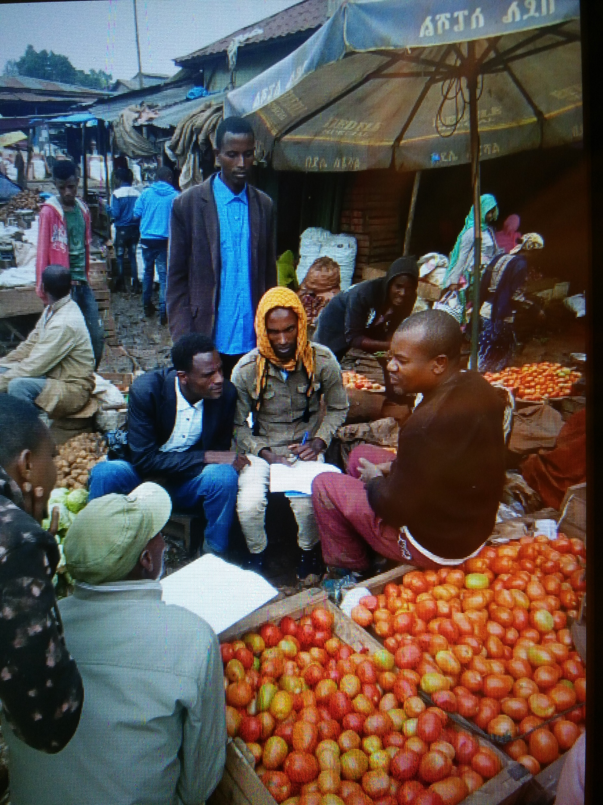
Determine the Markets
It is necessary that major markets for the target crops be identified
  The major markets are more reliable in terms of the quantities, consistency and even prices
Alternative markets, e.g. schools, hospitals, hotels etc., can also be identified
Jimma City Market

Slide 13
Prepare the Survey Questionnaire
Market Survey Questionnaire
Name & Contact of the Produce Dealer | Produce & Variety | Produce Quality Market Requirements | Peak Demand (months) | Quantity (kg) & Frequency (daily/weekly etc.) of Supply | Place of Production | Purchasing Unit Price (Et.Br./kg) | Mode of Payment | Terms of Payment | Marketing Challenges | Dealer’s Willingness to Purchase the Produce from the Group (*)
Sample of Market Survey Questionnaire

Slide 14
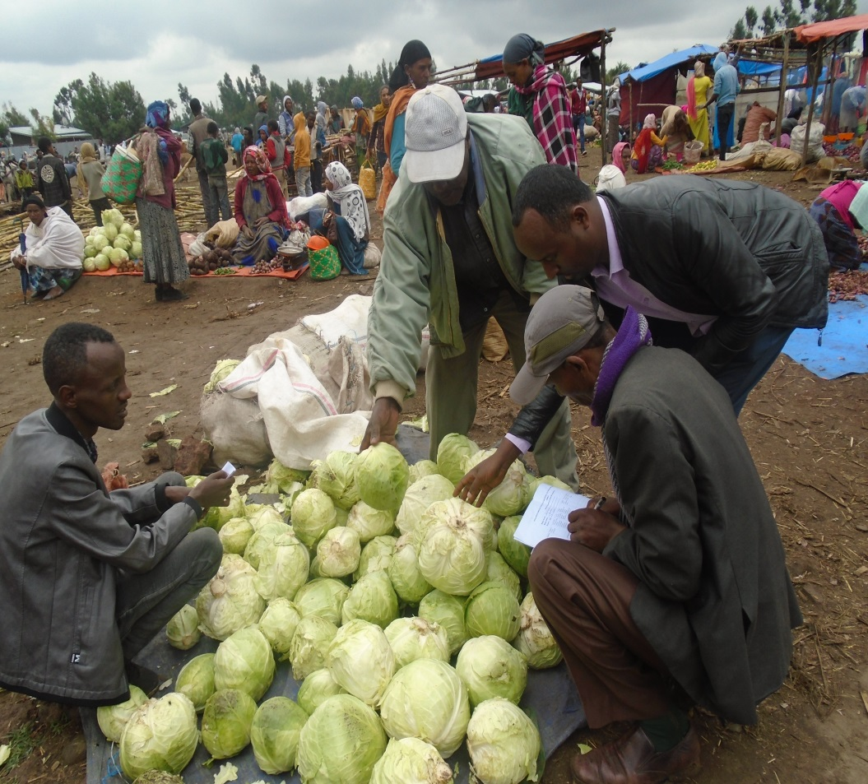
Prepare the Survey Questionnaire
Market Survey Questionnaire should contain:
Name and Contact of the target produce dealers
Produce/crop and Variety
Quality of produce
Season/month for peak demand
Quantity and frequency of demand of the target vegetables by dealers
Farmers asking questions during the market survey

Slide 15
Prepare the Survey Questionnaire
Place of Production
Unit price
Mode of payment
Terms of payment
Potential marketing challenges
Possibility of selling the target crops to the interviewee (produce dealer)
Farmers asking questions during Market Survey

Slide 16
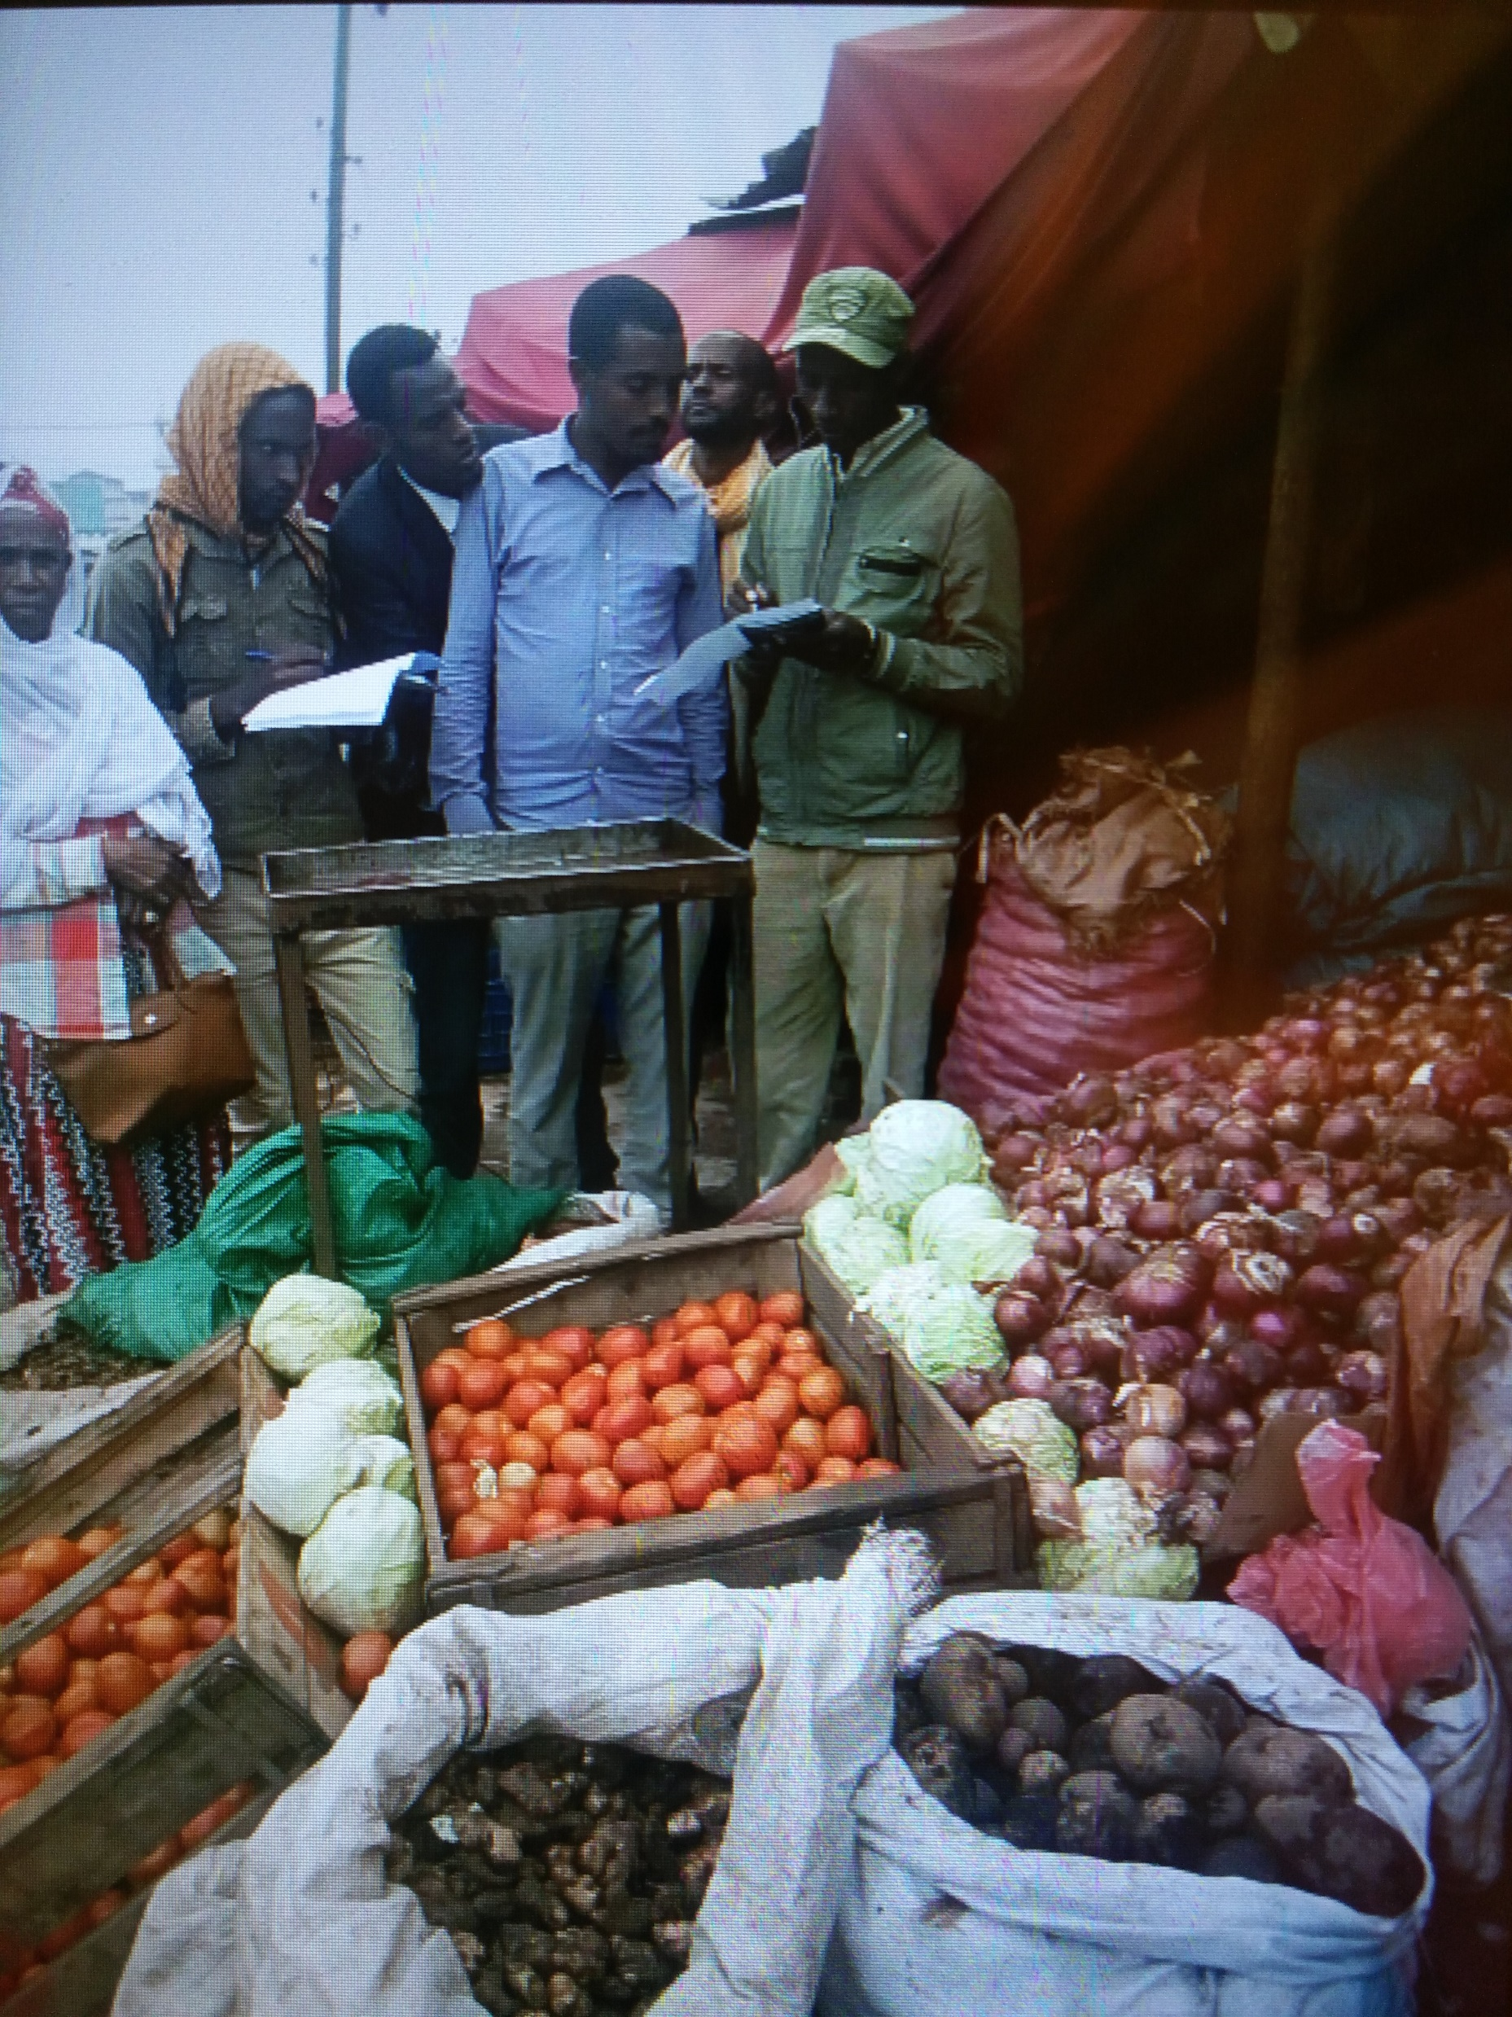
Seek Market Authority
It is important to seek permission to carry out the survey from the relevant market authority before the actual market survey
Prior discussion with a Wholeselers & produce dealers

Slide 17
Identify Major Dealers
Request the relevant market authority to introduce you to the major dealers of the target crops:
  For purposes of building relationship
  Explaining the purpose of the survey
  Making appointment for actual market survey

Slide 18
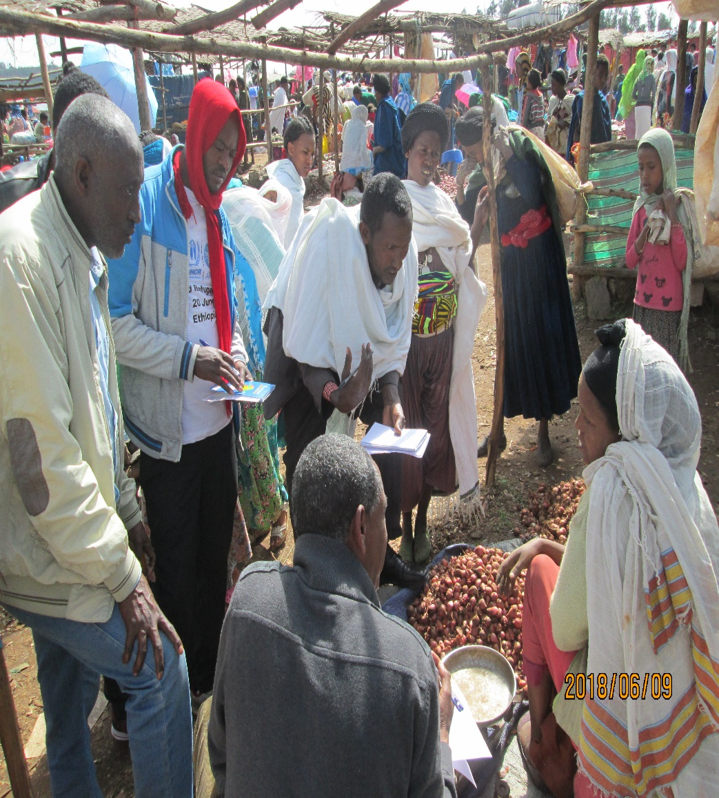
Implementation of the Survey
Timing: Morning time is preferable to find more dealers
Instruction: Give clear instruction for the representative farmers before the survey.
Assign duties & responsibilities (team leader, note taker, time keeper, interviewer)
Support: Experts support each farmer’s group
A Group Facilitator confirming the arrangement of survey

Slide 19
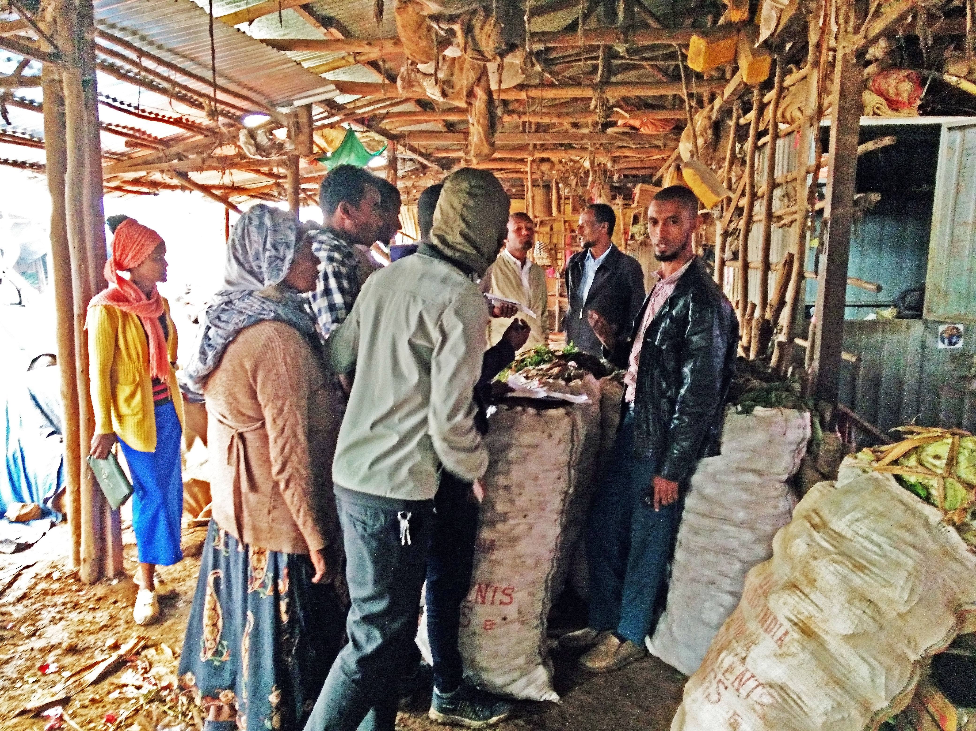
Carry out the Survey
Farmers
Wholesaler
Conduct the survey with respective working groups
Ensure all questions have been asked for the target crops
Observe the market carefully….
Market Survey by Farmers

Slide 20
Carry out the Survey Cont’
Note:
Keep the appointment time with the respective dealers
Avoid over crowding at the dealer’s stall
Temporarily suspend the interview to allow the dealer to serve the customers
A Wholesaler giving information on varieties of produce

Slide 21
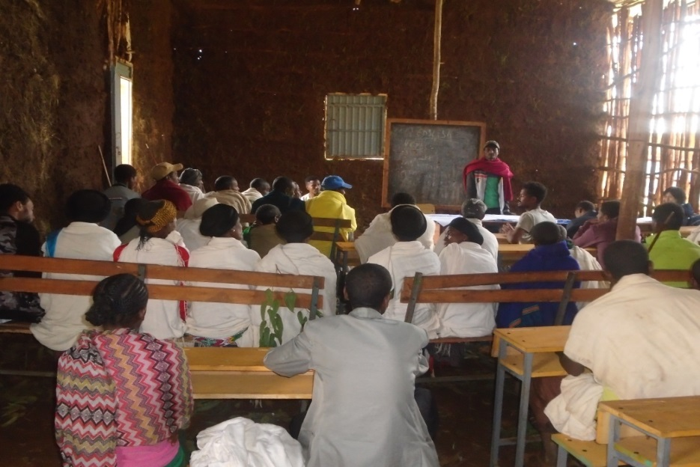
Analyze & Make Conclusion
DAs& Representative farmers
need to:
Collect all questionnaires & information of the survey
Summarise key findings
Analyse results of the survey
Share the results with all members of the group

Slide 22
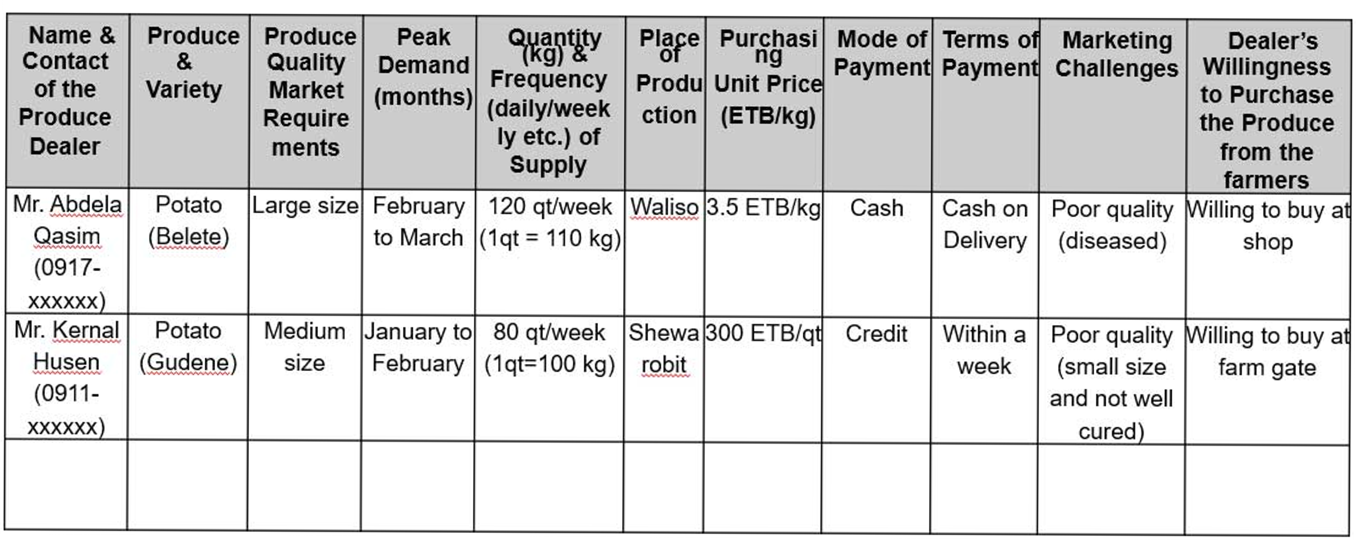
Result of Market Survey
Example of filled Market Survey Questionnaire

Slide 23
Implementation Tips
The market surveys should be conducted by farmers, not by government staff, with a questionnaire form in hand.
Roles of experts as supporter and facilitator for the smooth implementation.

Slide 24
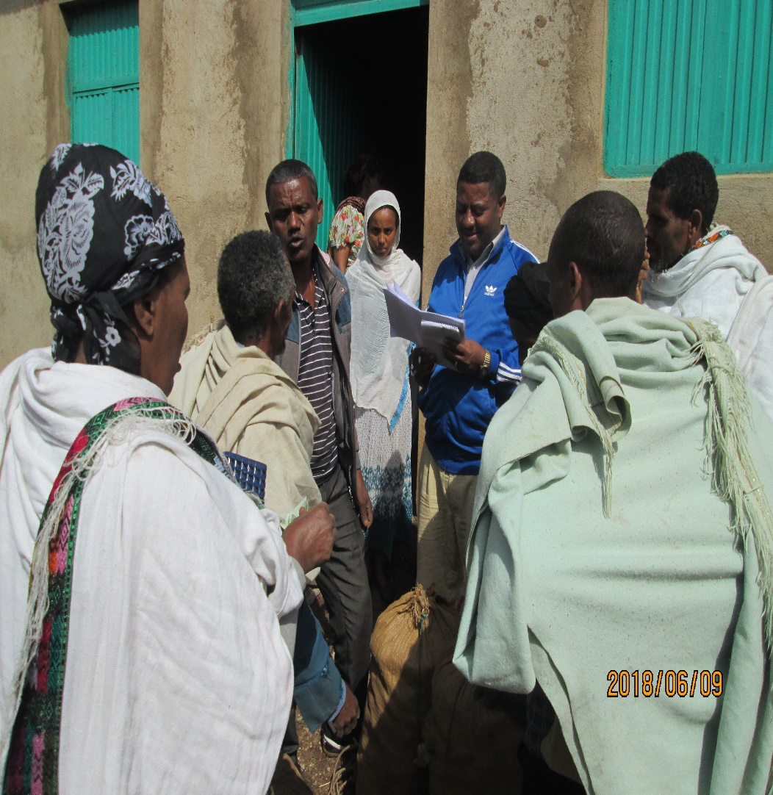
Implementation Tips
The market surveys aim at collecting information on not only market prices but also required quality and quantity of produce, seasonal fluctuations of prices and traded quantity, mode of payments, etc.

Slide 25
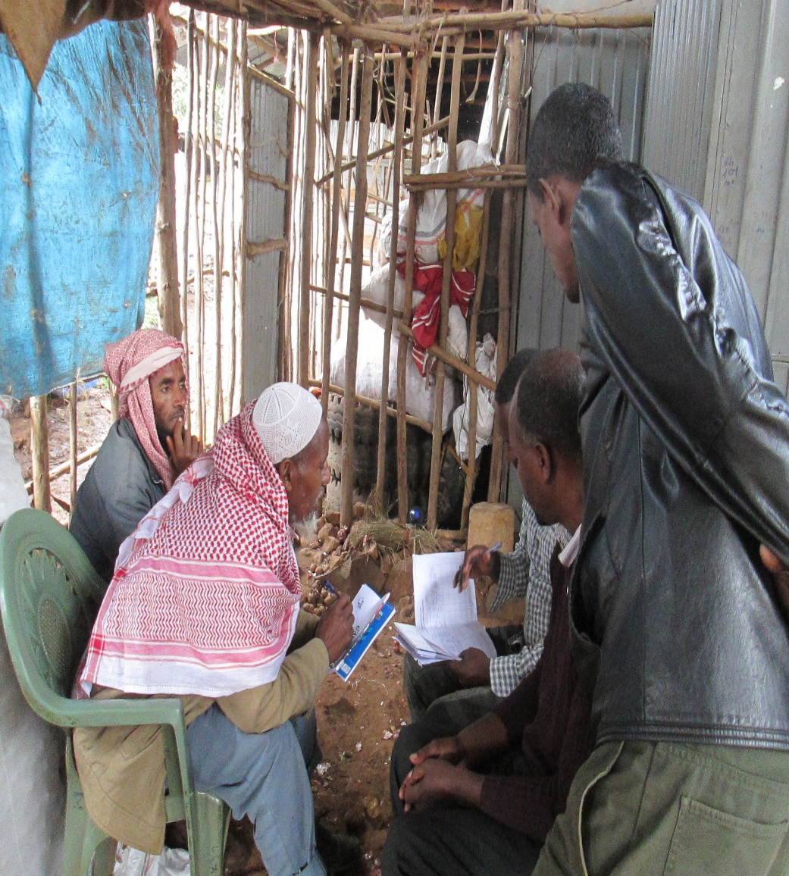
Implementation Tips
During the market surveys, the farmers are encouraged to establish business relationships with the market players they meet at the market.
Some farmers make business linkage during market survey!

Slide 26

Implementation Tips
Why market survey should be conducted continuously?
Farmers should understand that market surveys need to be carried out continuously by themselves on a regular basis without the help of the government.

Slide 27
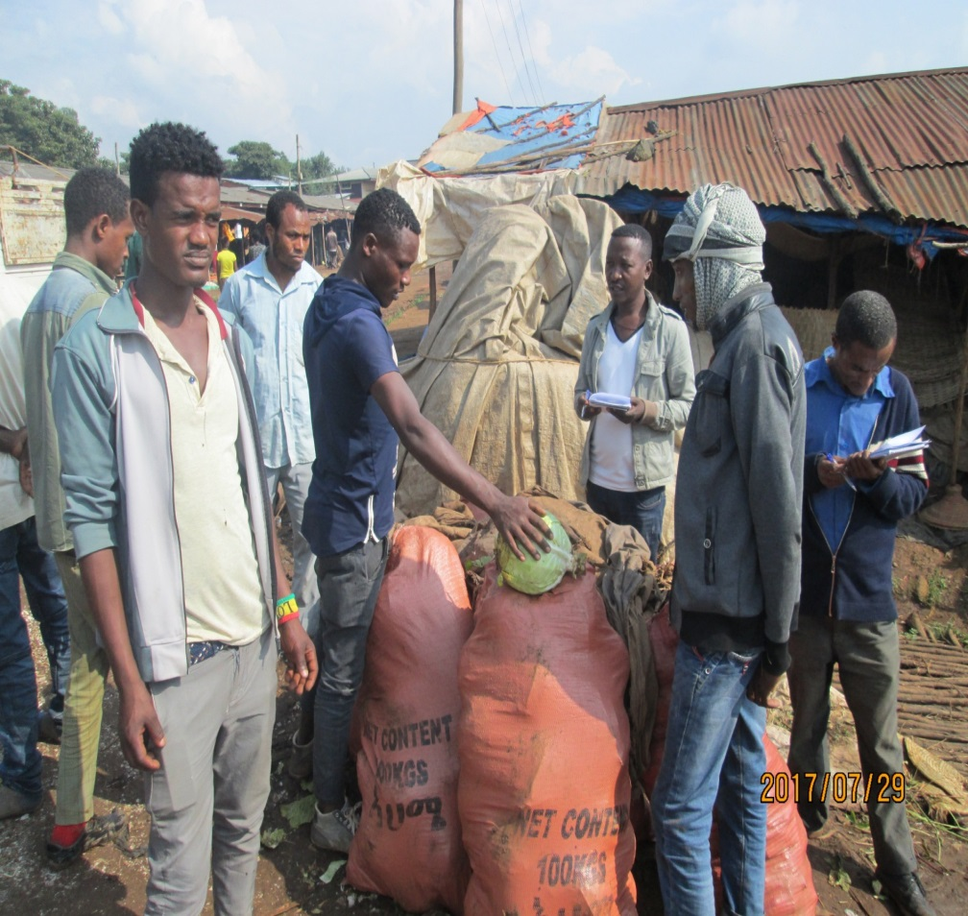
Challenges
Sometimes traders are not cooperative to the survey team.

Slide 28
Lessons from Ethio-SHEP Experience
It is difficult to find whole sellers for horticulture in most of woreda markets, so zonal markets can be options because there are more dealers which provide more information
Information from retailers is very limited and may not be enough to understand the real situation in the market.
Some dealers do not provide information during survey because of fear about tax related issues.
Farmers may be shy to have active conversation with traders during the survey.

Slide 29
Japan International Cooperation Agency
Crop Selection
Presented prepared
for Ethio-SHEP ToT

Slide 30
Essential 4 Steps
Essential 4 steps | Activities
1. Sharing goal with farmers. | Sensitization Workshop
2. Farmers’ Awareness is raised. | Participatory Baseline Survey Market Survey
3. Farmers make decisions. | Target Crop Selection (Optional) Market Linkage Forum Crop Calendar Making
4. Farmers acquire skills. | In-field trainings (Optional) Exchange Visit Field Day
Follow-up and monitoring (including Participatory Endline Survey)

Slide 31
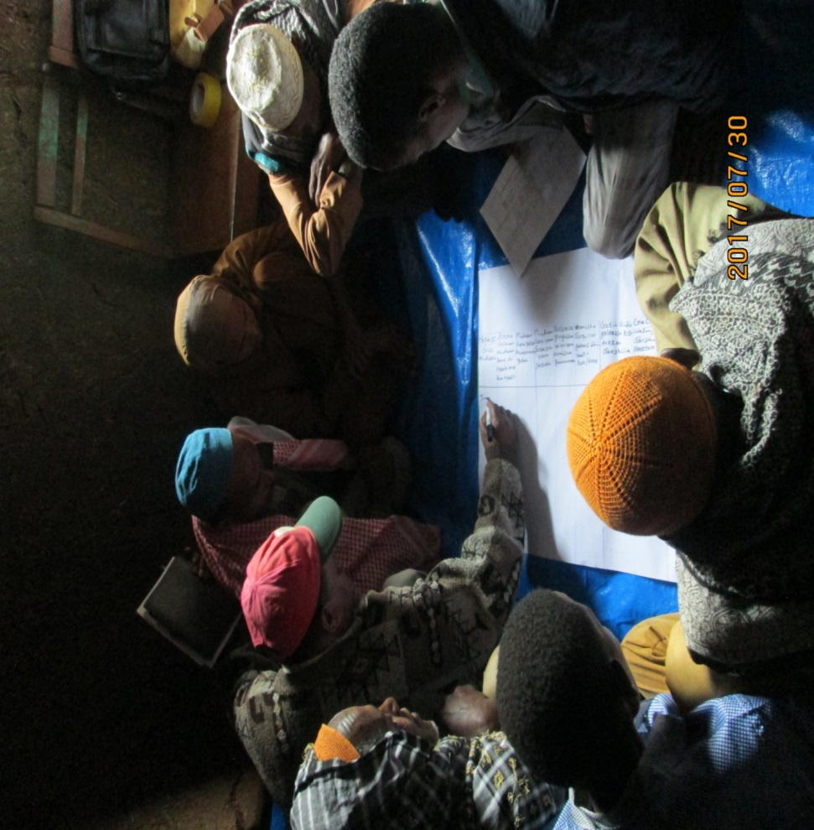
Crop Selection
Crop Selection is a process of choosing their target crops by members of Farmer Groups
Result of the Market Survey is used to decide the Two (2) Horticultural Crops through Crop Ranking

Slide 32
Objective
To undertake Crop Selection & Ranking in order to come up with two (2) priority horticultural crops which would lead Farmer Groups to increased income.
To motivate group members to produce adequate quantity and quality for the identified market.

Slide 33
Preparation
Prepare program for crop selection by discussing with stakeholders. (farmers representative, woreda and kebele experts)
Check available venues and convenient time for participants (Group members) and fix schedule.

Slide 34
Preparation
Prepare necessary items (presentation materials ,flip charts, pen notebook, crop selection sheet)
Translate crop selection sheet to local language (if necessary)
Send information to the participants about the date and venue.

Slide 35
Implementation Procedure
Gather target farmers in the venue.
Explain to farmers about the objectives, tools & procedures of crop selection (how to fill the format)
Request representative farmers (who conducted market survey) to share their experiences/ findings in the market to other farmer groups.

Slide 36
Implementation Procedure
Review Market Survey findings/results for each candidate crops by farmer groups.
Prepare and fill Crop Selection Sheet
Facilitate the group members to discuss & understand information entered for each candidate crop.
Facilitate the group members about past production experience (Goood or Bad!) on selected crops.

Slide 37
Implementation Procedure
Facilitate voting by farmers on each candidate crop based on their preference.
Decide Crop Ranking (1~5) in the Crop selection sheet based on results of vote.

Slide 38
Implementation Procedure
Select 2 priority crops based on results of voting
Group members choose their preferred crops in a democratic manner.
Members discuss their decision on information in the Crop Selection Sheet.
N.B Selected Crops should be easy to grow, suitable to local growing condition, low technical requirement and availability of inputs, affordability.

Slide 39
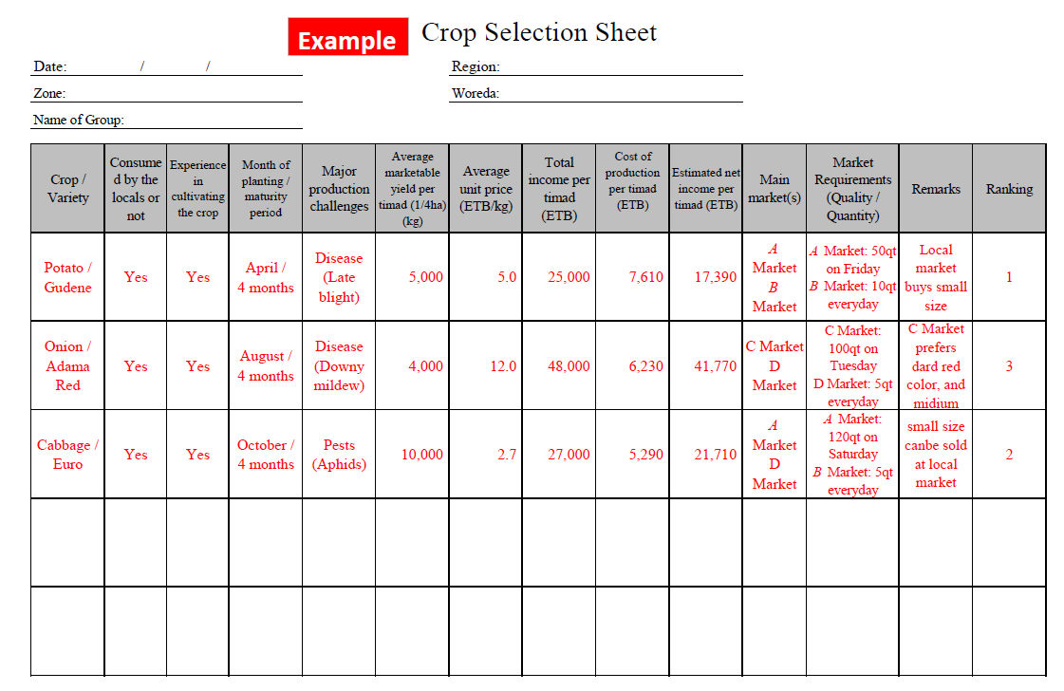
Crop Selection Sheet

Slide 40
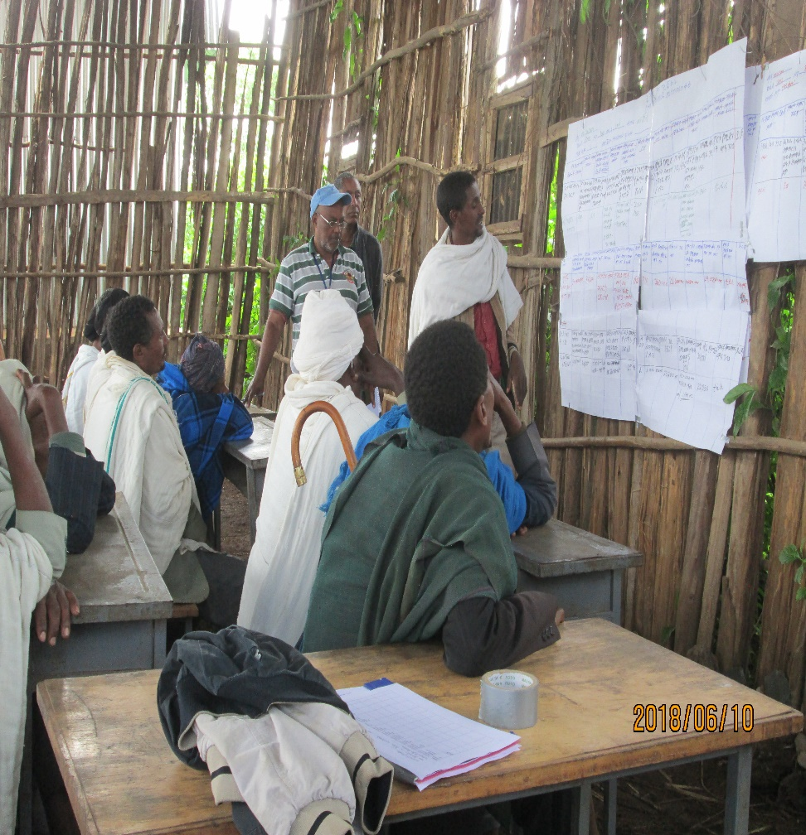
Implementation Tips
The target farmers understand that not only profitability but also agro-ecological conditions, technical skills and financial capacity, need to be taken into consideration in choosing crops to grow.

Slide 41
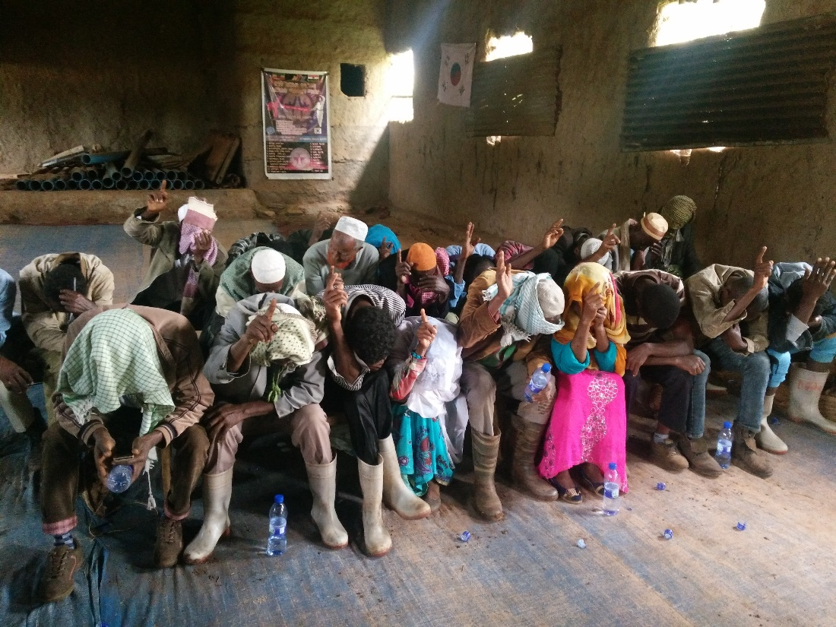
Implementation Tips
Voting: Each group member votes for his/her preferred crops (blind voting) – write the name of his/her 1st & 2nd preferred crops on the voting paper. The majority, preferably more than 70%, of the group members should participate in this process to build a consensus among the group members. Rank the crops in accordance of the number of votes and choose two target crops.
Tip! The extension staff should ensure that powerful members of the group, such as group leaders, elderly or well-educated members, do not influence the group’s decision.

Slide 42
Lessons from Ethio-SHEP Experience
Farmers may not have experience to contribute to the discussion and make decision on the crops during the crop selection process.
Farmers may have expectation of some support from project (seeds, tools) and may select new crops which are not relevant to the group.
Backstopping by experts is necessary to provide technical guidance on candidate crops for farmers during crop selection.
Challenges related to selected crops should be discussed.

Slide 43
Lessons from Ethio-SHEP Experience
Even if two priority crops will be selected by target farmers, farmers group members can continue to grow other low ranked crops individually.
Crop selection should be conducted regularly after every Market Survey.
Crop Ranking is only one of the objective of this activity. But all the farmers needs to understand each crop’s profitability, peak demand, target market, etc.
Expert should facilitate farmers to buy inputs together or marketing together as a group to gain bargaining power.

Slide 44
Thank you for your attention
THANK YOU
【Ethio-SHEP Project Office】
Address: 3rd Floor, Building A Horticulture Development & Technology Transfer Directorate (HDTTD)
E-mail: ethioshep@gmail.com

