Slide 1
Market Linkage stakeholders Forum
Presented to Participants of Ethio-SHEP ToT
The project for Smallholder Horticulture Farmer Empowerment Through Promotion of Market Oriented Agriculture (Ethio-SHEP)

Slide 2
Objective
The Market linkage Forum has two purposes:
(1) it shows farmers a business opportunity in horticultural farming
(2) it helps farmers to have direct business talk and establish business linkages with a variety of market actors involved in horticulture business.
*At the same time to discuss about the issues & bottle-neck faced by farmers related horticulture marketing for the improvement

Slide 3
Outline
The half-day Market Linkage Forum invites the representatives of the Ethio-SHEP target farmer groups and market stakeholders such as agricultural input suppliers, buyers (traders, middlemen, wholesalers, retailers, etc.), food processing companies, crop exporters, transporters, financial institutions, non-governmental organizations and so forth.
The farmers visit the booths of the market stakeholders and exchange information through business talks.

Slide 4
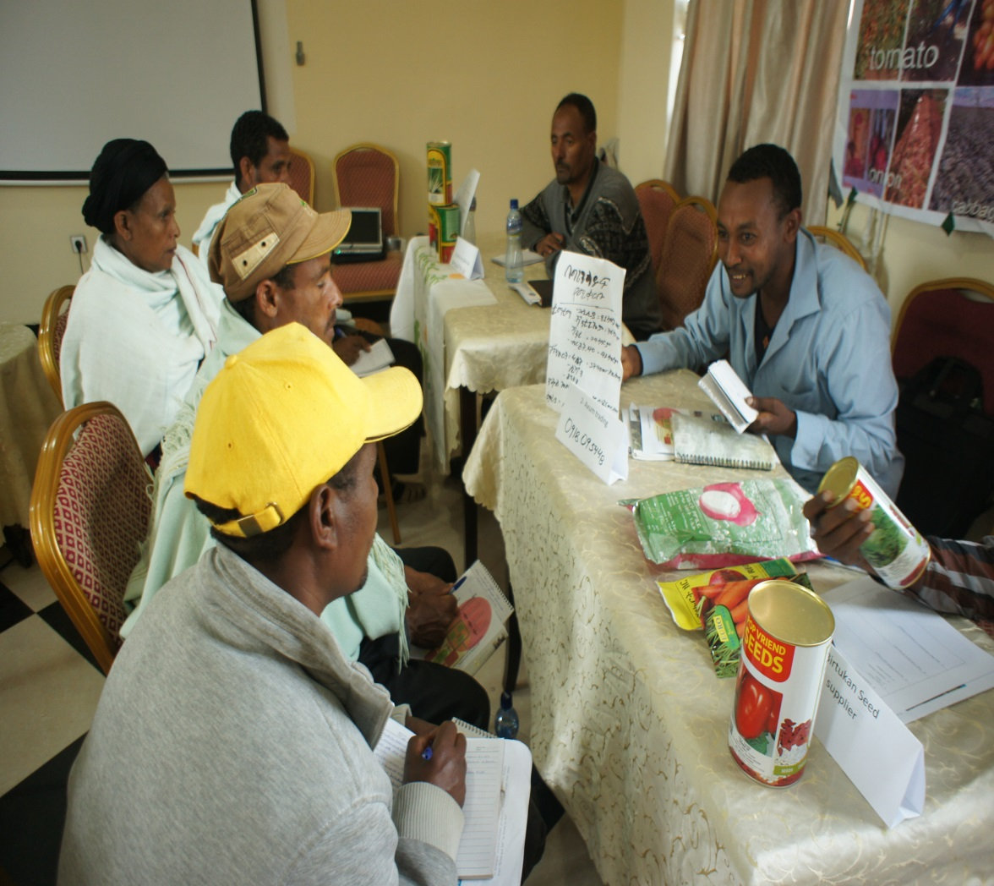
Key implementation Tips
Unlike large-scale events such as Agricultural Fair or Agricultural Day, the Market Linkage Forum should restrict the number of participants for facilitating easier communication between selected participants.
Only those market stakeholders, such as those local traders, who would become future business partners of the Ethio-SHEP farmer groups should be invited.

Slide 5
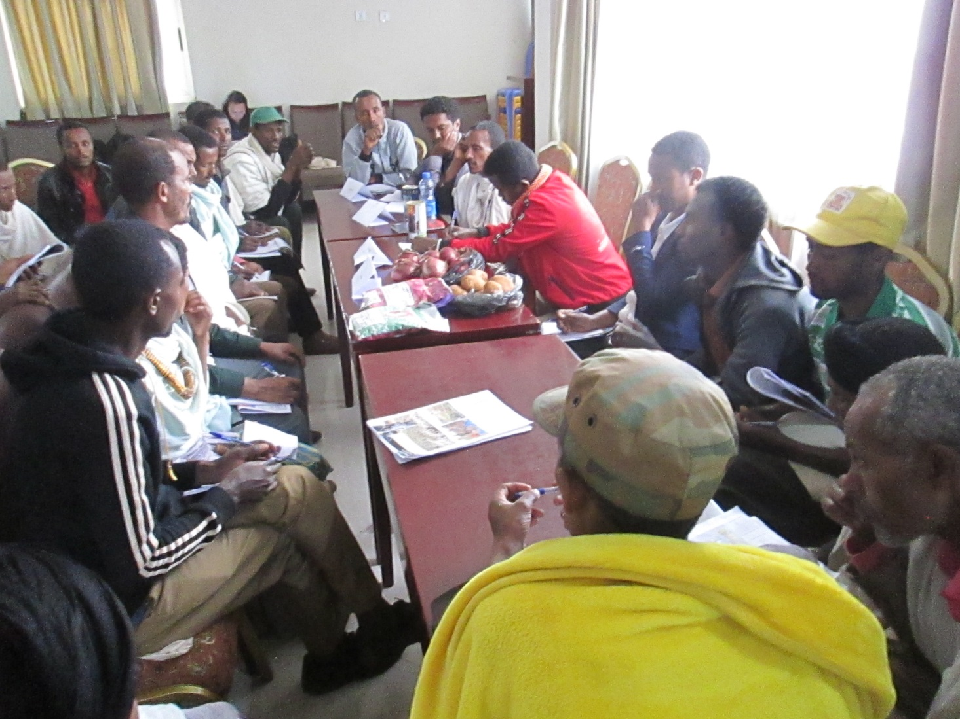
Key implementation Tips
Woreda and DAs should help farmers to have active business talks with market stakeholders.
(Sometimes it needs facilitation for smooth starting of communication, but later farmers have to take initiative.)

Slide 6
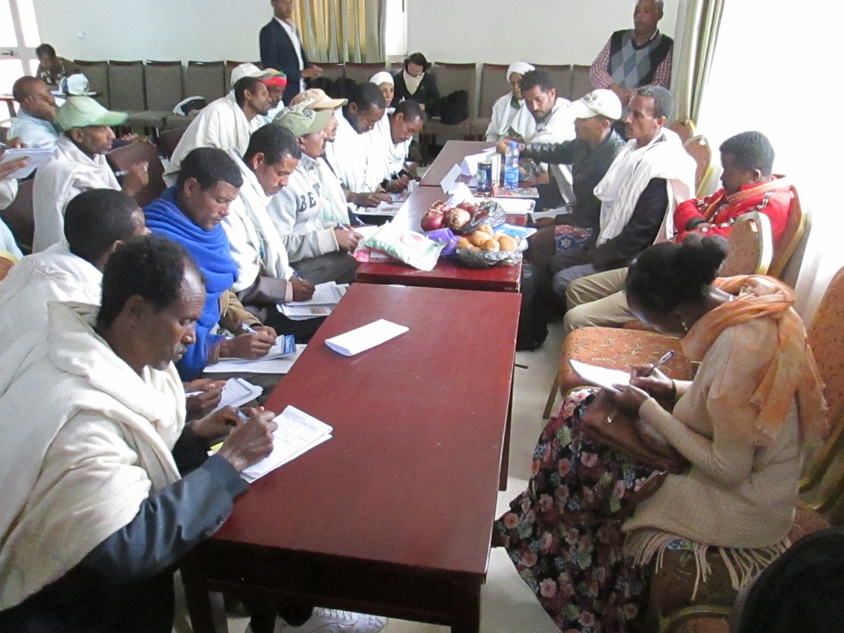
Key implementation Tips
Profiles of the participants should be exchanged beforehand so that the participants can start business talks right away without wasting too much time at the forum.
(At least, farmers group have to be ready and have clear idea on what they will achieve through forum.)

Slide 7
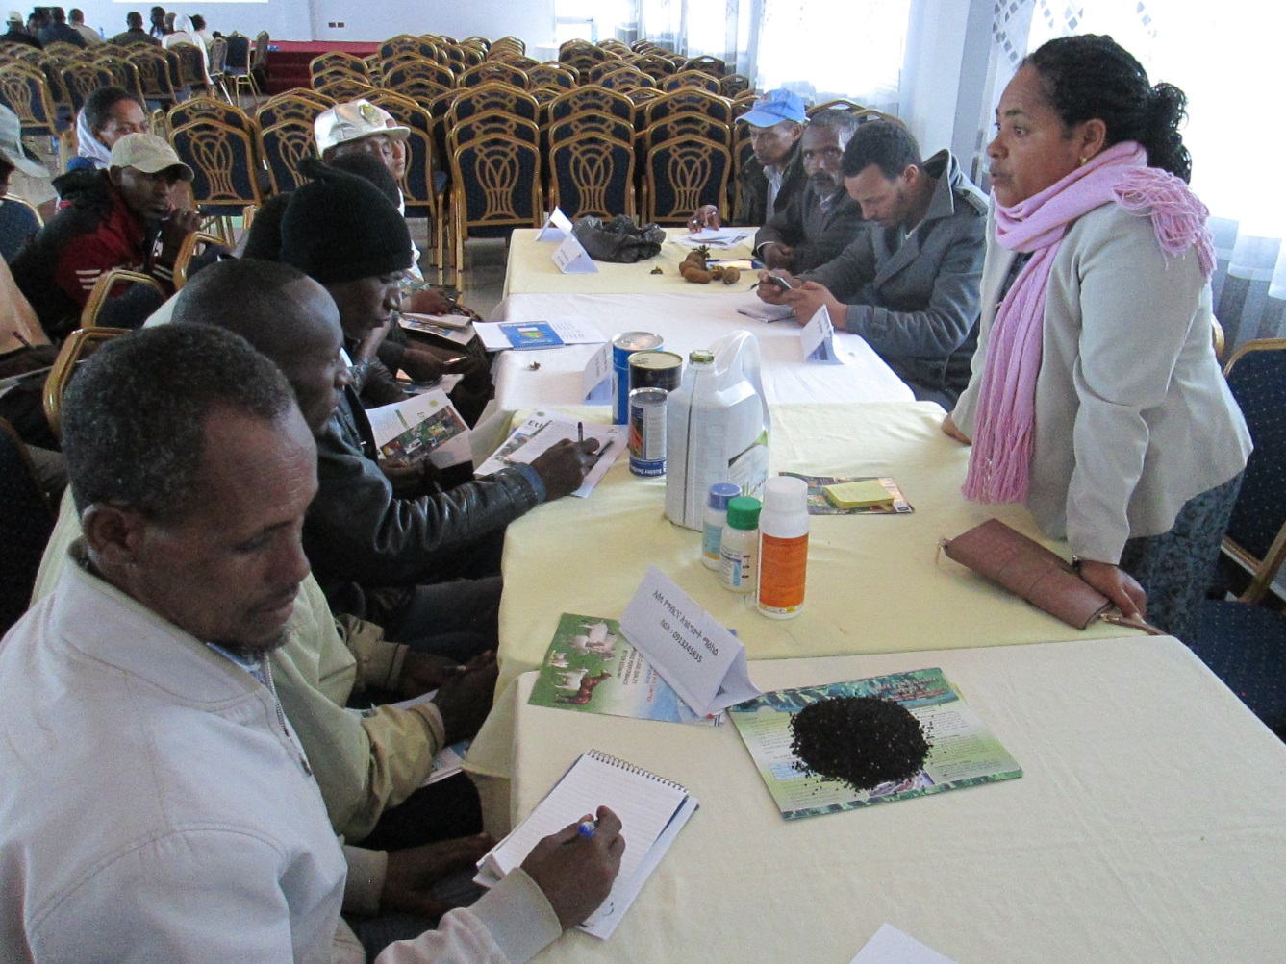
Implementation procedures
(Preparation) Reserve a conference room for holding the Stakeholder Forum.
Tip! If a government facility can be used for holding the Forum, the cost for renting a venue will be substantially reduced.
(Preparation) Identify and invite local market stakeholders to the forum. Tip! Invite only those stakeholders who are willing to start doing business with the smallholder farmers.

Slide 8
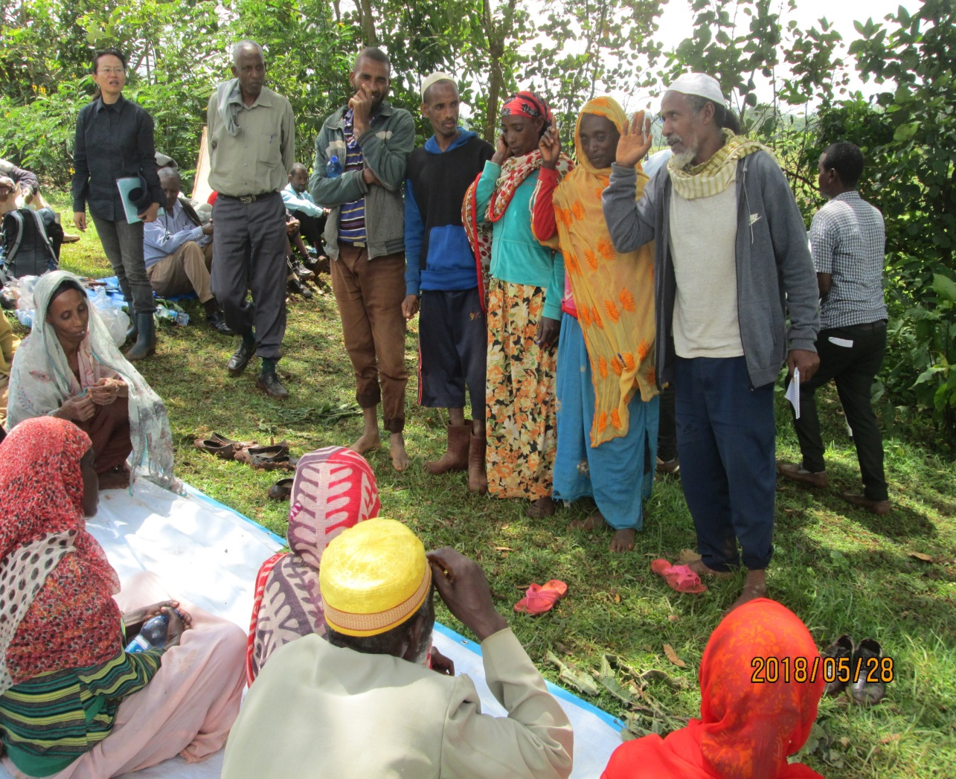
Implementation procedures
(Preparation) Ask farmer groups to select ex)two male and two female farmers to participate in the forum as representatives of the group.
Discuss with farmer group what kind of information group expects for representative farmers to collect during the forum.
Tip! Make sure both male and female farmers are chosen as representatives since a team consisting of both sexes can broaden their views during their interactions with market stakeholders.

Slide 9
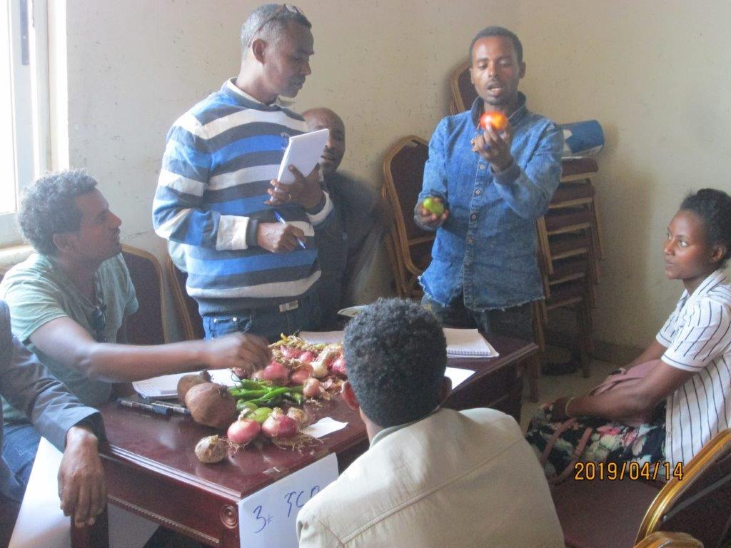
Implementation procedures
(Preparation) Exchange profiles of the participants at the forum day. Ask farmer groups to bring samples of their produce to the Forum.
This arrangement gives smooth business talk with wholesalers.
The samples are to be displayed at their booths.

Slide 10
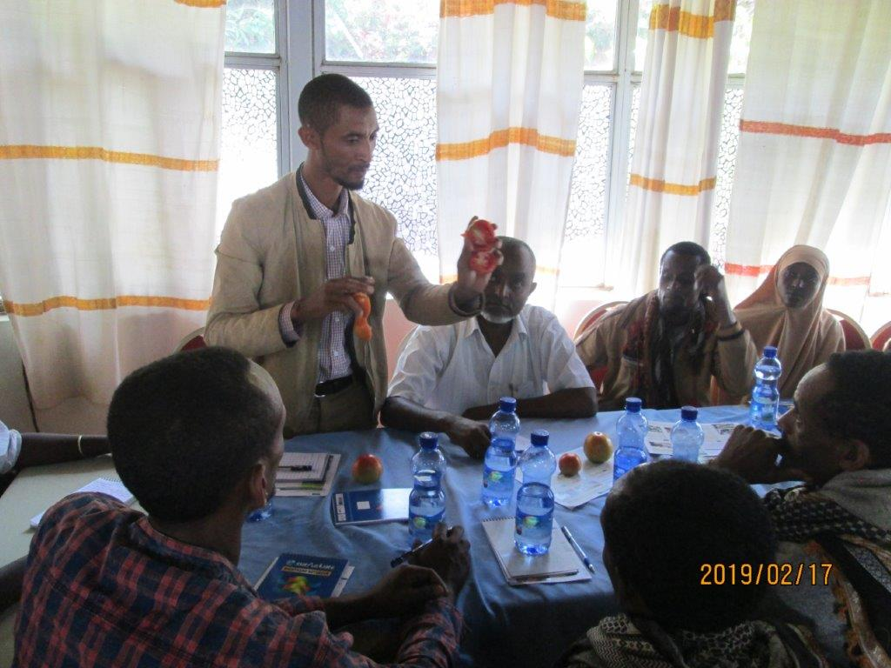
Implementation procedures
During the forum, the farmer representatives, accompanied by the extension staff, visit booths of the market stakeholders to exchange information and have business talks.
After the forum, the group representatives organize a feedback meeting at their group to share what they have learned during the forum.
*Sometimes no feed back to other group members,,,,no information sharing ,,,

Slide 11
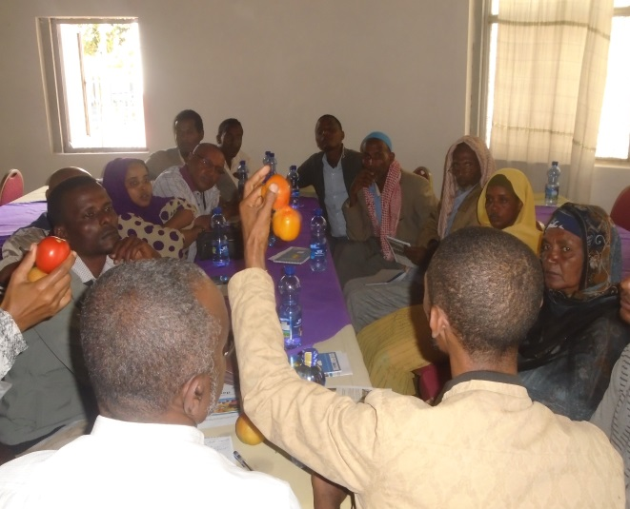
Points to be confirmed after this activity
After the market forum, the group members are informed of the findings and results of the forum by the farmer representatives who have participated in the forum.
The target farmers understand various business opportunities for vegetable production and market.

Slide 12
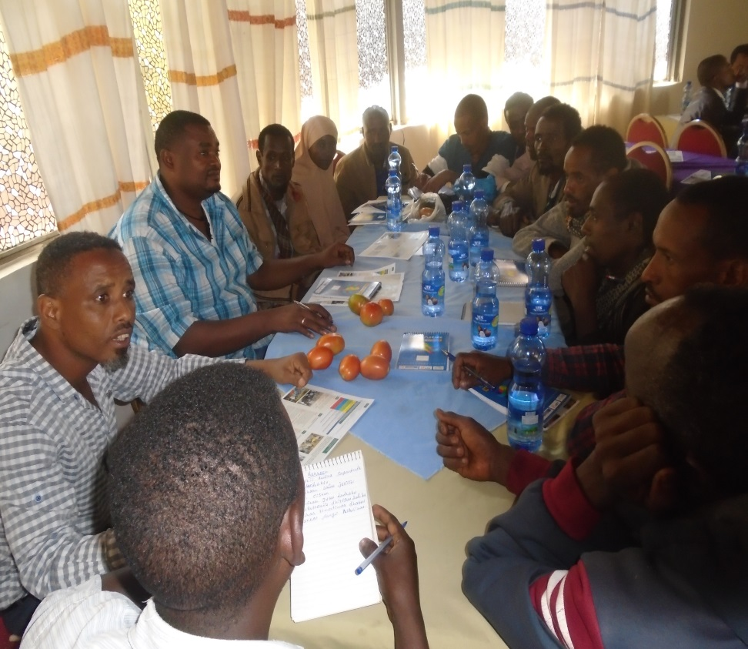
Points to be confirmed after this activity
The target farmers widen their business networks with market stakeholders invited to the forum.
Woreda and DAs should encourage farmers to exchange the contact address with stakeholders.

Slide 13
Before attending the forum
Representative farmers needs to collect interest of purchasing seeds or selling crops from the group members

Slide 14
Ethio-SHEP Linkage forum Input required notification Form (to be filled by farmers before the forum)
Date________________________
Region______________________Zone______________________Woreda______________________
Name of farmer group______________________________________
Farmer group representatives:
Name: ………………………………………………. Tel No: ……………………………….
Name: ………………………………………………. Tel No: ……………………………….
Name: ………………………………………………. Tel No: ……………………………….
Name: ………………………………………………. Tel No: ……………………………….
Name: ………………………………………………. Tel No: ……………………………….
Serial no. | Type of input required (seed, chemical etc) | Unit of measurement | Required amount for the group
1 | Potato Seeds (Gudene) | Qt | 10 qt by August 2021
2
3
4

Slide 15
Ethio-SHEP Linkage Forum Expression of interest to buy (Demand) by traders
Date________________________
Region______________________Zone______________________Woreda____________________
Name of farmer group______________________________________
Farmer group representatives:
Name: ………………………………………………. Tel No: ……………………………….
Name: ………………………………………………. Tel No: ……………………………….
Name: ………………………………………………. Tel No: ……………………………….
Name: ………………………………………………. Tel No: ……………………………….
Name: ………………………………………………. Tel No: ……………………………….
Serial no. | Name and Address of Buyer (Tel No.) | Type of produce to buy and amount | Tentative date for starting
1 | Mr. Abiot in Injibara market (0993165475) | Onion, 20 qt / week | November 2021
2
3
4

Slide 16
Ethio-SHEP Linkage Forum Expression of interest to sell (Supply) by farmer group
Date________________________
Region______________________Zone______________________Woreda____________________
Name of farmer group______________________________________
Farmer group representatives:
Name: ………………………………………………. Tel No: ……………………………….
Name: ………………………………………………. Tel No: ……………………………….
Name: ………………………………………………. Tel No: ……………………………….
Name: ………………………………………………. Tel No: ……………………………….
Name: ………………………………………………. Tel No: ……………………………….
Serial no. | Name and Address of farmer (Tel No.) | Type of produce to sell and amount | Tentative date for start selling
1 | Mustefa (Absera Aiko kebele) | Garlic, 80qt in total | Second week of December 2022
2
3
4

Slide 17
THANK YOU
GALATOOMAA
DOMO ARIGATO GOZAIMASU

