Slide 1
Role & Responsibility of the Project and CPs
Ethio-SHEP Project team

Slide 2
General idea of Project Implementation
Objective of project intervention is contribute to strengthen the existing extension service by using Market-oriented extension approach(Ethio-SHEP approach)
Implementation is based on the existing government extension structure (Federal ,Region ,Zone, Woreda, Kebele)
Assignment of Focal person at each level:
Region, Zone, Woreda & Kebele
(*Woreda: 2 :Process owner & Focal person)

Slide 3
Project Implementation Structure
Based on the existing government Structure
MoA
General Extension Directorate
Horticulture Development & Technology Transfer Directorate
Ethio-SHEP Project Team
AGP
Federal Level
Research
Regional Level
OBoANR
ABoA
Zonal Level
Zone (ZAO)
Zone (ZAO)
Woreda Level
Woreda (WAO)
Woreda (WAO)
DAs
DAs
Cooperative
Trader
Kebele level
Input Supplier
Farmer Groups
Water User’s Association (WUA)
Retailer

Slide 4
Role & Responsibility of CPs
Role & Responsibility | Responsible body
1. Implementation within the existing extension system | Woreda & Kebele
2. Follow up of the activities | Woreda & kebele, zone, region
3. Reporting and documentation (*Incorporate into regular reporting system) | Woreda & Kebele → Zone → Region → MoA (Project)
4. Monitoring and Evaluation | Region , Zone & Woreda
5. Scale-up and create synergy with Project intervention & regular extension program(Incorporate into regular program) | Region, Zone, Woreda & Kebele

Slide 5
Project Intervention Modality
Technical cooperation project based on the bilateral government agreement
Focus on capacity building of experts & farmers
No direct budget support for woreda
(*Activity based per-dim payment & support)
(*Per-dim rate based on Harmonized DSA set by MoFEC)
*Actual Implementation is done by CPs, not by the project
Project provide training, implementation done by government extension officers

Slide 6
Ethio-SHEP project team
Japanese experts: Chief Advisor/SHEP approach(1)
Technical advisor(Horticulture)(1)
Coordinator/Training(1)
Ethiopian national staffs: National SHEP coordinator(1)
Regional technical advisor(1+1)
Office management(1)
Driver(3)

Slide 7
Role & Responsibility of the Project
1.Technical support :Organizing ToT for implementors
2. Financial support for implementation
3. Organizing Ethio-SHEP related event: (Market Linkage Forum, Exchange visit, etc.)
*Back support and monitoring
*Overall management of the project

Slide 8
Project support for the implementation
1. Technical support
Organizing ToT for experts: Ethio-SHEP activity steps
Technical training
Support for In-field technical training including providing extension materials and field follow-up
*Participants of those ToT (specially woreda and kebele experts) will be the actual implementor of the activity.
*The project will take the role of back support.

Slide 9
Project support for the implementation
2. Financial support:
No budget transfer, budget management by the project.
Support based on the project activity.
Communication fee will be provided by submitting the monthly activity report (DAs/Woreda → Zone → Region (Project)
*Based on the report and actual attendance and performance, it will be checked and settled by the project.

Slide 10
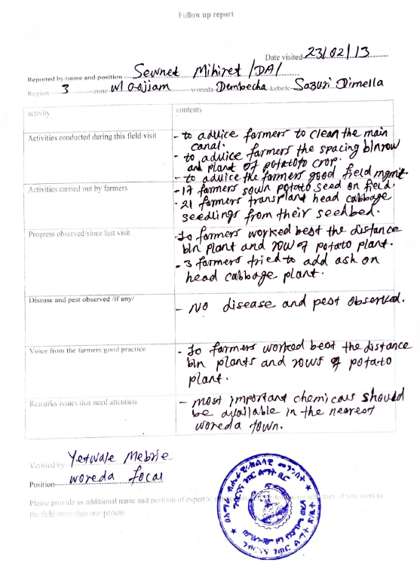
Report Submission
Example
Submitted by woreda

Slide 11
Project support for the implementation
3. Arrangement of Event:
Organizing Market survey ToT
Organizing Market Linkage Forum
Organizing Exchange visit or Field day(New groups)
(*New group can choose the option, Exchange visit or Field day).

Slide 12
Project support for the implementation
*Support for field training and follow-up
The project mainly support for new groups(Not for old groups)
Training materials and technical support will be provided. Overall follow-up, responsibility & management is by woreda & kebele and target group members.

Slide 13
*General idea of Project intervention for farmer groups
4th year groups(new):The project and CPs jointly: Actual activities will be decided based on the result of consultation with the groups & CPs.
(Current woreda)
3rd year groups: F/U and support for specific gaps identified through previous year intervention. (Not full package,,)
1st and 2nd year groups: Handing over to CPs and support through regular extension service by CPs.

