Slide 1
Ethio-SHEP Project Overview
Market Linkage Forum
August 2019
Jimma
The project for Smallholder Horticulture Farmer Empowerment Through Promotion of Market Oriented Agriculture (Ethio-SHEP)

Slide 2
Program for Linkage Forum
Time | Activity | Responsible
8:30- 9:00 | Registration | Project team
9:00-9:05 | Welcome Remarks | Zone Agriculture/ Project
9:10-9: 30 | Project briefing | Project team
9:30-9:55 | Explanation on Farmer groups profile (input requirement, production potential) | Farmer groups (6groups)
9:55-10:10 | Comments by Traders and input suppliers | Traders, Input suppliers
10:10-10:30 | Tea Break | Hotel
10:30- 10:40 | Experience from first year and second year farmers | (Deti Duke, Birbirsa, Gibe)
10:50 -11:20 | Group discussion (Farmers and Traders)----- 1 group (Kersa and Seka chekorsa) Group discussion Farmers and input suppliers --1 group( (Dedo and Mana) Group discussion (Government offices)----- 1group | 3 groups
11:20-11:40 | Presentation of group discussion | 4 groups
11:40-11:50 | Closing | Regional Agriculture Bureau
12:00~ | Lunch | Hotel

Slide 3
1. Basic Information of Ethio-SHEP
Project Title: The Project for Smallholder Horticulture Farmer Empowerment through Promotion of Market-Oriented Agriculture(Ethio-SHEP)
Duration: Jan2017~Jan 2023 (6 Years)

Slide 4
2. Project Objective
Promotion of Market-Oriented Agriculture for small holder farmers in Ethiopia by using the SHEP approach.
Support Farmers to change their mind set from “Grow and sell” to “Grow to sell” Realizing “Farming as business”)

Slide 5
3. What is SHEP?
Stands for “Smallholder Horticulture Empowerment and Promotion(SHEP)” Approach
Focuses on “Market-Oriented Agriculture” Changing farmers’ mind from “Grow and Sell” to “Grow to Sell”

Slide 6
4. SHEP Concept
Promoting “Farming as a Business”
Developing and motivating people by effective activity designs and “Tips”
Sharing information among market actors & farmers for improving efficiency of local economies(Mitigating the asymmetry of information)
Raising internal motivation for continuous activities implementation
(Self-Determination Theory)
~Three psychological needs to motivate people~
Market Info
（(Variety,price,season, required quality etc)
SHEP
Family Budgeting
Market Survey by Farmers
Autonomy
People need to feel in control of their own behaviors and goals
Sharing market Information
Competence
People need to gain mastery of tasks and learn different skills
Stakeholders forum
Decision making by farmers
Producer Info
（Farm location, Production potential ,etc)
Relatedness
People need to experience a sense of belonging and attachment to other people
Market Actors
・Retailers ,Middleman
・Agriculture inputs companies(Seed Fertilizer etc)
・Agriculture product processers
Producer
Filling Information Gaps
X
Considering Motivation of the actors

Slide 7
5. Essential SHEP 4 steps
Essential 4 steps | SHEP Activities
1. To share the goal with farmers | /Selection of Target Beneficiaries(farmer groups) /Sensitization WS
2.Farmer’s awareness is raised. | /Participatory Baseline Survey /Market Survey /Market linkage Forum(Input & Output)
3.Farmers make decisions | /Crop selection, /Crop calendar making etc
4.Farmers acquire skill | /Demand Driven In-Field Training for Farmers (Basic Cultivation skill, Post harvest handling etc)
Farmer’s Relatedness
Farmer’s Autonomy
Farmer’s Competence

Slide 8
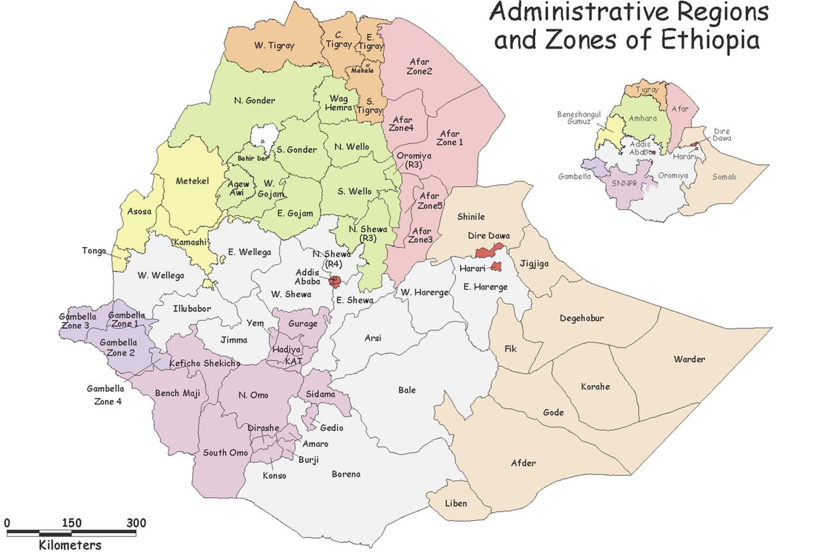
6.Target Areas
Amhara region
-West Gojam zone
South Achefer woreda
Jabi Tehanin woreda
Dembacha woreda
-Awi zone
Ankasha woreda
Guagusa woreda
Ayu Guagusa woreda
Banja woreda
Oromia region
-Arsi zone
Degelu Tijo
Tiyo
Lude Hetosa
-Jimma zone
Kersa woreda
Seka Chokorsa
Dedo woreda
Mana woreda

Slide 9
Major SHEP Activities

Slide 10
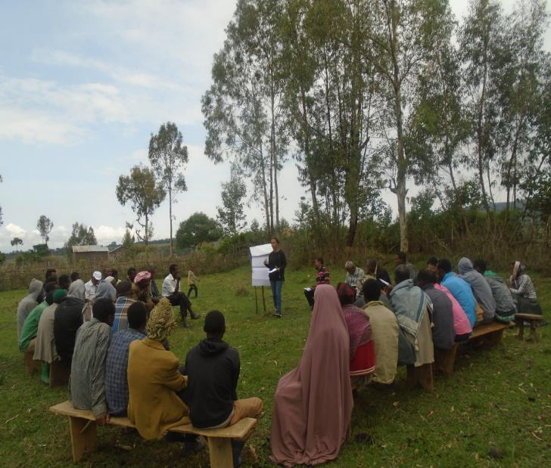
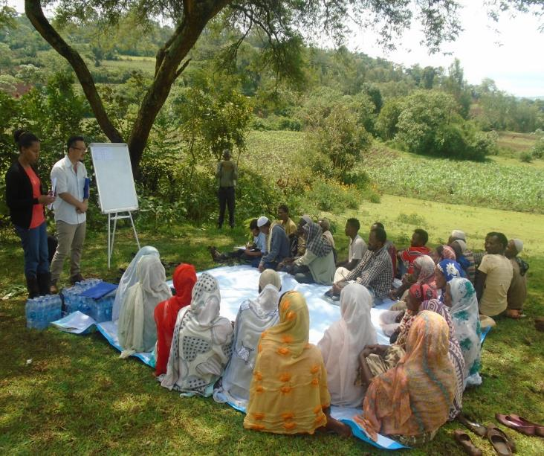
1. Sensitization with farmers
Objective: To create awareness on SHEP approach activities, implementation modality, select target farmers

Slide 11
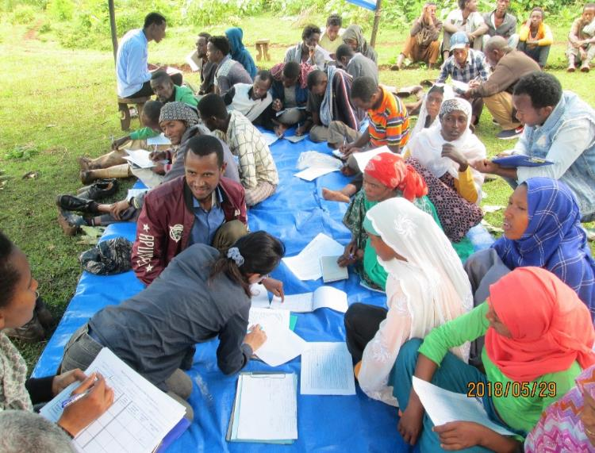
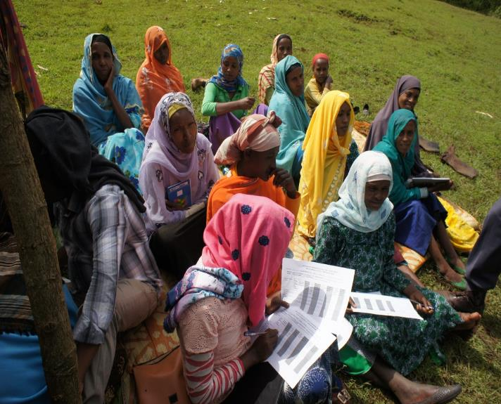
2. Baseline Survey
Objective: To collect data on farmers experience on horticulture production and marketing. Farmers (with support by experts) fill the questionnaire by themselves.

Slide 12
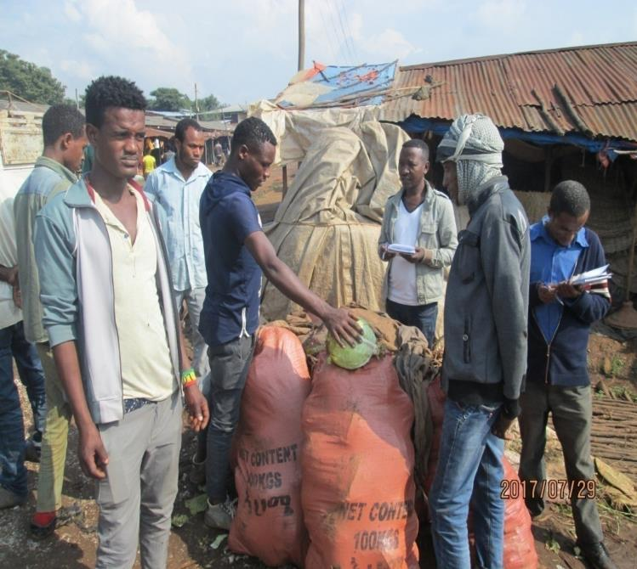
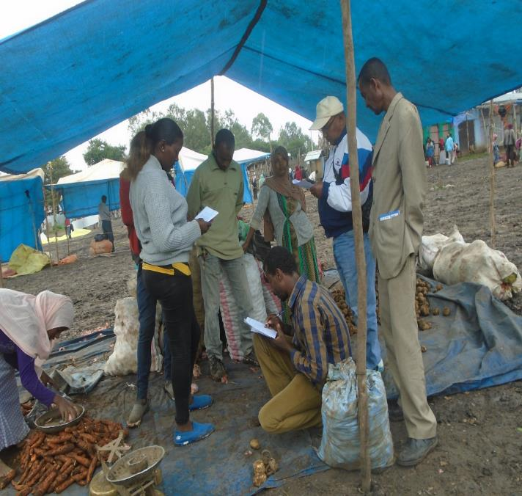
3. Market survey
Objective: To study market situation around target areas before crop selection.

Slide 13
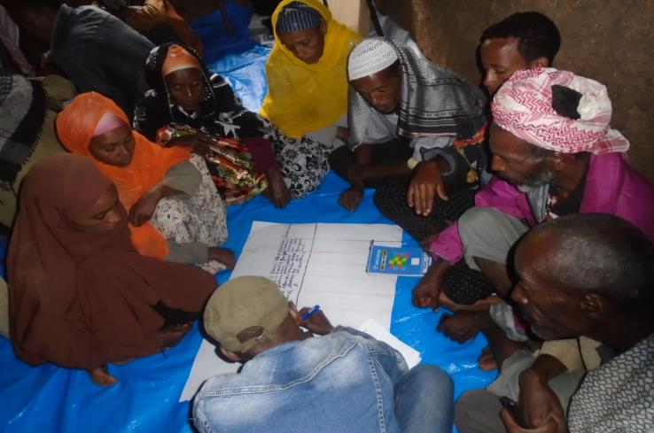
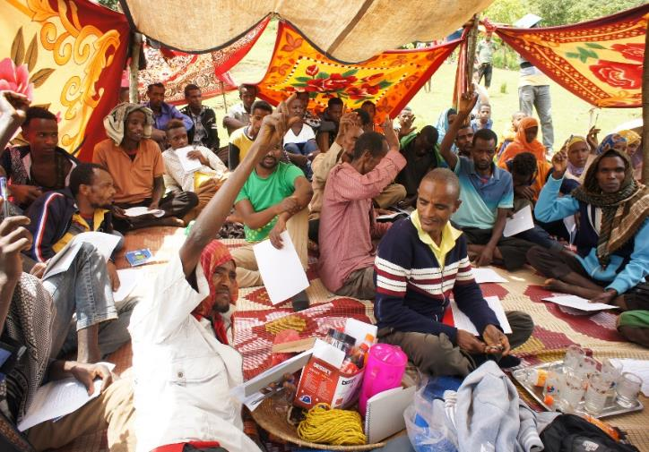
4. Crop Selection
Objective: Select two(2) priority crops based on market survey results & previous experience, agro ecology etc
Discussion
Voting

Slide 14
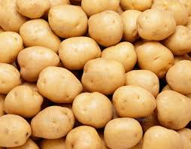
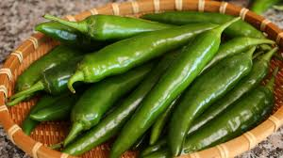
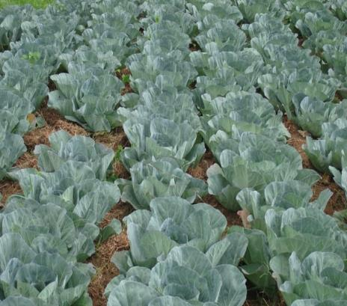
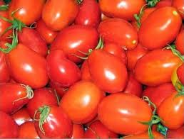
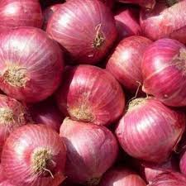
(4-1). Crops Selected

Slide 15
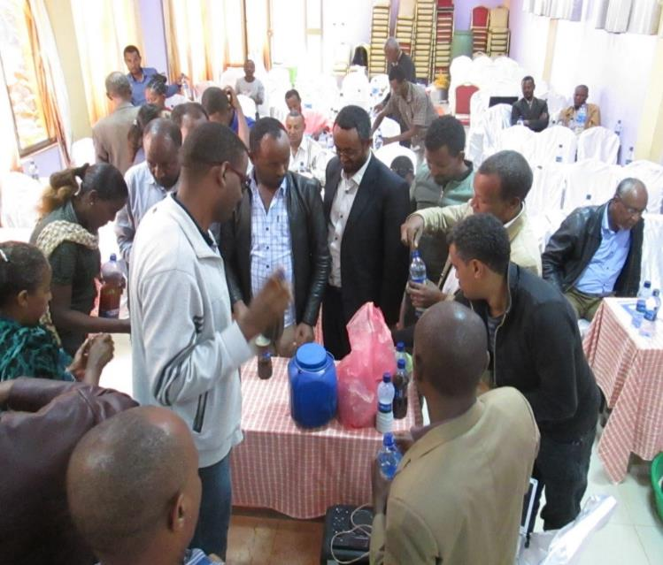
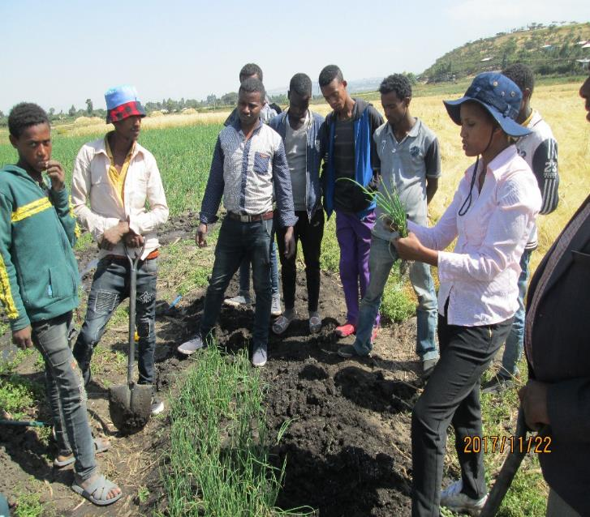
5.1. Technical Training for Target farmers and experts
Objective: Provide basic techniques on production of selected crops

Slide 16
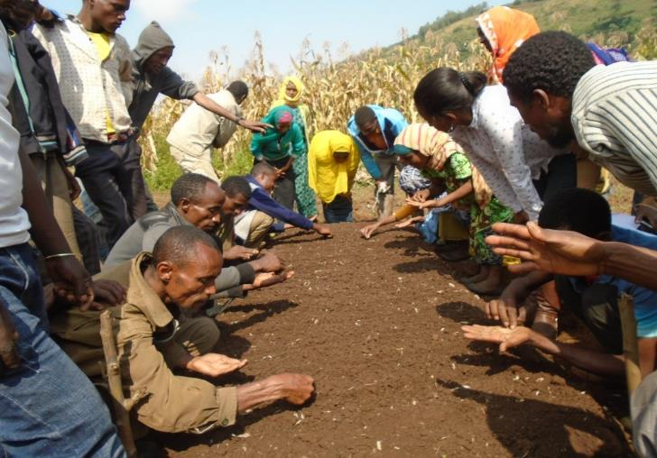
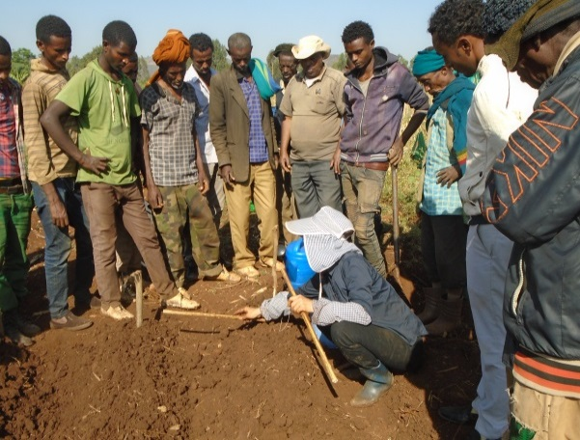
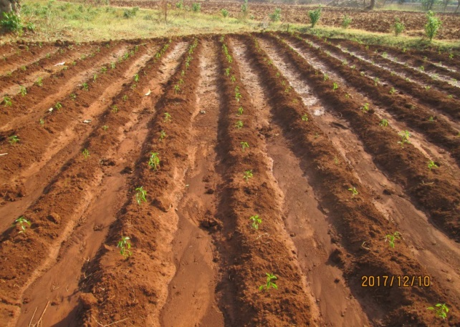
5-2 Basic production techniques,

Slide 17
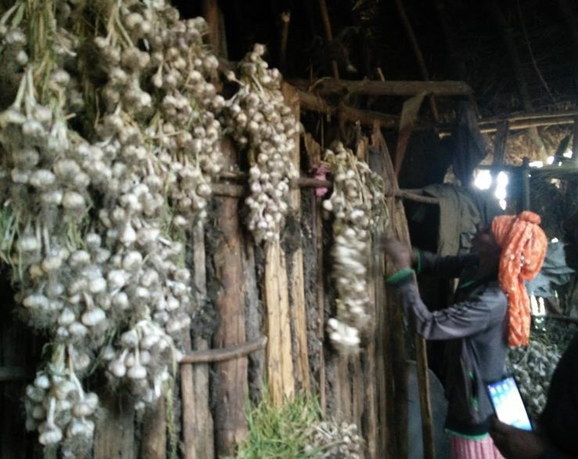
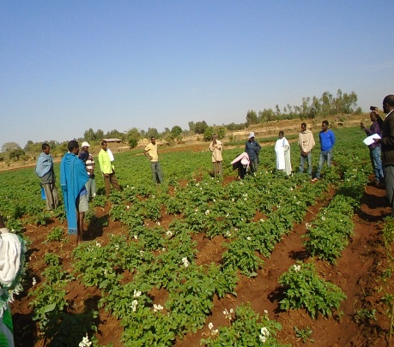
5-3. Post-harvest ,,
Objective: provide basic techniques on post harvest management on the crops selected by target groups

Slide 18
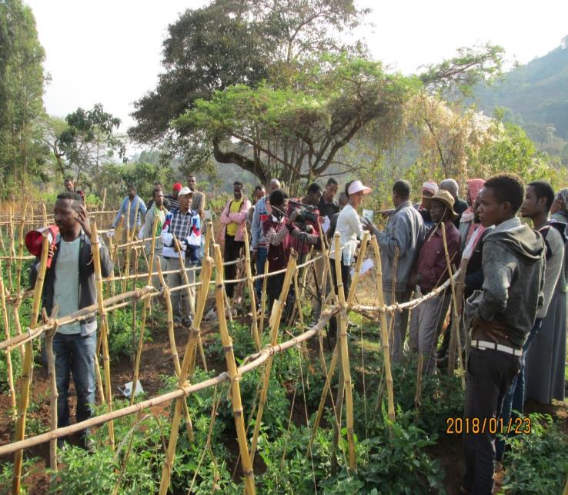
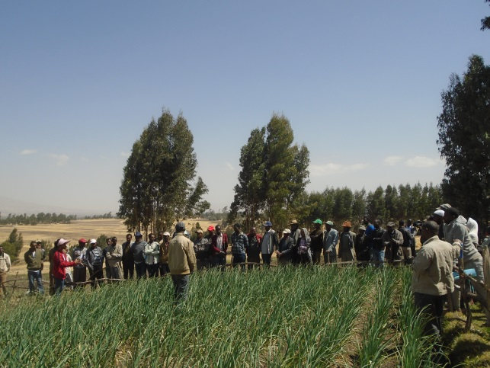
5-4. Field Day program
Objective: To review the performance of demonstration activities, share the experience with neighboring farmers
Notes:
Different size of font in a table is disturbing information catch up. Photo size also should be same in case of parallel formation, like this

Slide 19
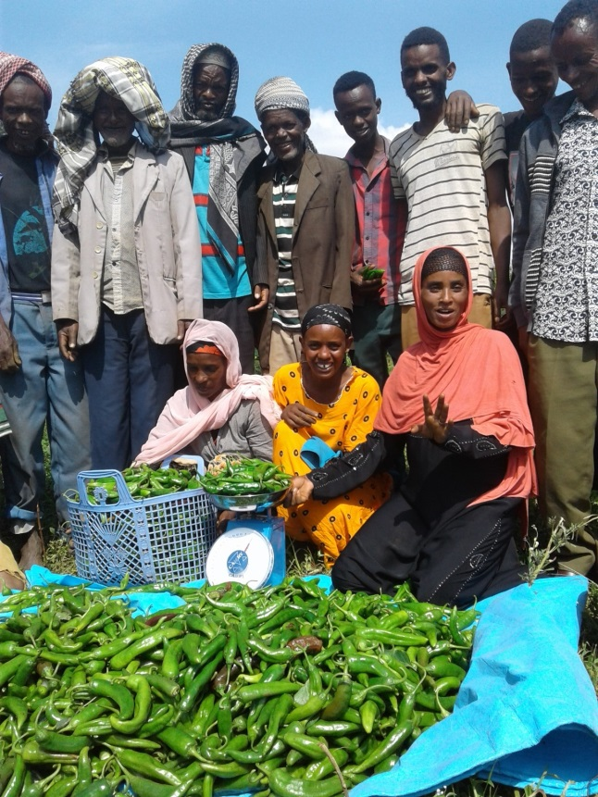
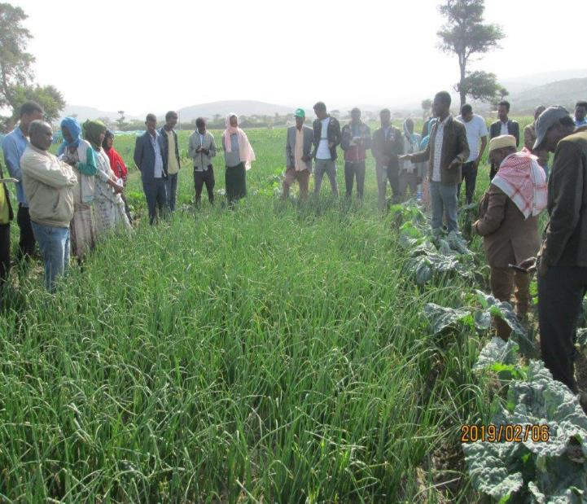
5-5. Exchange visit program
Objective: To visit and learn from the Horticulture advanced area and share with the group members for the next action,,,
Notes:
Different size of font in a table is disturbing information catch up. Photo size also should be same in case of parallel formation, like this

Slide 20
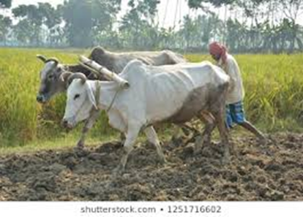
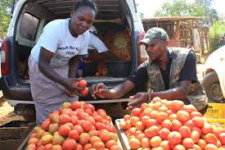
6. SHEP approach and marketing
Concept of Asymmetric Information
Information gap affect marketing

Slide 21
7. Information gap on what aspect??
?
?
Produce amount required
Quality requirement
Timing of demand
Unit of measurement
Prices information
Delivery process needed
Payment conditions
Production amount available
Quality of product available
Timing of supply (Harvesting)
Production places (location)
Prices information
accessibility)
Delivery process
Payment conditions

Slide 22
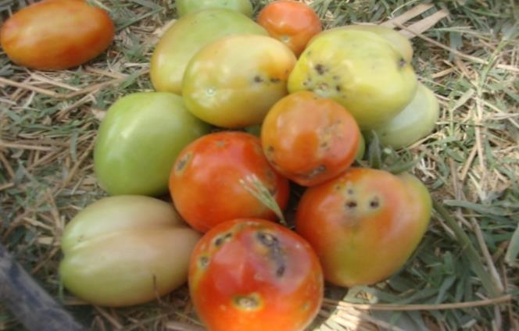
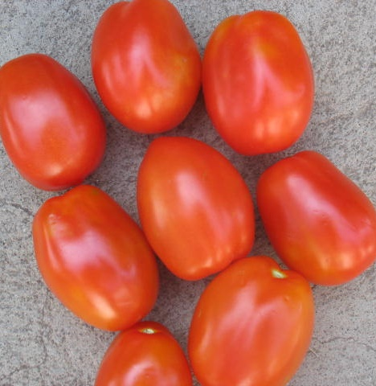
7.1. Quality

Slide 23
7.2. Amount

Slide 24
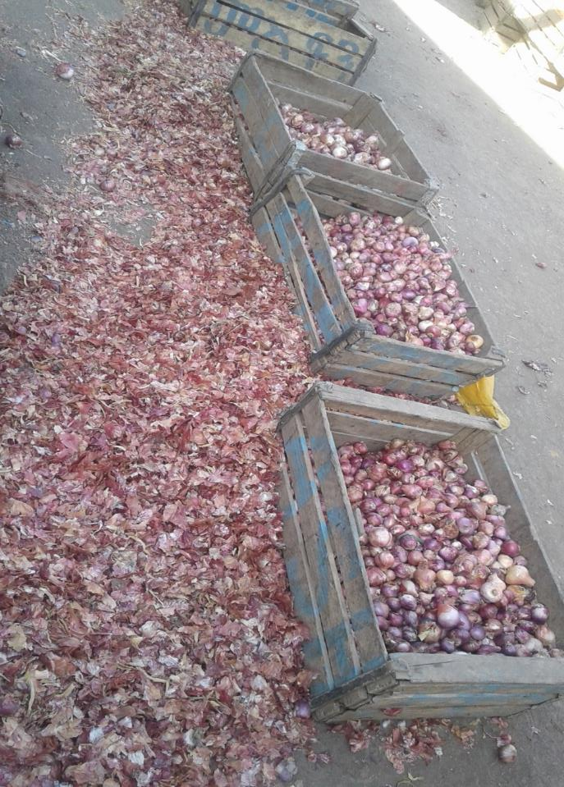
7.3.Sorting and cleaning

Slide 25
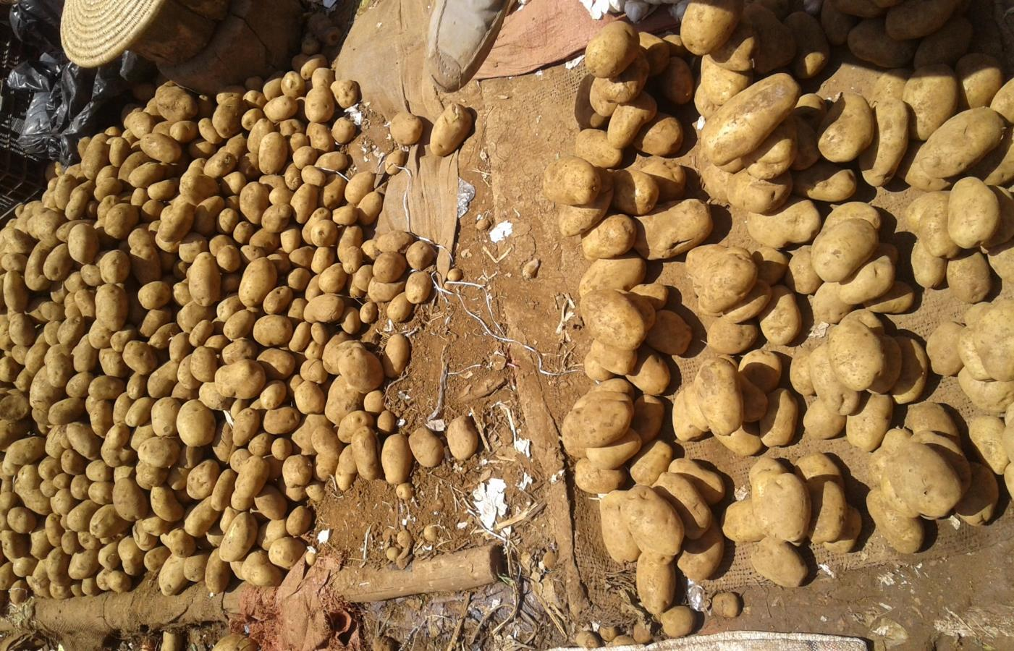
7.4. Grading

Slide 26
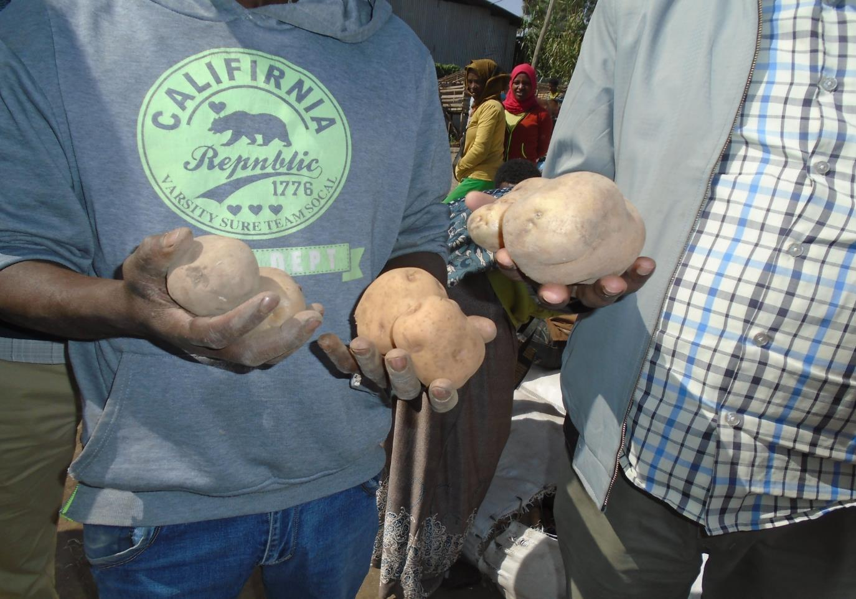
7.5. Selecting right variety

Slide 27
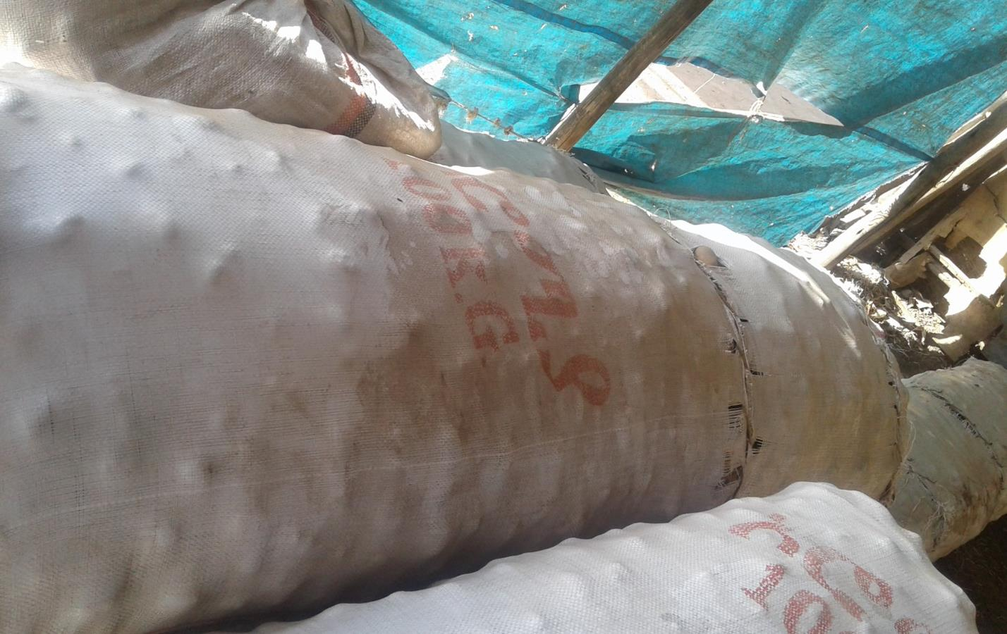
7.5. Potato : Unit of Measurement

Slide 28
8. How can we improve the situation?
Who can play this role to link ??
SHEP

Slide 29
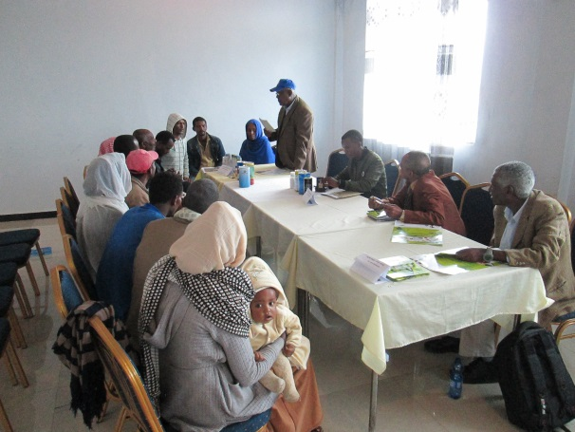
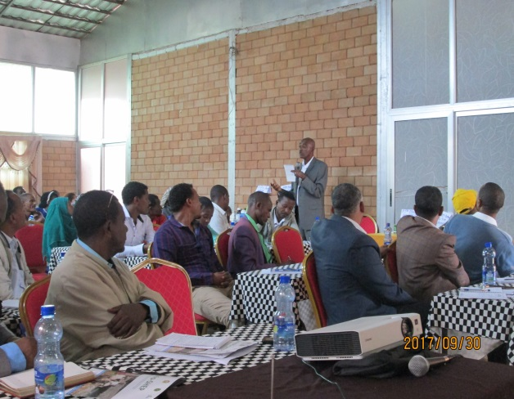
8.1. Market Linkage Forum (Input)
Objective: To facilitate input access for target farmers before sowing/planting

Slide 30
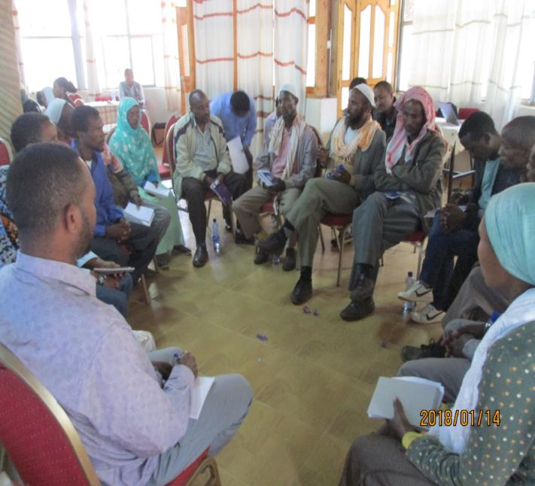
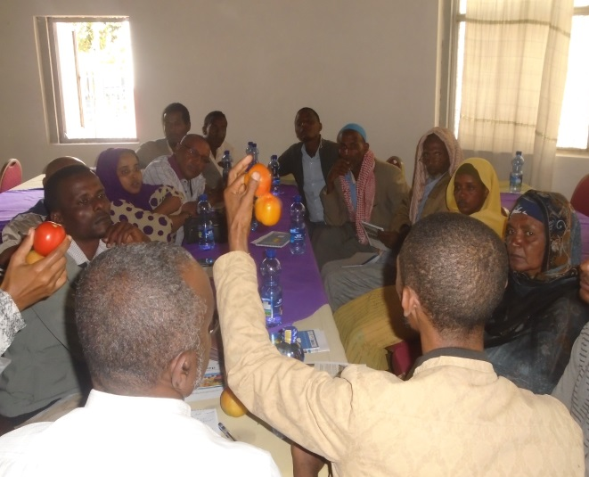
8.2 Market Linkage Forum(Output)
Objective :To create linkage for target farmers with traders and other buyers.

Slide 31
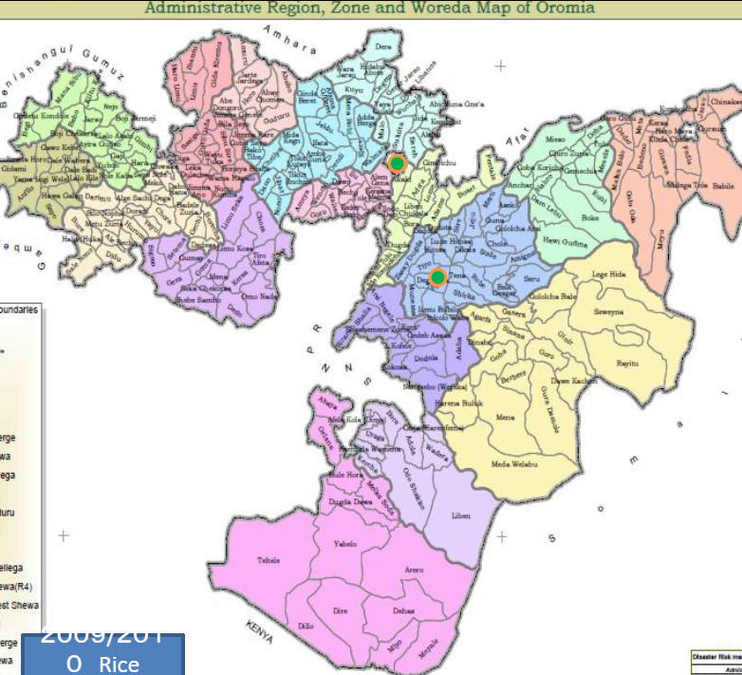
Some sources of vegetables to Jimma
Jimma
Onion, Tomato
Onion, Garlic
Potato, Onion,
Tomato
Potato,

Slide 32
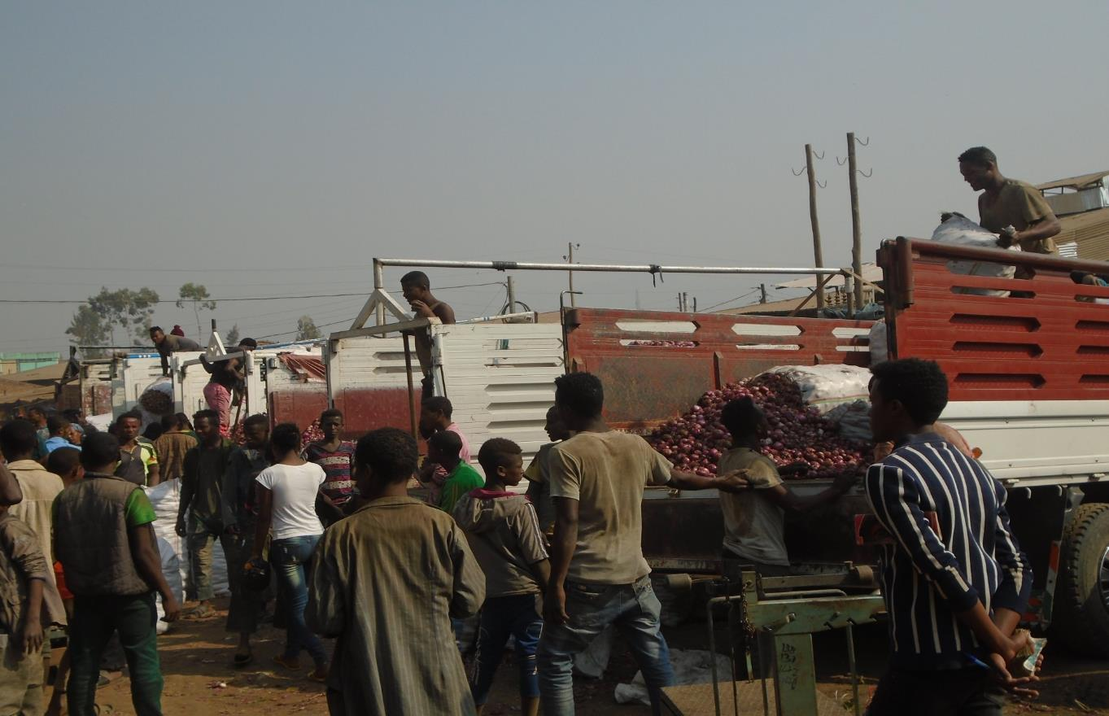
Opportunities in Jimma Market

Slide 33
11. Good practices since last year Forum
Farmers start to consider market for their production
Direct communication and transaction enhanced between farmers and buyers
Farmers start to purchase seeds as group
Agriculture offices and D.As facilitated group purchase of inputs by farmers

Slide 34
Group Discussion Agendas
Farmers and input suppliers
Exchange ideas on farmers willingness to purchase input (timing, amount, price , conditions etc
Exchange contact address and profiles
Farmer and buyer Group
Exchange ideas on potential production amount by farmers and interest of traders to buy (which varieties needed, peak demand time, possibility of business linkage etc)
Exchange address and profiles of farmer groups and buyers
Government Offices
Actions that each stakeholder should undertake to improve horticulture marketing (Action plan) Use format on next page

Slide 35
Action plan for Group discussion
S/R | Main Issue /problem | Activities to solve the problem | Responsible stakeholder to implement | Schedule
1

