Slide 1
Session 1:
Triggers and Cravings (1)
Psycho-Education for Patients and Family Members
Notes:
Slide 1-1—Triggers and Cravings
This presentation begins with an overview of addiction and dependence.
It then focuses on the development of addiction and cravings and the relationship of environmental and internal triggers for craving.
Understanding this process allows both patients and families to view substance use disorders in a new, more understandable way and to see what is behind much of the advice given to patients in treatment.
In short, triggers lead to cravings, and cravings lead to using drugs or drinking alcohol.
Common sense suggests that being around people, places, or situations that have resulted in past substance use can increase the chances of using or drinking again.
The influence that triggers have on the brain makes the advice to avoid triggers more than just a good idea; there is no other reliable way to avoid cravings and relapse.

Slide 2
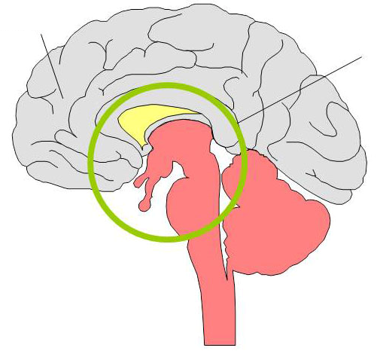
Changes in the Brain
Prefrontal Cortex
Limbic System
The mechanism of addiction is biological phenomena.
Notes:
Slide 1-2—Changes in the Brain
Addiction is a neurobehavioral disorder. To understand what this means, we must look at two important areas of the brain: the prefrontal cortex and the limbic system.
In a healthy brain, the prefrontal cortex, or outside portion of the brain, is responsible for rational thinking. It is the decisionmaker, the onboard computer of the human being.
Underneath the cortex is a much older, more primitive part of the brain’s anatomy, the limbic system.
To a greater or lesser degree this lower part of the brain is involved in all forms of addiction. It is where the pleasure and reward system is located and where most, if not all, survival mecha­nisms originate.
Pleasure is a powerful biological force for survival. If you do something pleasurable, the brain is wired in such a way that you tend to do it again.
Unlike the cortex, the limbic system is not under conscious or voluntary control. The powerful effects of drugs and alcohol on this and other parts of the brain can lead to addictive use, lessening normal, rational restraints on behavior.
Prolonged drug use changes the brain in fundamental and long-lasting ways. These changes are a major component of the addiction itself.
Accepting addiction as a complicated relationship between the brain and behavior is a step toward recovery.

Slide 3

Conditioning
Notes:
Slide 1-3—Conditioning
The part of the brain affected by mood-altering substances is the same part of the brain that makes us seek food when we are hungry and water when we are thirsty and is responsible for our sexual drive.
Hunger, thirst, sexual desire, and the need for nurturing are natural cravings. Satisfying these cravings promotes our survival as individuals and as a species. When a craving is not satisfied (e.g., when a person has not eaten for a long time), satisfying the craving overpowers all other concerns.
When long-term drug or alcohol use occurs, the brain can become rewired and adapt to these substances as if survival depends on them.
There is a demonstration that reflects the power of drugs on the brain and behavior:
If you release a caged mouse and it has the option to run into a well-lighted area or a dark area, it always will run into the dark.
Mice and other small rodents have been conditioned to seek out the dark automatically, because darkness protects them from predators. This ingrained survival mechanism evolved over millions of years in this species.
If the mouse is given doses of cocaine in the lighted area, the mouse will go into the lighted area each time it is released from its cage. This classic experiment demonstrates “conditioned place preference,” reversing the conditioning that took place over millions of years.

Slide 4
Question:
Please give an example of “conditioning”.
Notes:
Slide 1-4—Question
Ask participants to give some examples of “conditioning”.

Slide 5
I.P. Pavlov (1849–1936)
Notes:
Slide 1-5—Pavlov
To understand the relationship of triggers to craving, it is important to understand a bit about a process called conditioning.
I.P. Pavlov, a Russian scientist, received the Nobel Prize for a series of experiments he conducted on the physical processes of digestion.
These experiments were continued by some of his students, and the conclusions from these experiments became known as the principles of classical conditioning.

Slide 6
Pavlov’s Dog
Notes:
Slide 1-6—Pavlov’s Dog
Pavlov would feed the dogs and ring a bell at the same time.
The dogs saw and smelled the food that then stimulated, or triggered, a part of their brain, causing them to produce saliva and secrete stomach acid in anticipation of eating.
In a relatively short time, Pavlov and his colleagues rang the bell without the presence of food, and the dogs still produced saliva and stomach acid as if food were present.
The dogs connected the sound of the bell, the trigger, with anticipation of eating and responded (involuntarily) physically to the powerful trigger, or stimulus, of the bell.
Once a dog had been conditioned in this way, no matter how smart or well trained the dog was, it continued to produce fluids at the sound of the bell. It had no choice; the only way that Pavlov’s dogs could avoid drooling was by avoiding the bell.
The dogs had developed a conditioned response to the bell.
The human brain responds in much the same way to conditioned drug and alcohol triggers that produce cravings.
Drugs and alcohol produce changes in the brain, which result in feelings of pleasure. Events that people experience or surroundings that people are in when they use are like Pavlov’s bell; they cause people to experience cravings (like the dogs’ physical response to the bell, salivat­ing) even when they are not using. The brain may even trigger physical reactions that are simi­lar to those initially created by the drug itself.
For example, if participants were to think about sucking on a lemon, they probably would pucker their lips without even meaning to. This response is based on their experiences of tasting a lemon in the past.
This sort of response to drug triggers occurs regardless of whether a person intends to use. The dependent person can prevent his or her brain’s reaction only by avoiding triggers.
Triggers and cravings are hallmarks of addiction.

Slide 7
Questions:
What is “addiction”? How do you define it?
Is “addiction” a disease?
What are some of the behaviors characterized by drug addiction?
Notes:
Slide 1-7—Question
Ask participants the following questions:
What is “addiction”? How do you define it?
Is “addiction” a disease?
What are some of the behaviors characterized by drug addiction?

Slide 8
A Definition of Addiction
A primary, chronic, neuro-biologic disease with genetic, psychosocial, and environmental factors influencing its development and manifestations.
Addiction is characterized by behaviors that include one or more of the following: impaired control over drug use, compulsive use, continued use despite harm, and craving.
    Graham, A.W.; Schultz, T.K.; Mayo-Smith, M.F.; Ries, R.K.; and Wilford, B.B. eds. Principles of Addiction Medicine, Third Edition. Chevy Chase, MD: American Society of Addiction Medicine, Inc., 2003.
Notes:
Slide 1-8—A Definition of Addiction
The slide shows a definition of addiction developed by the American Society of Addiction Medicine.
“Primary” means that addiction is not just a symptom of another disease or disorder; it is a disease in and of itself.
“Chronic” means that the disease continues over time and can be treated but not cured. Examples of other chronic diseases include diabetes and heart disease.
The definition states that genetic, psychosocial, and environmental factors may influence the development and manifestations (symptoms) of the disease.
“Genetic” means that some people are born with certain susceptibilities to becoming addicted to drugs or alcohol.
“Psychosocial and environmental factors” means that a person’s emotional, mental, and social life as well as his or her family, peers, living situation, employment or school situation, and other life circumstances can affect whether addiction develops and how it develops.
These psychosocial and environmental factors are important to consider when looking at a person’s triggers for drug or alcohol use.

Slide 9
The Addictive Process
Introductory phase
Maintenance phase
Disenchantment phase
Disaster phase
Notes:
Slide 1-9—The Addictive Process
The rest of this session looks at the process of developing addiction over time, focusing on craving and the triggering of craving.
The process of addiction can be looked at in terms of four phases: the introductory phase, the maintenance phase, the disenchantment phase, and the disaster phase.
During each phase, people experience increasing levels of obsessive thinking, craving responses, use, and consequences resulting from their substance.
Although the slides are methamphetamine specific, the process of addiction is virtually the same for other addictive drugs and alcohol.

Slide 10
Question:
What are positives and negatives of Shabu use?
  When you start using?
  After a long-term continuous use?
Notes:
Slide 1-10—Question
Ask participants what are positives and negatives of Shabu use.
Highlight the differences between when they start using and after a long-term continuous use.

Slide 11
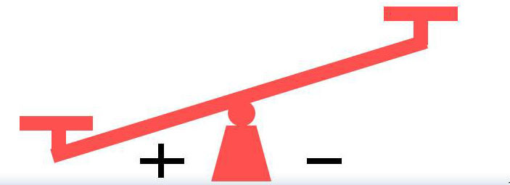
Addictive Process - Introductory Phase
Positives and Negatives of Shabu Use
Positives
Relief from
  Depression
  Anxiety
  Loneliness
  Insomnia
Euphoria
Increased status
Increased energy
Increased sexual/social confidence
Increased work output
Increased thinking ability
Negatives
Illegal
May be expensive
May cause missing work
Notes:
Slide 1-11—Positives and Negatives of Shabu Use (Introductory Phase)
Shabu (or another drug or alcohol) use is relatively infrequent during the introductory phase of the process of addiction.
Use may be limited to a few times a year, by chance, or on special occasions.
The positives of drug or alcohol use appear to outweigh the negatives.

Slide 12
Strength of Conditioned Connection: Mild
Addictive Process - Introductory Phase
Conditioning Process During Addiction
Triggers
Parties
Special occasions
Other events
Responses
Pleasant thoughts about Shabu
Use but not frequent
Notes:
Slide 1-12—Conditioning Process During Addiction (Introductory Phase)
Unknowingly, persons who use drugs or alcohol are conditioning their brains every time they use, but they experience only a mild association between people, places, or events and drug or alcohol use.

Slide 13
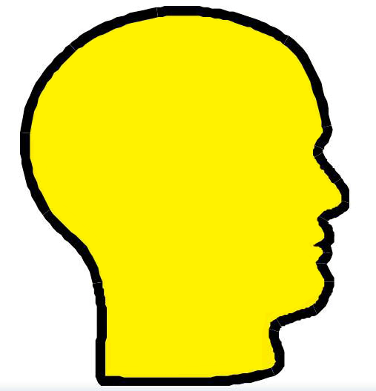
Development of Obsessive Thinking
Addictive Process - Introductory Phase
Food
School
Sports
TV
Hobbies
Girlfriend
Job
Shabu
Family
Parties
Exercise
Notes:
Slide 1-13—Development of Obsessive Thinking (Introductory Phase)
During this phase, drug or alcohol use is only one small component of a person’s overall thought process.

Slide 14
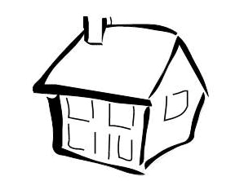
Development of Craving Response
Addictive Process - Introductory Phase
Entering Using Site
Use of Shabu
Shabu Effects
Heart/pulse rate
Respiration
Adrenaline
Energy
Shabu taste
Notes:
Slide 1-14—Development of Craving Response (Introductory Phase)
The craving response is the combined experiences of drug or alcohol triggers activating the limbic system and the continuing thoughts about using drugs or alcohol associated with these triggers.
During this introductory phase, the limbic system is activated directly by Shabu and physiological arousal increases.

Slide 15
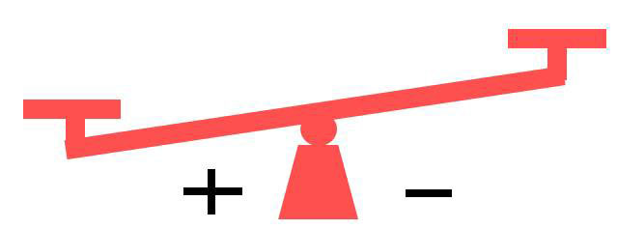
Addictive Process - Maintenance Phase
Positives and Negatives of Shabu Use
Negatives
Employment/school disruptions
Relationship concerns
Financial problems
Beginnings of physiological dependence
Positives
Depression relief
Confidence boost
Boredom relief
Sexual enhancement
Social lubricant
Notes:
Slide 1-15—Positives and Negatives of Shabu Use (Maintenance Phase)
During the maintenance phase of the addictive process, the frequency of drug or alcohol use increases to perhaps monthly or weekly.
The scales begin to lean away from the positives.

Slide 16
Addictive Process - Maintenance Phase
Conditioning Process During Addiction
Triggers
Parties
Friday nights
Friends
Alcohol
“Good times”
Sexual situations
Responses
Thoughts of Shabu
Eager anticipation
of Shabu use
Mild physiological arousal
Cravings occur as use approaches
Occasional use
Strength of Conditioned Connection: Moderate
Notes:
Slide 1-16—Conditioning Process During Addiction (Maintenance Phase)
Conditioning is progressing. The people, places, and things associated with drug and alcohol use have become triggers.
Exposure to these triggers causes thoughts about drug and alcohol use.
These thoughts produce moderate physiological reactions leading to a drive to find and use drugs and alcohol.

Slide 17
Development of Obsessive Thinking
Addictive Process - Maintenance Phase
Food
School
Shabu
TV
Hobbies
Girlfriend
Job
Shabu
Family
Parties
Exercise
Notes:
Slide 1-17—Development of Obsessive Thinking (Maintenance Phase)
Thoughts of drug and alcohol use occur more frequently.

Slide 18
Addictive Process - Maintenance Phase
Development of Craving Response
Entering Using Site
Physiological Response
Use of Shabu
Shabu Effects
Heart
Breathing
Adrenaline effects
Energy
Shabu taste
Heart
Blood pressure
Energy
Notes:
Slide 1-18—Development of Craving Response (Maintenance Phase)
A mild physiological arousal occurs in situations closely associated with drug and alcohol use.
As the person encounters drug and alcohol triggers, the limbic system is activated, and drug and alcohol cravings occur.
When drugs and alcohol finally are ingested, a concurrent physiological state occurs.

Slide 19
The Addictive Process
Introductory phase
Maintenance phase
Disenchantment phase
Disaster phase
To be covered in the next session
Notes:
Slide 1-19—Addictive Process (Review)
Today, we have learned about the introductory phase and maintenance phase of the addictive process.
The next session looks at the disenchantment phase and disaster phase in the additive process.

