Slide 1
Country Presentation
Name of country:
Presenter:
*You may add extra information if necessary . However, please keep in mind that you have only 10 min. for your presentation!
*In your presentation, please focus on challenges related to your responsibilities, not abstract and general challenges.
*Participants from a regional/district office, please show the data of your region/district as much as possible.
1

Slide 2
Geographical and political features
Map, table, explanation etc. for geographical and political features
2

Slide 3
Vital statistic
Fill in the matrix with of national and/or regional data at any available year
Year |  | 1990 | 1995 | 2000 | 2005 | 2010 | 2015
Population growth rate (% per annum)
Total Fertility Rate (TFR)
Mortality rate (per 1,000 population)
Infant mortality rate (per 1,000 live birth)
The rate of the population of 60 years and over to the total population(%)
Life expectancy at birth | M
 | F
3

Slide 4
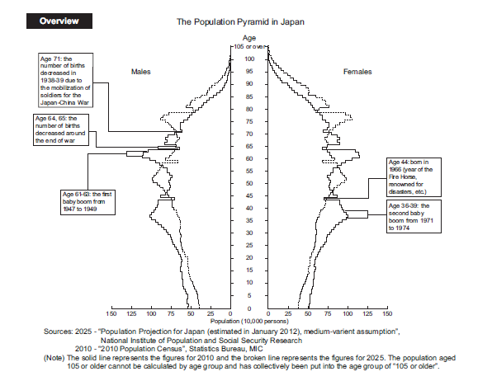
Demographic transition
Please show the figure of population composition (pyramid) in the most recent year and within 20-30 years in the future (national and/or regional)
4

Slide 5
Economic indicators
Fill in the matrix with national and/or regional data at any available year
Year | 1990 | 1995 | 2000 | 2005 | 2010 | 2015
GNI/GDP/GNP (US $)
GNI/GDP/GNP per capita (US $)
Average income
…… (any relevant data)
5

Slide 6
Five leading causes of death
Fill in the matrix with national and/or regional data at any available year
 | 1990 | 1995 | 2000 | 2005 | 2010 | 2015
1st
2nd
3rd
4th
5th
6

Slide 7
Organizational structure
Please describe the organization in charge of public health administration in your country/region/area. And explain the office you belong to or your position and relevant office or department.
Ex)
MOH
MOH
Regional Health Office
Regional Health Office
Community Health Section
Other section
Other section
Director of Community Health
NGO
Director of Hospital
I am here.
The responsibility is …….
Head of MD
Head of MD
  Head of NS
  Head of NS
  The Others
  The Others
7

Slide 8
Current major health policies related to your responsibilities
 | Name of policy/program | targets | Annual budget (US $) | Details of contents
1
2
3
・・・・・
8

Slide 9
Top 3 challenges of management on the prioritized health policy you picked up
Here, NOT focus on health issues itself but focus on administrative/management issues to respond health issues. The challenges may be identified in the following categories such as institutional development, human resource development, health services delivery, quality improvement, health care financing etc.
 | Challenge | Reason
1
2
3
9

Slide 10
Possible solutions you may think for the challenges picked up in the previous slide
 | Challenge | Possible solution
1
2
3
10

