Slide 1

1.Do you know what country it is?
I went there during this summer.

Slide 2
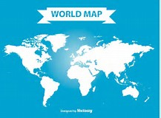
2.Do you know where it is?

Slide 3
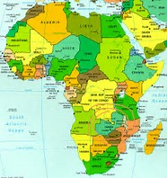
2.Do you know where it is?

Slide 4
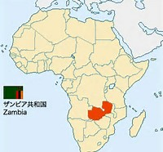
2.Do you know where it is?

Slide 5
What do you think of Africa?

Slide 6
Zambia’s outlines
Population(人口) … 1,454万人(2013年：世銀)
Language (言語)
… 英語（公用語）、ベンバ語、ニャンジｱ語、トンガ語
capital city(首都) … ルサカ（人口約270万人）、
（海抜１，２２７ｍ）
民族 … 73部族!（トンガ系、ニャンジャｱ系、ベンバ系
独立 … 1964年（宗主国 イギリス）
主要産業 … 農業、銅工業・加工、建設、食品等
Currency(通貨) …
ザンビア・クワチャ（1クワチャ＝約11円）
出所：外務省HP

Slide 7

What do you think of Africa?
Try to make your mind-map for 2min!
hot
Africa
(ｱﾌﾘｶ）

Slide 8

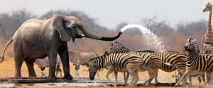
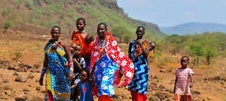
What’s your Zambia’s and Africa’s image ?

Slide 9
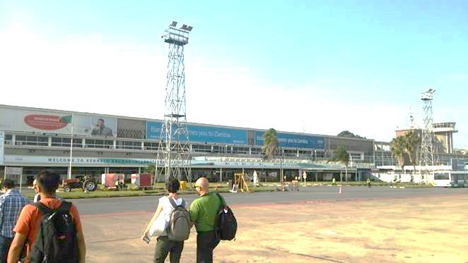
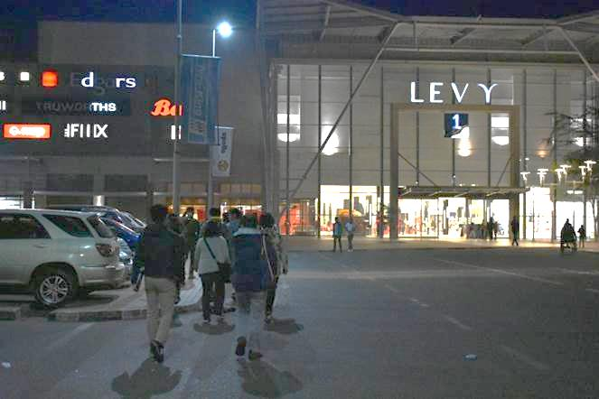
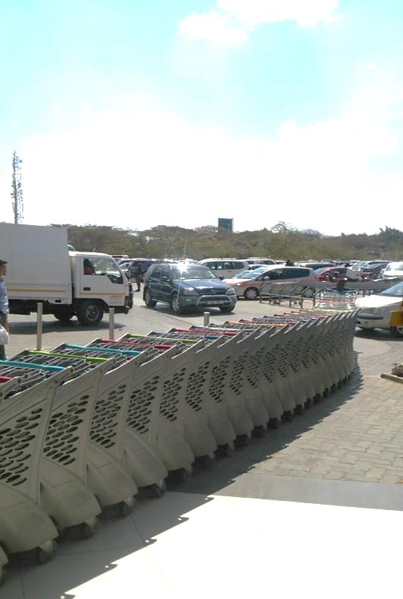
In fact, what I saw was…

Slide 10
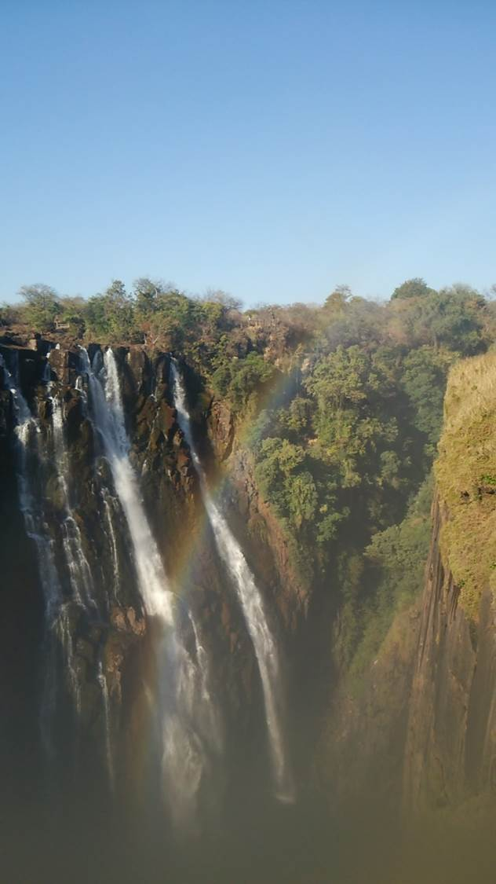
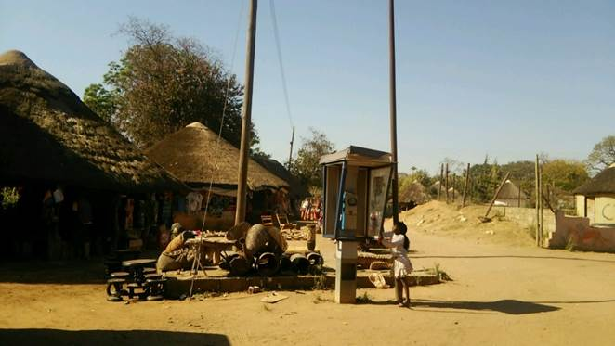
However, I also saw …

Slide 11

There are common points and differences between Japan and Africa, Zambia.

Slide 12
Then, let’s think about commons and differences between them.
(1.by yourself, 2.pair, 3.group)

Slide 13

Useful language
What do you think of them?
( common points/differences
I think … because…
For example, …

